Slide 1
University of Wollongong in Dubai

Slide 2
CSIT242 - Mobile Application Development Architectural patterns (MVC , MVP, & MVVM)
Dr. Haitham Yaish

Slide 3
Outline
1
Introduction
2
Why do we need design patterns?
3
Model View Controller (MVC)
4
Model–view–presenter (MVP)
5
Model–view–viewmodel (MVVM)
6
MVC vs MVP vs MVVM

Slide 4
Introduction
The application development process has become significantly vast and complex due to a variety of features that are now required in modern applications.
To cater to that, there are multiple options available in the tech industry for architecture design patterns.
The three most prominent ones are:
- Model View Controller (MVC)
- Model View View-Model (MVVM)
- Model View Presenter (MVP).

Slide 5
Why do we need design patterns?
These design patterns or architectures were introduced to make the application development process more manageable by separating the responsibilities of:
1. visualization (how the application will look like).
2. Processing (how it will work on different devices)
3. Data management (how data will be processed).

Slide 6
Why do we need design patterns?
The primary goal is to attain more modularity, testability, flexibility and maintainability.
It enables the software engineers to follow convenient practices and allows them to design cleaner and more manageable code to reduce the complexity of the application.

Slide 7
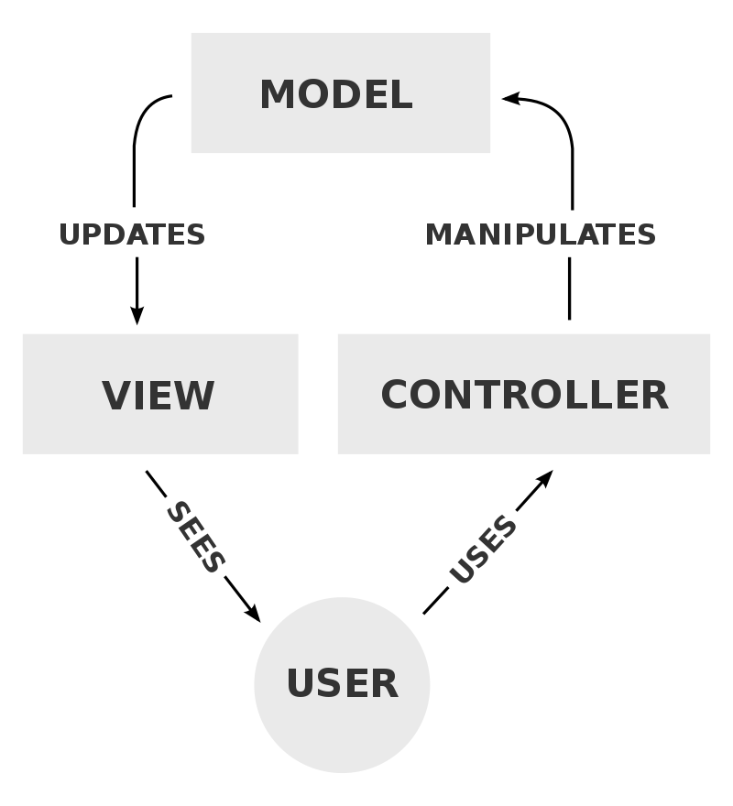
Model View Controller (MVC)
Is commonly used for developing user interfaces that divide the related program logic into three interconnected elements.
This is done to separate internal representations of information from the ways information is presented to and accepted from the user.
MVC has three components:
- Model
- View
- Controller.

Slide 8
Model View Controller (MVC)
Model
Is the central component of the pattern.
It directly manages the data, logic and rules of the application.

Slide 9
Model View Controller (MVC)
View
Any representation of information such as a chart,
Diagram, data, or table

Slide 10
Model View Controller (MVC)
Controller
Accepts input and converts it to commands for the
model or view.

Slide 11
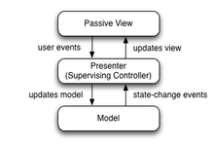
Model–view–presenter (MVP)
Is a derivation of the model–view–controller (MVC) architectural pattern.
Is used mostly for building user interfaces.
In MVP, the presenter assumes the functionality of the "middle-man".
In MVP, all presentation logic is pushed to the presenter

Slide 12
Model–view–presenter (MVP)
In MVC, user inputs are handled by the Controller that instructs the model for further operations.
But in MVP, user inputs are handled by the view that instructs the presenter to call appropriate functions.

Slide 13
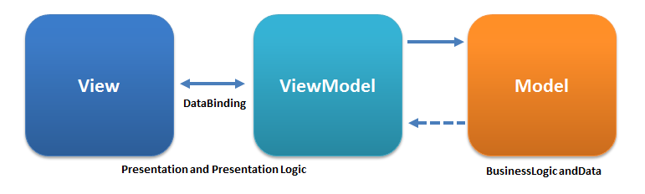
Model–view–viewmodel (MVVM)
Model–view–viewmodel is also referred to as model–view–binder.
Is an architectural pattern in computer software that facilitates the separation of the development of the Graphical User Interface (GUI).
The viewmodel of MVVM is a value converter, meaning it is responsible for exposing the data objects from the model in such a way they can be easily managed and presented.

Slide 14
Model–view–viewmodel (MVVM)
In this respect, the viewmodel is more model than view, and handles most (if not all) of the view's display logic.
The viewmodel may implement a mediator pattern, organizing access to the back-end logic around the set of use cases supported by the view.

Slide 15
MVC vs MVP vs MVVM
Difference | MVC | MVP | MVVM
Architecture | The view is the topmost layer of architecture, it is integrated with the controller and the model layer is placed below it. The exposure of the controller to the entire model view could result in security issues | The view is the topmost layer of architecture, it is integrated with the controller and the model layer is placed below it. The exposure of the controller to the entire model view could result in security issues | The view is the topmost layer of architecture, it is integrated with the viewmodel layer. overcomes the security issues, as It is built differently and limits the exposure between each layer.
Performance | Has presented some mixed performance as compared to MVP and MVVM | During the testing of the UI performance, MVP resulted to be the best one with the highest reliability. | MVVM is a bit behind in performance due to more processing

Slide 16
MVC vs MVP vs MVVM
Difference | MVC | MVP | MVVM
Compatibility | Comes last due to limited compatibility. | Second lead. | Takes the lead. It offers the best compatibility especially when it comes to data processing. Although data binding is not good for performance, it does have a positive impact on compatibility
Customization | Offers the greatest number of changes in the majority of the scenarios, being the most mature design pattern. | Offers way fewer options to make changes than other patterns. | contributes a lot to customization.

Slide 17
MVC vs MVP vs MVVM
Difference | MVC | MVP | MVVM
Unit testing performance | Is not a good choice for it as it is relatively difficult to perform unit testing using the MVC model. | Unit testing performance is average using the MVP pattern | Is the clear winner in performing unit testing from all three models. It shows great performance and features for unit testing.
XML Complexity (Note: MVC and MVP model is very commonly used in android application development as it involves heavy work with the user interface) | XML is commonly used with it in the view layer. It is used for designing and implementing the user interface of applications. It has very low complexity while working with XML in MVC | XML is commonly used with it in the view layer. It is used for designing and implementing the user interface of applications. Has noticeably minimum complexity with XML. | XML is commonly used with it in the view layer. It is used for designing and implementing the user interface of applications. It gets complex while working with XML on the MVVM model.

Slide 18
MVC vs MVP vs MVVM
Difference | MVC | MVP | MVVM
Modularization | Has some limitations in modularization unlike MVP and MVVM. | Does a great job in breaking down the application in the modules. | Does a great job in breaking down the application in the modules.
Usage | Primarily used for mobile applications. Android applications are the best example of it. Also suitable for web applications | Primarily used for mobile applications. Android applications are the best example of it. Also suitable for web applications | For extremely interactive applications or games that require complex user-interface code to be added and a lot of custom behaviors, it is better to use MVVM as it is more data-centric and provides more control.

Slide 19
MVC vs MVP vs MVVM
Difference | MVC | MVP | MVVM
Integration with Modern User Interface | Being a relatively older design pattern, it works well with standard GUI but it is quite difficult to use it with modern user interfaces. | Has a bit of improvement in comparison with MVC. | Is the best option among all when it comes to integrating with new user interfaces.

Slide 20
Summary
Despite the differences of the different design patterns, we cannot decide on which pattern wins this battle.
All three design patterns offer some unique and exclusive advantages that can be very useful in different situations.
MVC vs MVP vs MVVM: it would be a tie in this case because all three of them offer different usability based on the requirements of the application to be developed.

Slide 21
References
MVC vs MVP vs MVVM – Top 10 Differences You Should Know, https://xperti.io/blogs/mvc-vs-mvp-vs-mvvm/ . Last Accessed 2 March 2025
Model–view–controller, https://en.wikipedia.org/wiki/Model%E2%80%93view%E2%80%93controller . Last Accessed 2 March 2025
Model–view–presenter, https://en.wikipedia.org/wiki/Model-view-presenter . Last Accessed 2 March 2025
Model–view–viewmodel, https://en.wikipedia.org/wiki/Model–view–viewmodel . Last Accessed 2 March 2025
Difference Between MVC and MVP Patterns.
https://www.baeldung.com/mvc-vs-mvp-pattern#:~:text=User%20Input%3A%20In%20MVC%2C%20user,between%20the%20controller%20and%20view. Last Accessed 2 March 2025

Slide 22
THANK YOU

