Slide 1

MultiKey

Slide 2
Symbolik

Slide 3
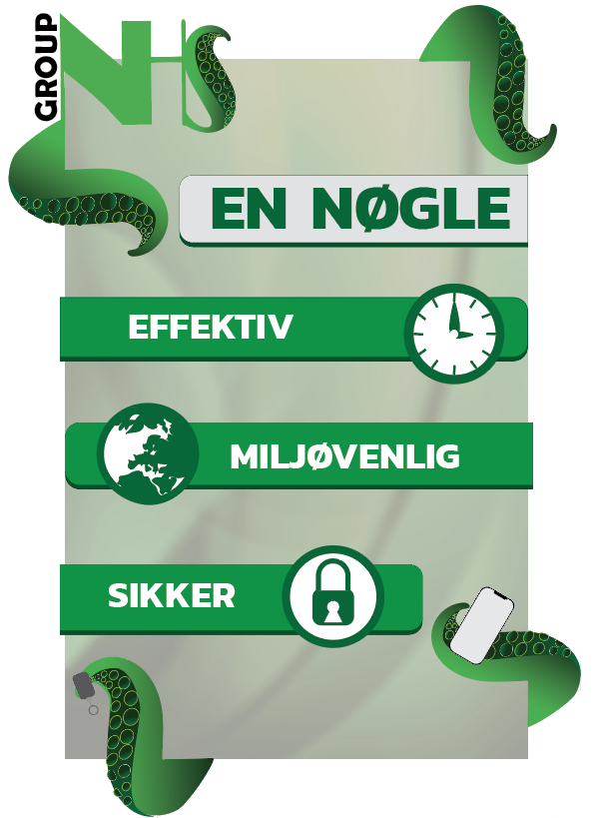

Slide 4
Styleguide

Slide 5
Styleguide
https://l.facebook.com/l.php?u=https%3A%2F%2Fxd.adobe.com%2Fview%2Fa78de8ba-f94f-4e52-6661-53385b55fbfc-d1bc%2F%3Fhints%3Doff%26fbclid%3DIwAR07WbYD6w-NVwlAiRVK6PwEoELEYqf2BQqFtVY5E71alQhPLcvwdBdHpqY&h=AT0DROrLIF-CJ9CpT1NeKOFYz-ny5vuXqHFPeYK7WcXfD8qZC5mg-p_tTYBxfZqfca6ZRSX0Hjythx5QQbxMT5-L3KfHMoUYBWA0jHgT1eAzMEcQQeqvD3A07VpZ7O8LBHbf3U7JrtP7qBc

Slide 6
Wireframe

Slide 7
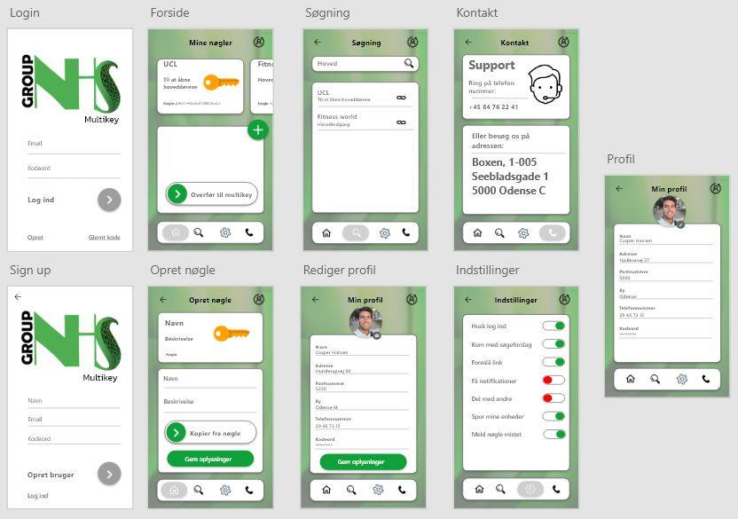

Slide 8
Personaer

Slide 9
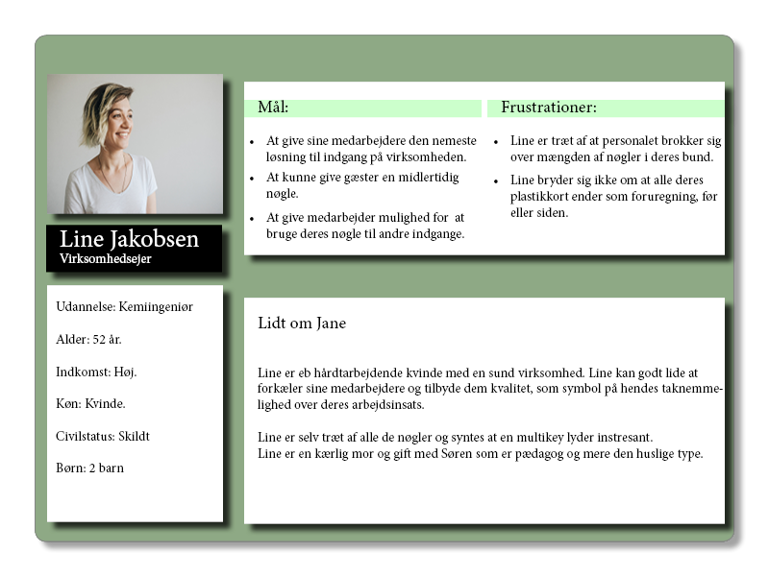

Slide 10
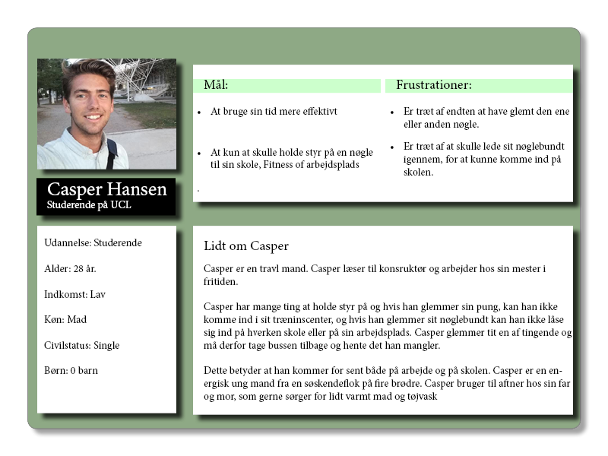

Slide 11
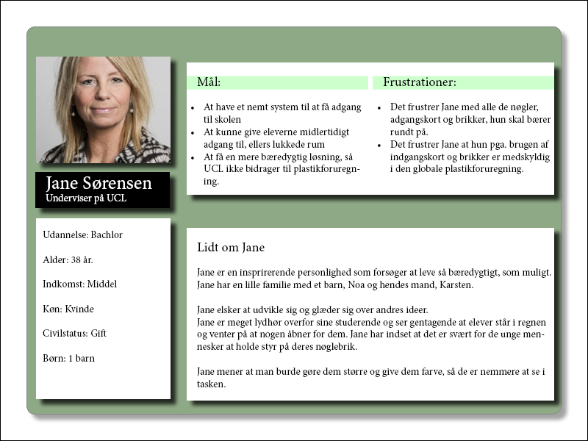

Slide 12
LOGO

Slide 13




