Slide 1
Alexa and IoT for Energy Conservation
Workshop

Slide 2
Content
Day 1
Introduction to IoT
Smart Homes and Energy Conservation
Basic control
Day 2
IoT: web control
IoT: Alexa controlled smart devices
Competition

Slide 3
Know your KIT
Nodemcu ESP8266
Single Channel Relay
IR Sensor
DHT11 Sensor
DC Motor
LED
Jumper Cables

Slide 4
IoT
The Internet of Things (IoT) is the network of physical objects, devices, vehicles, buildings and other items embedded with electronics, software, sensors, and network connectivity that enables these objects to collect and exchange data.

Slide 5
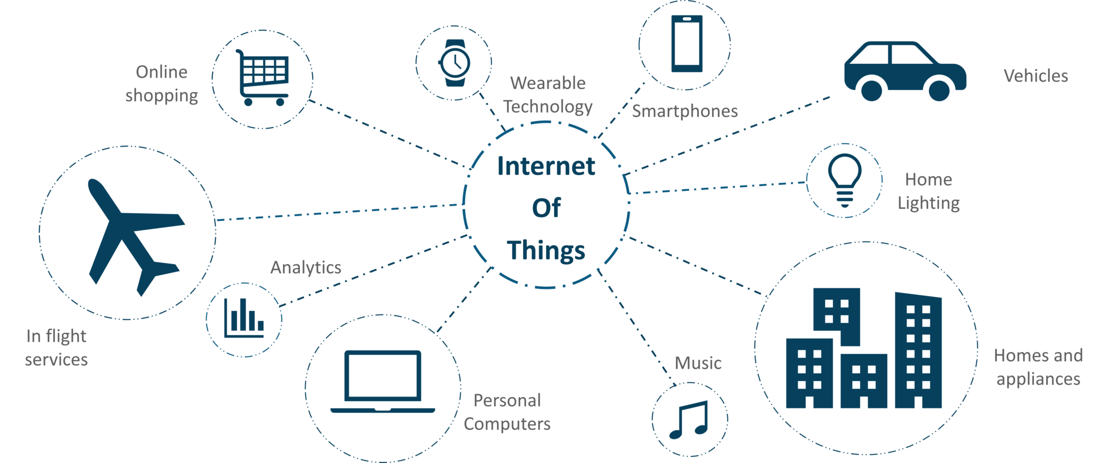
IoT

Slide 6
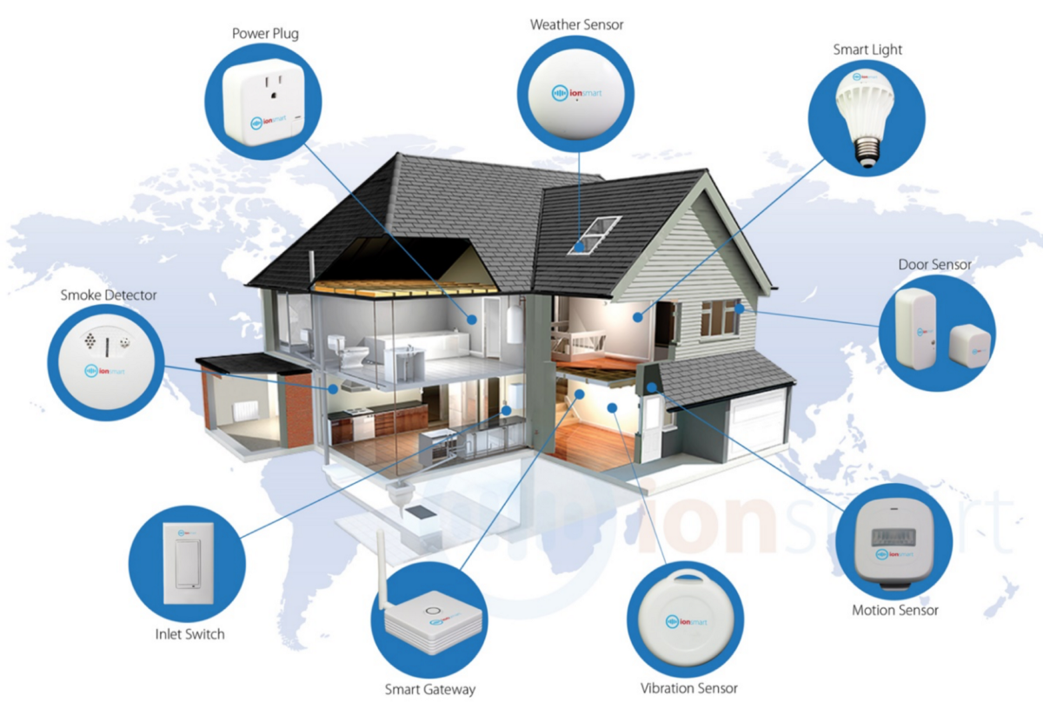
Smart Home

Slide 7
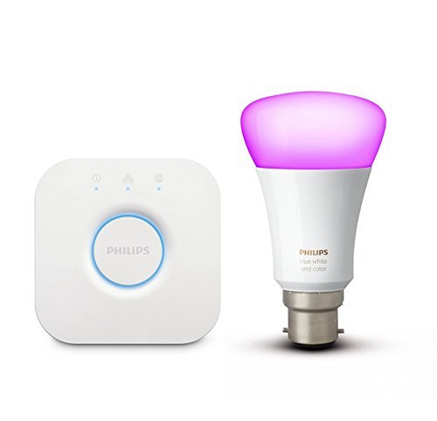
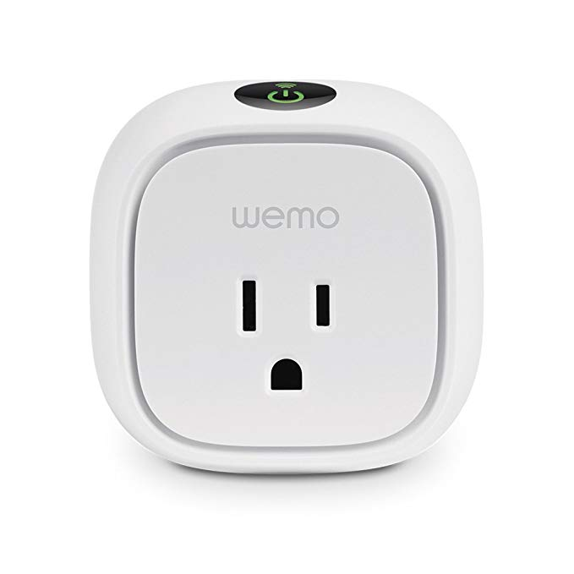
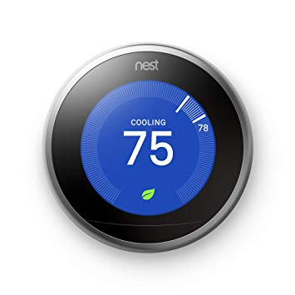
Devices Available

Slide 8
Other Smart Devices
Lighting Control
Relays
Occupancy Sensors
Daylight Sensors
Timers
Dimmers
Switches
Lighting Control Accessories and Other Products
Security and Access Control
Video Surveillance Systems
Hardware
Cameras
Storage Devices
Monitors
Servers
Accessories and Others
Software/Video Analytics
Access Control Systems
Biometric Access Control
Facial Recognition
Iris Recognition
Fingerprint Recognition
Others (Include Vein Recognition and Voice and Speech Recognition )
Non-Biometric Access Control
HVAC Control
Smart Thermostats
Sensors Used in HVAC Applications
Control Valves
Heating and Cooling Coils
Dampers
Actuators
Pumps & Fans
Smart Vents
Entertainment and Other Controls
Entertainment Control Products
Audio, Volume, & Multimedia Controls
Home Theater System Controls
Touchscreens and Keypads
Other Controls
Smart Meters
Smart Plugs
Smart Hubs
Smart Locks
Smoke Detectors
Home Healthcare
Health Status Monitors
Physical Activity Monitors
Smart Kitchen
Smart Coffee Makers
Smart Kettles
Smart Dish Washers
Smart Ovens
Smart Cooktops
Smart Cookers
Home Appliances
Smart Refrigerators
Smart Washers
Smart Water Heaters
Smart Vacuum Cleaners
Smart Furniture
Smart Tables
Smart Desks
Smart Stools & Benches
Smart Sofas
Smart Chairs

Slide 9
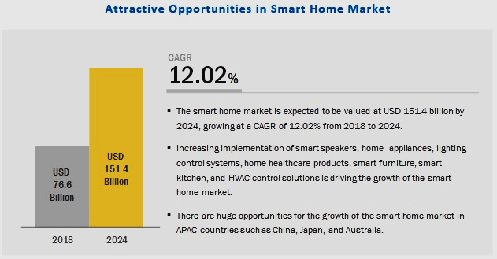
Smart Home Market Forecast

Slide 10
Benefits of Smart Homes
Better monitoring and surveillance
Better emergency response
Better energy Management
Better energy Conservation
Ability to remote control
Improved healthcare
Sense of security

Slide 11
Smart Homes and Energy Conservation
HVAC Systems
Water Heating System
Power plugs
Lighting
Energy Meters
Window shades control

Slide 12
Energy Conservation Strategies
Sensing and remote monitoring
Remote control
Scheduling
Artificial Intelligence

Slide 13
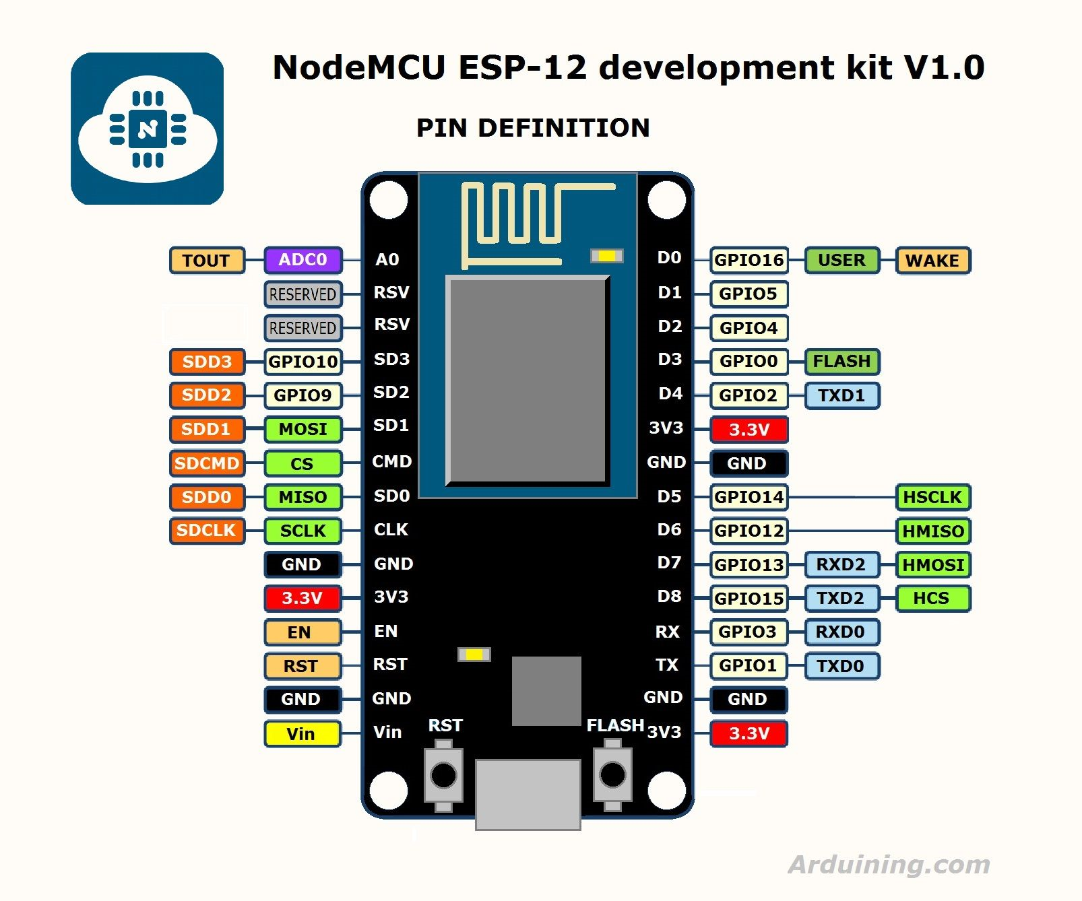
Components
Nodemcu ESP8266
Micro Controller
WiFi Connector
4MB of internal
storage

Slide 14
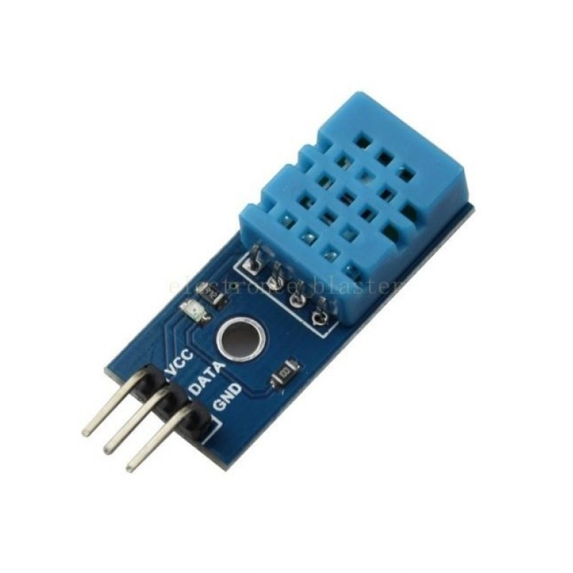
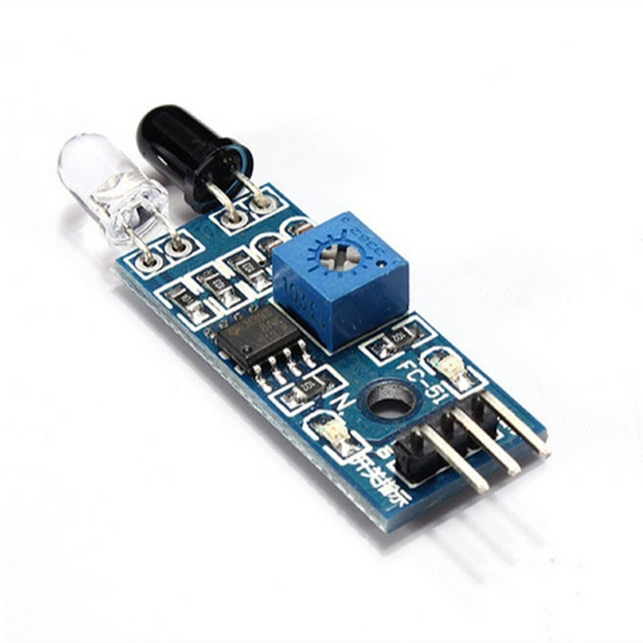
Sensors
DHT11 Sensor
IR Sensor

Slide 15
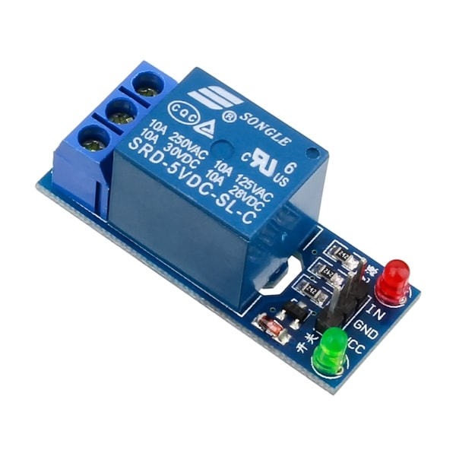
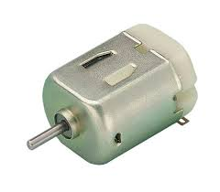
Actuator
Relay
DC Motor

Slide 16
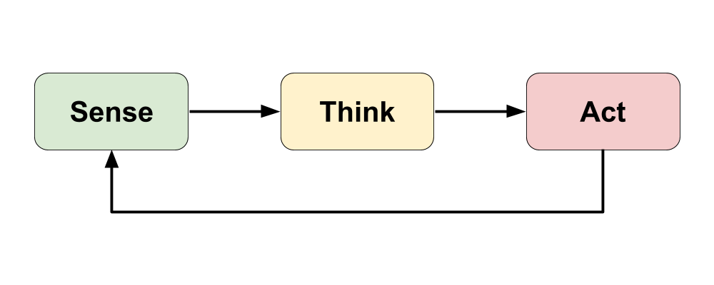
Basic Control Theory
The sense think act cycle

Slide 17
Basic Control Theory: Practical
Blink LED
Run Motor
Blink LED on sensing object
Change LED brightness on sensing temperature

Slide 18
IoT: Web Control
Control LED from web
Control LED brightness from web
Display DHT11 Sensor values
Control relay from web

Slide 19
IoT: Alexa Control
Control LED and Fan by Alexa commands
Control LED brightness by Alexa commands

Slide 20
Thank You
Problem Statement for Competition:

