Slide 1

Week 4 Part 2

Slide 2

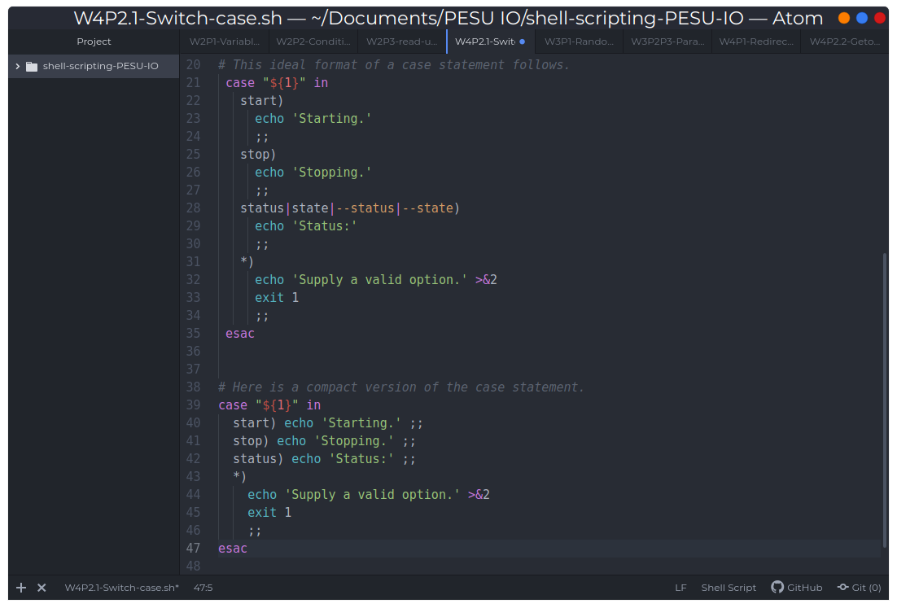
Case Statements

Slide 3
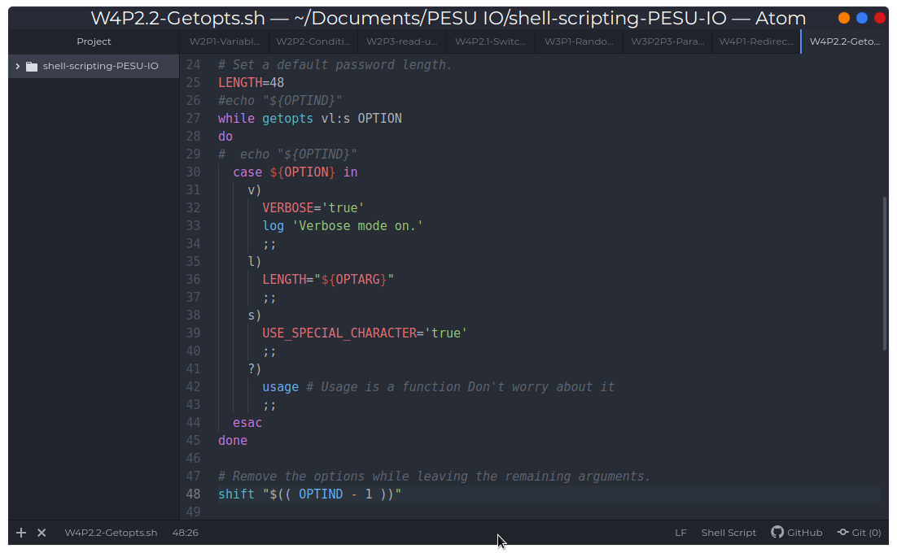
Getopts

