Slide 1

Week 4 Part 3

Slide 2

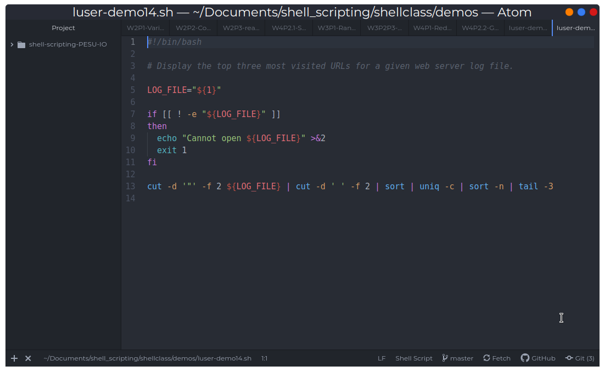
Data processing

Slide 3
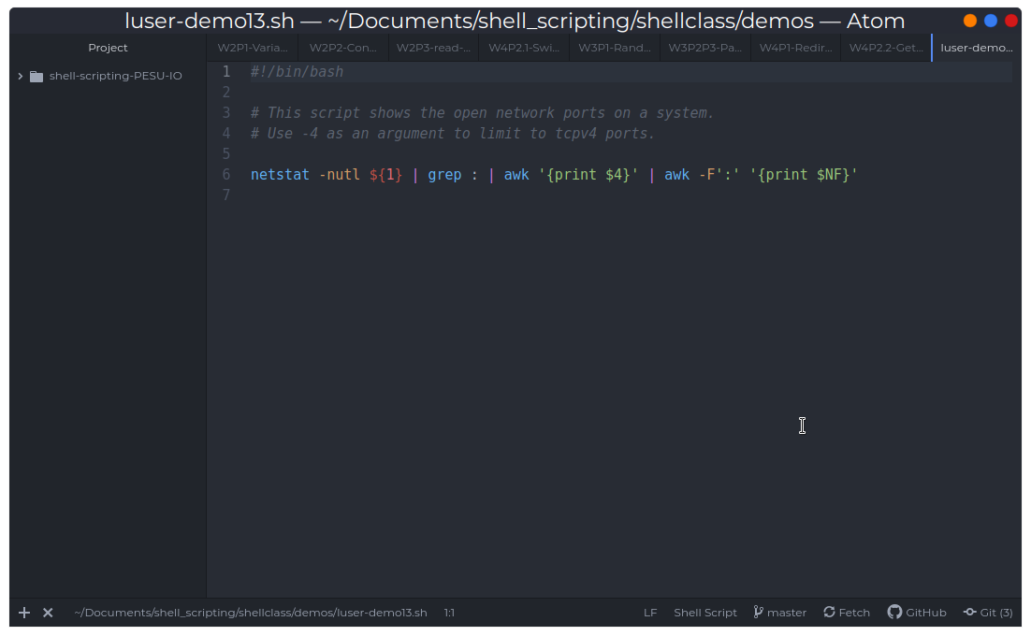
Awk Example

Slide 4
Thank You!
That's all folks!

