Slide 1

Week 3 Part 2

Slide 2
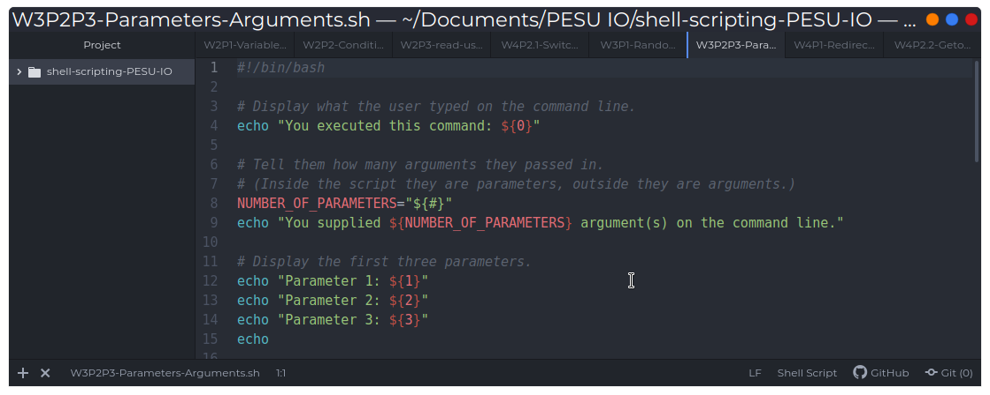
Parameters and arguments

