Slide 1

Week 2 Part 3

Slide 2
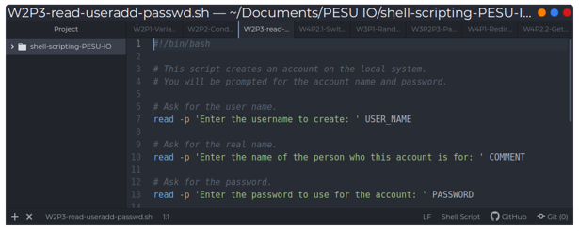
Reading Input

Slide 3

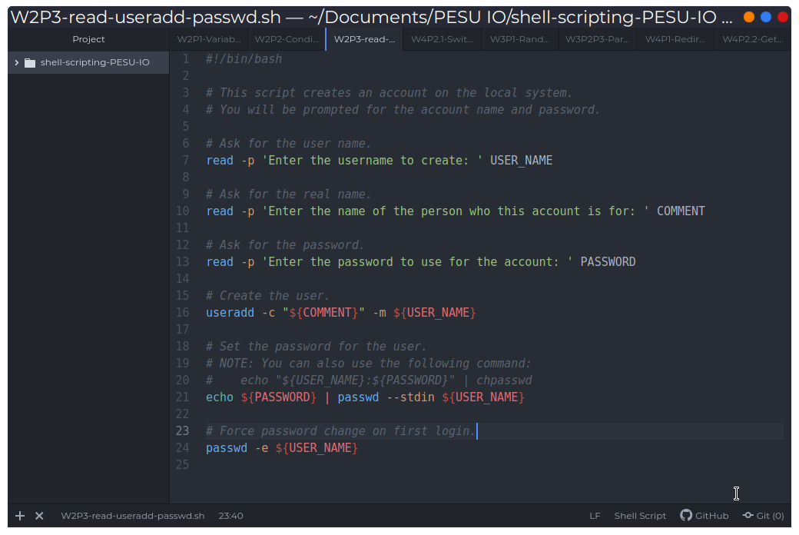
SysAdmin Functions

