Slide 1

Week 3 Part 1

Slide 2

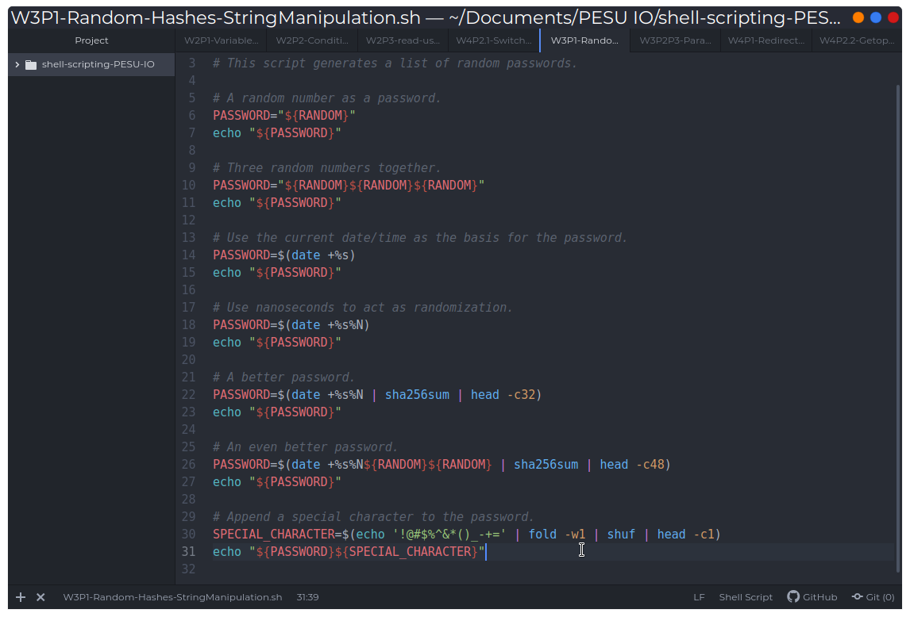
Random, hashes and string manipulation

