Slide 1

Week 3 Part 3

Slide 2

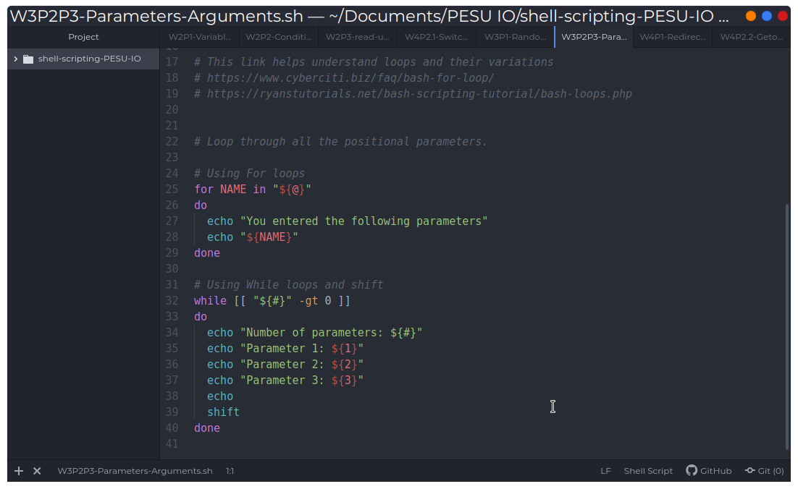
Loops

