Slide 1

Week 4 Part 1

Slide 2

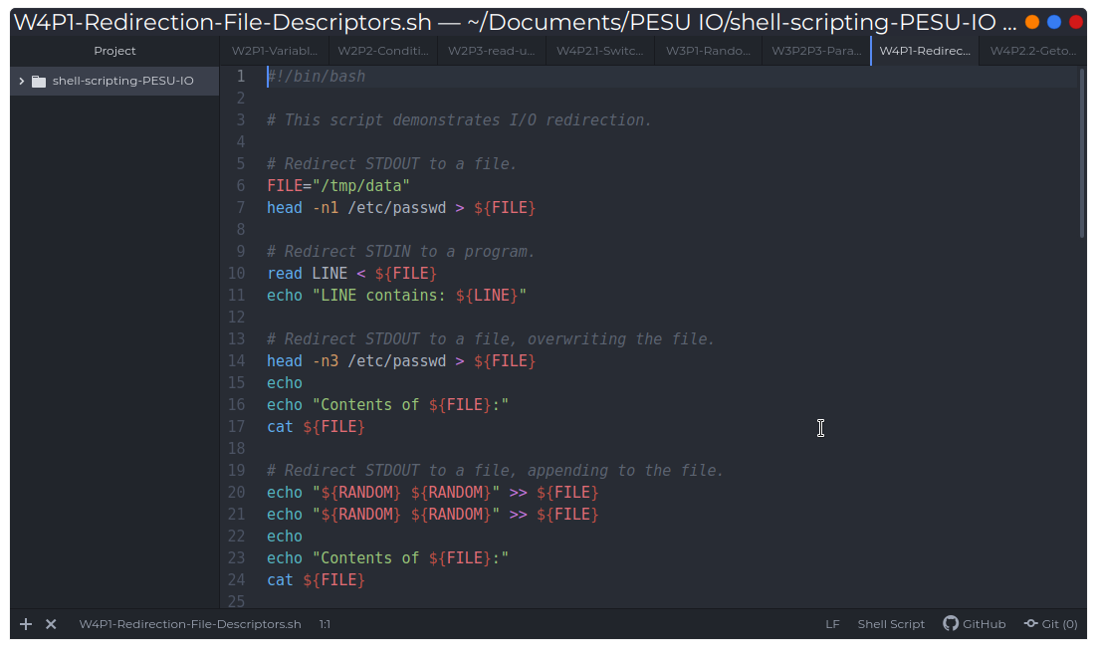
Redirection

Slide 3
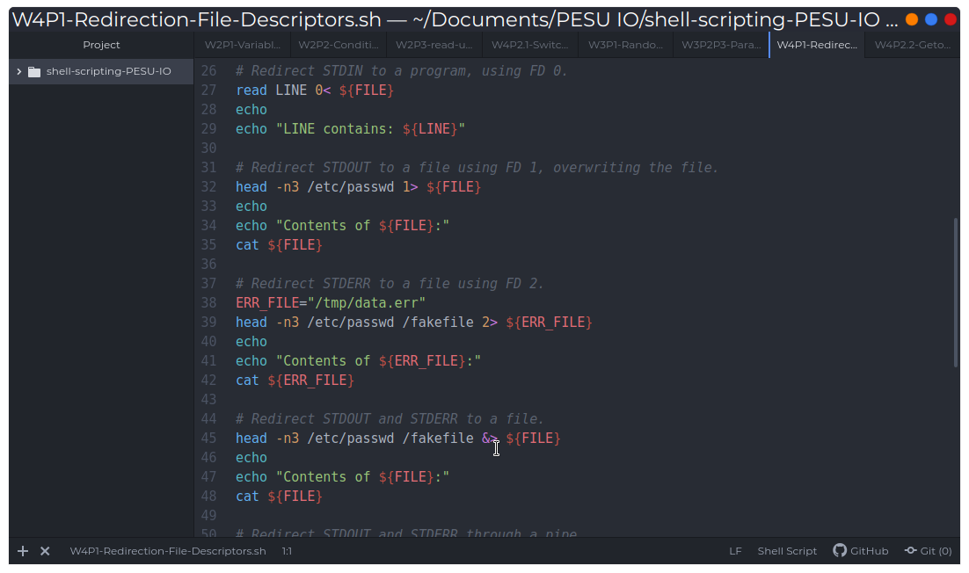
File descriptors

Slide 4
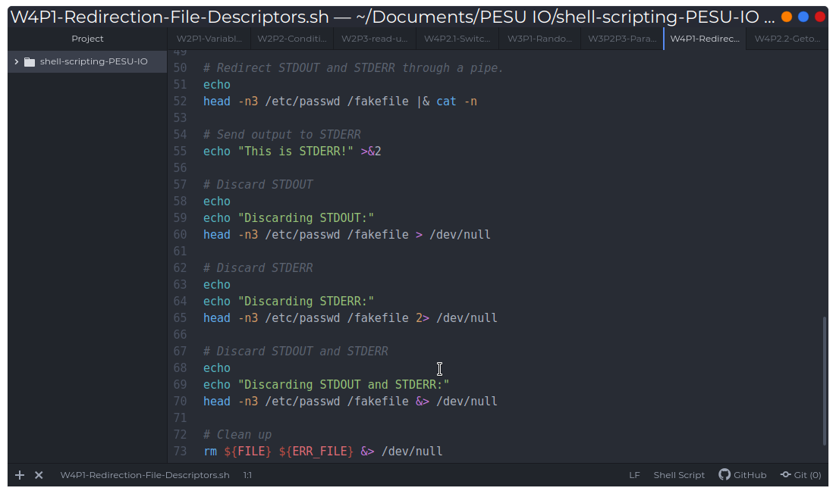
Redirection through pipes and /dev/null

