Slide 1

Week 1 Part 3

Slide 2

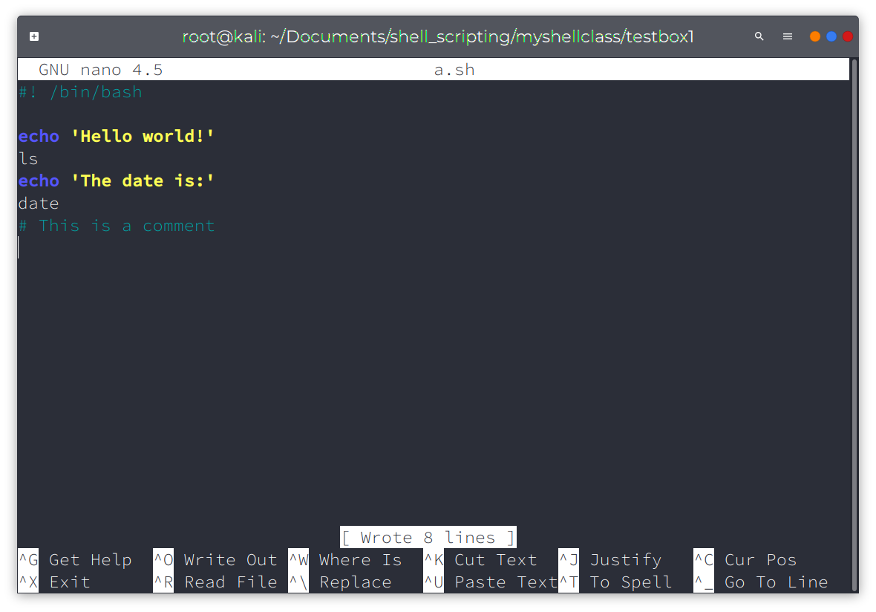
Our first script

Slide 3
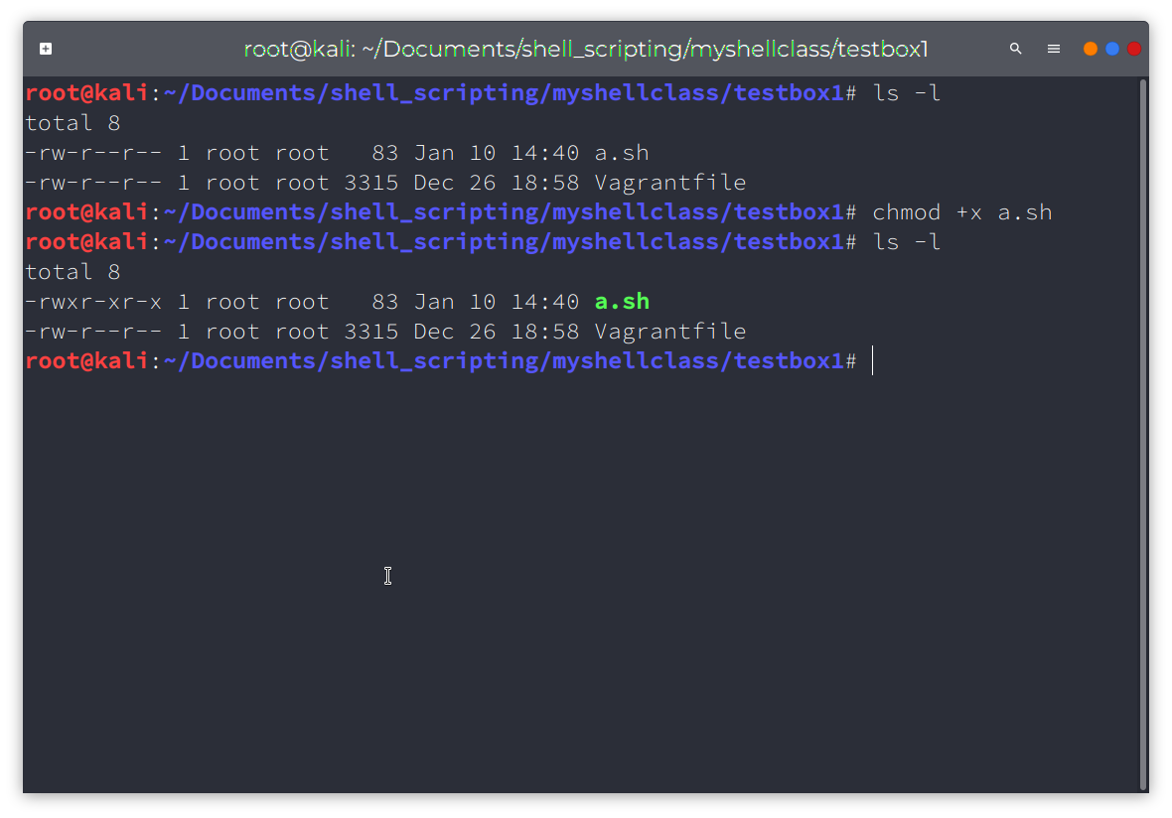
Setting Permissions

Slide 4
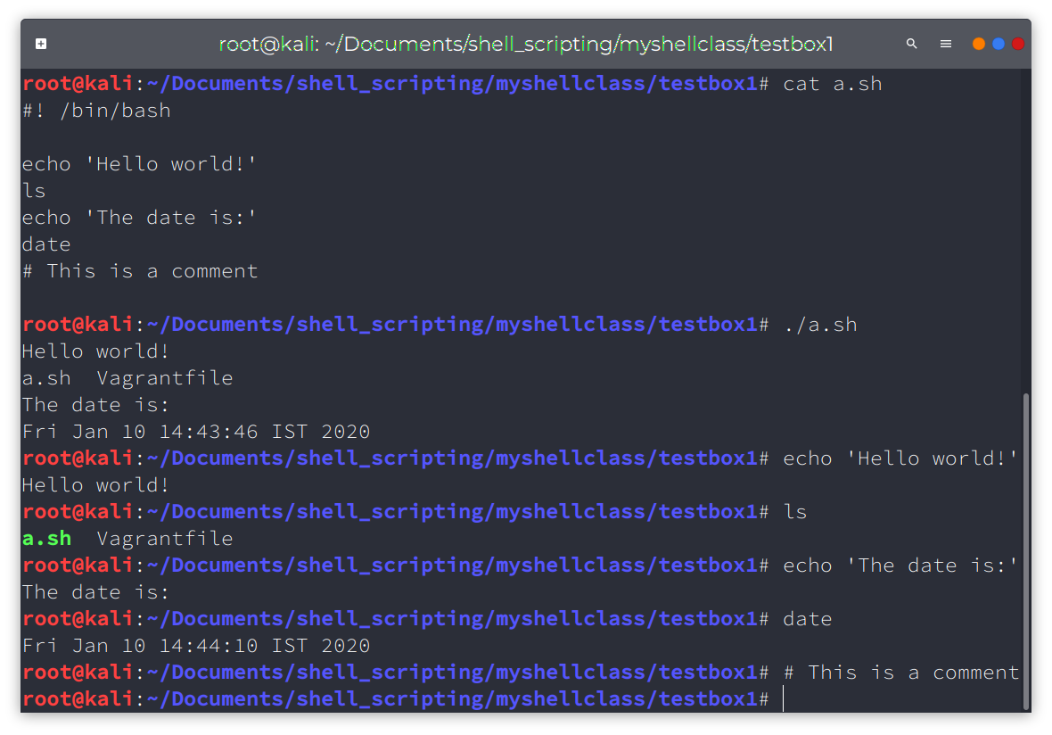
Executing our script

