Slide 1

Week 2 Part 1

Slide 2

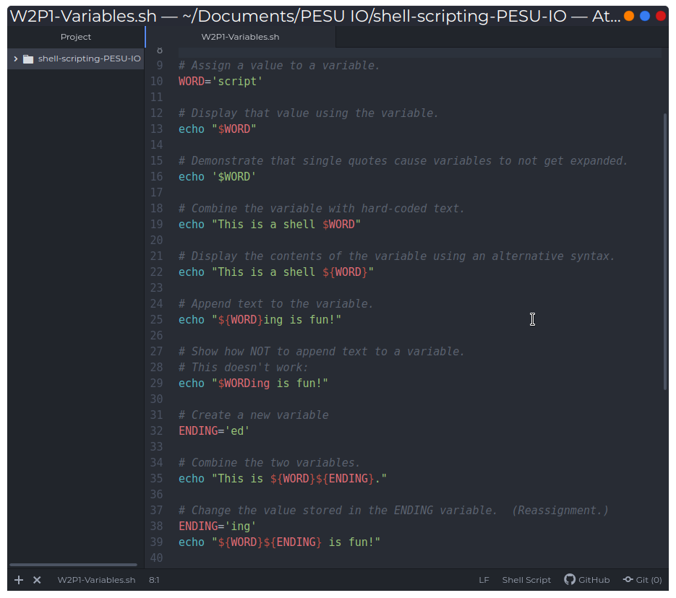
Variables

Slide 3
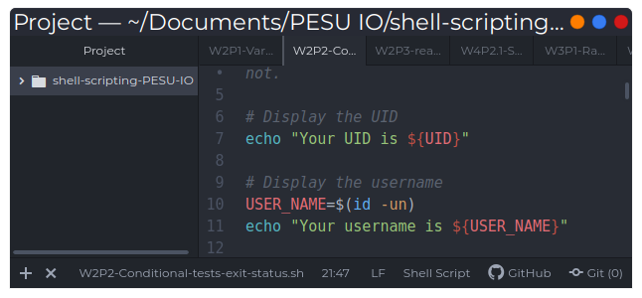
Special Variables

