Slide 1

Week 2 Part 2

Slide 2

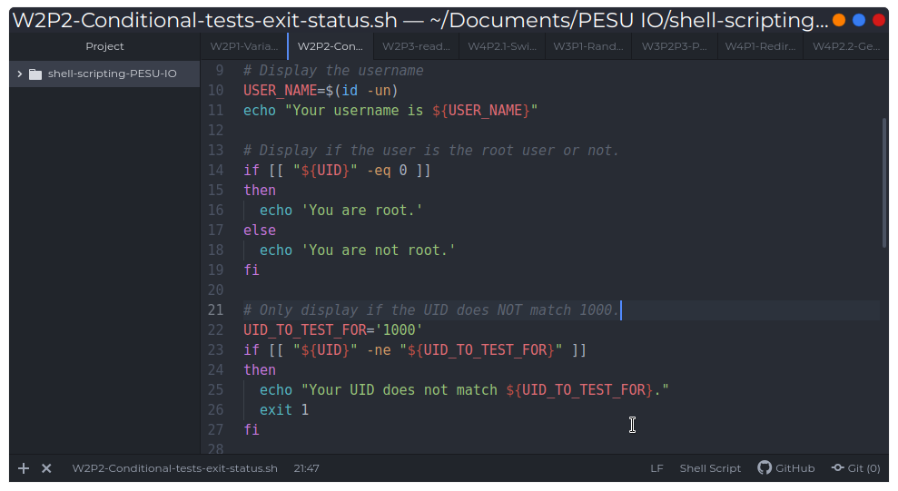
Conditionals

