Slide 1

Week 1 Part 1

Slide 2
What is shell scripting?
A shell script is a program that can be run on a Linux Command line.

Slide 3

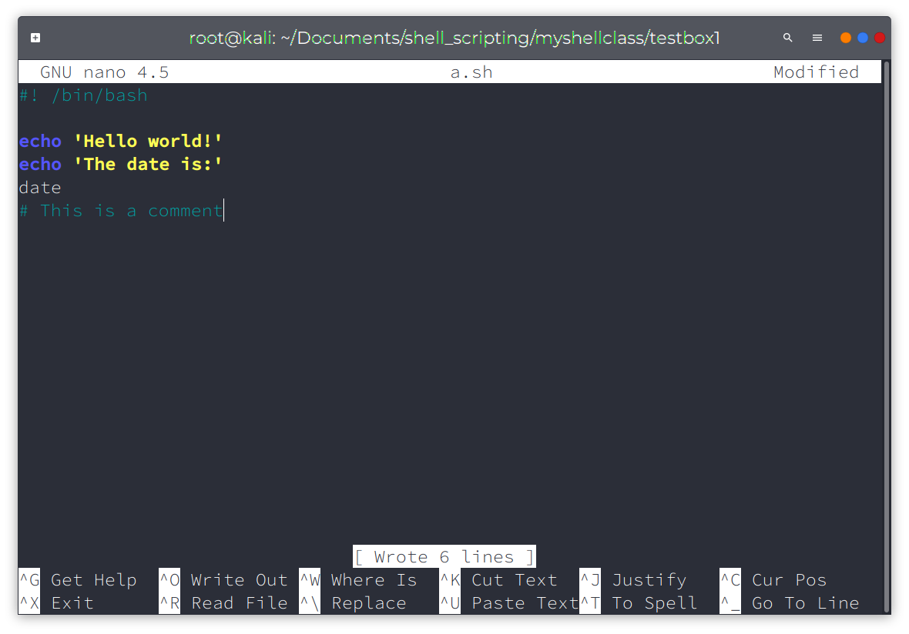
Shell script

