Slide 1

Appcelerator Titanium
Antti Tuovinen, Valtteri Seuranen

Slide 2
Description
Appcelerator Titanium is a opensource framework for development of mobile applications to Android, IOS, Windows UWP and Mobile Web browser with one code.
Developer Appcelerator Inc.
In year 2013, 10% of phones at global market use Titanium based programs
Appcelerator’s homepage: www.appcelerator.com
Notes:
Valitettavasti JAMK on jostain syystä estänyt www.appcelerator.com sivuston.

Slide 3
Tools
For development of Titanium applications Appcelerator offers tools Appcelerator Studio and Appcelerator CLI.
Appcelerator Studio offers 3 different version: Indie, Pro and Enterprice.
Titanium uses Android SDK to emulate program to Android device
For testing applications in IOS, Titanium uses Xcode enviroment.
For testing app in Windows UWP, Titanium uses Windows Phone SDK
Notes:
Appcelerator studio tarjoaa enemmän työkaluja
Appcelerator CLI tarjoaa komentoriviä
Indie versio on ilmainen, mutta

Slide 4
Programming
Main programming language is JavaScript
For development of graphical user interface Titanium uses Alloy framework that allows the structure of the graphic inteface to be writen in xml-format.
Appcelerator offers Axway Marketplace from where free modules can be loaded or paid modules can be bought.

Slide 5
Connections between javascript and mobile phones
Main code is writen in javascript
Javascript
Titanium SDK translates the code
Titanium SDK
Translated code is sent to the device
Android, IOS, Windows Phone, Mobile webpages

Slide 6
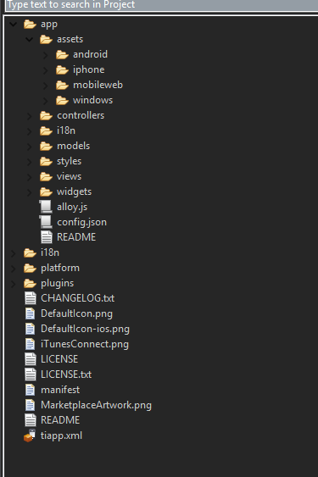
App Structure
Required folders
Assets
Pictures, mediafiles…
Controllers
Internal logics of the application (for example: loading a view, handling events, functions…)
Models
Models allow handling interactive data and it’s logic.
Styles
Defines the appearance of a View (very similar to css).
Views
Structure of the user inteface defined in xml-file.
Optional folders
Widget
Contains reusable components
I18n
Program localization files
Notes:
Controllers käsittelee funktiot, jotka reagoivat käyttöliittymään. Samalla tavalla miten androidissa on MainActivitylle oma luokka koodeille.

Slide 7
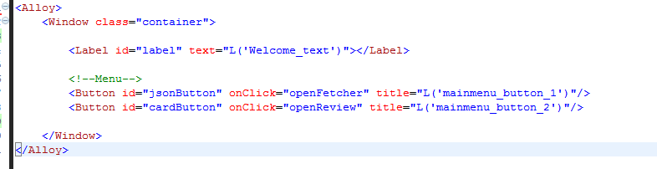
Views
Views defined the structure of the user inteface (what components view contains?)
A View has a controller of same name in the controllers folder. When controller is loaded can the view be opened

Slide 8
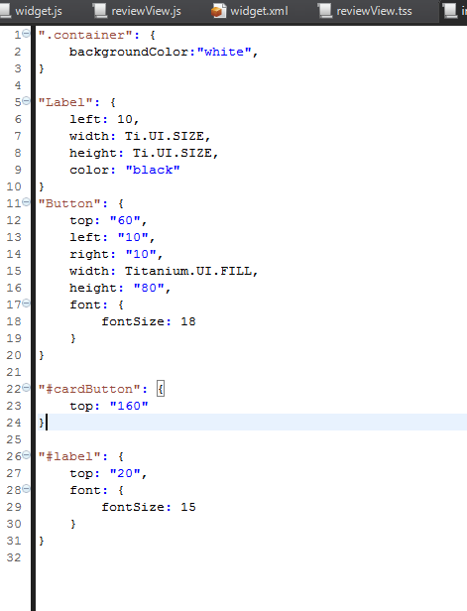
Styles
Style defines the appearance of the View
Writing styles in Titanium are very similar to css programming
”.Label” refers to all elements that have the class attribute ”Label”
”#Label” refers to a element with a id ”Label”
”Label” refers to all Label-objects in the View.

Slide 9
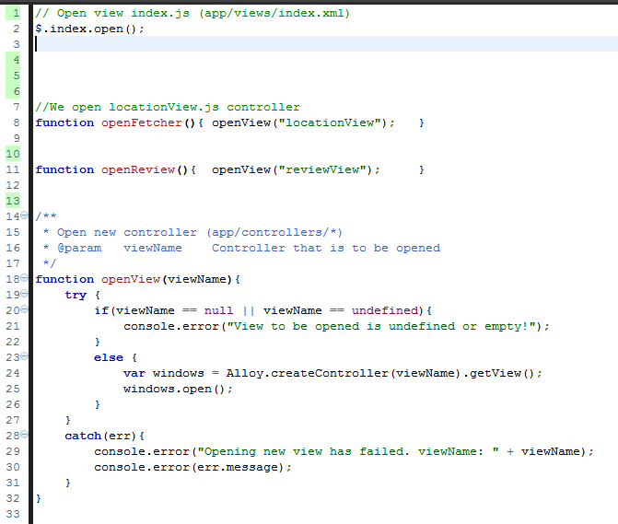
Controllers
Controllers manage the internal logics of the application.
In controller if a View is used, can the elements from the View be called with $.objectID
In example $.index.open() is a function that opens the View ”index.xml” from views folder

Slide 10
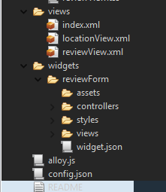

Widget
Widgets are reusable components that can be used in other projects or multiple times in the current application.
Every widget has a folder in widgets that contains views, controllers, assets and styles specific to that widget.

Slide 11
Demo application
http://student.labranet.jamk.fi/~K1967/androidCourses/appDemostration.mp4
Demo has 2 parts
Map application
Fetches locations from url and then displays results in a list.
If a element from the list is clicked, a map is opened and the selected location is in the center of the view.
Sending reviews
Form created with a widget is used to save a review in phones internal database.
Reviews are then read from the database and put into a list.
Notes:
https://alloyui.com/examples/carousel/real-world

Slide 12
Pros
Program is created to support multiple operation systems in one go.
Prototyping application is fast.

Slide 13
Cons
Appcelerator Studion Indie versio sallii vain yhden henkilön kehittää ohjelmaa.
Appcelerator Studio’s Indie version allows only one contributor. So if a team wants to develop Titanium application together they need to buy better version of the studio.
Indie version does not contain the drag-and-drop styled ”App designer” for creating user interfaces.
Troubleshooting can sometimes be difficult.
Notes:
Vianetsintä esim. Unohtunut puolipiste → seurauksena ohjelma valittaa, että kontrollerin luominen ei onnistunut.

Slide 14
Questions?
Appcelerator homepage: www.appcelerator.com
Titanium documentation: https://docs.appcelerator.com/
Project demo application: https://github.com/Gitvalt/Appcelerator_Titanium_Demo

