Slide 1
操作系统答疑
2025年10月28

Slide 2
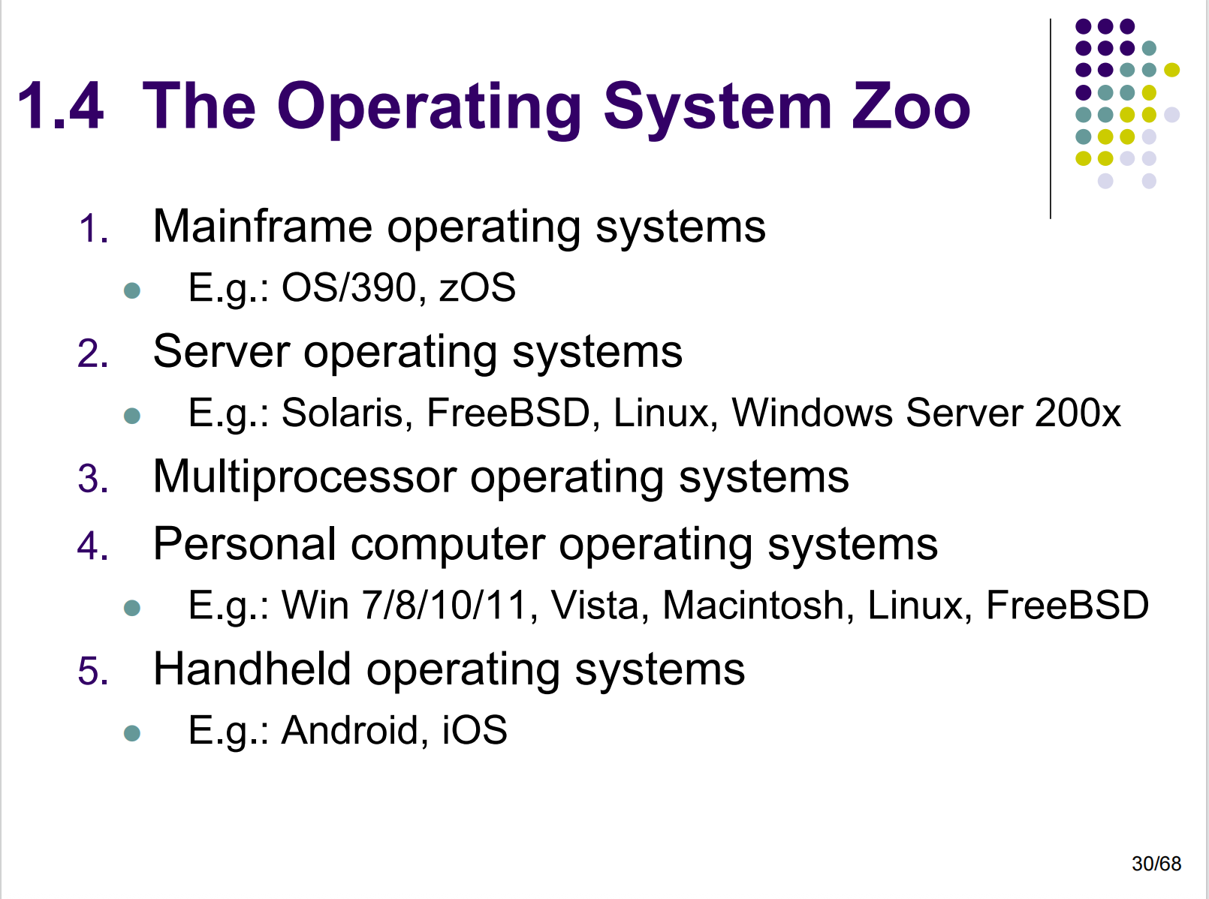
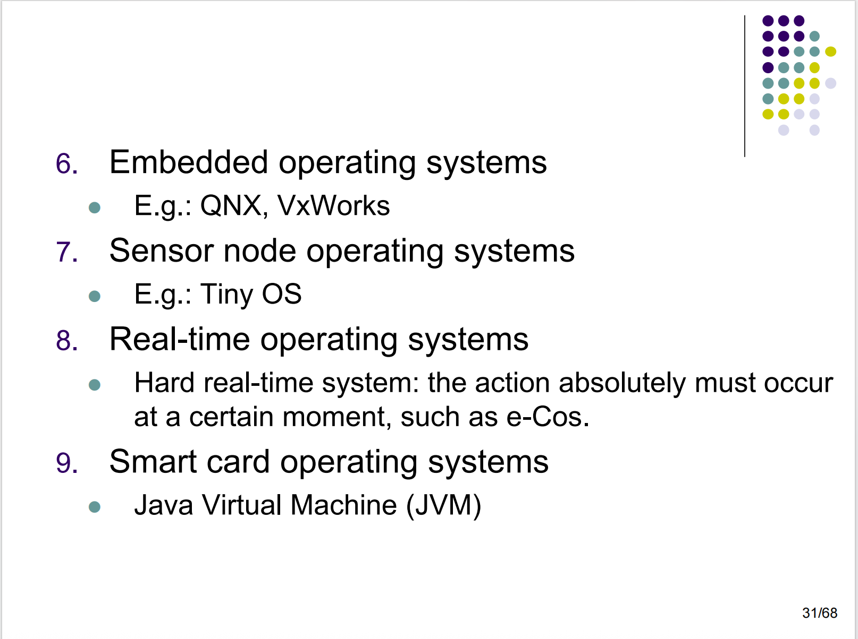
Chapter 1
2. In Section 1.4, nine different types of operating systems are described. Give a list of applications for each of these systems (one per operating systems type).

Slide 3
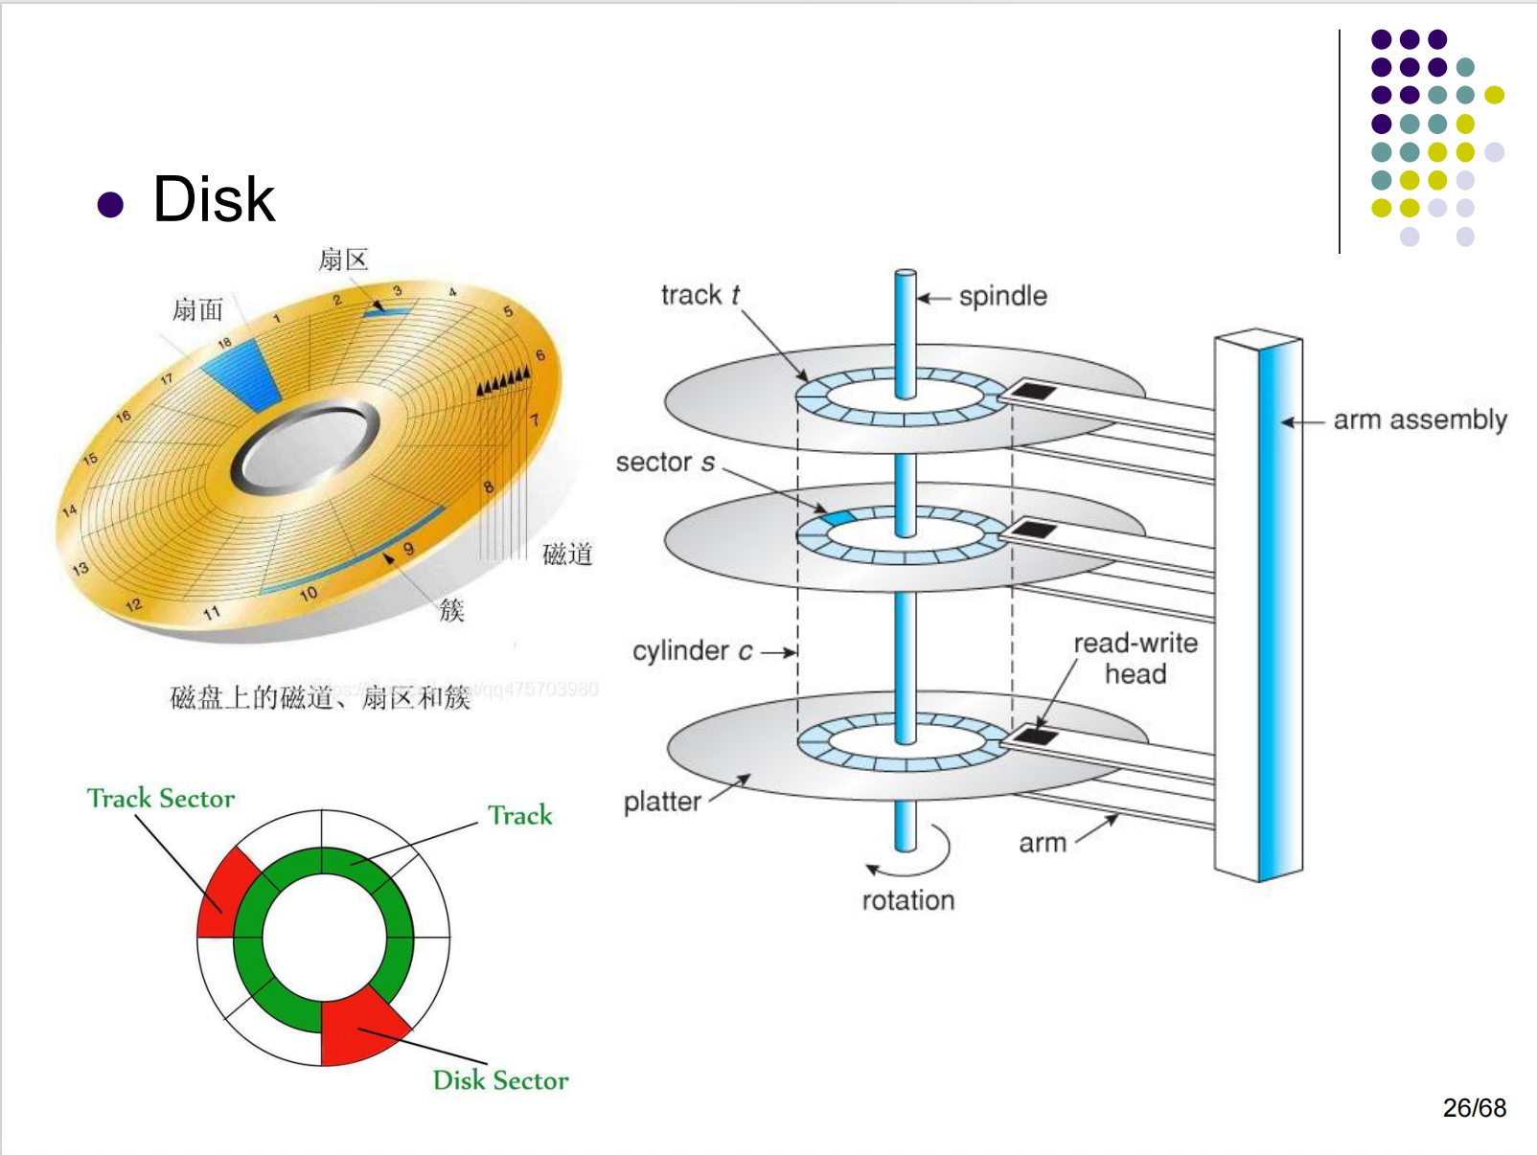
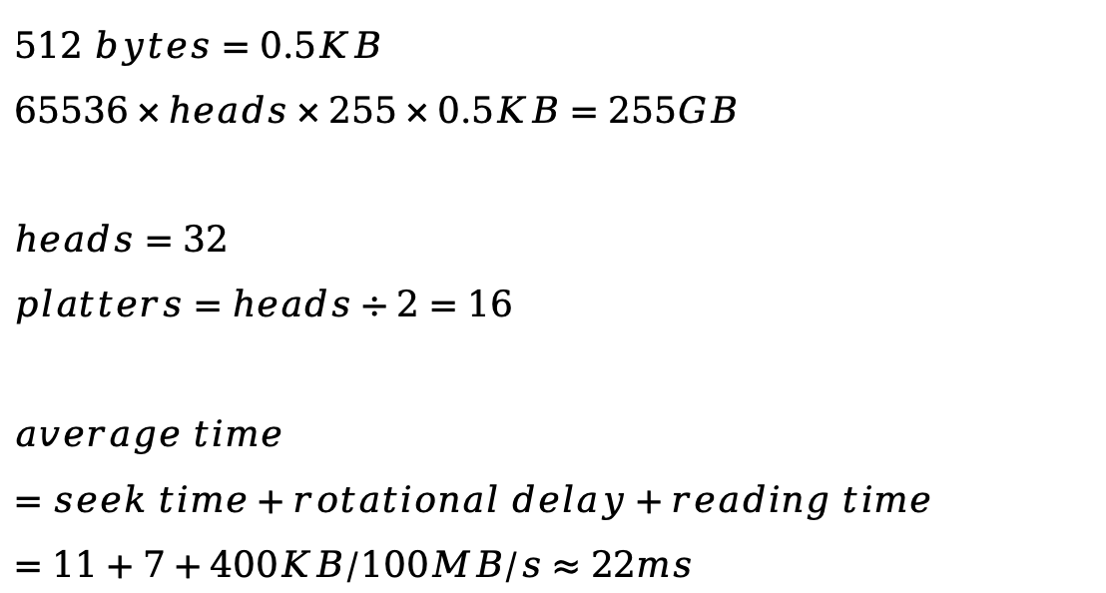
Chapter 1
11. A 255-GB disk has 65,536 cylinders with 255 sectors per track and 512 bytes per sector. How many platters and heads does this disk have? Assuming an average cylinder seek time of 11 ms, average rotational delay of 7 msec and reading rate of 100 MB/sec, calculate the average time it will take to read 400 KB from one sector.
$$512 bytes=0.5KB$$
$$65536×heads×255×0.5KB=255GB$$
$$heads=32$$
$$platters=heads÷2=16$$
$$average time=seek time+rotational delay+reading time=11+7+400KB/100MB/s≈22ms$$

Slide 4
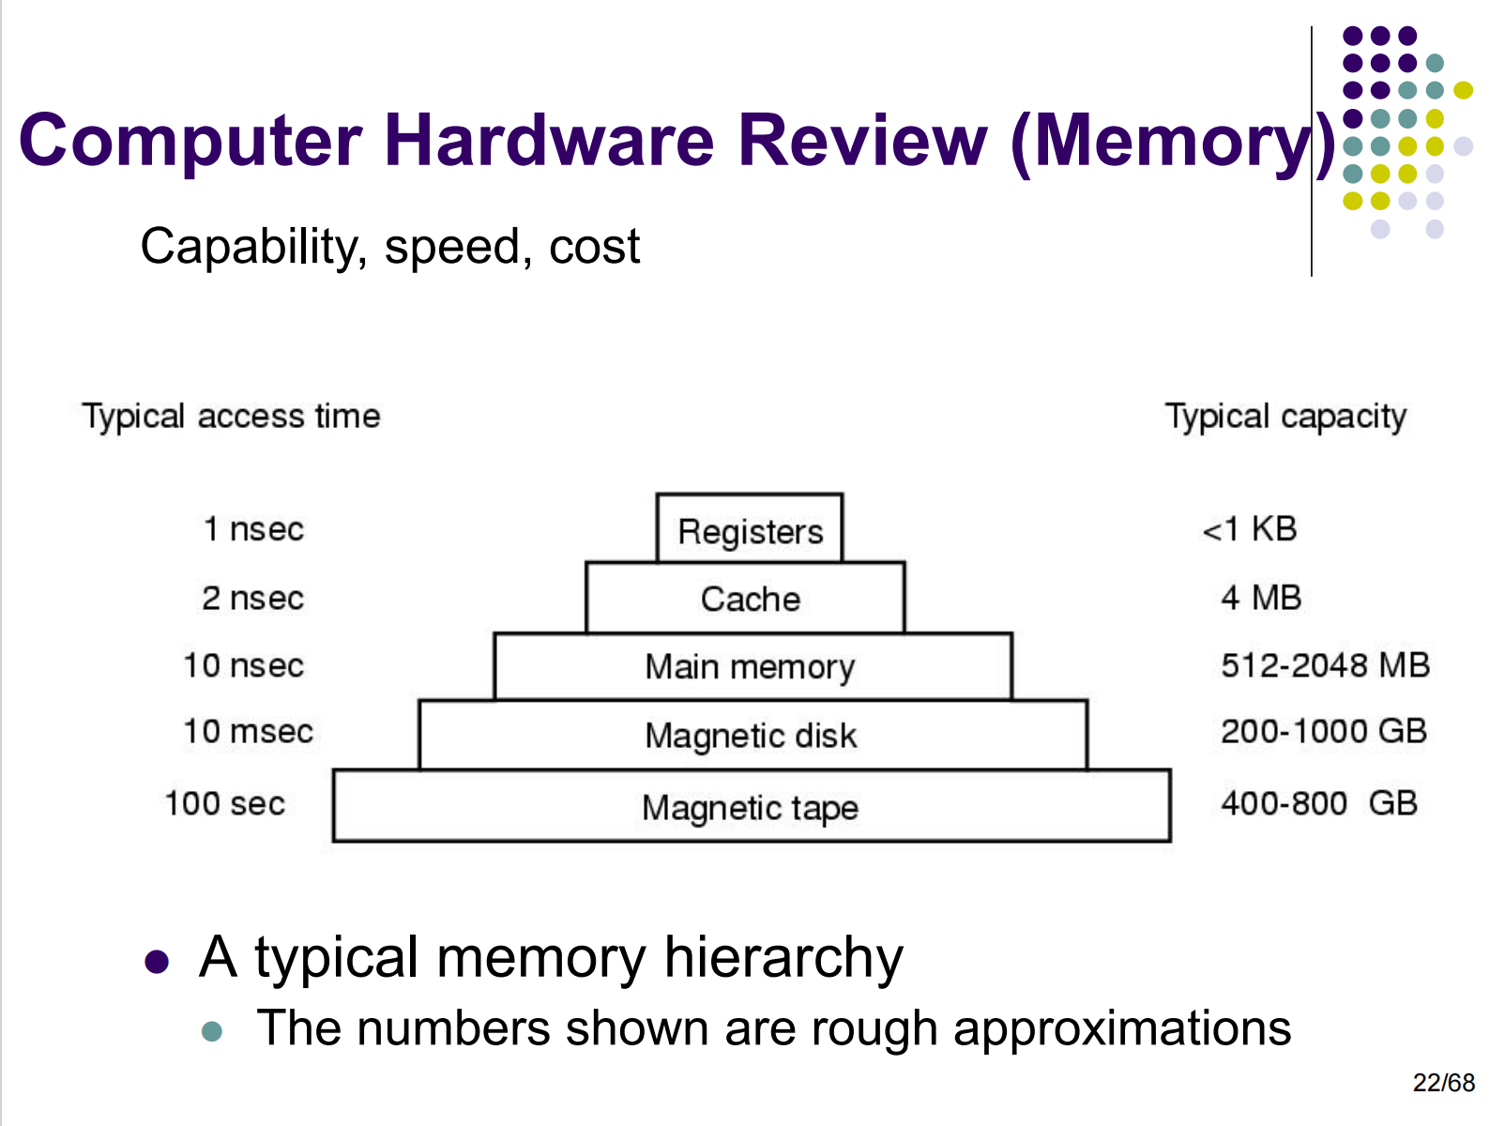
Chapter 1
15. Consider a computer system that has cache memory, main memory (RAM) and disk, and an operating system that uses virtual memory. It takes 1 nsec to access a word from the cache, 10 nsec to access a word from the RAM, and 10 ms to access a word from the disk. If the cache hit rate is 95% and main memory hit rate (after a cache miss) is 99%, what is the average time to access a word?
Average access time =
0.95 × 1 nsec (word is in the cache)
+ 0.05 × 0.99 × 10 nsec (word is in RAM, but not in the cache)
+ 0.05 × 0.01 × 10,000,000 nsec (word on disk only)
= 5001.445 nsec
= 5.001445 μsec

Slide 5
Chapter 1
24. Suppose that a 10-MB file is stored on a disk on the same track (track 50) in consecutive sectors. The disk arm is currently situated over track number 100. How long will it take to retrieve this file from the disk? Assume that it takes about 1 ms to move the arm from one cylinder to the next and about 5 ms for the sector where the beginning of the file is stored to rotate under the head. Also, assume that reading occurs at a rate of 200 MB/s.
Time to retrieve the file =
1 * 50 ms (Time to move the arm over track 50)
+ 5 ms (Time for the first sector to rotate under the head)
+ 10/200 * 1000 ms (Read 10 MB)
= 105 ms

Slide 6
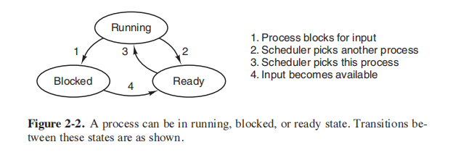
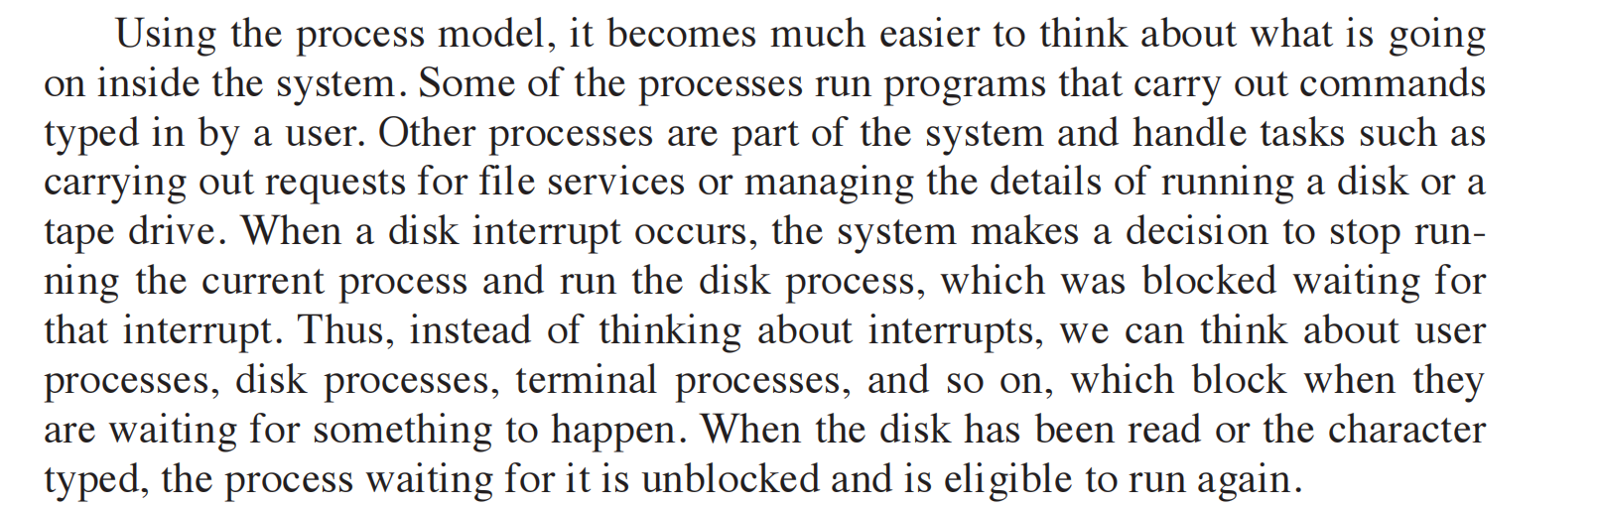
Chapter 2
1. In Fig. 2-2, three process states are shown. In theory, with three states, there could be six transitions, two out of each state. However, only four transitions are shown. Are there any circumstances in which either or both of the missing transitions might occur?
The transition from blocked to running is conceivable.
Suppose that a process is blocked on I/O and the I/O finishes. If the CPU is otherwise idle, the process could go directly from blocked to running.
The other missing transition, from ready to blocked, is impossible.
A ready process cannot do I/O or any thing else that might block it. Only a running process can block.
书 P93

Slide 7
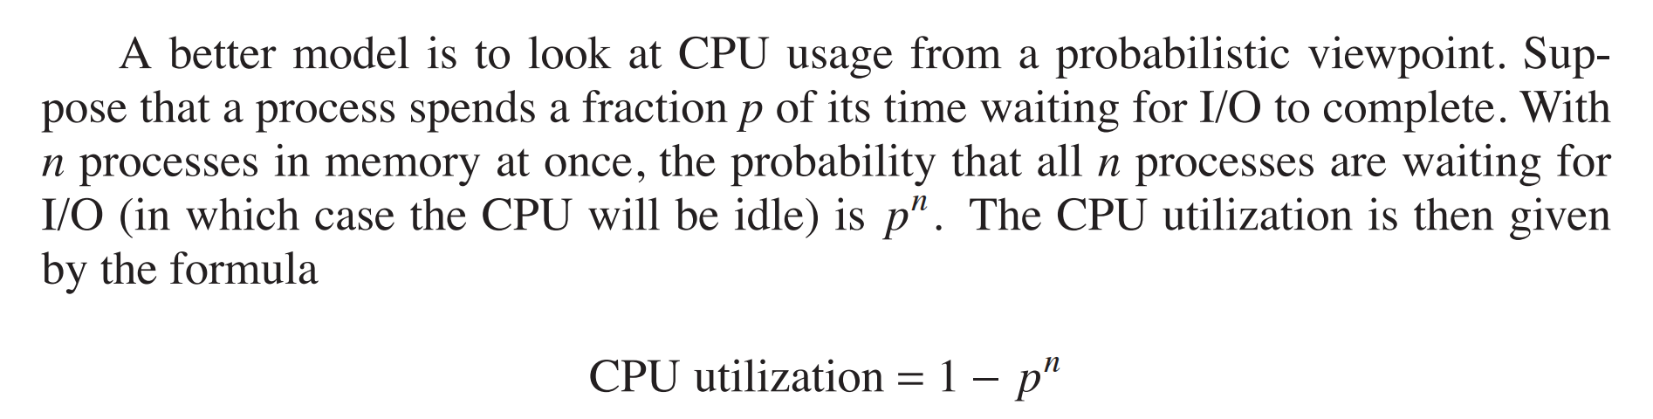
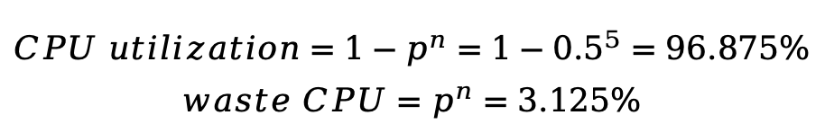
Chapter 2
5. A computer system has enough room to hold five programs in its main memory. These programs are idle waiting for I/O half the time. What fraction of the CPU time is wasted?
书 P96
$$CPU utilization=1−p^{n}=1−{0.5}^{5}=96.875\%$$
$$waste CPU=p^{n}=3.125\%$$

Slide 8
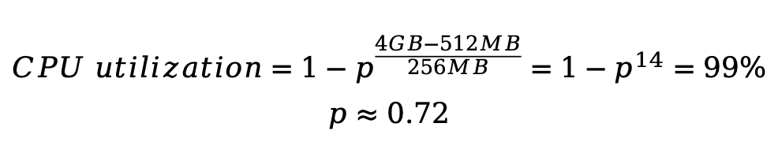
Chapter 2
6. A computer has 4 GB of RAM of which the operating system occupies 512 MB. The processes are all 256 MB (for simplicity) and have the same characteristics. If the goal is 99% CPU utilization, what is the maximum I/O wait that can be tolerated?
书 P96
$$CPU utilization=1−p^{\frac{4GB−512MB}{256MB}}=1−p^{14}=99\%$$
$$p≈0.72$$

Slide 9
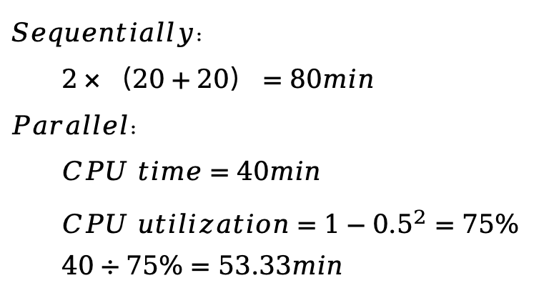
Chapter 2
7. Multiple jobs can run in parallel and finish faster than if they had run sequentially. Suppose that two jobs, each needing 20 minutes of CPU time, start simultaneously. How long will the last one take to complete if they run sequentially? How long if they run in parallel? Assume 50% I/O wait.
$$Sequentially：$$
$$2×（20+20）=80min$$
$$Parallel：$$
$$CPU time=40min$$
$$CPU utilization=1−{0.5}^{2}=75\%$$
$$40÷75\%=53.33min$$

Slide 10
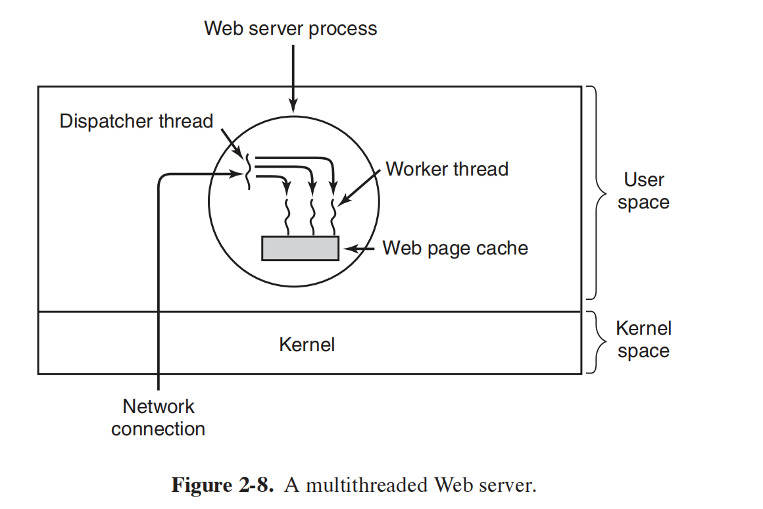
Chapter 2
12. In Fig. 2-8, a multithreaded Web server is shown. If the only way to read from a file is the normal blocking read system call, do you think user-level threads or kernel-level threads are being used for the Web server? Why?
kernel-level.
A worker thread will block when it has to read a Web page from the disk. If user-level threads are being used, this action will block the entire process, destroying the value of multithreading. Thus it is essential that kernel threads are used to permit some threads to block without affecting the others.

Slide 11
Chapter 2
15. Why would a thread ever voluntarily give up the CPU by calling thread_yield? After all, since there is no periodic clock interrupt, it may never get the CPU back.
Threads in a process cooperate. They are not hostile to one another. If yielding is needed for the good of the application, then a thread will yield. After all, it is usually the same programmer who writes the code for all of them.

Slide 12
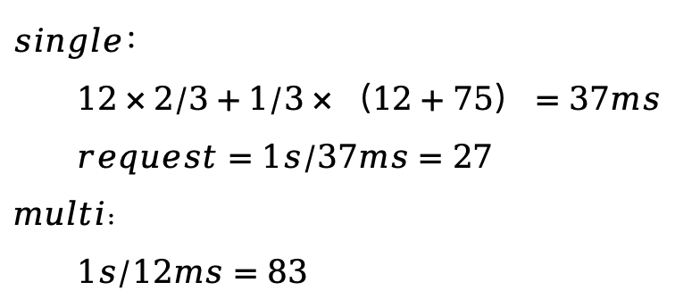
Chapter 2
17. In this problem you are to compare reading a file using a single-threaded file server and a multithreaded server. It takes 12 msec to get a request for work, dispatch it, and do the rest of the necessary processing, assuming that the data needed are in the block cache. If a disk operation is needed, as is the case one-third of the time, an additional 75 msec is required, during which time the thread sleeps. How many requests/sec can the server handle if it is single threaded? If it is multithreaded?
$$single：$$
$$12×2/3+1/3×（12+75）=37ms$$
$$request=1s/37ms=27$$
$$multi：$$
$$1s/12ms=83$$

Slide 13
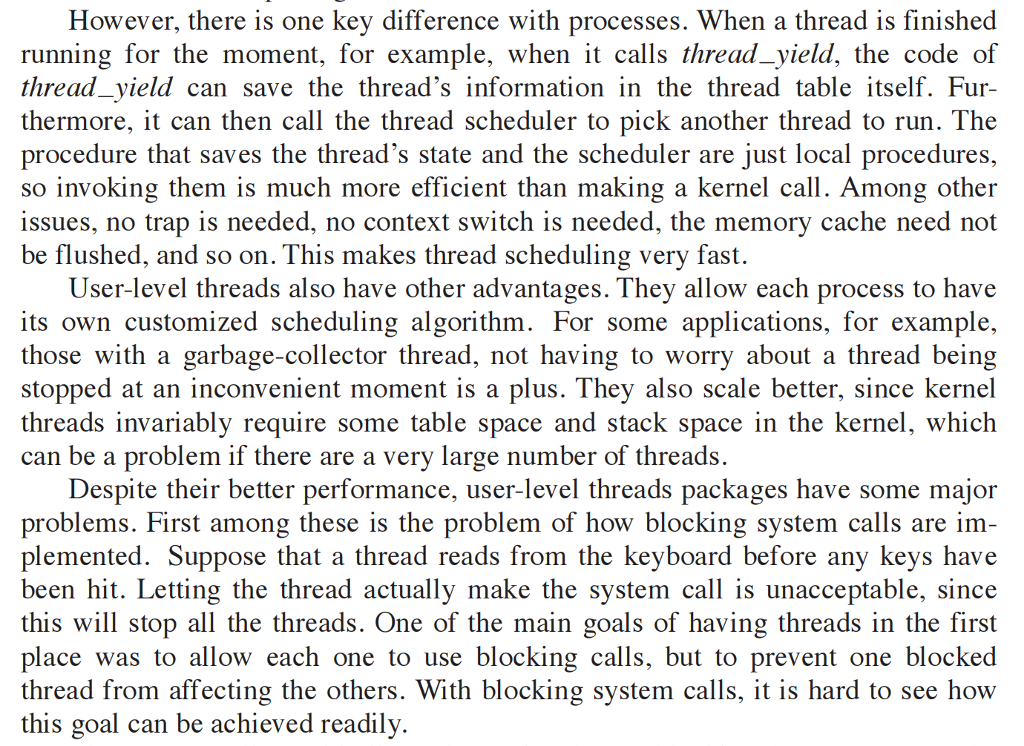
Chapter 2
18. What is the biggest advantage of implementing threads in user space? What is the biggest disadvantage?
The biggest advantage is the efficiency. No traps to the kernel are needed to switch threads.
The biggest disadvantage is that if one thread blocks, the entire process blocks.
书 P110

Slide 14
课堂检测
45. Five batch jobs. A through E, arrive at a computer center at almost the same time.They have estimated running times of 10, 6, 2, 4, and 8 minutes. Their (externally de_x0002_termined) priorities are 3, 5, 2, 1, and 4, respectively, with 5 being the highest priority.For each of the following scheduling algorithms, determine the mean process turnaround time. Ignore process switching overhead.
(a) Round robin.
(b) Priority scheduling.
(c) First-come, first-served (run in order 10, 6, 2, 4, 8).
(d) Shortest job first.
For (a), assume that the system is multiprogrammed, and that each job gets its fair share of the CPU. For (b) through (d), assume that only one job at a time runs, until it finishes. All jobs are completely CPU bound.
 | time | priority
A | 10 | 3
B | 6 | 5
C | 2 | 2
D | 4 | 1
E | 8 | 4

Slide 15
课堂检测
(a) Round robin.
（10+18+24+28+30）/5=22
(b) Priority scheduling.
（6+14+24+26+30）/5=20
(c) First-come, first-served (run in order 10, 6, 2, 4, 8).
（10+16+18+22+30）/5=19.2
(d) Shortest job first.
（2+6+12+20+30）/5=14
10
18
24
28
30
ABCDE
ABDE
ABE
AE
E
 | time | priority
A | 10 | 3
B | 6 | 5
C | 2 | 2
D | 4 | 1
E | 8 | 4
6
14
24
26
30
B
E
A
C
D
2
6
12
20
30
C
D
B
E
A

