Slide 1
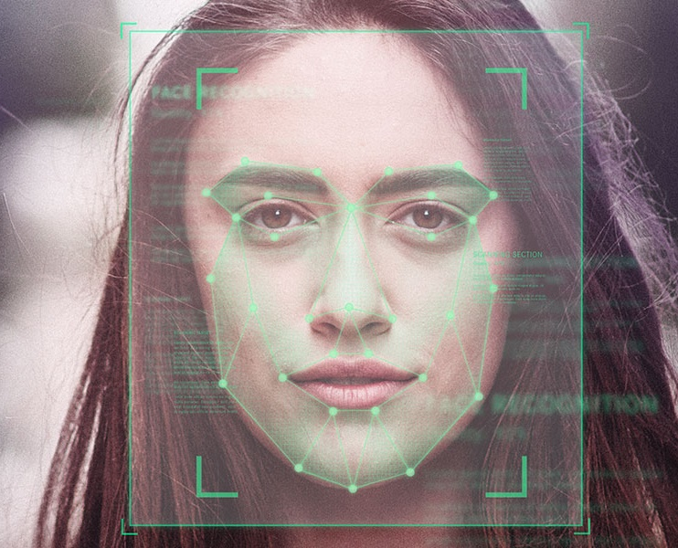
Face Attendance Checking System
Course: Artificial Intelligence in Control Engineering
Lecturer: Dr.Pham Viet Cuong
Group: 09

Slide 2
Content
Problem definition
Literature review
Implementation
Experimental results
Demo

Slide 3

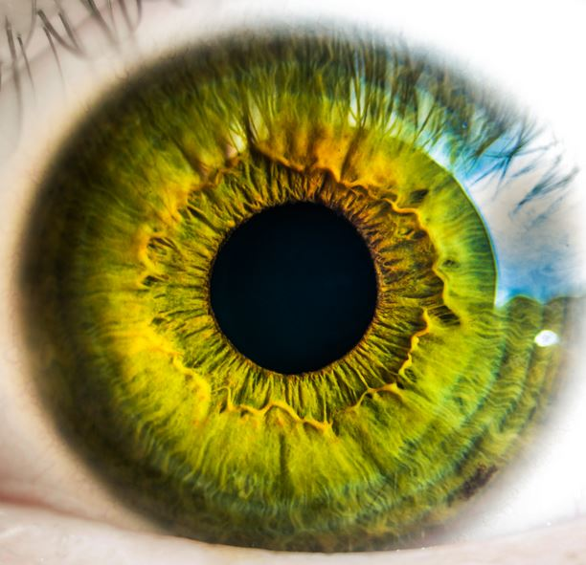

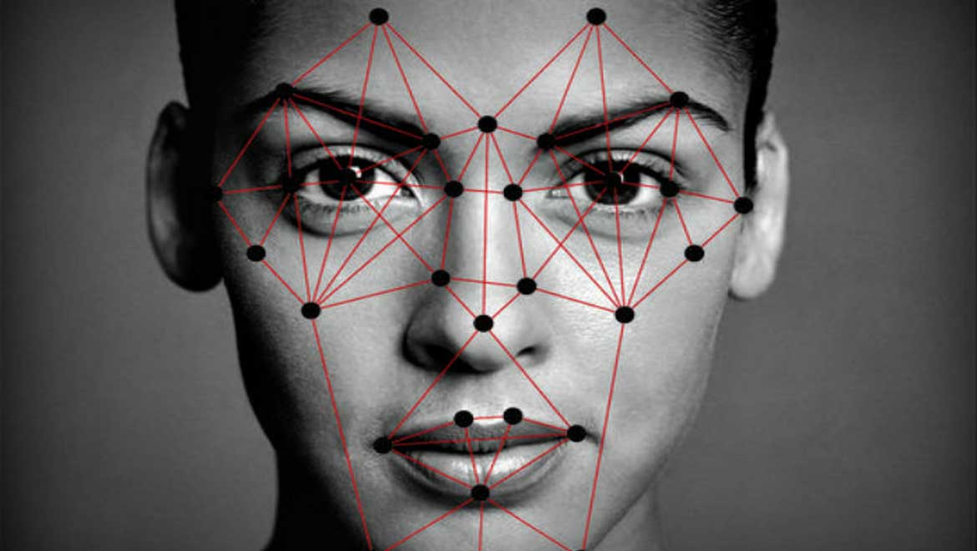

Problem definition

Slide 4
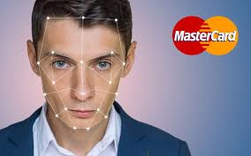
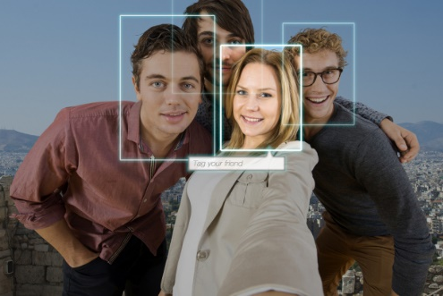
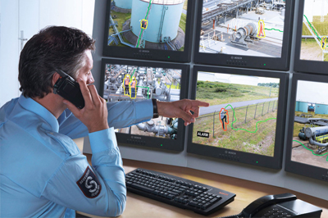
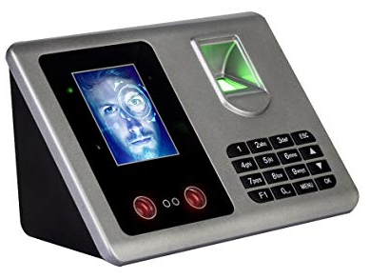
Problem definition

Slide 5
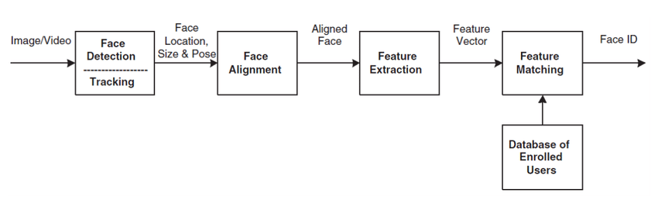
Problem definition

Slide 6
Members
https://github.com/AntiAegis/Face-Attendance-System

Slide 7
Literature review

Slide 8
Implementation

Slide 9
Experimental results

Slide 10
Demo

Slide 11
Conclusion

