Slide 1

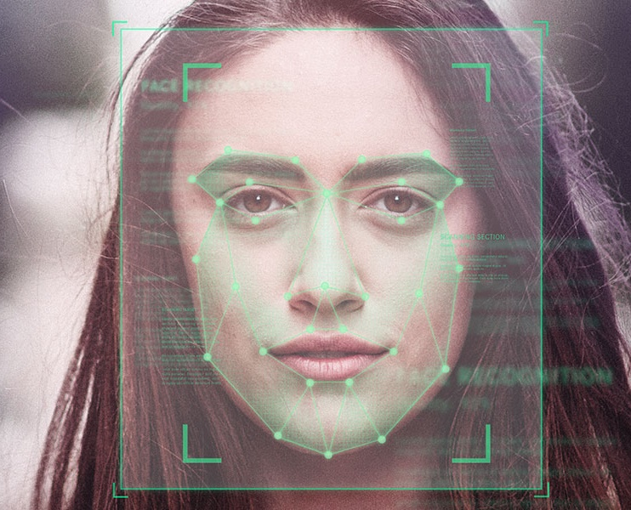
Face Attendance Checking
Course: EE3063 - Dr. Pham Viet Cuong
Conducted by Group 09
21/11/2018

Slide 2
Content
Problem definition
Literature review
Implementation
Experimental results
Demo

Slide 3
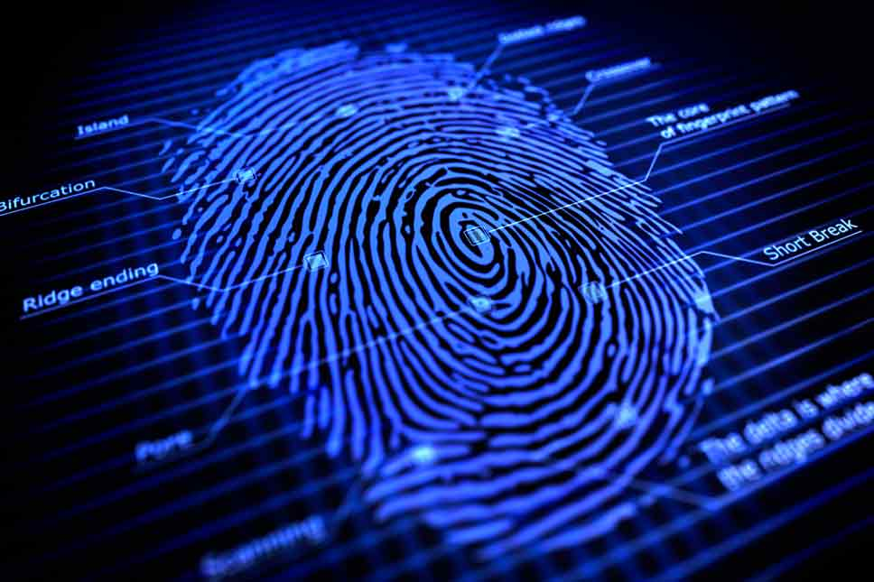
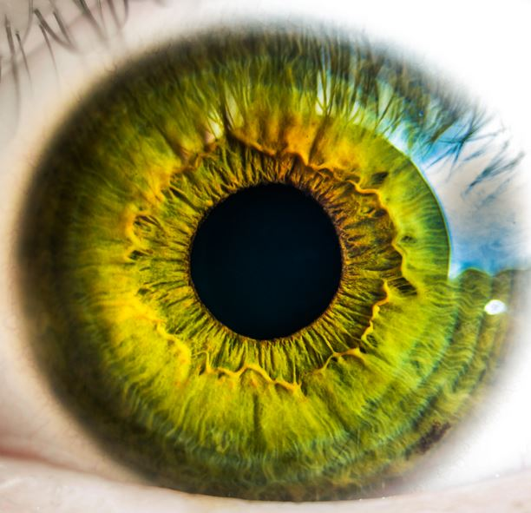

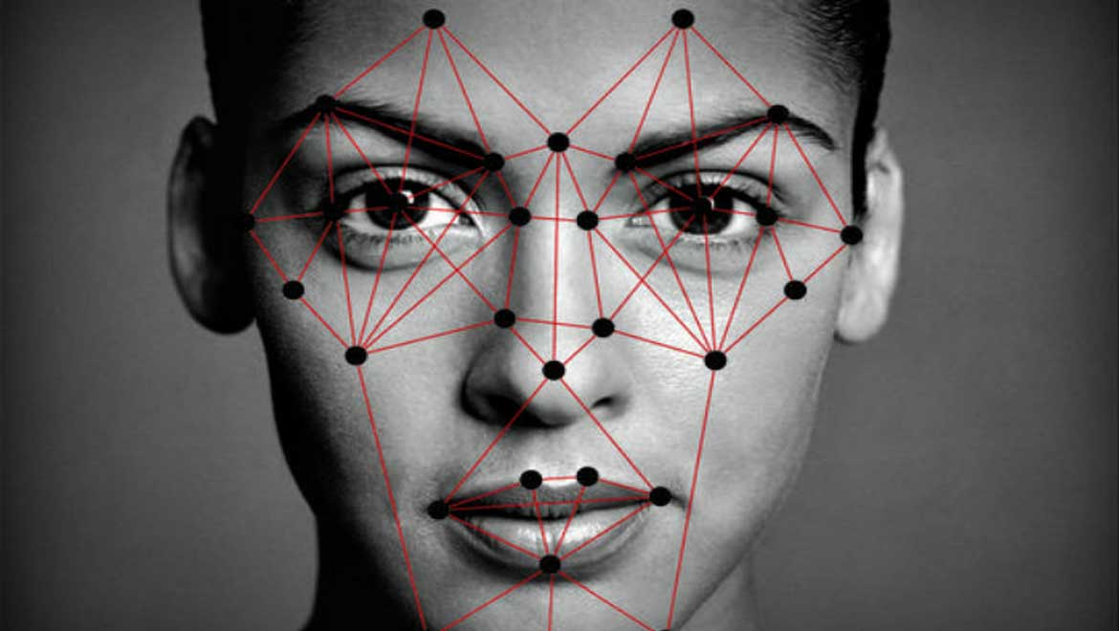

Problem definition

Slide 4
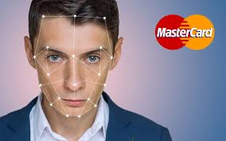
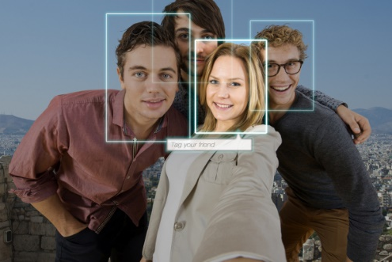
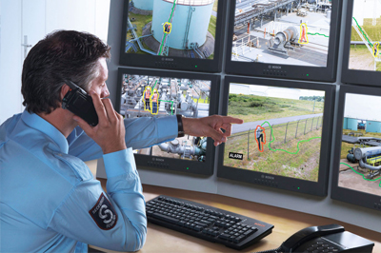
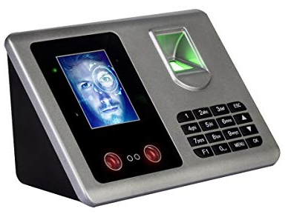
Problem definition

Slide 5
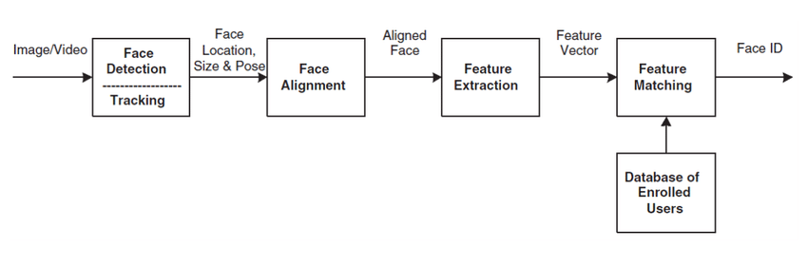
Problem definition

Slide 6
Members
https://github.com/AntiAegis/Face-Attendance-System

Slide 7
Literature review

Slide 8
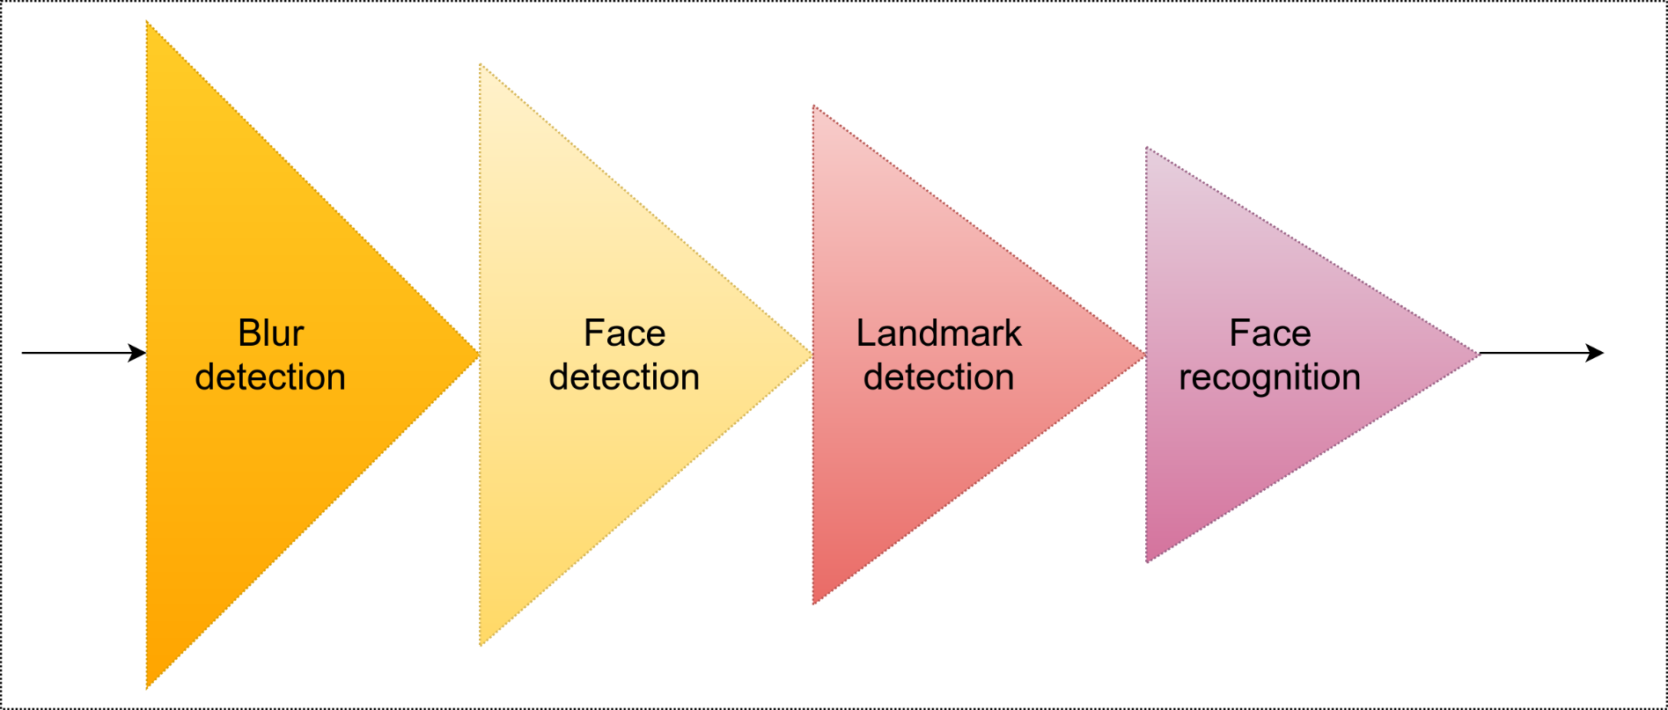
Implementation
System pipeline

Slide 9
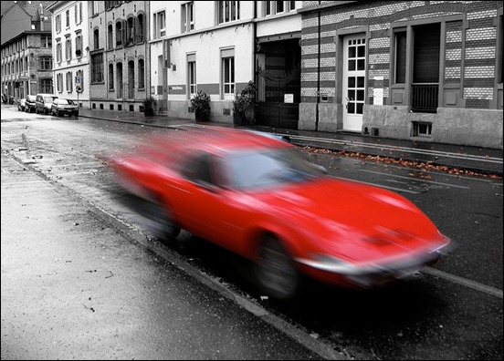
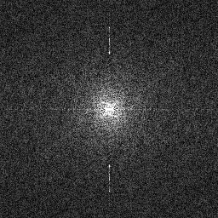
Implementation
Blur detection
FFT-2D

Slide 10
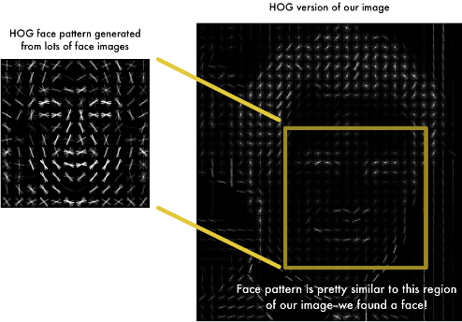
Implementation
Face detection (based on Histogram Of Gradient)
gradient

Slide 11
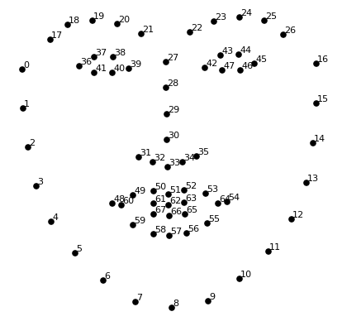
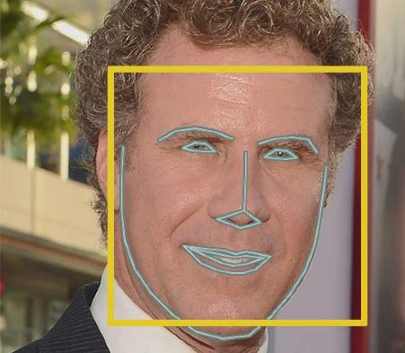
Implementation
Landmark detection

Slide 12

Implementation
Landmark detection
Regressor

Slide 13
Implementation
Landmark detection
Cascaded regressors
Regressor1
Regressor2
…
RegressorN

Slide 14
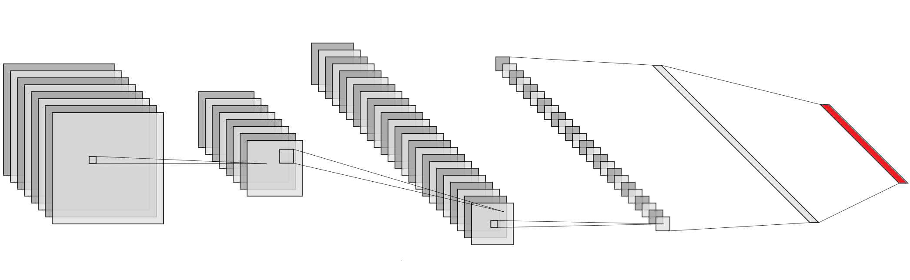

Implementation
Face recognition
Input image:
High-dimensional
Rich detail
Feature vector:
Low-dimensional
Representative

Slide 15
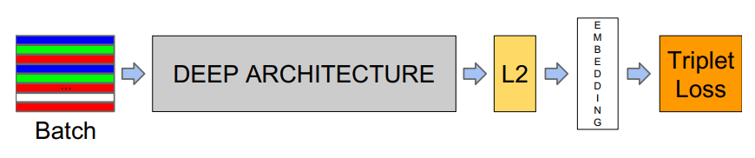
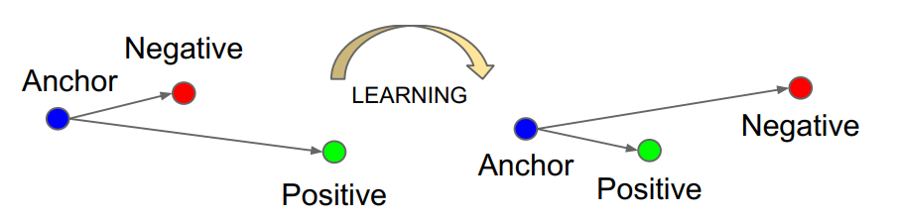
Implementation
Face recognition (based on FaceNet)

Slide 16
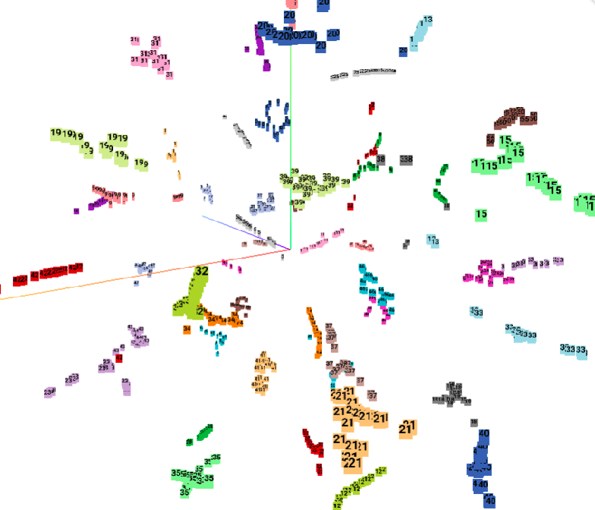
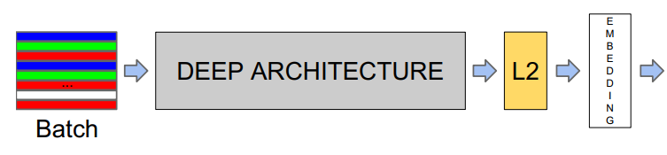
Implementation
Face recognition (based on FaceNet)
SVM
classifier

Slide 17
Experimental results

Slide 18
Demo

Slide 19
Conclusion
Hard:
Face Attendance Checking
Deep-learning based
Standard hardware
High accuracy
Easy-use GUI
Soft:
Specialized-task assignment
GitHub: store, collaborate, refer
Open-source: MIT license
Scientific-form paper report
Unity

Slide 20
Acknowledge
Dr. Pham Viet Cuong: promote a chance.
Course-EE3063 students: donate data.

