Slide 1

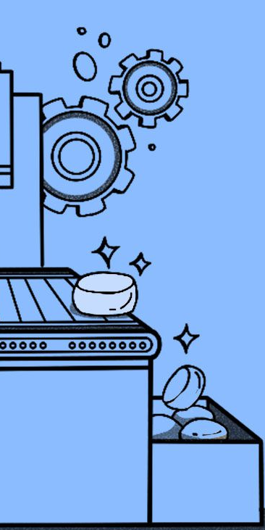
Data mining Project - Building a part of IBM Watson
Răuță Alexandra-Elena (DSI),
Popa Iulian-Alexandru (DB),
Stoian Silviu (DB),
Ardelean Daniel (DSI),
Chirvasiu Mihai (DSI)

Slide 2

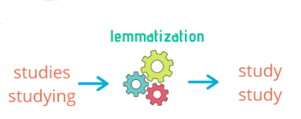
Building the index
For the processing part we are using the CoreNLP API provided by Stanford, to apply the process of tokenization and lemmatization. So we reduce inflexions of terms and effectively normalize and reduce the overall size of the index.
Particularly we used the: tokenize, split , pos and lemma annotators which will tokenize the text, split it into sentences, annotate each token and lemmatize the tokens to reduce inflexions ( was, were, being, all become “be” ).
We use 2 pointers: contentStart, contentEnd, which mark the beginning and end of the content of a document in the text file and we follow these steps:
1. Get the documents title
2. Get the content of the document
3. Add the document to the index

Slide 3

Building the query
The query was built from by combining the category of the question and the clue. We used all the words from this combination, and we used lemmatization on them before searching in the index.
To communicate with the created index, Lucene provides us with a class called IndexSearcher. This searcher ranks the index pages and retrieve the most relevant ones.
The algorithm used is called BM25 which has a modified term frequency (TF) k1 that saturates as the term frequency increases, and a b (IDF) weight which prioritizes terms that are more discriminative.
We went for k1 = 0.5 and b = 0.8 , which yielded the most correct answers in a row of multiple close values.

Slide 4

Performance analysis
We used metrics like:
P@1 or Precision at 1
Normalized Discounted Cumulative Gain (NDCG)
Mean Reciprocal Rank (MRR)
In our system the values for each performance metric, are P@1 = 0.34, NDCG = 100.0 and MRR = 0.38867857142857143.
After the examination of these results, we decided to continue using and evaluating our system with the following: P@1 and MRR.
As each definition states, P@1 is showing how performant is the system when looking only and the top ranked result and for MRR we calculate the reciprocal of the rank of the first relevant item, then average with across all the queries.

Slide 5


Errors Analysis
The correct questions can be effectively addressed by a straightforward system due to several key factors. Specifically, questions that exhibit a high degree of specificity and focus on well-known individuals, established facts, or recognized topics stand a greater chance of receiving accurate answers.
This clarity allows the system to better comprehend the intent of the question, contributing to its proficiency in delivering accurate responses.
When it comes to incorrect answers, the information used in the query is too extensive, making the search challenging, especially when the useful information is minimal and the direction of the search is given by irrelevant informations. Additionally, issues arise when the query has too little information, making the search ambiguous.

Slide 6


