Slide 1
Welcome and Introduction
Who? What? Why? How?
Simon Mayer, Karim Khamaisi, Luka Bekavac
University of St.Gallen
Bachelor in Computer Science
Computersysteme (1,904)

Slide 2
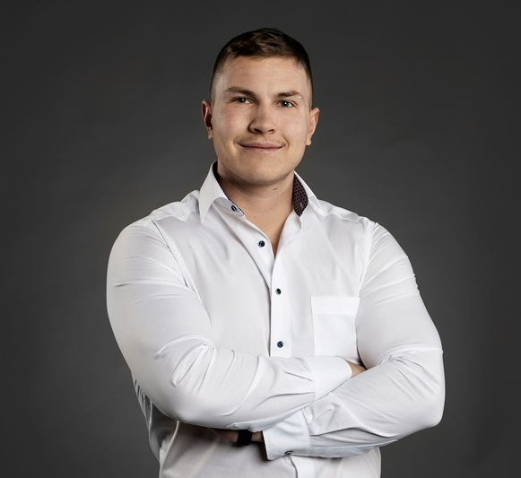
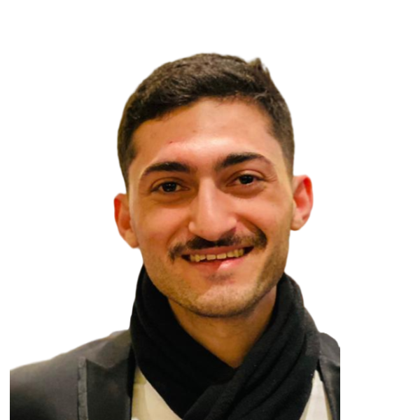
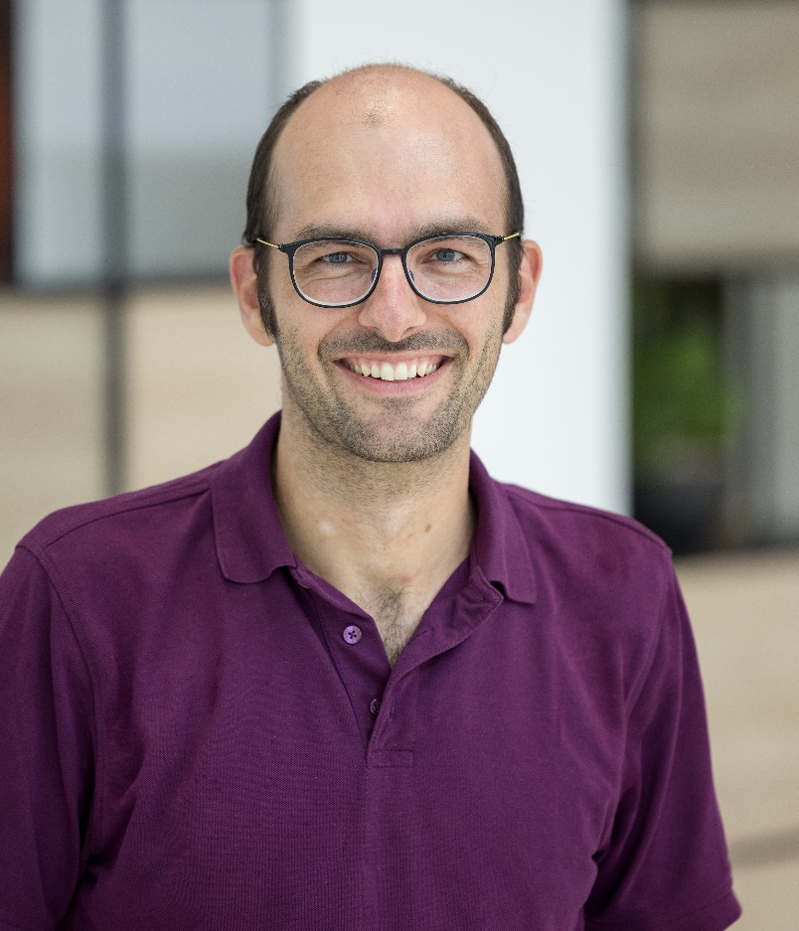
Course Team
Luka Bekavac, MSc
Doctoral Student on
Systemic Risks in Very Large Online Platforms
Prof. Dr. Simon Mayer
Chair for Interaction- and
Communication-based Systems
Karim Khamaisi, MSc
Doctoral Student on
Embedded Sensing Systems

Slide 3

What would you have studied if not CS?

Slide 4
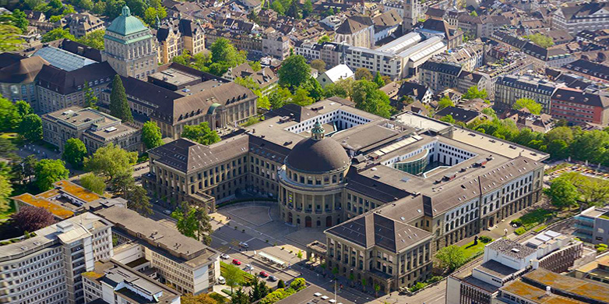


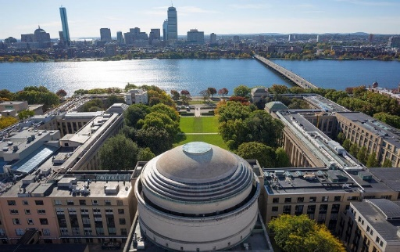



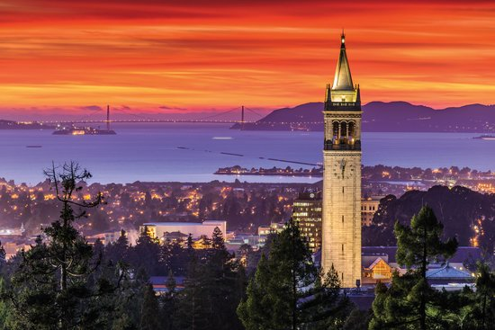
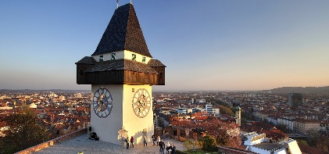









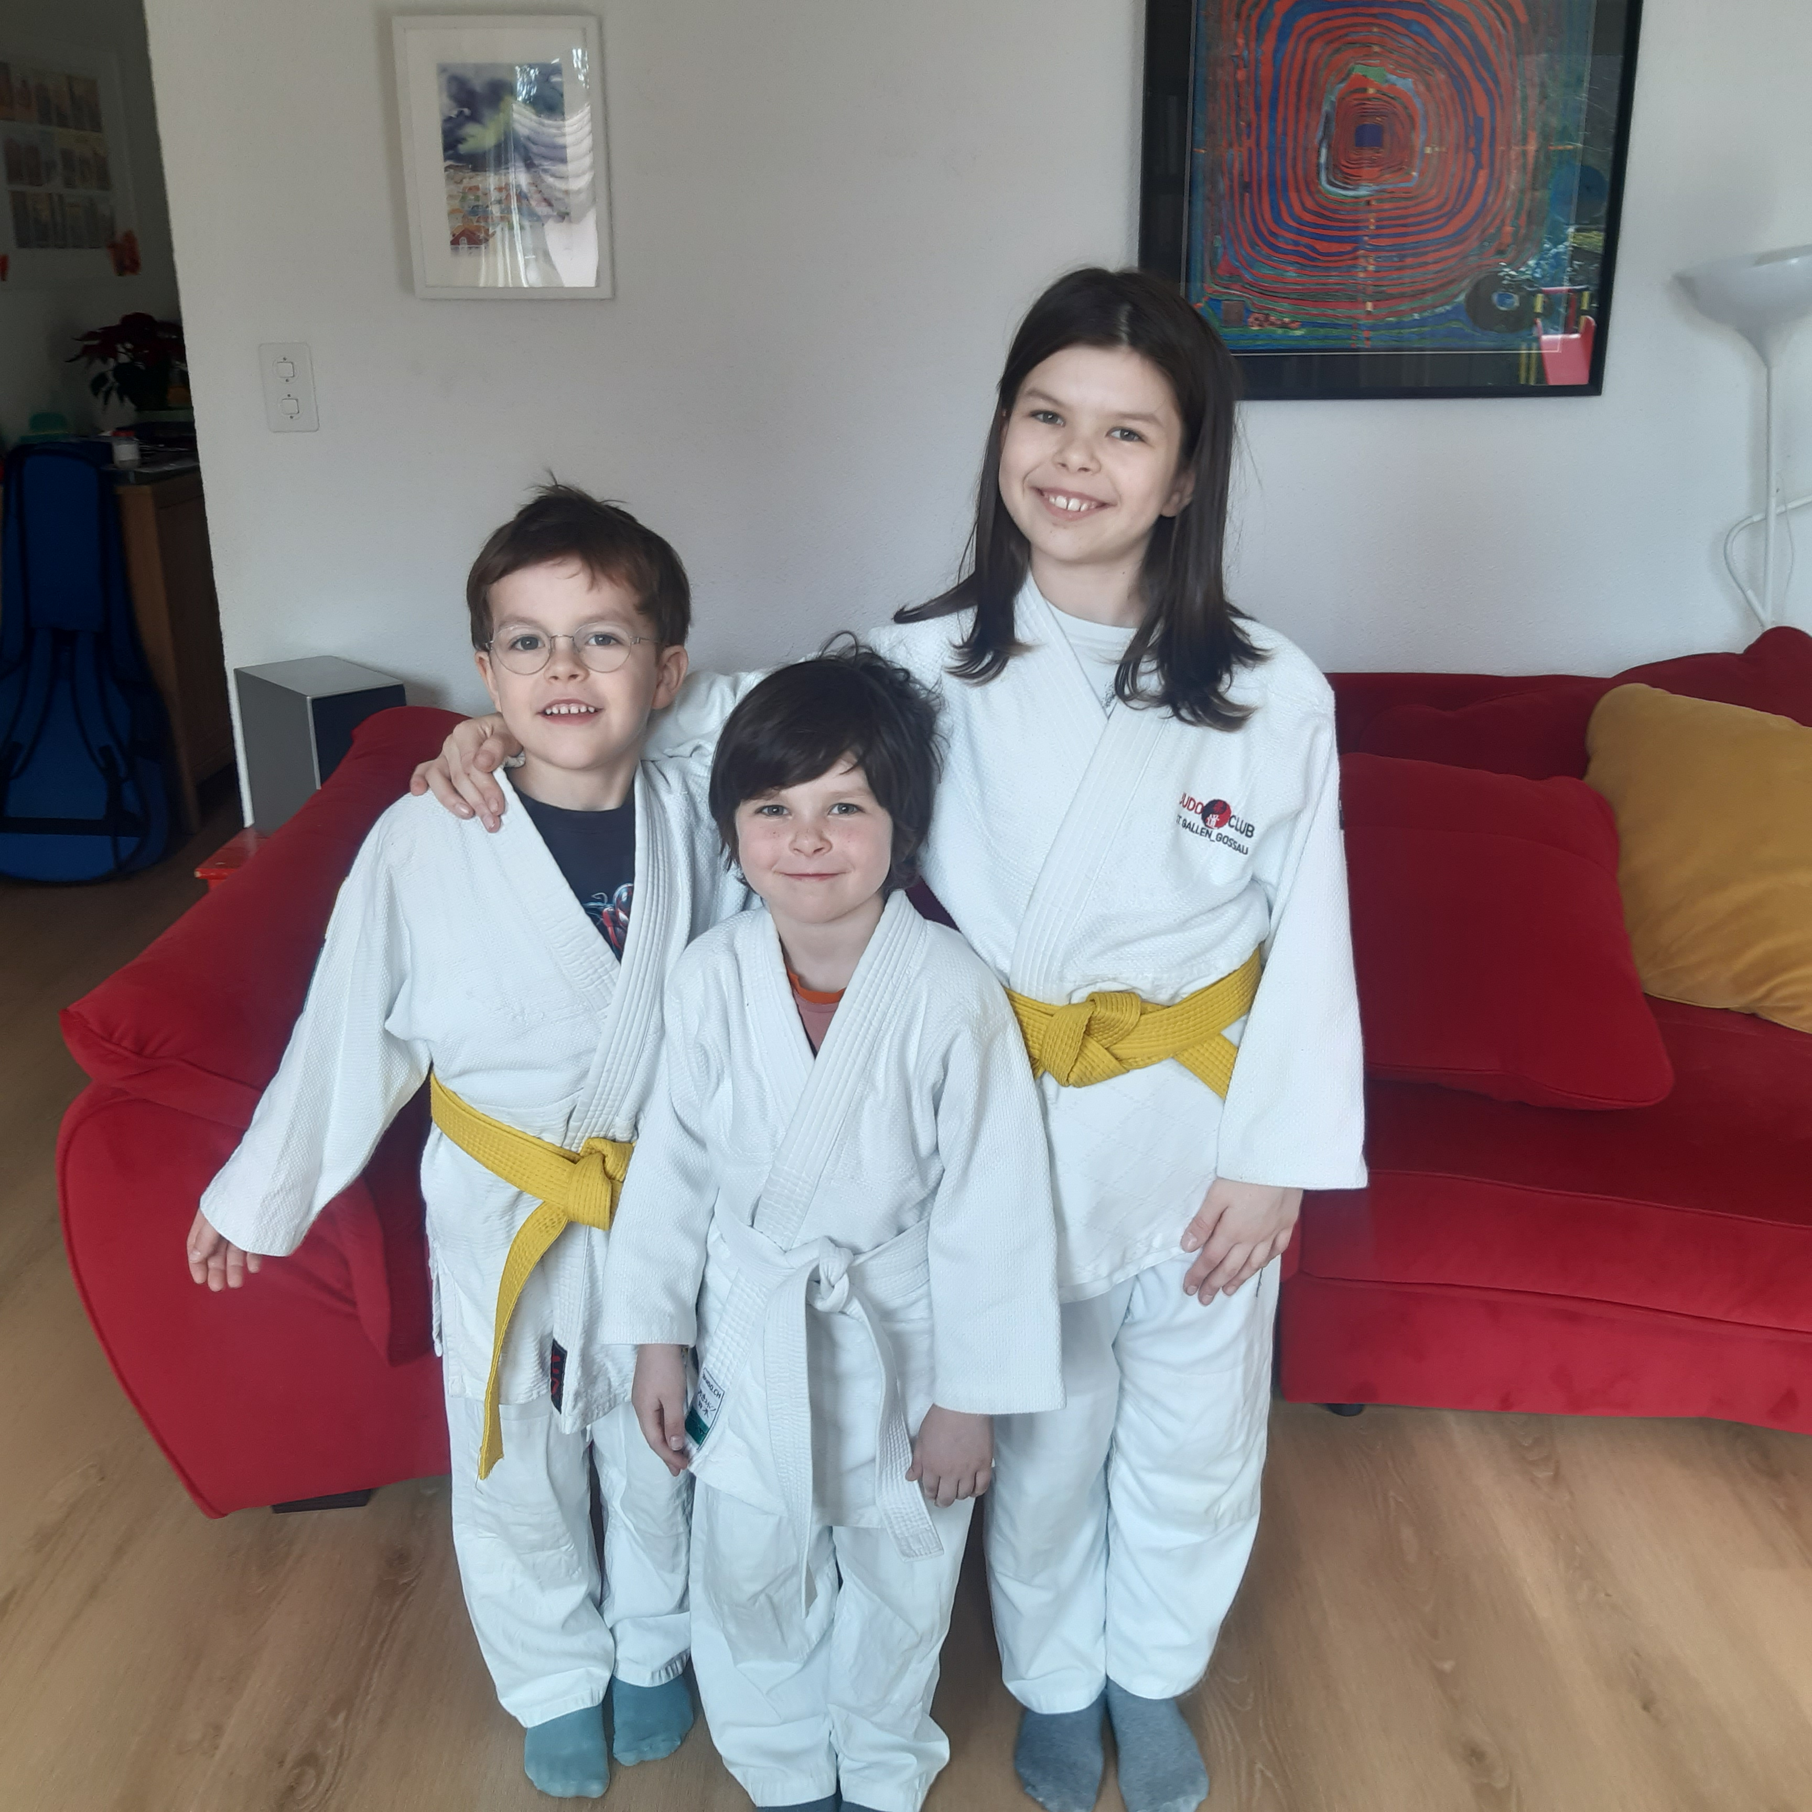

Simon
PhD in Computer Science, ETH Zurich (2010-2014)
Senior Key Expert, Siemens Corporate Technology, Berkeley (2014-2017)
Research Group Leader “Cognitive Products”, Pro²Future (2017-2018)
Postdoctoral Researcher, TU Graz (2017-2018)
Senior Researcher, ETH Zurich (2018-2020)
Professor for Interaction-and Communication-based Systems, University of St.Gallen (2018 →)
Director, Institute of Computer Science, University of St.Gallen (2019 →)
Dean, School of Computer Science, University of St.Gallen (2024-2026)
Lecturer, ETH Zurich (2015-2020), MIT (2015), UC Berkeley (2015-2017), TU Graz (2017-2019), University of Zurich (2020-2022), University of Bologna (2023)
3 Children, Backcountry Snowboarding

Slide 5
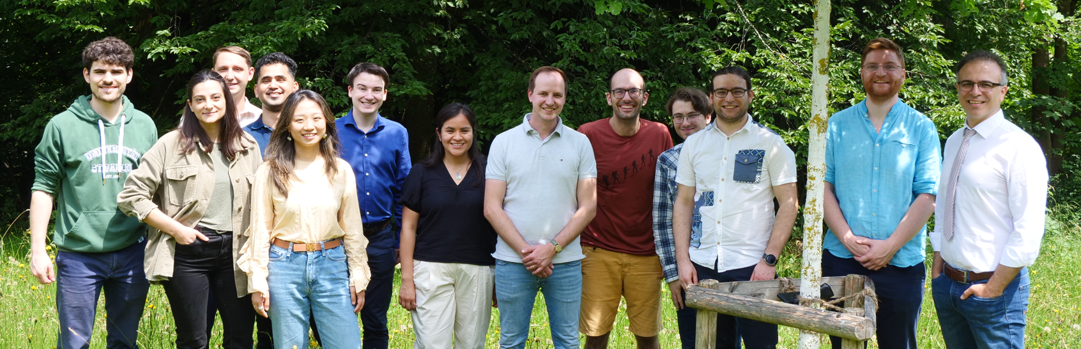
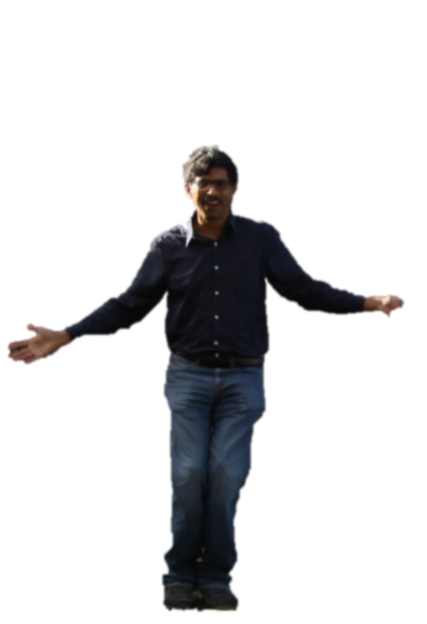
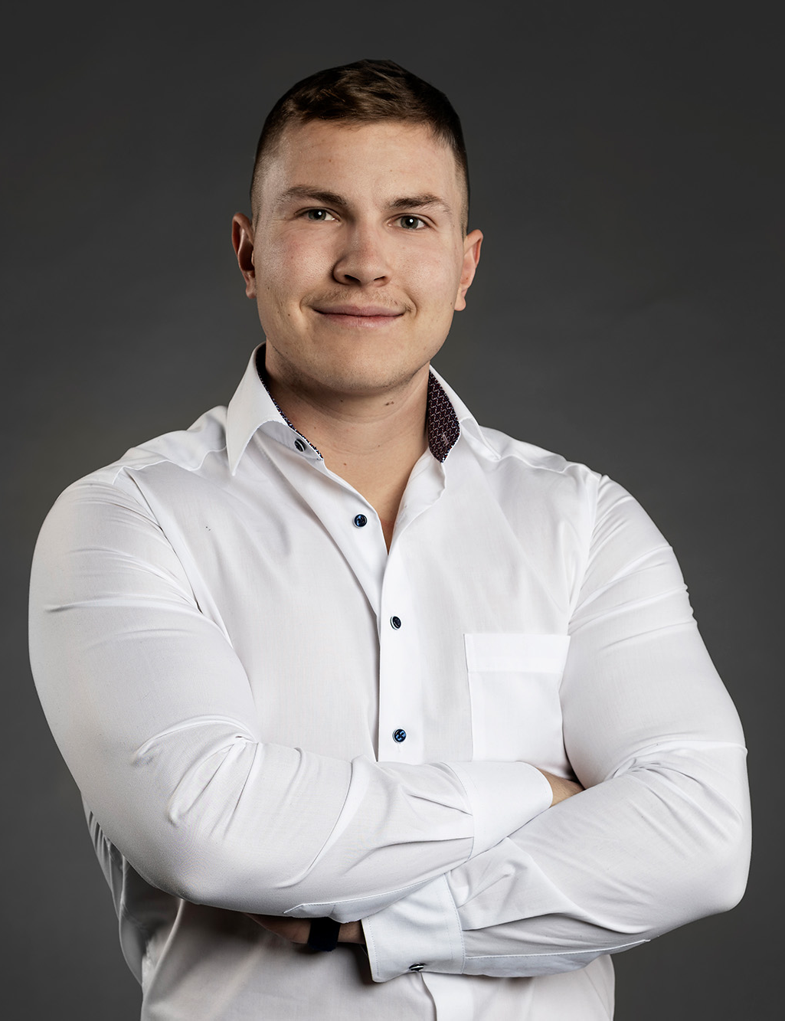
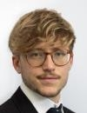

Sanjiv. Explainable CPS.
Jérémy. Interoperable Intelligence.
Jannis. Personalized Reality.
Andrei. HyperAgents.
Jan. Software.
Simon. Systems and People.
Damian. Automation and User Trust.
Lukas. Research Entrepreneur.
Jing. Personalized Diet.
Kenan. Gaze.
Danai. HyperAgents Interactions.
Kim. Sustainable Intelligence.
Alessandro. Bio-Inspired Agents
Ganesh. Autonomous Buildings.
Jan. Better Semantic Web.
Luka. Systemic Risks in VLOPs
Clement. Regulation Automation

Slide 6
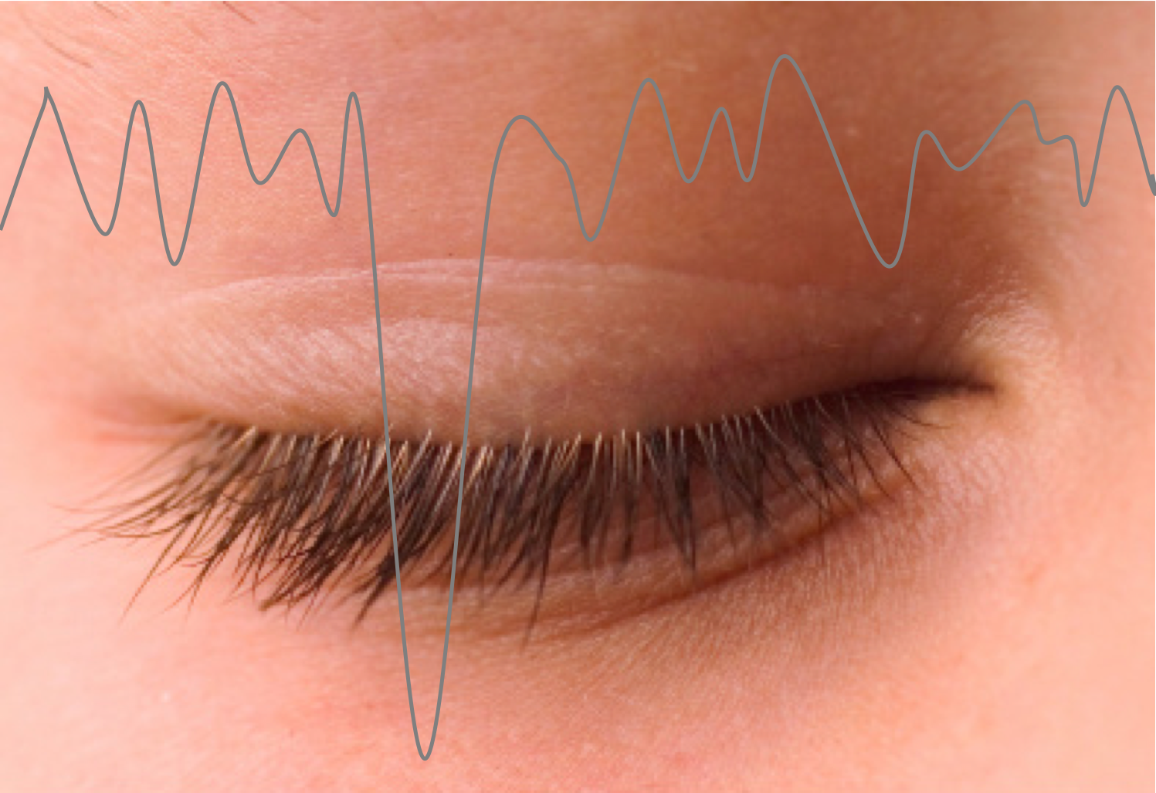
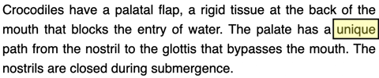
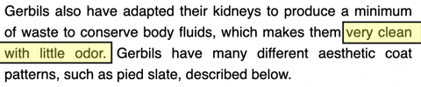
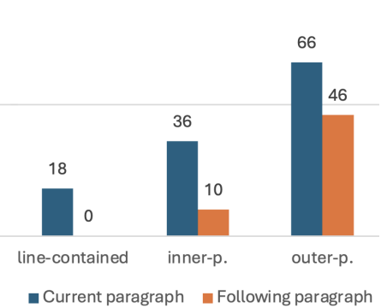
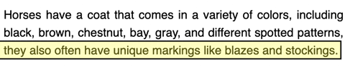
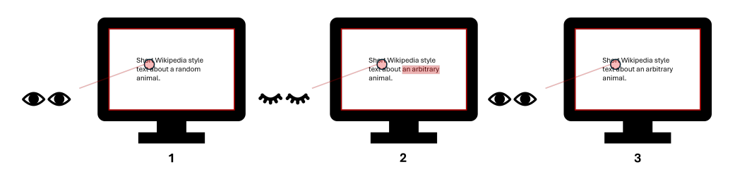
Open Your Eyes!
How fast is a blink?
Schultz, Bektas, Strecker-Bischoff, Mayer: Open your Eyes: Blink-induced Change Blindness while Reading. UbiComp 2025, Paper

Slide 7
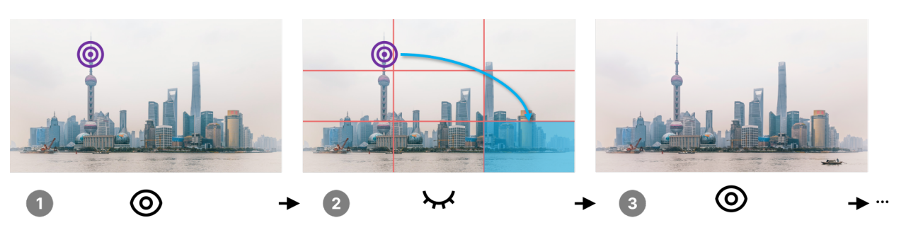
Turning this into BlinkArt ;-)
Steinmann, Strecker-Bischoff, Bektas, Williams, Mayer: BlinkArt: Using Change Blindness For AI-Generated Image Modifications in Artworks. UbiComp 2026

Slide 8
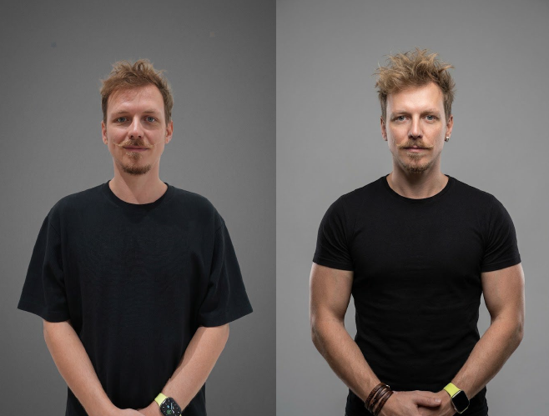
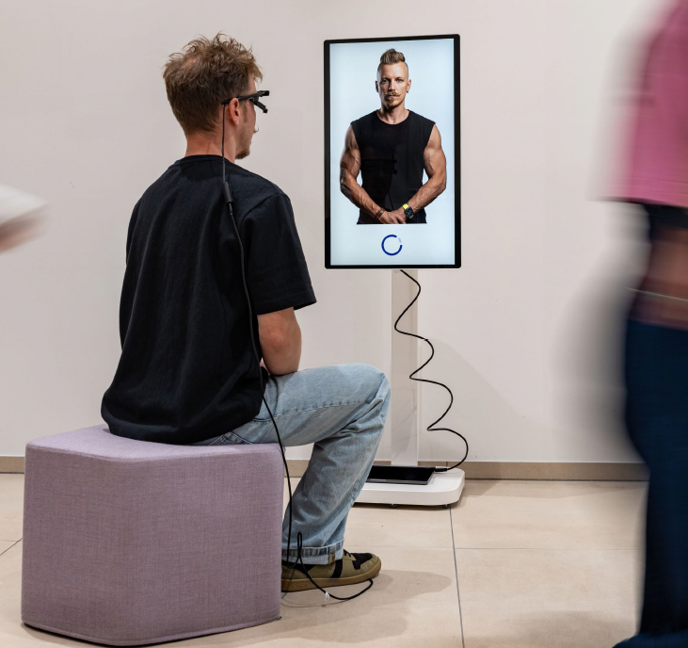
Introducing: The «For You» Portrait
“In doing so, it mobilizes these game-design elements both as an aesthetic strategy and as a modality for critical inquiry into technocratic obfuscation and today’s proliferating engagement-driven designs (e.g., on online social media platforms).”
Steinmann, Strecker-Bischoff, Bektas, Williams, Mayer: BlinkArt: Using Change Blindness For AI-Generated Image Modifications in Artworks. UbiComp 2026

Slide 9
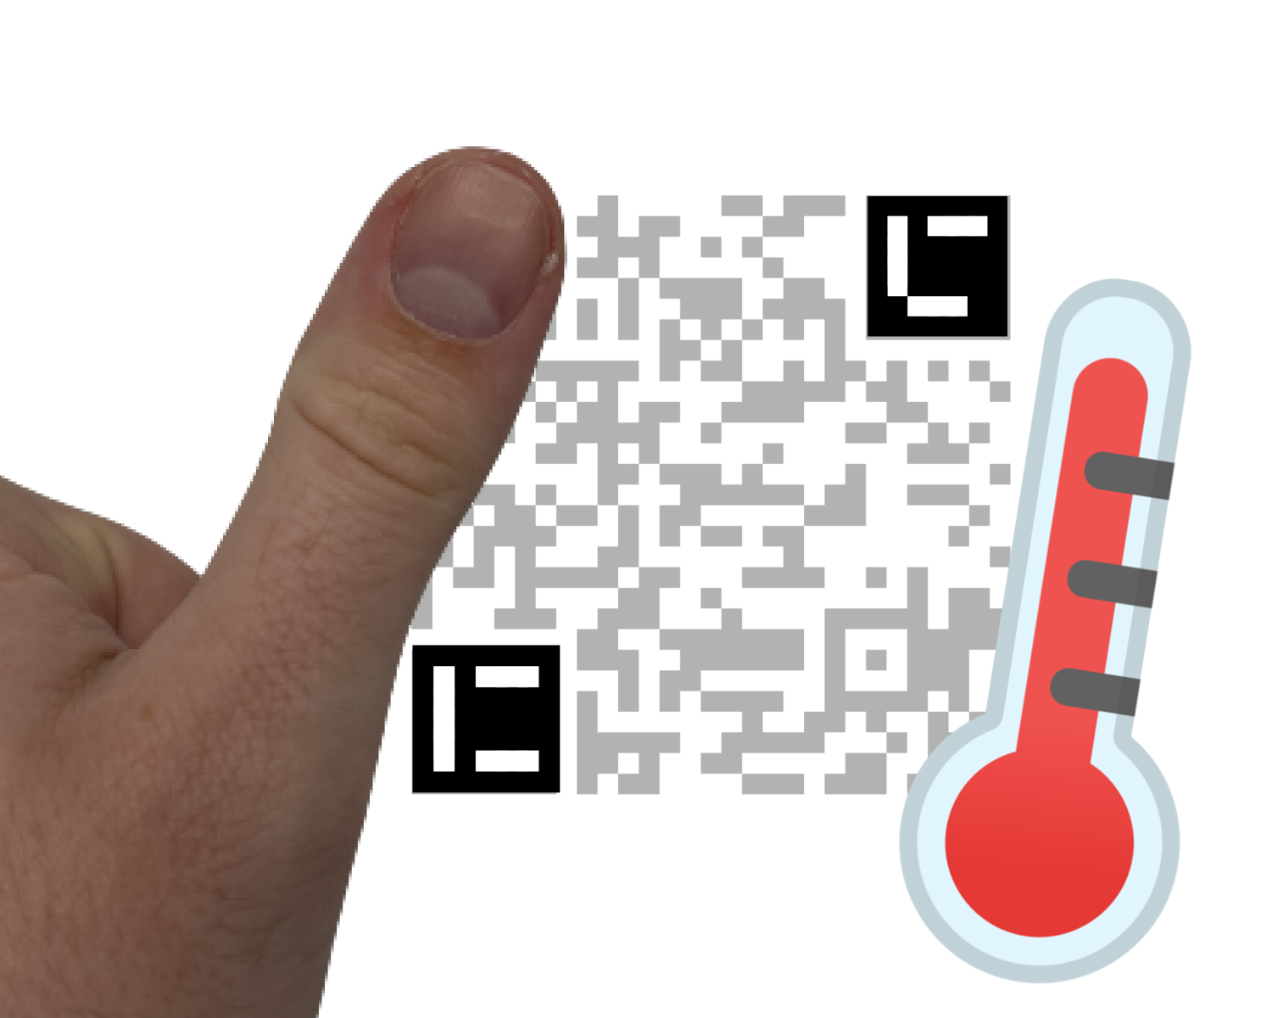

Interactions: Excerpt from our Research
3 standard ArUco Markers
Standard QR Code

Slide 10
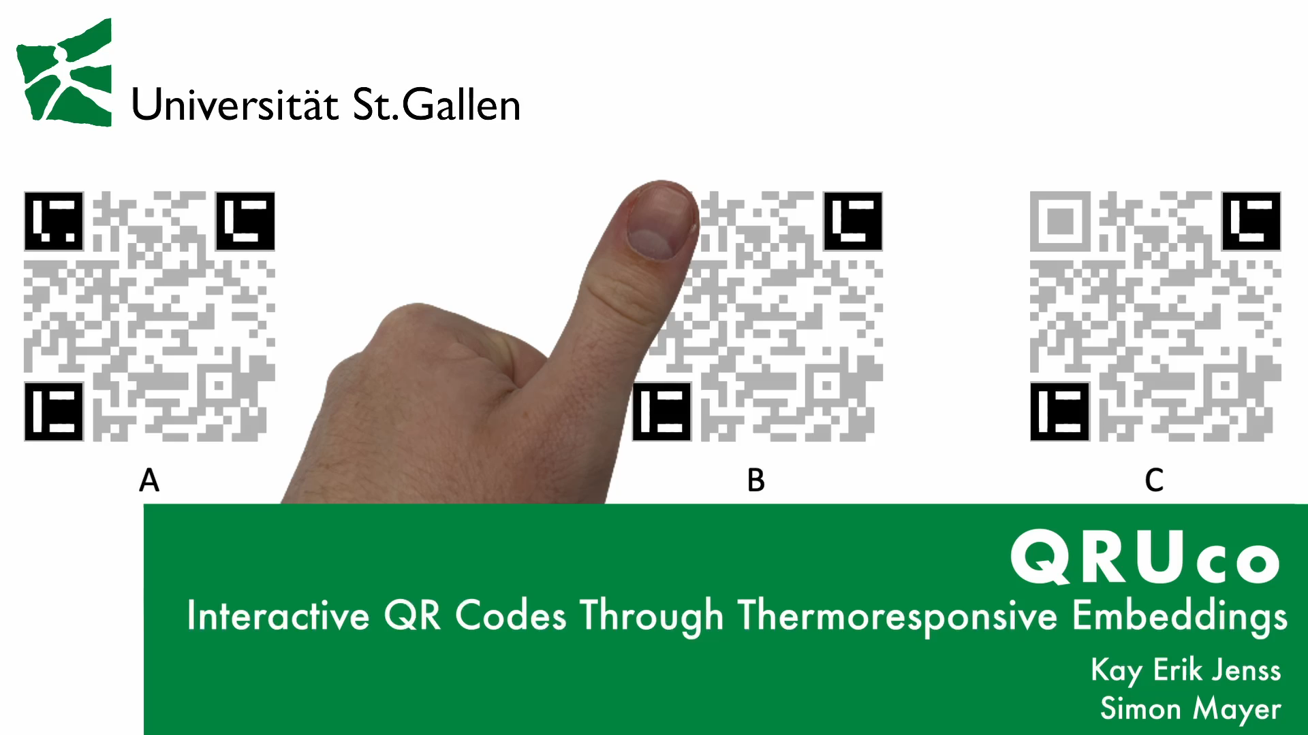

Interactions: Excerpt from our Research
QRUco: Interactive QR Codes through Thermoresponsive Embeddings
Jenss, Mayer. QRUco: Interactive QR Codes Through Thermoresponsive Embeddings. CHI 2023. Paper & Video

Slide 11
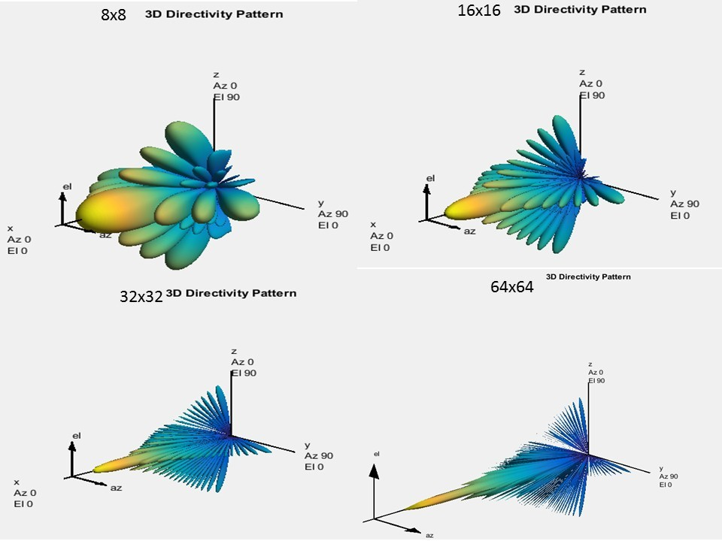

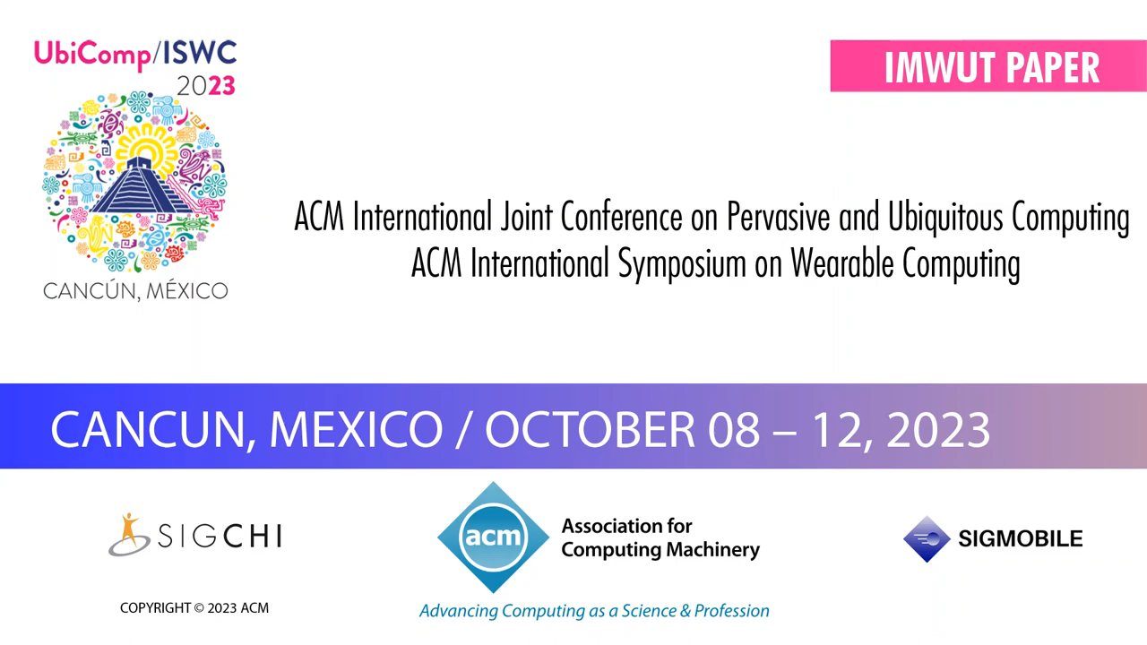
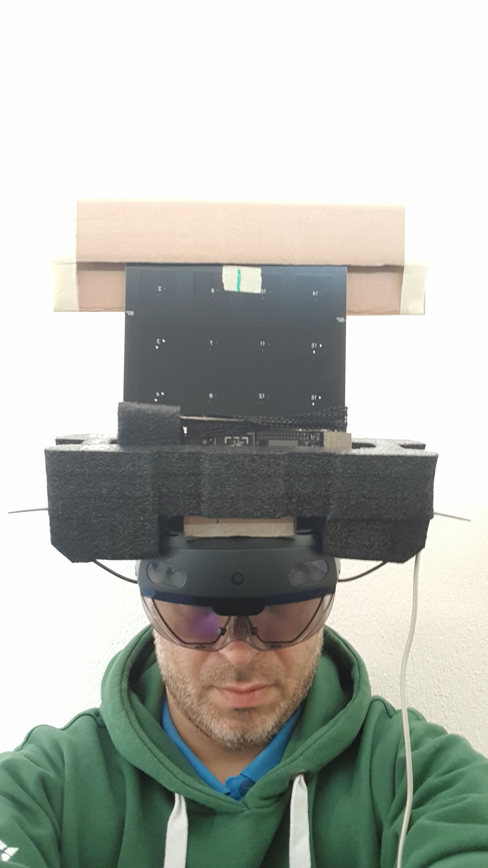
Interactions: Excerpt from our Research
Reverse Beamforming + Visual Object Reconition = ?
Strecker, Akhunov, Carbone, Garcia, Bektas, Gomez, Mayer, Yildirim. MR Object Identification and Interaction: Fusing Object Situation Information from Heterogeneous Sources. IMWUT 2024

Slide 12
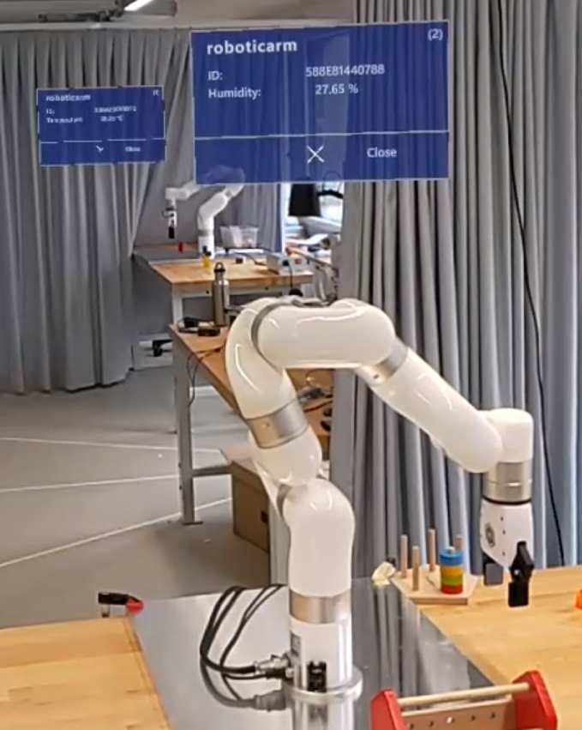
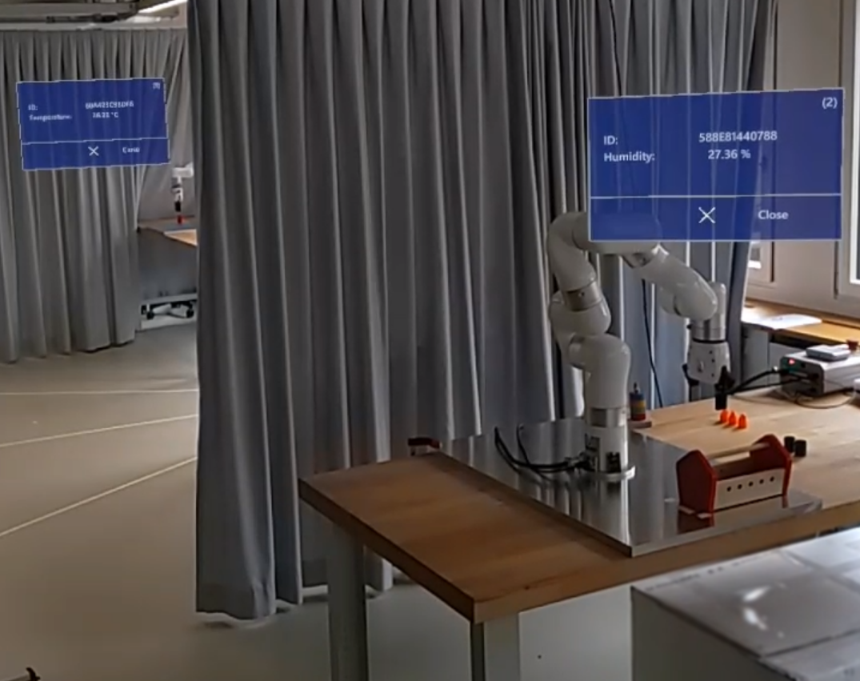
Interactions: Excerpt from our Research
Reverse Beamforming + Visual Object Reconition = ?
Strecker, Akhunov, Carbone, Garcia, Bektas, Gomez, Mayer, Yildirim. MR Object Identification and Interaction: Fusing Object Situation Information from Heterogeneous Sources. IMWUT 2024

Slide 13
Open Your Eyes!
How fast is a blink?
Schultz, Bektas, Strecker-Bischoff, Mayer: Open your Eyes: Blink-induced Change Blindness while Reading. UbiComp 2025, Paper

Slide 14
Turning this into BlinkArt ;-)
Steinmann, Strecker-Bischoff, Bektas, Williams, Mayer: BlinkArt: Using Change Blindness For AI-Generated Image Modifications in Artworks. UbiComp 2026

Slide 15
Introducing: The «For You» Portrait
“In doing so, it mobilizes these game-design elements both as an aesthetic strategy and as a modality for critical inquiry into technocratic obfuscation and today’s proliferating engagement-driven designs (e.g., on online social media platforms).”
Steinmann, Strecker-Bischoff, Bektas, Williams, Mayer: BlinkArt: Using Change Blindness For AI-Generated Image Modifications in Artworks. UbiComp 2026

Slide 16
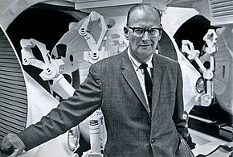
“Any sufficiently advanced technology is indistinguishable from magic.”
- Arthur. C. Clarke
One of the “Big Three” of English Science Fiction (with Asimov and Heinlein)
2001: A Space Odyssey [1986]
2010: The Year We Make Contact [1984]
et al.

Slide 17
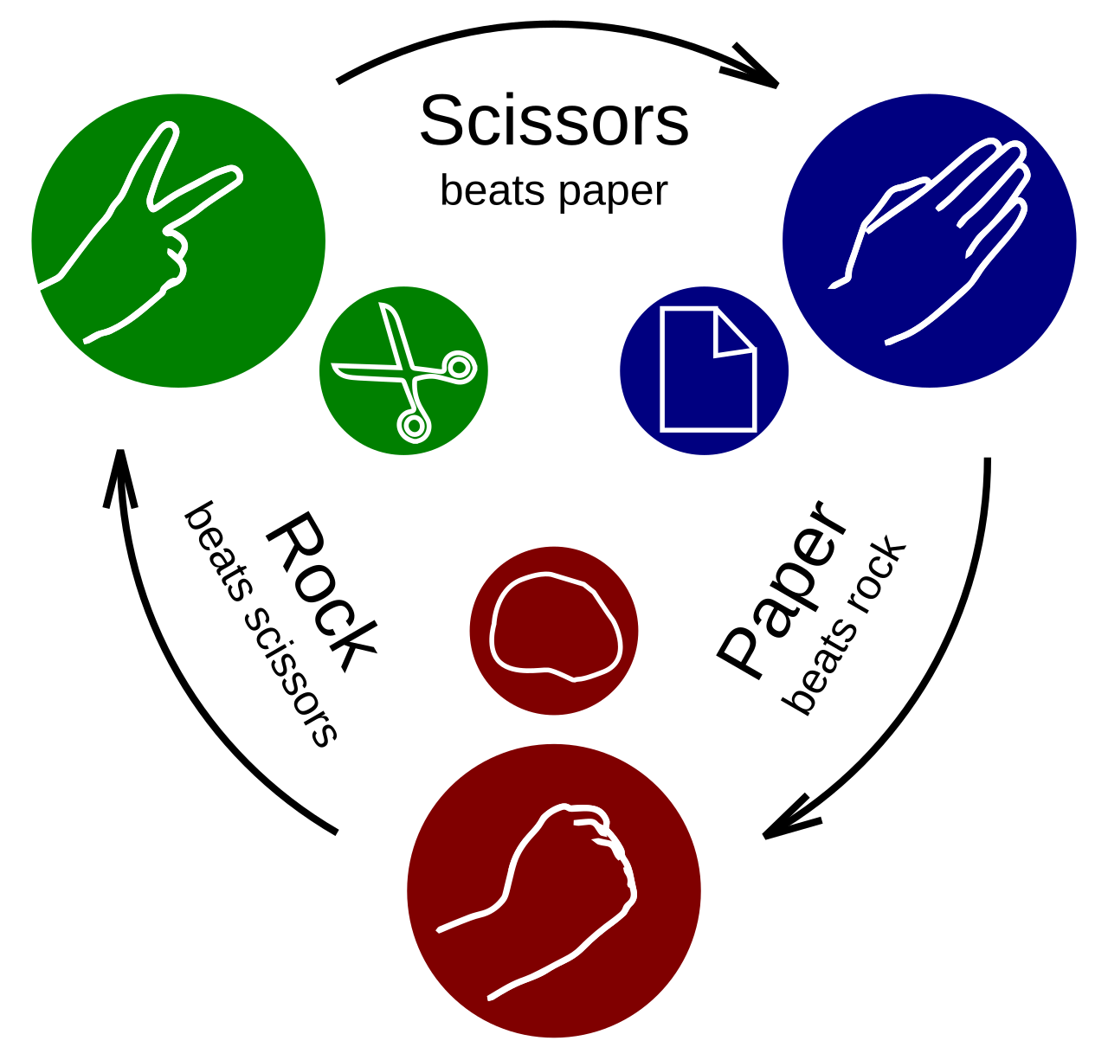
Look: «AI»
This works with an «Artificial Neural Network»
ANNs are also the core of current language models

Slide 18
From “this” AI to “real” AI…
Our Rock-Paper-Scissors AI has 108 weights/edges
How many weights/edges does a typical “large” neural network (e.g., GPT-5) have today?
Millions (small test applications) to billions (bachelor student projects) to trillions (GPT-5)
If our Rock-Paper-Scissors Model was a grain of rice (6mm)…
…how large would GPT-5 be?

Slide 19
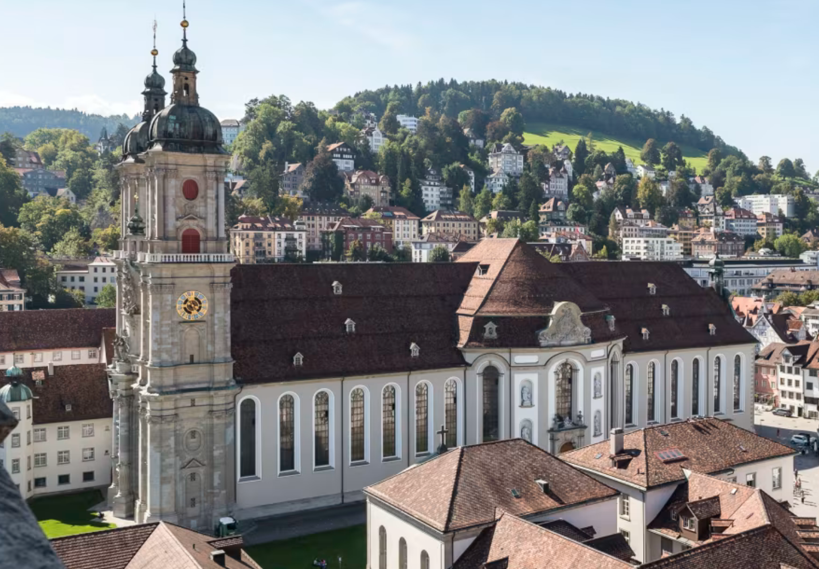

Slide 20
I’m showing this for a different reason though…
How exactly does it work?
Let’s look at the code!
See 01-rock-paper-scissors in your lecture materials on Canvas

Slide 21
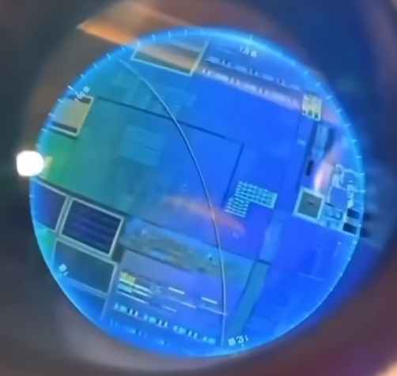
I’m showing this for a different reason though…
How exactly does it work?
And now let’s look a bit deeper…
https://www.youtube.com/watch?v=odx5NLbYz8g

Slide 22
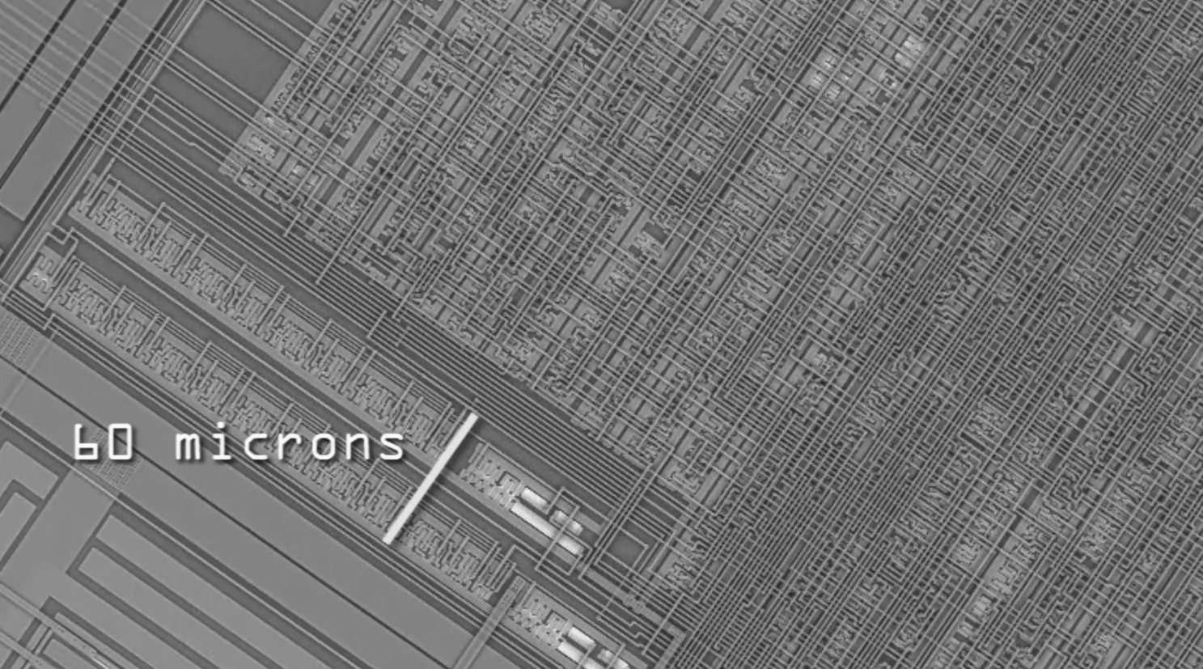

Slide 23
This part can compute logical operations on input signals...
Example:
2 Inputs:
2 Outputs:
A
B
S
1 if A is different from B, 0 otherwise
C
1 if A and B are both 1, 0 otherwise

Slide 24
What do we call this operation since primary school?
0₂ ? 0₂ = 0 0₂
1₂ ? 0₂ = 0 1₂
0₂ ? 1₂ = 0 1₂
1₂ ? 1₂ = 1 0₂
A
B
C
S

Slide 25
It‘s called Addition
0₂ + 0₂ = 0 0₂
1₂ + 0₂ = 0 1₂
0₂ + 1₂ = 0 1₂
1₂ + 1₂ = 1 0₂
A
B
C
S

Slide 26


If we are able to automatically add numbers, we can also…
Subtract (that’s just adding the negative inverse)
Multiply (that’s just repeated adding)
Divide (that’s just multiplying with the multiplicative inverse)
Draw Roots (that’s just smart adding and dividing)
…
Render Animation Movies (that’s mostly a ton of matrix multiplications)
…
Do Machine Learning (that’s just a smart combination of the above)
…
Build «Artificial Intelligence» (that’s again just a combination of the above)

Slide 27
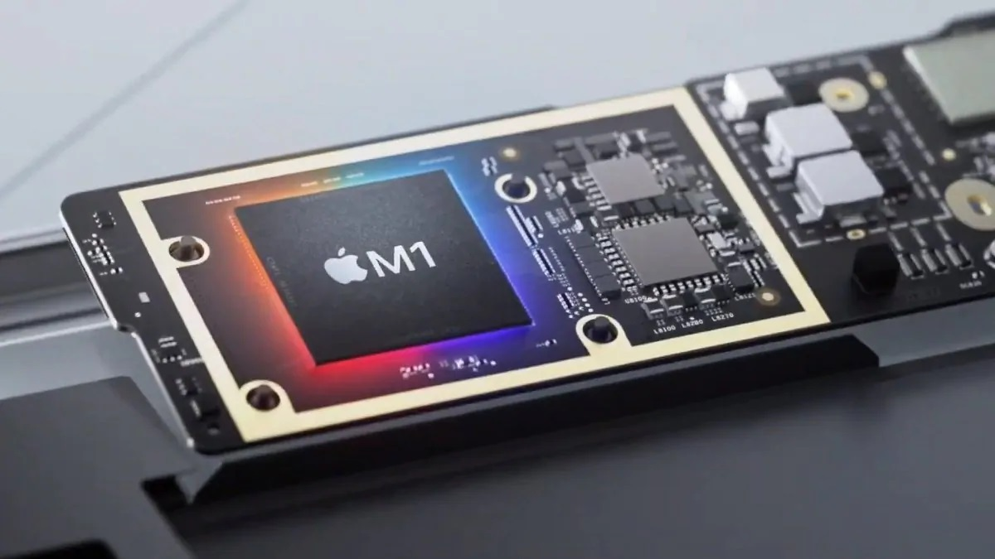
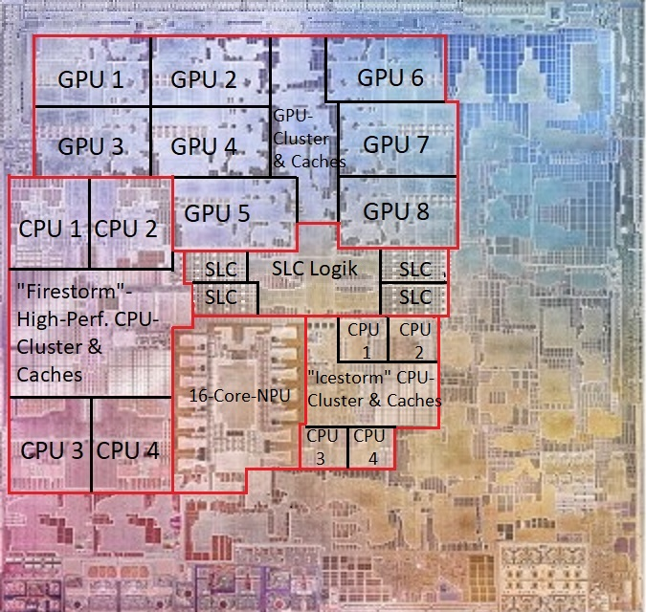
Course Purpose: Get rid of the Magic!
Understand how processors work
How do we encode information for them to “process” it?
What do they do while “processing” it?
How do they interact with memory while processing it?
What have been the major advancements in processor design?

Slide 28

Abstract Course Learning Goals
You can explain in detail and to anyone (kids, experts, the uninterested) how an algorithm that is formulated in a high-level language is turned into executable instructions and how these instructions are executed by a processor.
You can use the appropriate tools to compile and disassemble programs and can analyze assembly code.
You know about memory, processors and their architecture and can explain the most important steps that led to the design of modern processors.
You understand fundamentally and deeply that programs are simply instruction sequences that can be executed automatically.
You can place the different ways of programming computers – from machine code to instructing AI coding assistants – in their techno-historical context and relate them to each other.

Slide 29
Detailed Course Learning Goals
Information Representation and Processing (first 6 weeks)
You can explain how different types of data are represented in binary. Given a (simple) human-readable piece of data, you can represent this data in binary.
You can explain how binary representations of data are processed in electric circuits. You can simulate the processing of binary information in electric circuits by hand.
You can explain how high-level program code is turned into assembly instructions. Given a compiled program, you can reverse-engineer and modify this program purposefully to change its behavior.
Processors and Memory (second 6 weeks)
You can explain how assembly instructions are executed with a realistic instruction set architecture. Given an assembly program, you can simulate the execution of this program on a given instruction set.
You can explain how memory is organized in modern computers, including the memory hierarchy and caching. Given data from the execution of a memory-intensive program, you can reason about the underlying memory architecture.
You can explain the main advancements that led to the design of modern processors and can explain what the limits of modern processors are.

Slide 30
Course Syllabus and Grading
16.09.2026
Information: Numbers, Bits, Bytes, Encodings
23.09.2026
Bare Metal Programming
Bare Metal Programming
30.09.2026
Computing on Bits: Circuits and Processors
07.10.2026
Assembly Basics
Lecture
Assembly Reverse-Engineering & Assembly Bombs
Assembly Reverse-Engineering
14.10.2026
21.10.2026
Control Flow
Exercise
11.11.2026
Memory Basics
Assignment
18.11.2026
Memory Hierarchy and Caches
25.11.2026
Memory Experiments
Memory Experiments
02.12.2026
Processor Architecture
09.12.2026
Modern Processors
16.12.2026
Multiprocessors, GPUs, Heterogeneous Manycore

Slide 31
Course Syllabus and Grading
The main lectures take place on Wednesdays (10-12) at room 61-152
We will make flexible use of the Tuesday slots (9-10, room 61-152)
Continuation of the Lecture (core content) – come here!
Repetition of the Lecture (core content) – come here if you’re not sure about everything yet!
Exercise Introduction / Exercise Support / Exercise Discussion – come here!
Deepening of the Lecture (additional content and discussions, come if interested – not exam-relevant)
I’ll announce this during the lecture the week before
If you need support in your exercise, don’t wait for the next Tuesday! Get in touch ;-)

Slide 32
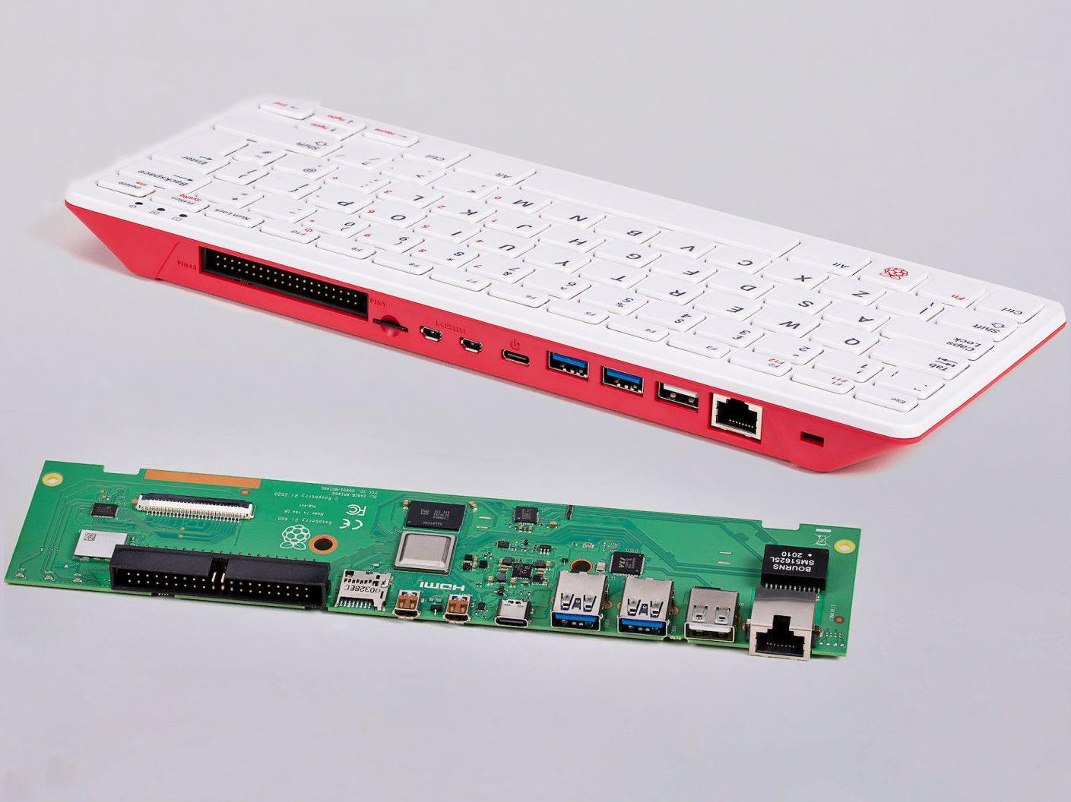
Course Syllabus and Grading: Exercises and Assignments
Are carried out on loaned RPi 400 hardware
  In this way, you all work on the same system
Will be puzzle-like
  Need to integrate what you know from the lecture with additional sources (and your own creativity)
Count for 20% of the final course grade
  Don’t work on them because of these 20%...
Are accomplished in teams of two,
  You are responsible for communicating the group members
  Please do this in the first week
  Send both names + Group Name to luka.bekavac@unisg.ch
Bare Metal Programming
Assembly Reverse-Engineering
Memory Experiments

Slide 33
Course Syllabus and Grading: Final Exam
Takes place after the winter holidays and counts for 80% of the final course grade
Focuses on lecture contents, but also contains exercise contents
Is not multiple-choice and will contain puzzle-like elements. It lasts 60 minutes and is closed book (only TI-30-series calculators are permitted)
Last year’s exams are online for you on Canvas
Study to understand the course content, don’t study to pass the exam

Slide 34

Course Syllabus and Grading: How To Study (and Pass)?
Role of the Lecture: Highlight and Motivate Material
Role of the Exercise: Introduce and Bootstrap Assignment
Role of the Assignment: Gain Experience
Each week’s lecture comes with four elements:
Lecture Slides (on Canvas): For you to remember what we were talking about
Study Guide (within lecture slides): For you to know what to read/do when studying the material
Demos (on Canvas): For you to run the demos that I show
Quiz (on Canvas): For you to get a feeling of what might be asked about the material
Look for this symbol!

Slide 35
Feedback and Backfeed
Solve and Understand the Assignments
The assignments are structured in the way they are on purpose
They cannot be done in passing but require long commitment
They need you to structure the contents, and are non-trivial (think «puzzle»)
We’re here to support you! Send your questions to us and/or make an appointment with us
Start working on them much much earlier
Understand the Lecture Contents

Slide 36
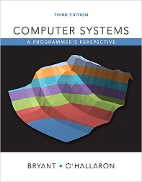
Course Context
Get the Book Here
I’ll make use of the textbook Computer Systems: A Programmer’s Perspective (3rd edition) by Bryant & O’Hallaron. This is a great book that goes much beyond this course, and it is available free as an e-book from the HSG library. Read it ☺
Parts of this course are based on some of my own and colleague’s former courses
S. Mayer: ICT Computer Architectures, TU Graz
S. Mayer and F. Michahelles: IoT: Foundations and Applications, UC Berkeley
T. Roscoe: Computer Architecture and Systems Programming, ETH Zurich
S. Mayer: Fundamentals of Computer Science, University of St.Gallen
S. Mayer: Introduction to Computers Systems and Networks, University of St.Gallen
The follow-on courses Computer Networks and Distributed Systems will build on your insights from this course!
If you get bored then tell us.
Or have a look at https://www.nandgame.com/ and build your own computer.

Slide 37
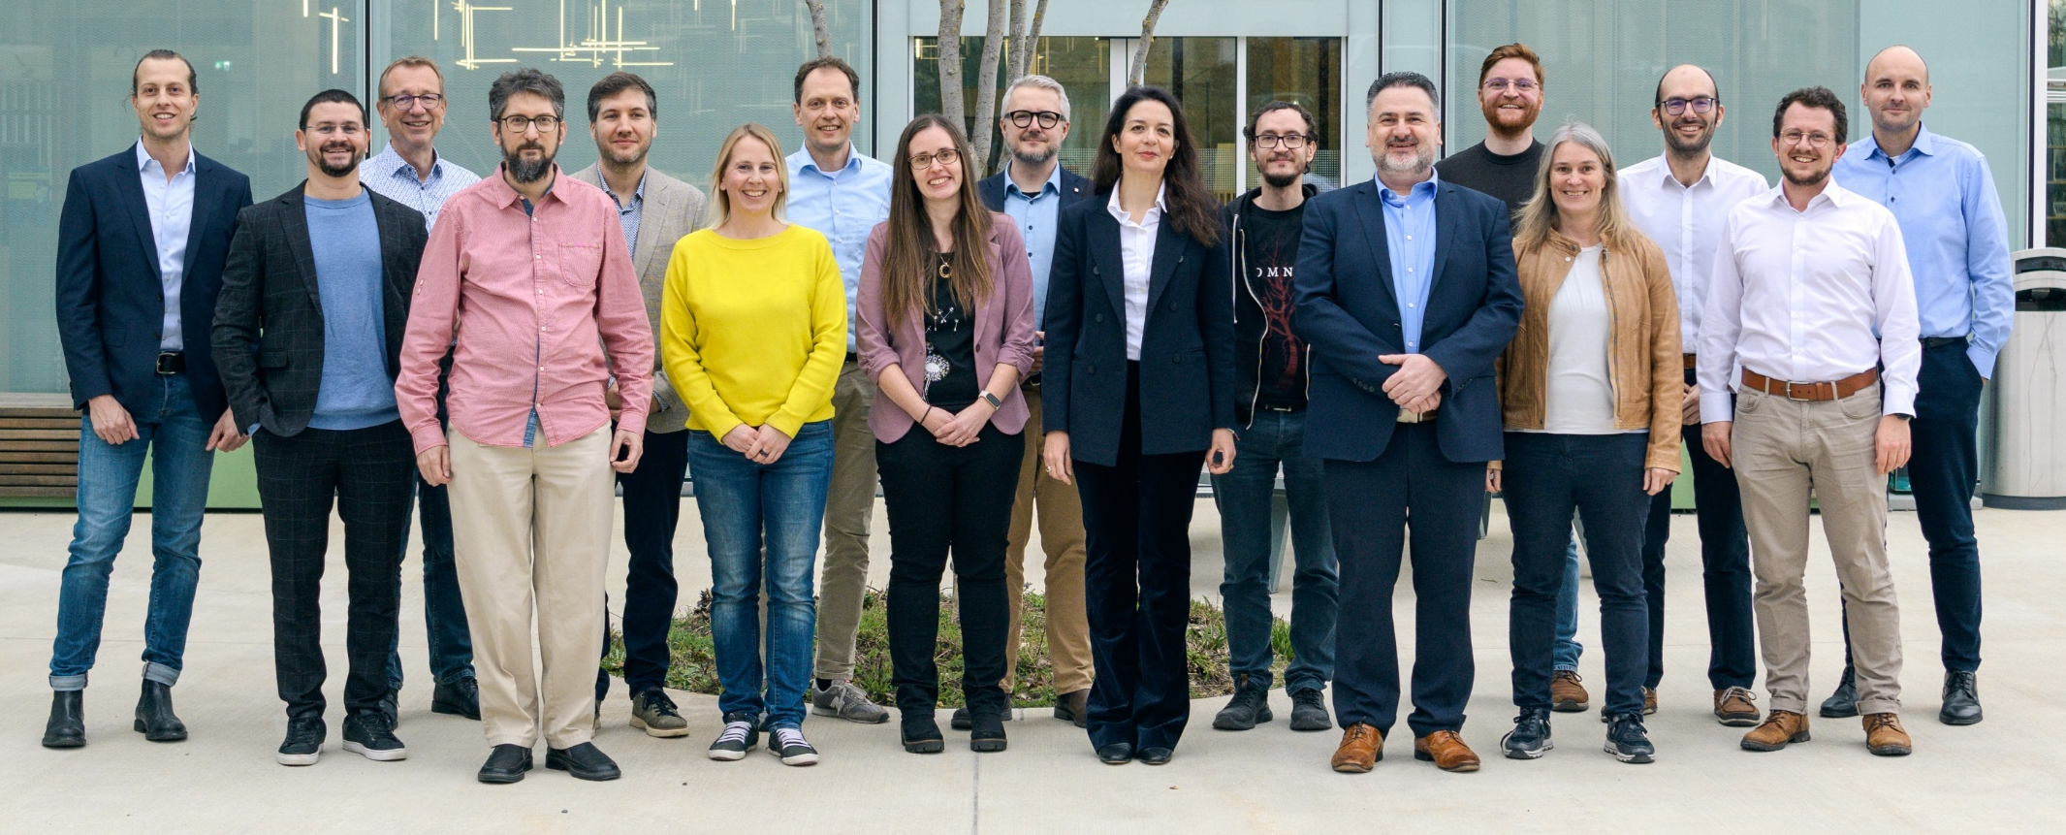
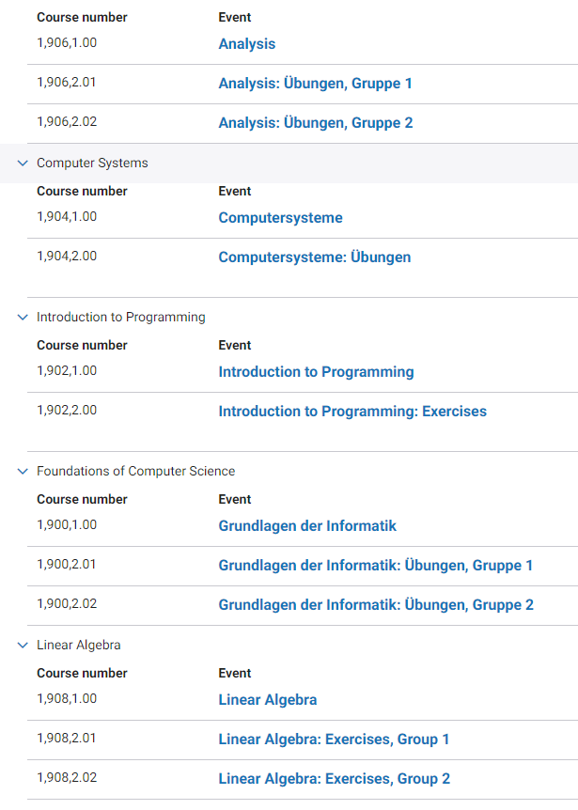
Course Context
We directly interface with Grundlagen der Informatik and Introduction to Programming
In this course, you will mostly program in C and C++. This is because we are very close to the system (i.e., the processor) and these languages allow us to exploit this closeness.
While you will program in this course, it is not a programming-focused course
You will (slowly) develop an “intuitive” understanding of the code you will work with.

Slide 38

Any Questions / Comments / Doubts / Concerns?

Slide 39
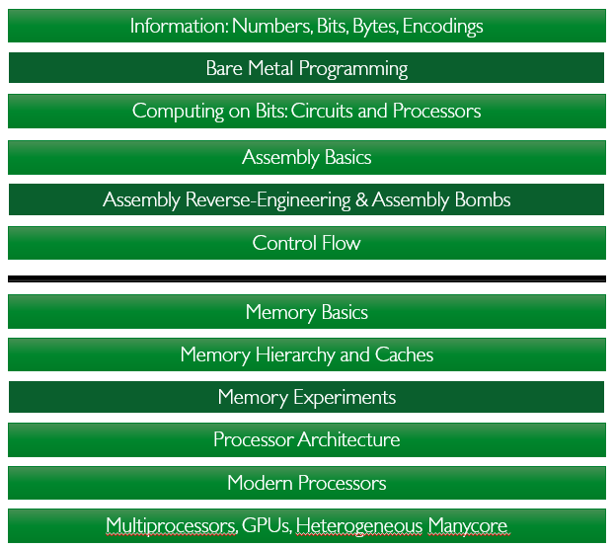
How to Study this Material?
There is not so much to study in this part of the course… Still! ☺
Basic Depth
Look at the syllabus and make sure that you get an idea of all technical terms and jargon that is used there
Do use Wikipedia for this! CS topics are very well-maintained there, and it provides a very good illustration and often lots of background information about topics that we cover
Get a hold of the Bryant & O’Hallaron Book and start reading it. If you read 5 pages per day over the semester (and understand them), you’ll already go far beyond the contents that we cover in this course
Advanced Depth
Actively look for the connections between our course and the course by Anna-Lena. These connections are highly enriching, and if you make them yourselves (instead of waiting for us) you will be highly satisfied with the level of understanding you have achieved
How about you have a look at our research? ;-)

