Slide 1
Computersysteme
Information = Bits and Bytes
Simon Mayer
University of St.Gallen
Bachelor in Computer Science
Computersysteme (1,904)

Slide 2
Course Syllabus and Grading
16.09.2026
Information: Numbers, Bits, Bytes, Encodings
23.09.2026
Bare Metal Programming
Bare Metal Programming
30.09.2026
Computing on Bits: Circuits and Processors
07.10.2026
Assembly Basics
Lecture
Assembly Reverse-Engineering & Assembly Bombs
Assembly Reverse-Engineering
14.10.2026
21.10.2026
Control Flow
Exercise
11.11.2026
Memory Basics
Assignment
18.11.2026
Memory Hierarchy and Caches
25.11.2026
Memory Experiments
Memory Experiments
02.12.2026
Processor Architecture
09.12.2026
Modern Processors
16.12.2026
Multiprocessors, GPUs, Heterogeneous Manycore

Slide 3
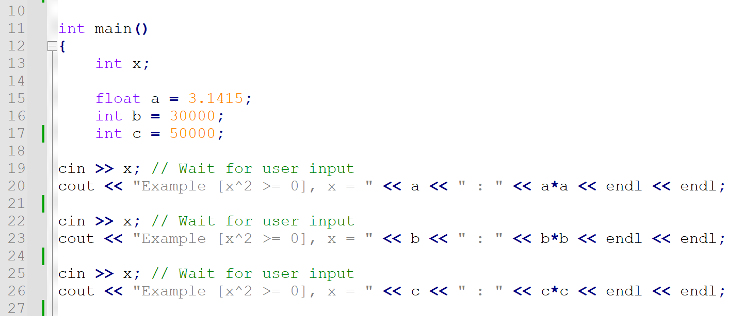
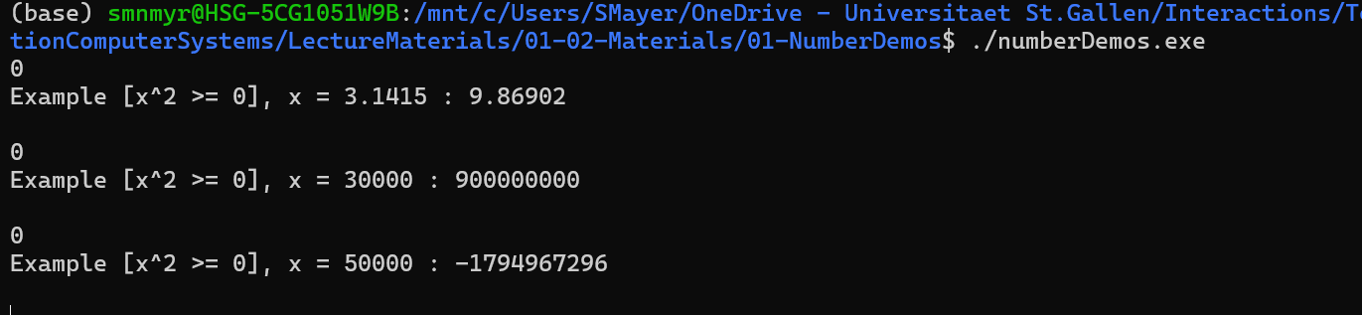
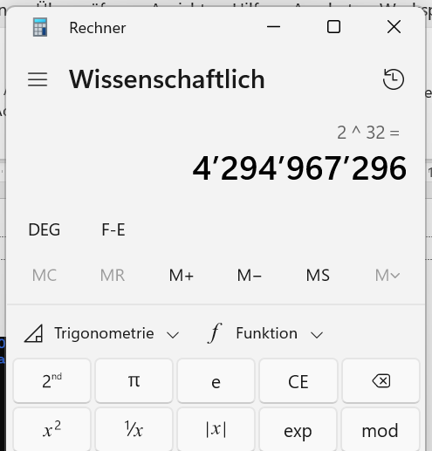
Good Questions…

Slide 4
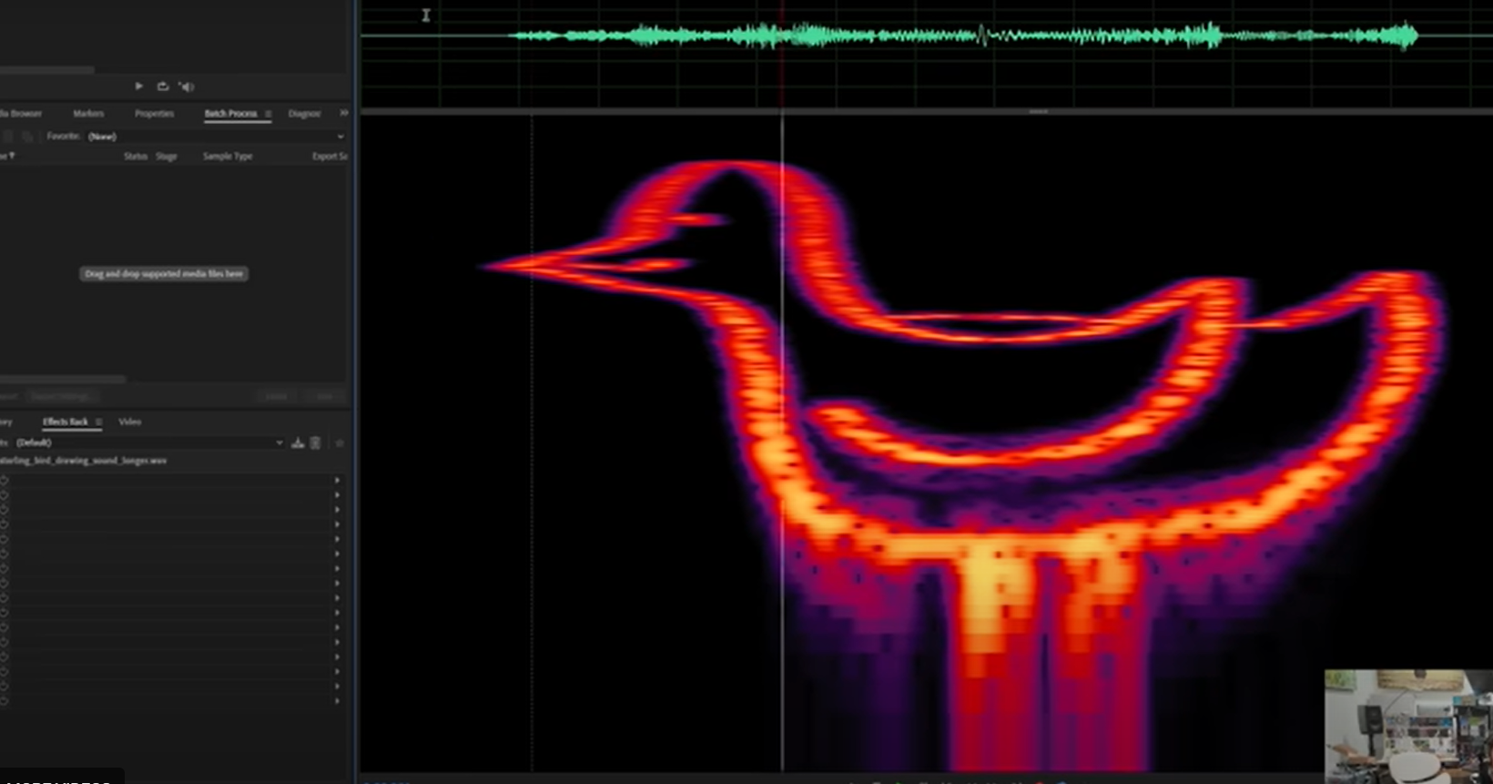
Yes, you can store data on a bird
Enthusiast converts PNG to bird-shaped waveform, teaches young starling to recall file at up to 2MB/s | Tom's Hardware

Slide 5

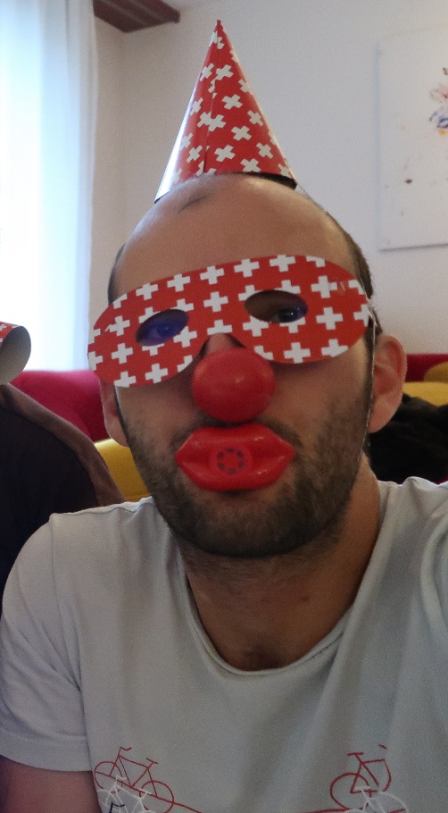

Magic & Quiz

Slide 6
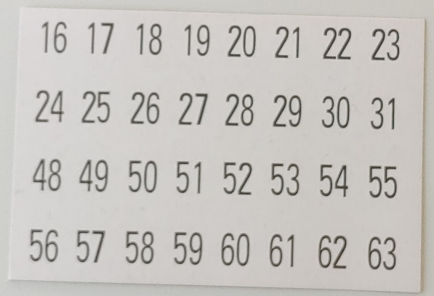

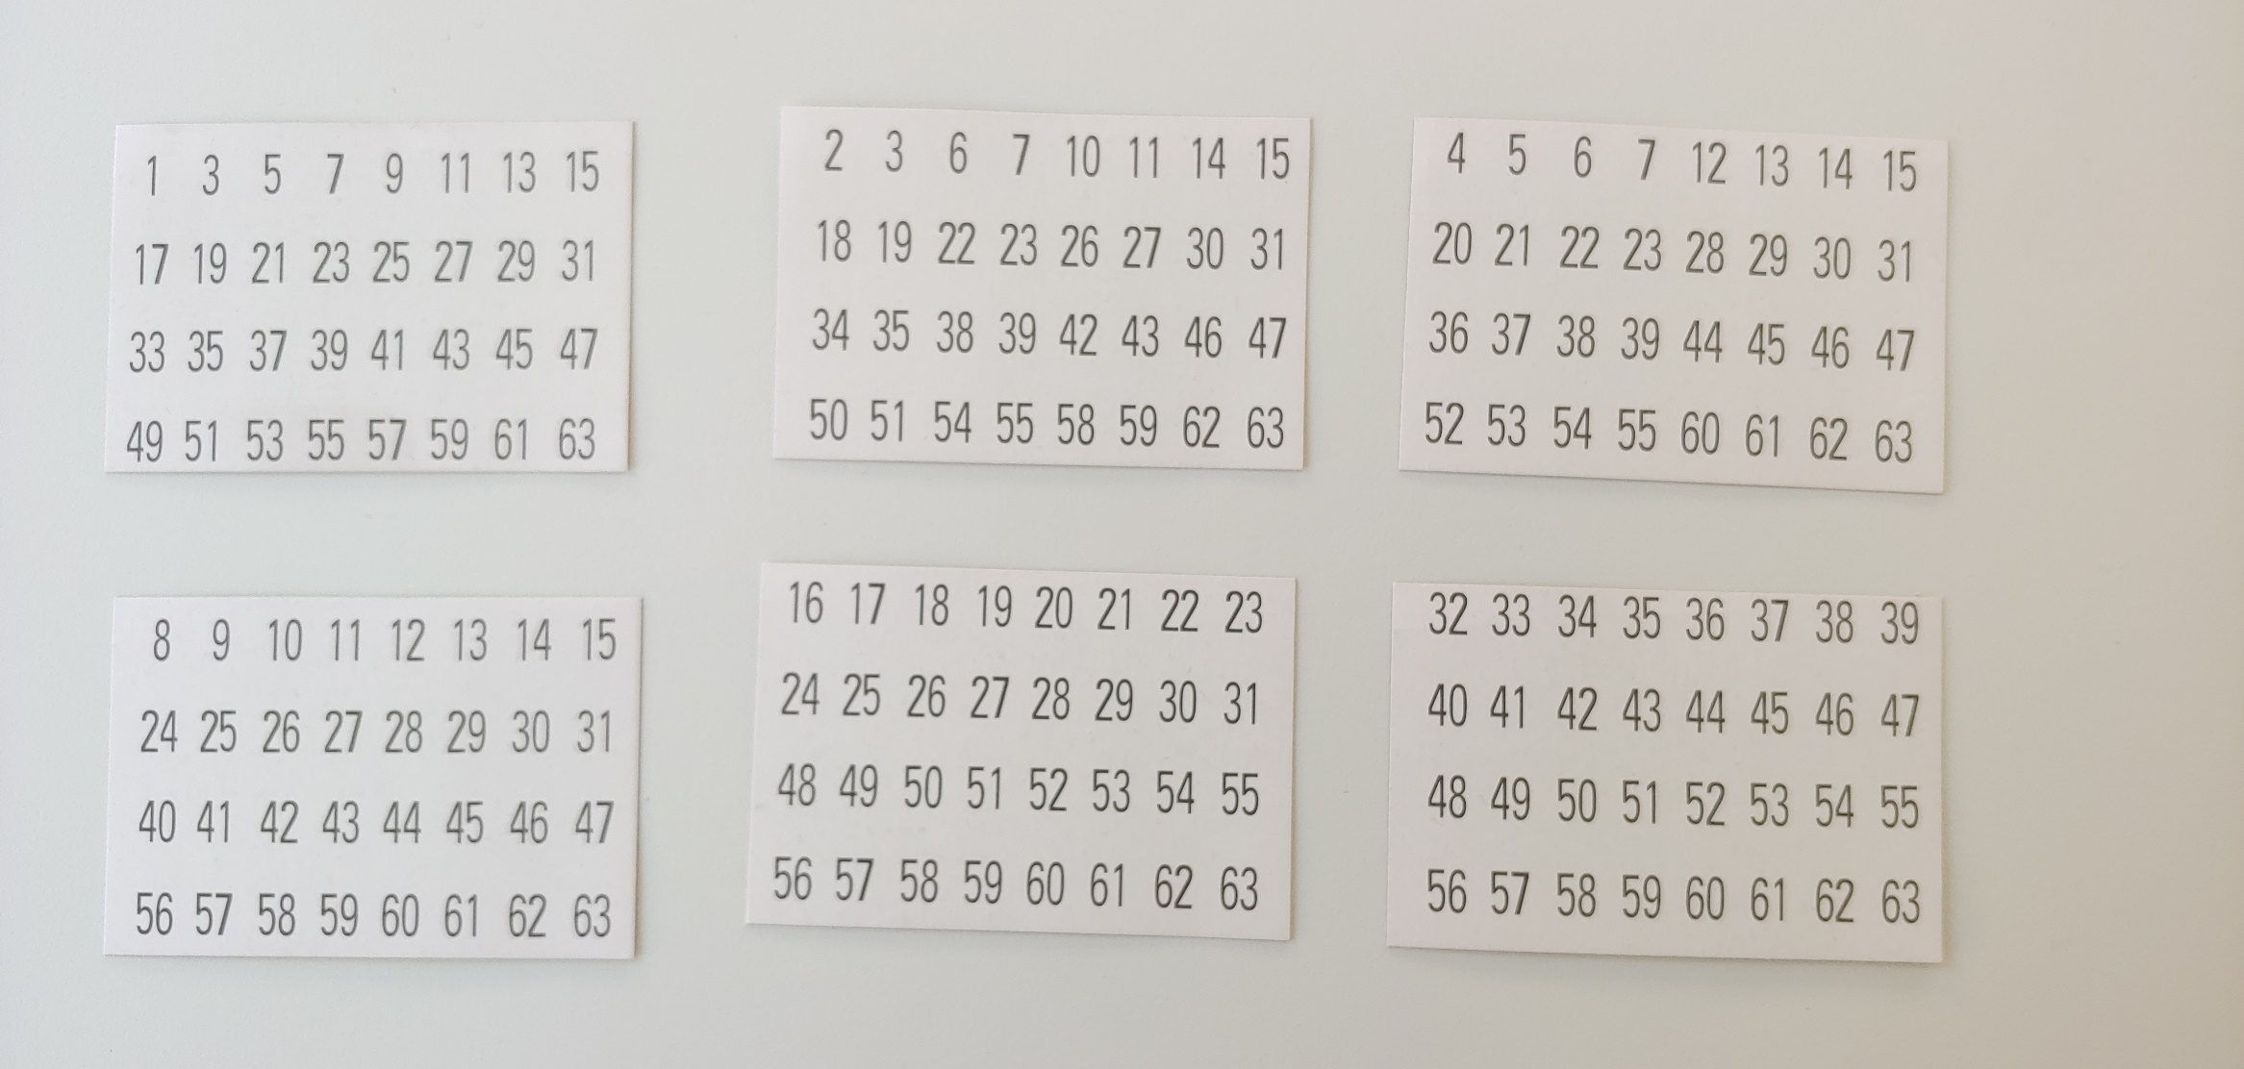
Magic & Quiz
Card #2
Card #3
Card #5
Card #1
“Think of a number. Hand me all cards that contain this number. I’ll tell you your number in almost no-time.”
Teams of 2, take 5 min
Find the pattern
Replicate the trick
Build a “Magic Computer” for the numbers 0-13
Questions
Does the trick also work for the number 0 ?
How many cards would be required for a "Magic Computer" that works for the numbers 0-20 ?
Card #4
Card #6

Slide 7

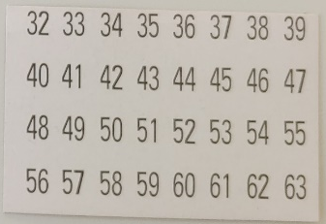

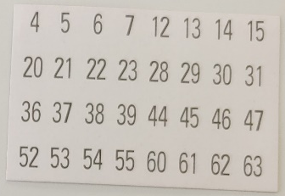
Magic & Quiz
Card #2
Card #3
Card #5
Observations
(Not) handing over one of the cards is a binary decision
The volunteer makes six such decisions
Thereby, s/he encodes one out of 2^6 (= 64) states
That state is the number the volunteer was thinking of
Examples
1 2 4 8 16 32
“4” 0 0 1 0 0 0
“7” 1 1 1 0 0 0
“63” 1 1 1 1 1 1
“0” 0 0 0 0 0 0
Card #1
Card #4
Card #6

Slide 8
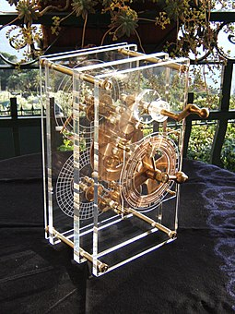
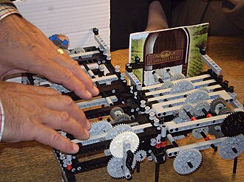
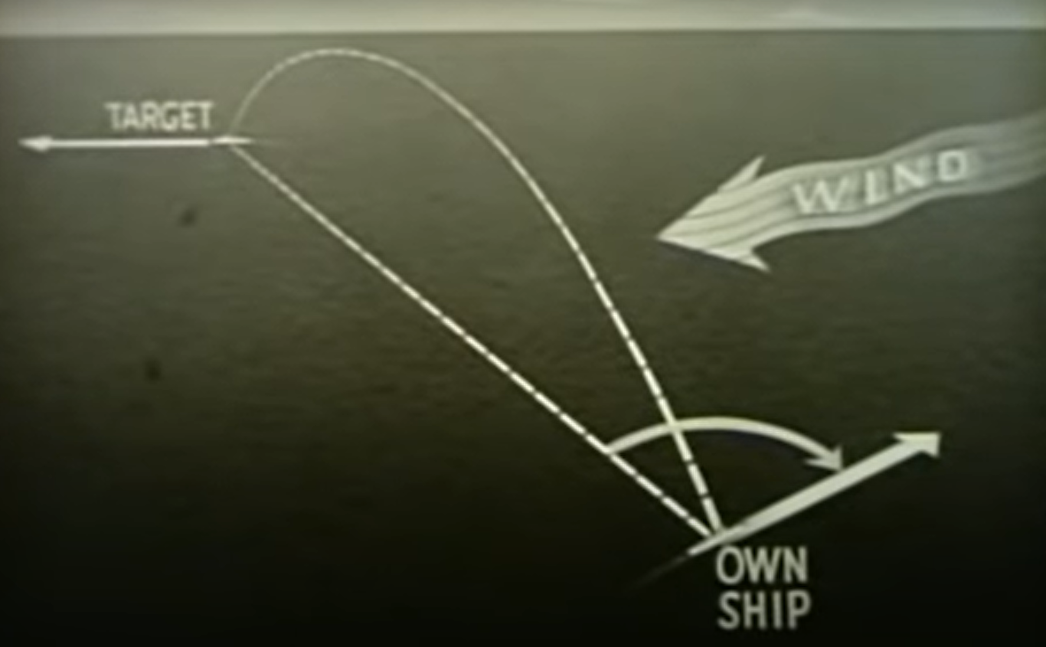
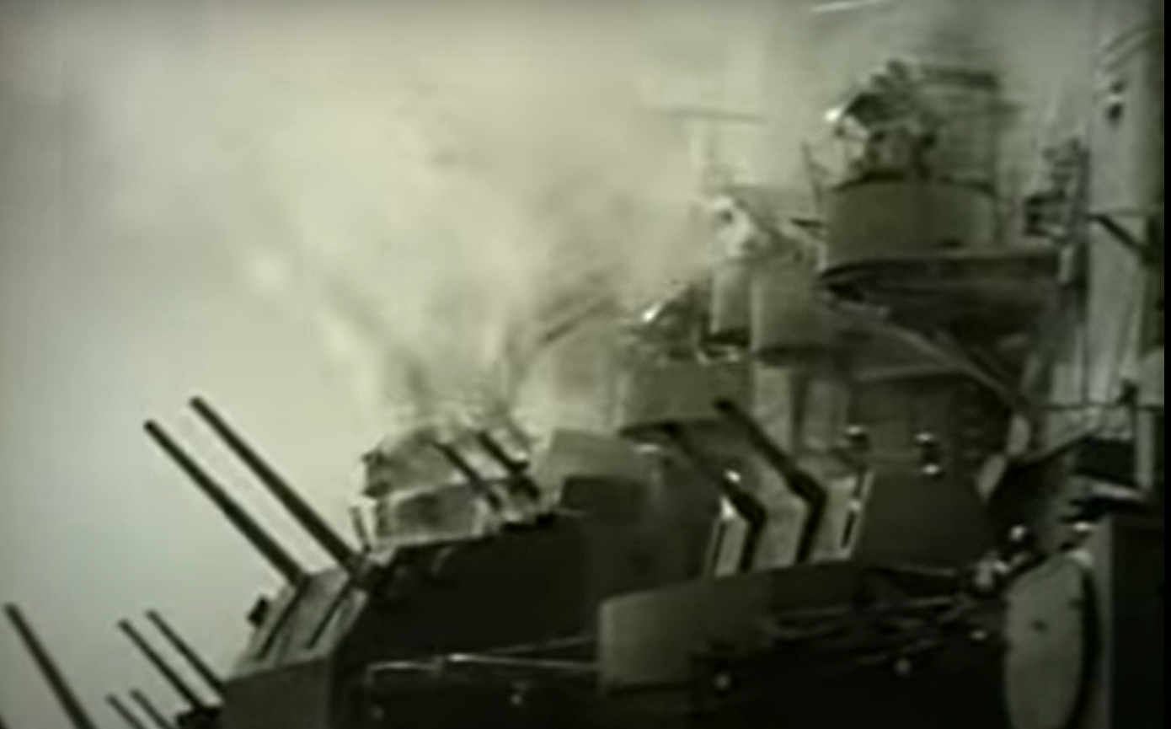
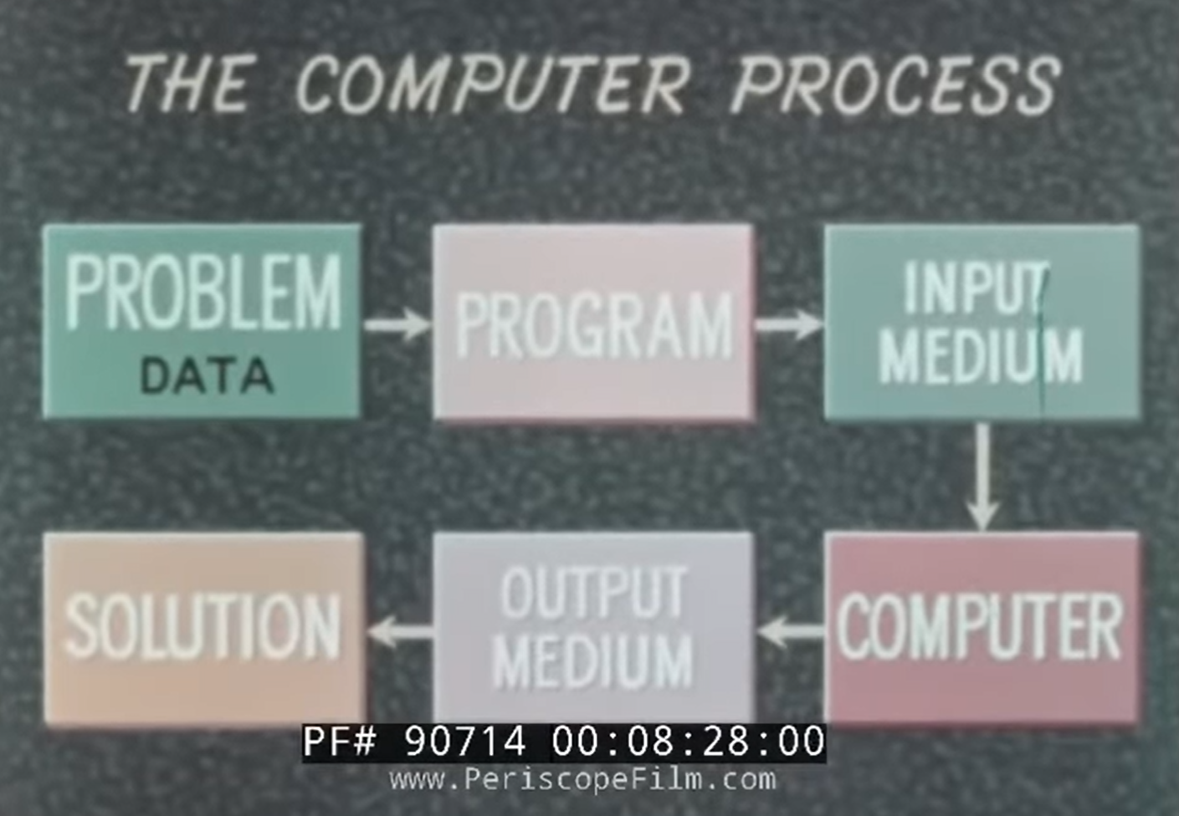
Why Computers?
Predicting the Future!
~200 B.C.E.
Making War!
~1953 C.E.
Doing… anything?
~Today
https://www.bbc.com/reel/video/p09pcwnz/unlocking-the-secrets-of-the-world-s-oldest-computer
National Geographic Naked Science Star Clock aka Ancient Computer theblackpacket com - YouTube
Navy Mechanical Fire Control Computers (1/2) - YouTube
DIGITAL COMPUTER TECHNIQUES & PRINCIPLES 1962 U.S. NAVY FILM UNIVAC IBM ELECTRODATA 90714 – YouTube (from 4:15-6:16)

Slide 9
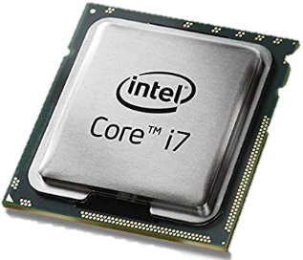
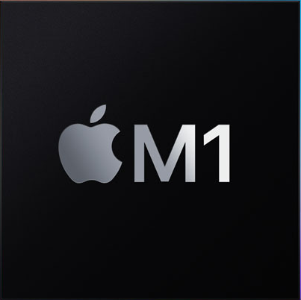

A tour of computer systems…
Voilà! This is a Central Processing Unit, or CPU!
Numbers
Information
Text
School Mathematics (Logic, Set Theory)
Context
Registers
Pixels / Colors
Instructions
Instruction Set
Binary Digits
Control Unit
Logic + Arithmetic
Arithmetic/Logic Unit
Electronic Components
(today: Transistors)
Logic Operations
(NOT, NOR, …, NAND)
General-Purpose Calculator!
Function Selector
Adder Circuits
Circuits for other arithmetic functions
Logic Gates

Slide 10
Our Menu
Information Basics: Numbers, Bits, Bytes, Encodings
Computing Basics: Transistors and Circuits
Processor Basics

Slide 11
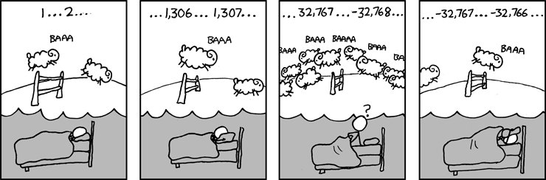

Slide 12
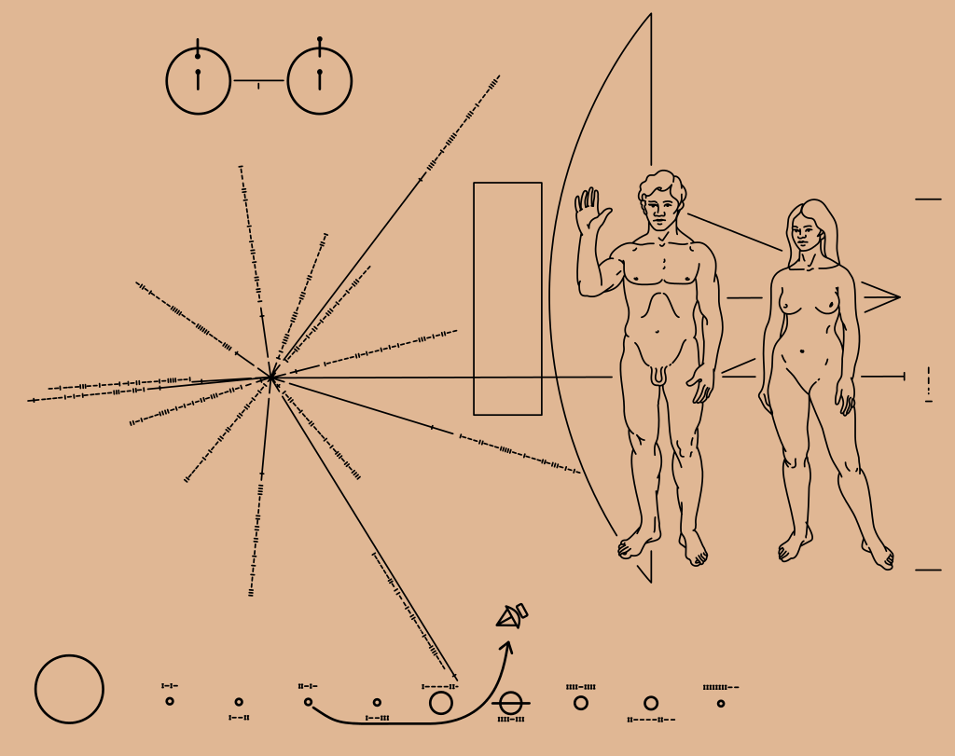
Stripping away the “Magic”
Goal: Understand the inner workings of a computer system.
We’ll start with the simple (?) concept of information and build upon this foundation.
https://en.wikipedia.org/wiki/Pioneer_plaque

Slide 13
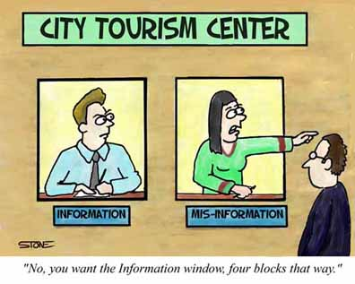
What‘s „Information“ in Computer Science
In CS, all Information = Bits + Context
Example: img.jpg
-> display as text (ANSI encoding)
-> display as hexadecimal numbers (in the demo, I use the HxD program)
-> display as binary code, i.e. as bits (https://mothereff.in/binary-ascii)

Slide 14
Information in Computer Science
Interpret the bit string „11111111 00111111 11111111 00111111“ !
(this bit string is 4x8 = 32 bits long)
In CS, all Information = Bits + Context
Unsigned Decimal Number: 4‘282‘384‘191
Hexadecimal Number: FF 3F FF 3F
Floating-Point Number (IEEE 754): -2.5520786 x 10^38
Signed Decimal Number (2‘s Complement, 32 bits): -12583105
Text in ANSI encoding: ÿ?ÿ?
One pixel of an image (at 32bit color depth)
Fascinating, right?
You’ll understand better in a week, and much better in 6 weeks!
One pixel of one frame of a movie (at 32bit color depth)
A machine-level instruction in an x86 processor: e.g. addq %rax,%rbx
https://www.exploringbinary.com/twos-complement-converter/
https://www.h-schmidt.net/FloatConverter/IEEE754.html
https://mothereff.in/binary-ascii
“Add the two numbers stored at locations %rax and %rbx, and store the result in location %rbx.”

Slide 15
Lecture Notepad: Bits and Programs
Definition Befehlssatzarchitektur / Instruction Set Architecture (ISA)
Befehlssatz:
00 = Klatschen
01 = Schreien
10 = Ruhe
11 = Stampfen
Programm:
001001110001

Slide 16
Information in Computer Science
Interpret the bit string „11111111 00111111 11111111 00111111“ !
(this bit string is 4x8 = 32 bits long)
In CS, all Information = Bits + Context
Unsigned Decimal Number: 4‘282‘384‘191
Bits = Binary Digits
Why binary digits?
Hexadecimal Number: FF 3F FF 3F
Floating-Point Number (IEEE 754): -2.5520786 x 10^38
Signed Decimal Number (2‘s Complement, 32 bits): -12583105
Text in ANSI encoding: ÿ?ÿ?
One pixel of an image (at 32bit color depth)
One pixel of one frame of a movie (at 32bit color depth)
A machine-level instruction in an x86 processor: e.g. addq %rax,%rbx
https://www.exploringbinary.com/twos-complement-converter/
https://www.h-schmidt.net/FloatConverter/IEEE754.html
https://mothereff.in/binary-ascii

Slide 17
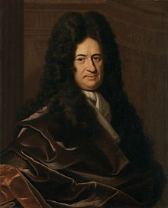
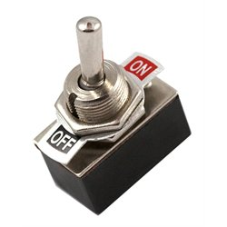
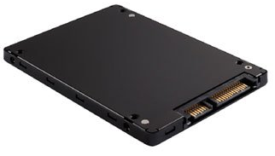
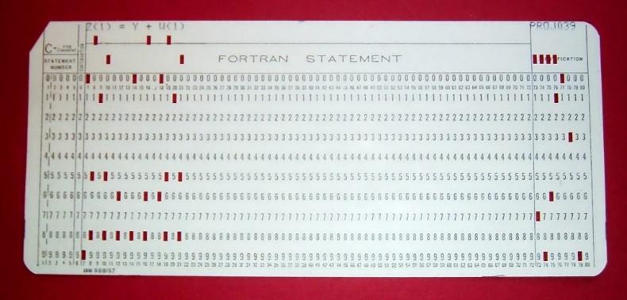
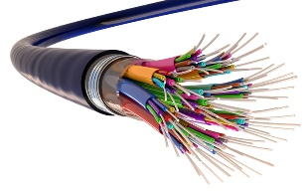
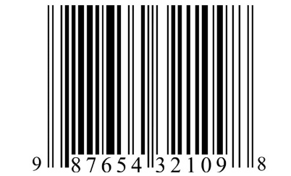
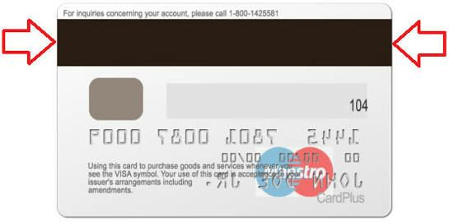
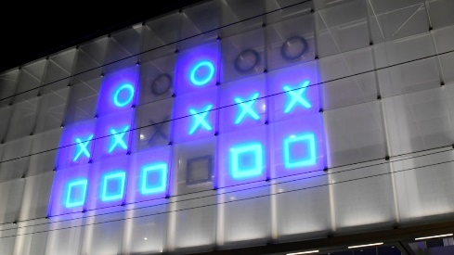
Bits: Binary Digits
Logic: Basic representation of the logical values True and False
Practicality: Many easily feasible physical representations
Punched card: Hole vs. No Hole
Electrical switch: On vs. Off
SSD: High vs. Low Electrical Charge
Fibre Optics: Light vs. No Light
Credit Card: Polarity of Magnetization
Bar Code: Thick Line vs. Narrow Line
Station Clock: Light vs. No Light
G.W. Leibniz: Using binary, arithmetic and logic can be combined!

Slide 18
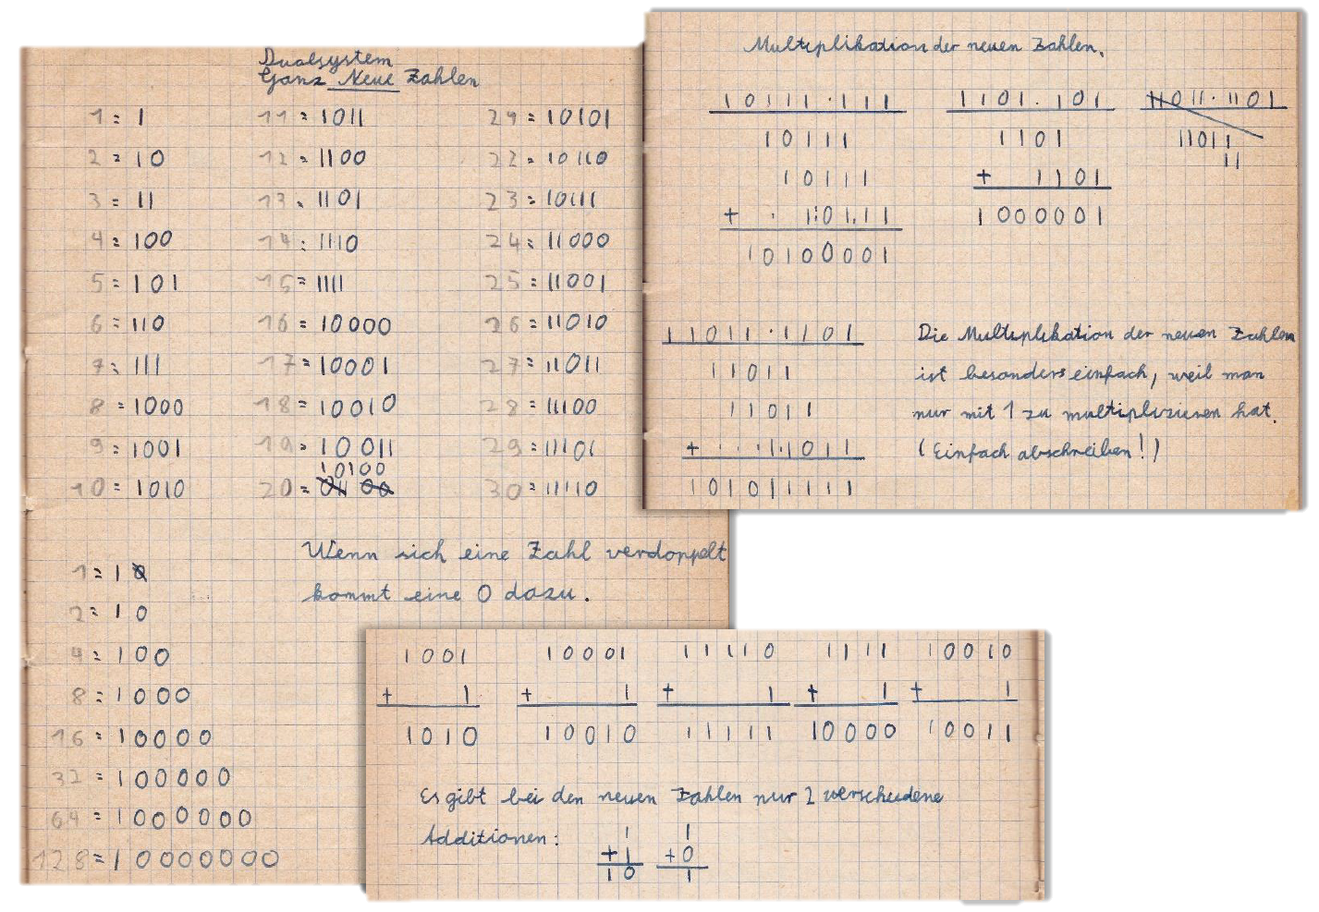
Bits: Binary Digits
At school, in 1966.
(courtesy of F. Mattern)

Slide 19

Bits: Binary Digits
First Number (5 bits)
All Information = Bits + Context
Bits that represent three numbers…
In this context, that’s a clock!
Second Number (6 bits)
Third Number (6 bits)
What are the current hour, minute, and second?

Slide 20
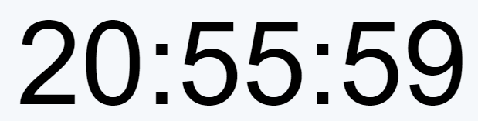

Bits: Binary Digits
A Decimal Clock…
A Binary Clock…
i.e., in a base-10 number system!
Hour
Minute
Second
20
55
59
2 x 10^1 + 0 x 10^0
5 x 10^1 + 5 x 10^0
5 x 10^1 + 9 x 10^0
20 + 0
50 + 5
50 + 9
Hour = 20
Minute = 55
Second = 59
i.e., in a base-2 number system!
Hour
Minute
Second
10100
110111
111011
1 x 2^4 + 0 x 2^3 + 1 x 2^2 + 0 x 2^1 + 0 x 2^0
1 x 2^5 + 1 x 2^4 + 0 x 2^3 + 1 x 2^2 + 1 x 2^1 + 1 x 2^0
1 x 2^5 + 1 x 2^4 + 1 x 2^3 + 0 x 2^2 + 1 x 2^1 + 1 x 2^0
16 + 0 + 4 + 0 + 0
32 + 16 + 0 + 4 + 2 + 1
32 + 16 + 8 + 0 + 2 + 1
Convention:
We express decimals in the way we’re used to: 20 (i.e., decimal 20)
Binary values get a trailing lower-case ‘b’: 10100b (i.e., decimal 20 as well)

Slide 21
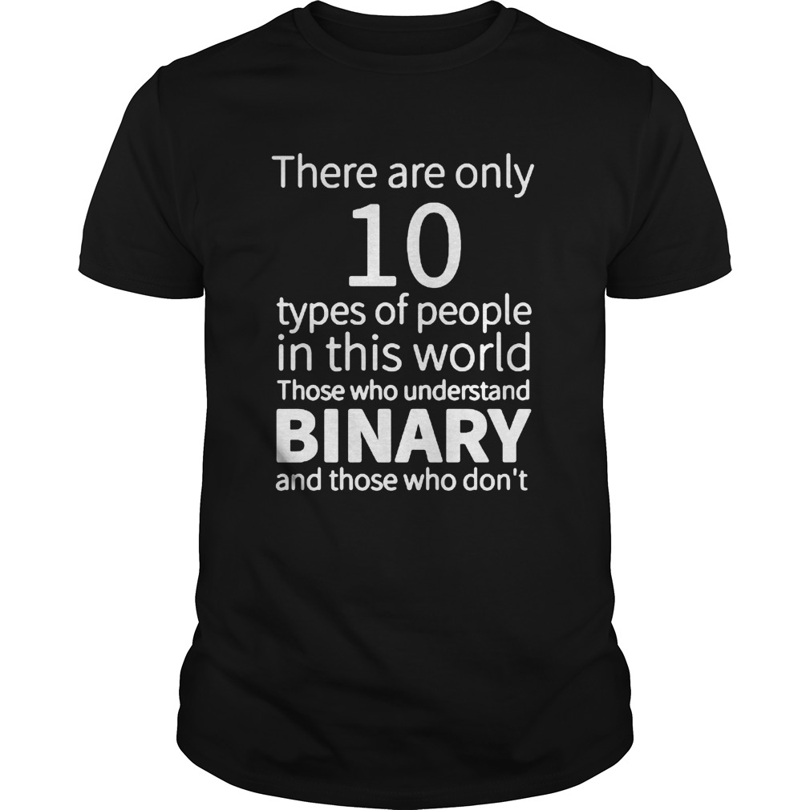
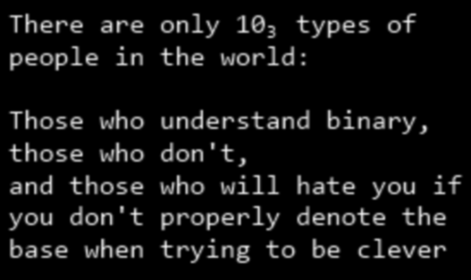
Jokes?!
Actually, this should be 10b or 10₂ to signify that it’s binary!
Make sure you fully understand both these jokes!

Slide 22
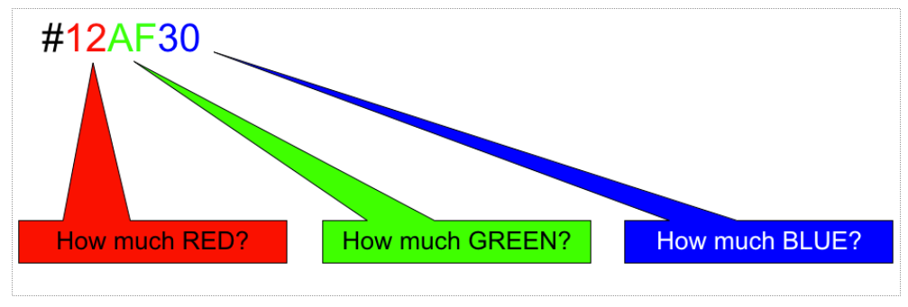
Hexadecimal numbers work in the same way!
For reference
Decimal digit range: [0, 1, 2, 3, 4, 5, 6, 7, 8, 9]
Binary digit range: [0, 1]
Hexadecimal digit range: [0, 1, 2, 3, 4, 5, 6, 7, 8, 9, A, B, C, D, E, F]
Why Hexadecimal Numbers?
Convenience!
Compact format!
Simple conversion!
i.e., in a base-16 number system!
A Hexadecimal Clock…
Hour
Minute
Second
12
2A
1F
1 x 16^1 + 2 x 16^0
2 x 16^1 + 10 x 16^0
1 x 16^1 + 15 x 16^0
16 + 2
32 + 10
16 + 15
12 : 2A : 1F
Hour = 18
Minute = 42
Second = 31
Convention:
We express decimals in the way we’re used to: 18 (i.e., decimal 18)
Binary values get a trailing lower-case ‘b’: 10010b (i.e., decimal 18 as well)
Hexadecimal values get a leading ‘0x’: 0x12 (i.e., decimal 18 as well)

Slide 23
Quick Exercises
What are the current hour, minute, and second?
Represent the time 10:20:30 in binary!
What‘s the binary representation of the largest hour (i.e., 23)?
What number range can be represented using n bits?
1 bit → ?; 2 bits → ?; 3 bits → ?; n bits → ?

Slide 24
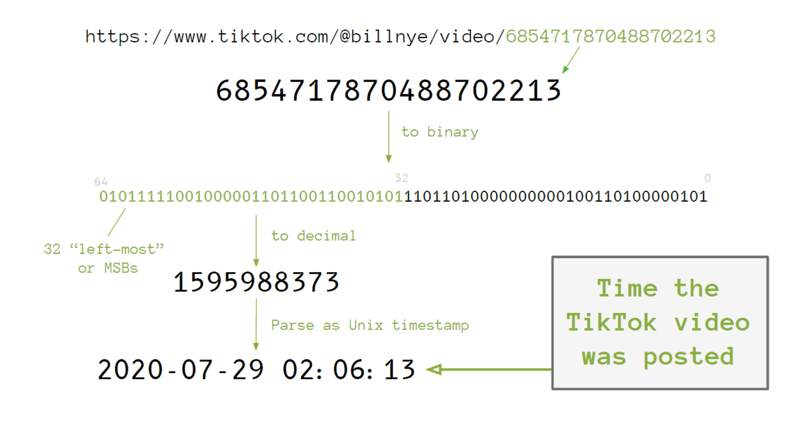
Look! Some more binary ☺
Tinkering with TikTok Timestamps

Slide 25
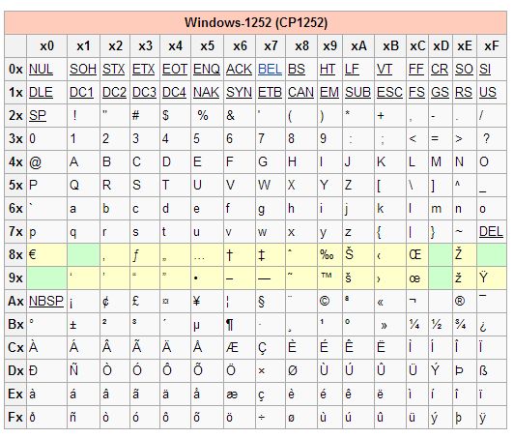
Not Just Numbers: Encodings!
When we talk about data, we don’t talk about bits anymore, but about Bytes
1 Byte = historically, the number of bits used to encode a single character
Today de-facto standard of 8 bits in one Byte
8 bits permit encoding values from 0…255 (i.e., from 2⁰ – 1 to 2⁸ – 1)
Encodings
We’ve already seen that colors can be encoded using hexadecimal
In fact, anything can be represented in binary
Example: Windows-1252 Encoding
  Typically given in hexadecimal
  The most widespread legacy single-byte encoding (today, UTF-8 dominates)
Example: Encoding of “©” in hexadecimal and in binary.
Example: Encoding emoticons. What happens when we send a smiley by phone?
https://www.unicode.org/emoji/charts/full-emoji-list.html
https://www.gammon.com.au/unicode/ contains an interesting and easy to read historic account of encodings. Recommended!

Slide 26
Core Points up to now
G.W. Leibniz: Using binary, arithmetic and logic can be combined!
F. Mattern, Math Exercises, 1966

Slide 27
Information Representation in Computers
As you know, the accurate representation of the number PI (3.1415…) is infinitely long.
What happens when this number is represented (e.g., stored) in a computer system?
This is not only true for numbers with infinite representations!
Machine representations of numbers are finite approximations, and they can behave in unexpected ways.

Slide 28
Some surprises ☺
x² >= 0
float a = 3.1415;
int b = 30000;
int c = 50000;
(d + e) + f == d + (e + f)
float d,e,f; d = 1e20; e = -1e20; f = 3.1415;
(x+1) > x
Solve the puzzle by finding the number for which this is violated!
int puzzle = ?;

Slide 29
int puzzle = ?;
Set the value of puzzle so that (puzzle+1) is smaller than puzzle
And what if “puzzle” was an unsigned integer number?
…need to look at exactly how finite are typical data types (in the C programming language)?
C Data Type | Size (in an x86-64 system) | Lowest Value | Highest Value
char | 8 bits | -128 | 127
short | 16 bits | -32’768 | 32’767
int | 32 bits | -2’147’483’648 | 2’147’483’647
unsigned int (similar unsigned char, short, long) | 32 bits | 0 | 4’294’967’295
long | 64 bits | -‭9,223,372,036,854,775,808 | ‭9,223,372,036,854,775,807‬
float | 32 bits | -3.4 * 10^38 | 3.4 * 10^38
double | 64 bits | -1.7 * 10^308 | 1.7 * 10^308
long double | 128 bits | -3.4 * 10^4932 | 3.4 * 10^4932
pointer (memory address) | 64 bits | 0 | ‭18,446,744,073,709,551,615‬

Slide 30
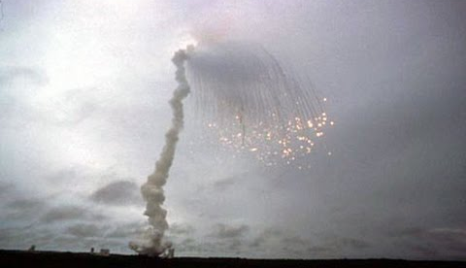
Real Issues!
declare
v_veloc_sensor: float; -- represented using 64 bit
h_veloc_sensor: float; -- represented using 64 bit
v_veloc_bias: integer; -- represented using 16 bit
h_veloc_bias: integer; -- represented using 16 bit
begin
sensor_get(v_veloc_sensor);
sensor_get(h_veloc_sensor);
v_veloc_bias := integer(v_veloc_sensor);
h_veloc_bias := integer(h_veloc_sensor);
decide_bias(v_veloc_bias, h_veloc_bias);
-- code courtesy of Dr. Peter Tröger, TU Chemnitz
Ariane 5, flight 501, Video
The internal SRI* software exception was caused during execution of a data conversion from 64-bit floating point to 16-bit signed integer value. The floating point number which was converted had a value greater than what could be represented by a 16-bit signed integer.

Slide 31
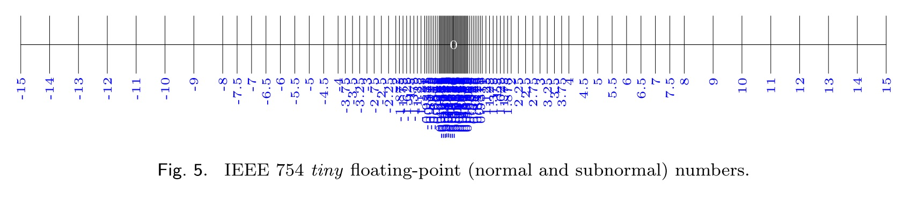
Why does this happen?
Important Insight: Compare int and float. How can it be that float covers a much much broader range but is represented using the same number of bits?
C Data Type | Size (in an x86-64 system) | Lowest Value | Highest Value
int | 32 bits | -2’147’483’648 | 2’147’483’647
unsigned int | 32 bits | 0 | 4’294’967’295
float | 32 bits | -3.4 * 10^38 | 3.4 * 10^38
Floating-point numbers are most precise very close to zero. The density decreases with distance to zero.

Slide 32
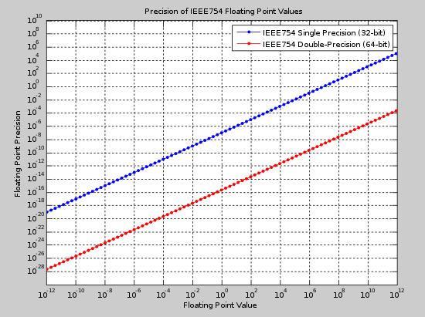
Why does this happen?
Around a value of 10’000’000’000 (x-Axis), the precision of 32-bit single-precision numbers is around +/- 1000 (y-Axis).

Slide 33
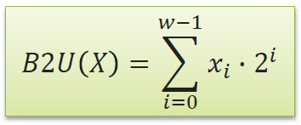

Excursion: Representing Integers
Unsigned Ints
Signed Ints: 2‘s Complement
First bit: sign bit
(Asymmetric) Range
  | TMin | = TMax + 1
  UMax = 2 * TMax + 1
Why 2‘s complement?
What‘s the value of the 4-bit unsigned integer 1001 ?
You know this already! ;-)
What‘s the value of the 4-bit 2‘s complement integer 1001 ?
What are the highest/lowest values of a 4-bit 2‘s complement integer?
sign bit

Slide 34
2‘s Complement Examples
sign bit
Word size: 4 bits (-8…7)
0000₂
0101₂
1000₂
1111₂
0
5
-8
-1

Slide 35
Lecture Notepad: «Wie stellen wir negative Zahlen dar?»
Ohne Vorzeichen: 0000b (0) - 1111b (15)
Mit einem Vorzeichen-Bit?
1 111 (-7) --- 1 000 (-0) --- 0 000 (+0) --- 0 111b (+7)
Mittels 2's complement / Zweierkomplement
-2^3 2^2 2^1 2^0
    1 000 (-8) --- 0000 (0) --- 0 111 (+7)
Achtung! Dies ist kein 2’s Complement!

Slide 36
Lecture Notepad: «Erfundener» Standard mit einfachem Sign-Bit
1.Bit = Sign-Bit (wenn gesetzt, dann ist die Zahl negativ)
Restliche Bits = (vorzeichenlose) Zahl selbst
Beispiele
01001b = 9
11001b = -9
00000b = +0
10000b = -0
01111b = 15
11111b = -15
Achtung! Dies ist kein 2’s Complement!

Slide 37
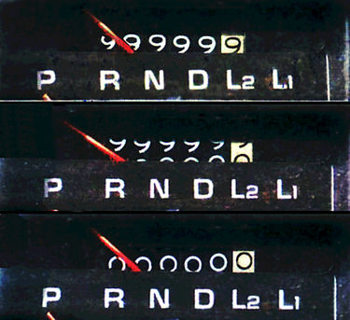
Lecture Notepad: 2’s Complement
1001b = 1 * -2^3 + 0 * 2^2 + 0 * 2^1 + 1 * 2^0 = -7
0111b = 7
1000b = -8
Berechnung von (2'147'483'647 + 1) im 2er-Komplement auf 32 Bits
0111 1111 1111 1111 1111 1111 1111 1111b (= Dezimale 2'147'483'647)
+ 0000 0000 0000 0000 0000 0000 0000 0001b (= Dezimale 1)
----------------------------------------------------------
1000 0000 0000 0000 0000 0000 0000 0000b (= Dezimale -2'147'483'648)
Überlauf!!

Slide 38
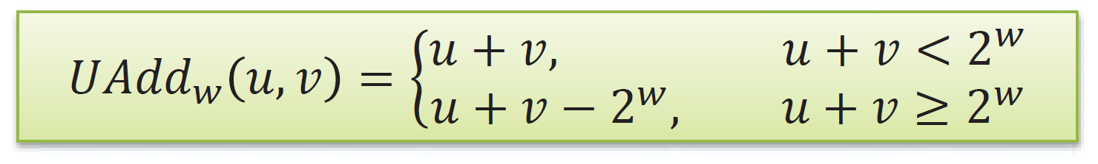
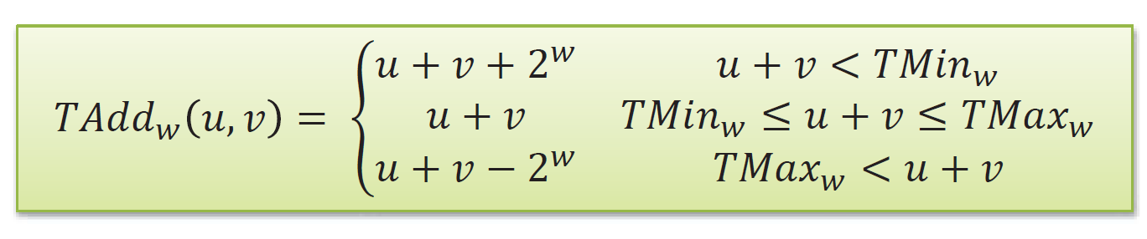
Arithmetic & Shifts
~x + 1 = -x
2‘s Complement Negation
Flipping all bits and then adding one gives me the 2‘s complement negation
Unsigned Addition
Standard addition
Ignores last carry -> positive overflow
2‘s Complement Addition
Identical bit-level behavior, remaining bits are treated as 2‘s complement
Positive and negative overflow may occur
If two x-bit numbers are added, how many bits are needed to (accurately) represent the result?

Slide 39
2‘s Complement Addition Example
Word size: 4 bits (-8…7)
-8 + -8 -> 1000₂ + 1000₂ = (1)0000₂ -> 0
-8 + -1 -> 1000₂ + 1111₂ = (1)0111₂ -> 7
3 + 3 -> 0011₂ + 0011₂ = 0110₂ -> 6
3 + 5 -> 0011₂ + 0101₂ = 1000₂ -> -8
7 + 7 -> 0111₂ + 0111₂ = 1110₂ -> -2
neg. overflow
-8 + -8
-8 + -1
3 + 3
3 + 5
7 + 7
pos. overflow

Slide 40
Lecture Notepad: «Addition»
Addition (alles unsigned)
0010b + 0010b = 0100b (korrekt!)
1010b + 1011b = 0101b (Überlauf! Dezimal: 10 + 11 = 5)
2te Rechnung genauer:
1 0 1 0 Dezimal 10
+ 1 0 1 1 Dezimal 11
= 0 1 0 1 Dezimal 5 (= 10 + 11 - 16, siehe Formel)
Warum 16? 16 = 2^4, also 2^wordsize (=4)
2‘s Complement Negation
0101b Dezimale 5
~0101b = 1010b Dezimale -6
-0101b = 1011b Dezimale -5

Slide 41
Multiplication
Multiplication (both signed and unsigned)
„Standard“ multiplication
Ignores overflow bits
If two x-bit numbers are multiplied, how many bits are needed to represent the result?
If an x-bit number is multiplied with a y-bit number, how many bits are needed to represent the result?

Slide 42
Multiplication
If two x-bit numbers are multiplied, how many bits are needed to represent the result?
Multiplication (both signed and unsigned)
„Standard“ multiplication
Ignores overflow bits
Shifting
(x << k) multiplies by 2^k, both for signed and unsigned!
(x >> k) divides by 2^k and rounds down (bits to the right of the binary point are lost)
  Unsigned: „logical shift“ (shift in 0s)
  Signed: „arithmetic shift“ (shift in a copy of the most significant bit)
  Careful: for x < 0 the arithmetic shift rounds toward minus infinity, while C integer division truncates toward zero. So (x >> k) is not the same as (x / 2^k) for negative x
Compiler automatically replaces multiplications and divisions by powers of two with (much faster) shift-and-add operations! For signed division it first adds a bias.
If an x-bit number is multiplied with a y-bit number, how many bits are needed to represent the result?
What‘s (+7)/2 ?
(0111₂ >> 1)
What‘s (-7)/2 ?
(1001₂ >> 1)
Demo: https://godbolt.org/

Slide 43
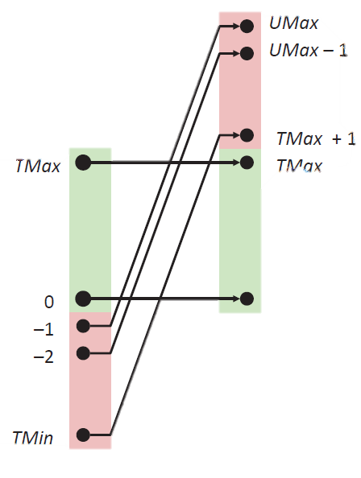
Expanding, Truncating, Casting
Expanding (e.g., short -> int)
Unsigned: add zeros
Signed: sign extension
Truncating (e.g., unsigned int -> unsigned short)
Simple bit truncation & re-interpretation
Expected behavior for small enough numbers
Casting: Converting one type to another
Signed -> Unsigned vs. Unsigned -> Signed
Conversion keeps the same bit pattern…
  Change of context, not of bits
  Order Inversion
Take care with implicit casts (i.e., conversion of one type to another) in assignments and procedure calls
What happens if we cast the largest possible unsigned int to a signed int?

Slide 44
Expanding, Truncating, Casting
#include <stdio.h>
int main(void)
{
unsigned int plus_one = 1;
int minus_one = -1;
if(plus_one < minus_one)
printf("1 < -1");
else
printf("boring");
return 0;
}
https://godbolt.org/
Expanding (e.g., short -> int)
Unsigned: add zeros
Signed: sign extension
Truncating (e.g., unsigned int -> unsigned short)
Simple bit truncation & re-interpretation
Expected behavior for small enough numbers
Casting: Converting one type to another
Signed -> Unsigned vs. Unsigned -> Signed
Conversion keeps the same bit pattern…
  Change of context, not of bits
  Order Inversion
Take care with implicit casts (i.e., conversion of one type to another) in assignments and procedure calls
Take extreme care with mixed expressions

Slide 45
Do you understand what is happening here?
#include <stdio.h>
int main(void)
{
unsigned int plus_one = 1;
int minus_one = -1;
if(plus_one < minus_one)
printf("1 < -1");
else
printf("boring");
return 0;
}
https://godbolt.org/
Solution: Look at the Bits!
What is the binary representation of the unsigned int „1“ ?
What is the binary representation of the signed int „1“ ?
In CS, all Information = Bits + Context
But here, we change the context!

Slide 46
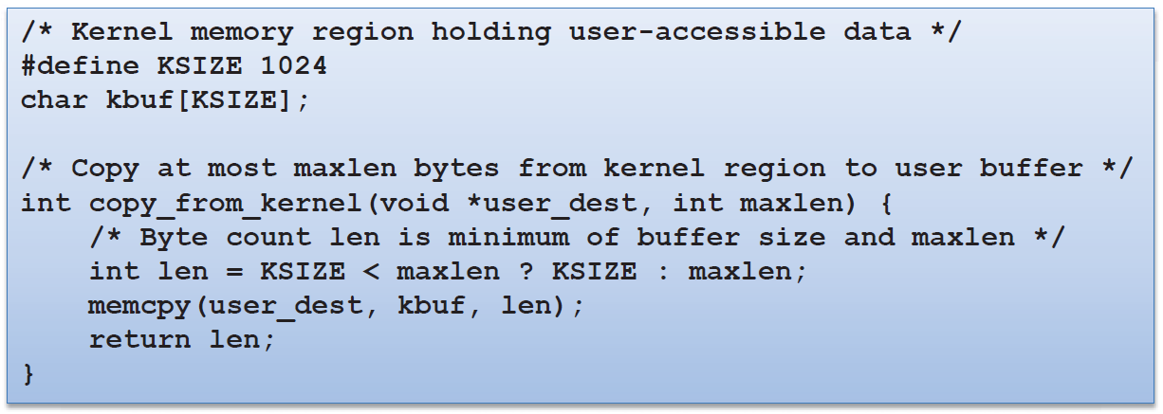
Homework
How can you make this code copy much more than „maxlen“ bytes?
The specification of this code is: „Copy bytes from the kernel to the location „user_dest“. But never copy more than „maxlen“ bytes.
This is the getpeername library function of FreeBSD
What happens for a negative maxlen ?
„if (KSIZE < maxlen) then len=KSIZE, otherwise len=maxlen“
„Copy n bytes from the kernel buffer [kbuf] to [user_dest]“

Slide 47
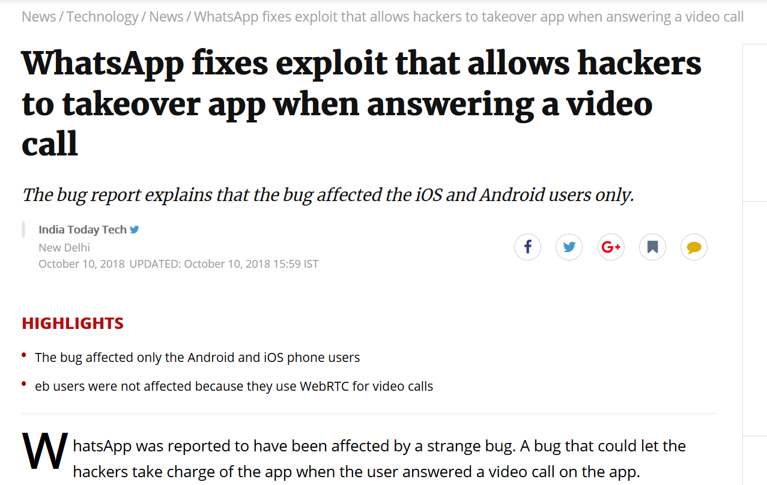
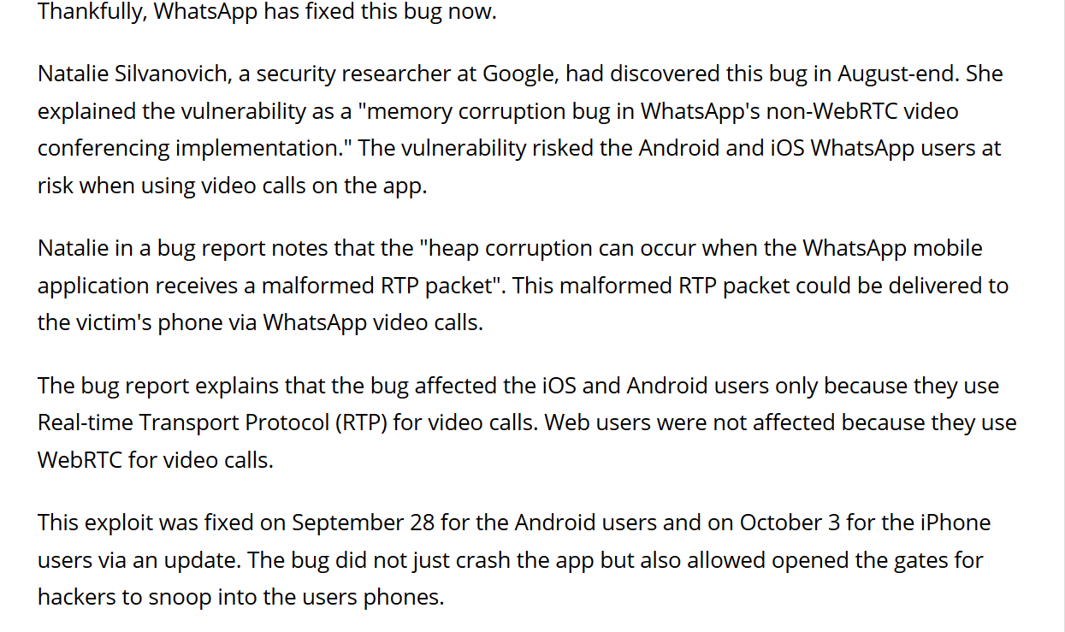
https://www.exploit-db.com/exploits/45579/

Slide 48

Our journey so far…
Voilà! This is a Central Processing Unit, or CPU!
Numbers
Information
Text
School Mathematics (Logic, Set Theory)
Context
Registers
Pixels / Colors
Instructions
Instruction Set
Binary Digits
Control Unit
Logic + Arithmetic
Arithmetic/Logic Unit
Electronic Components
(today: Transistors)
Logic Operations
(NOT, NOR, …, NAND)
General-Purpose Calculator!
Function Selector
Adder Circuits
Circuits for other arithmetic functions
Logic Gates

Slide 49

Any Questions / Comments / Doubts / Concerns?
Take-Homes
Computers represent all information as finite sequences of bits that are interpreted in context
Representations of numbers (and of all other data types) in computer systems are necessarily finite
Programming languages use a defined number of bits per instance (e.g., 32 bits to represent an Integer number in C)
  Check this out for python as well! https://codeblessu.com/python/size-of-data-types.html
  We need to calculate within these finite spaces (and we’ve looked at additon, multiplication, shifting,…)
We can represent any information using bits, where the context is given by a standard
  Floating-point Numbers: IEEE 754-2019
  Text (including exotic characters): ISO 10646 „Unicode“
  JPEG: ISO 10918-1
  etc.
You can also create your own mapping! (but is this useful if you are the only person using it)

Slide 50

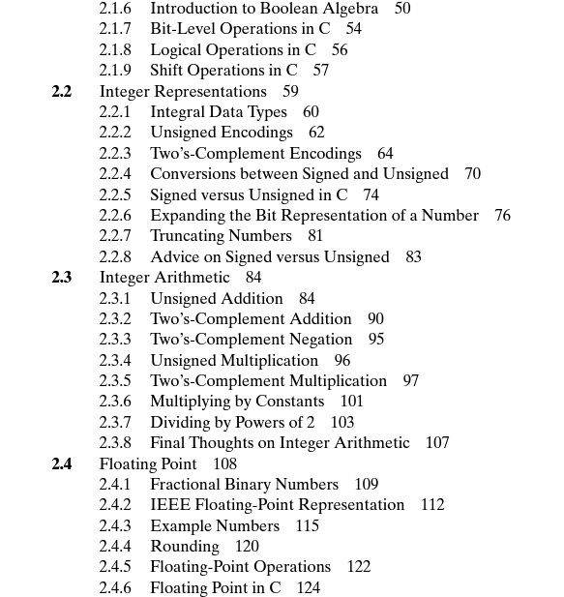
How to Study this Material?
Basic Depth
Watch the rest of the (historical) videos
The lecture corresponds to the first two chapters of Bryant & O’Hallaron: Read these!
  Chapter 1: A Tour of Computer Systems (excellent overview, 28 pages)
  Chapter 2: Representing and Manipulating Information (~90 pages, we covered about 1/3 of this – you’ll recognize it)
Internalize bit-level representatons of numbers also through other sources
Everything depends on these representations!
Try out what I showed you!
Play with the examples!
Advanced Depth
Easy: Read Chapters 1 & 2 of Bryant & O’Hallaron in depth
Solve the book’s practice problems ☺
https://en.wikipedia.org/wiki/Two%27s_complement

Slide 51
Preparing for the next lecture…
Solve the first five levels of the NAND Game!
https://www.nandgame.com/

Slide 52
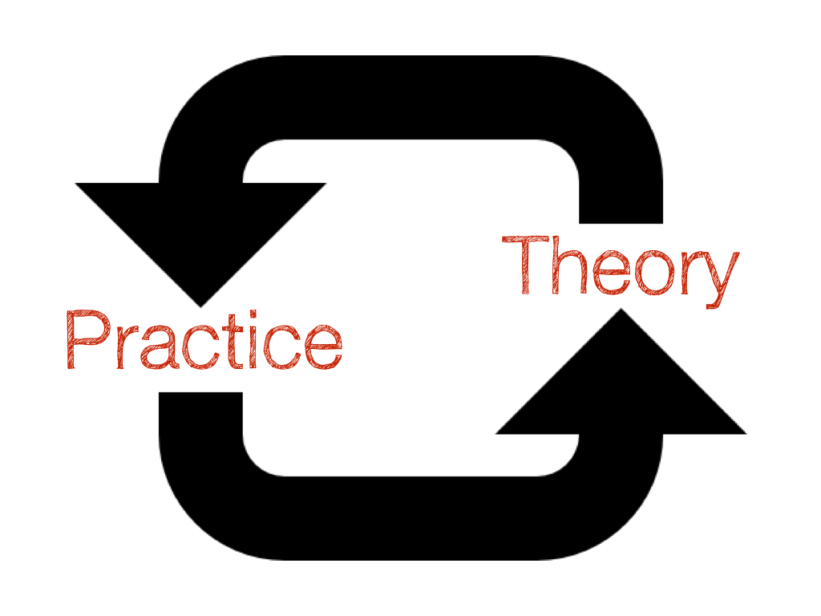
Preparing for the first exercise…
Verify that you can run the command line / shell / terminal on your machine and familiarize yourself with basic commands (ls, cd, etc.)
Windows: Use PowerShell
Mac: Use Terminal
Linux: Use whatever you have
Basic Commands
Navigation cd (“change directory”)
Inspecting ls (“list”)
Printing a file content cat <filename> (“concatenate”)
Compiling (with g++) g++ <filename> -o program
Run an executable file (“program”) ./program
Deleting a file rm (“remove”)
Autocompletion <Tab>

Slide 53
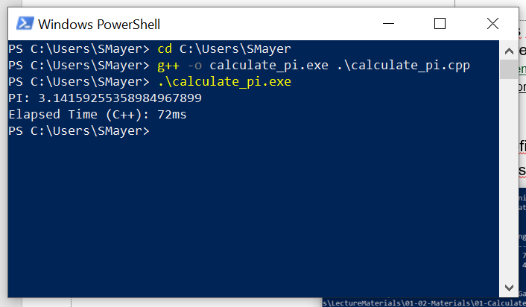
Preparing for the first exercise…
You should from now on have a computer that is set up to compile C code (i.e., with the gcc/g++ compiler). There are many options of how to do this, here are a few:
Windows: Set up Linux Subsystem for Windows: https://learn.microsoft.com/en-us/windows/wsl/about
Mac: Follow https://www.mkyong.com/mac/how-to-install-gcc-compiler-on-mac-os-x/
Linux: Run sudo apt install gcc
Try the compiler on the program calculate_pi.cpp (in the zipfile on Canvas).
This will look something like this on your console (Windows in this case):
Change Directory to C:\Users\SMayer (this is where the file calculate_pi.cpp is located)
Compile calculate_pi.cpp to yield the output (-o) calculate_pi.exe
Run the program calculate_pi.exe
…and observe the program’s output

