Slide 1
Computersysteme
Computing on Bits
Simon Mayer
University of St.Gallen
Bachelor in Computer Science
Computersysteme (1,904)

Slide 2
Course Syllabus
16.09.2026
Information: Numbers, Bits, Bytes, Encodings
23.09.2026
Bare Metal Programming
Bare Metal Programming
30.09.2026
Computing on Bits: Circuits and Processors
07.10.2026
Assembly Basics
Lecture
Assembly Reverse-Engineering & Assembly Bombs
Assembly Reverse-Engineering
14.10.2026
21.10.2026
Control Flow
Exercise
11.11.2026
Memory Basics
Assignment
18.11.2026
Memory Hierarchy and Caches
25.11.2026
Memory Experiments
Memory Experiments
02.12.2026
Processor Architecture
09.12.2026
Modern Processors
16.12.2026
Multiprocessors, GPUs, Heterogeneous Manycore

Slide 3

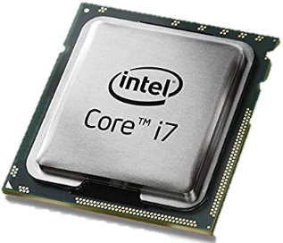
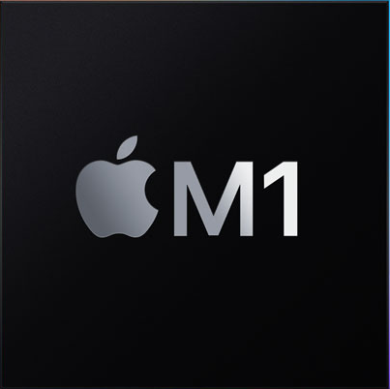
Our journey so far…
Voilà! This is a Central Processing Unit, or CPU!
Numbers
Information
Text
School Mathematics (Logic, Set Theory)
Context
Registers
Pixels / Colors
Instructions
Instruction Set
Binary Digits
Control Unit
Logic + Arithmetic
Arithmetic/Logic Unit
Electronic Components
(today: Transistors)
Logic Operations
(NOT, NOR, …, NAND)
General-Purpose Calculator!
Function Selector
Adder Circuits
Circuits for other arithmetic functions
Logic Gates

Slide 4
Today’s Menu
Information Basics: Numbers, Bits, Bytes, Encodings
Computing Basics: Transistors and Circuits
Processor Basics

Slide 5
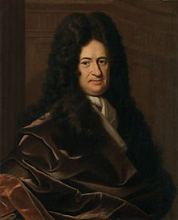
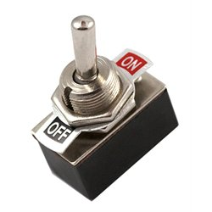

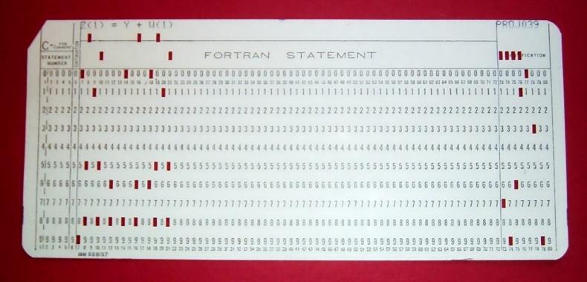
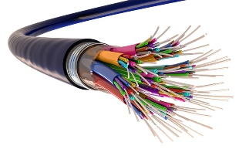

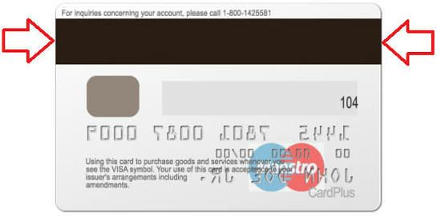
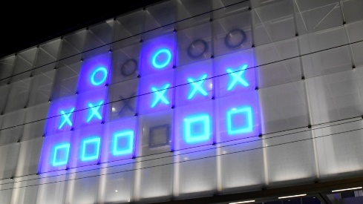
Bits: Binary Digits
Logic: Basic representation of the logical values True and False
Practicality: Many easily feasible physical representations
Punched card: Hole vs. No Hole
Electrical switch: On vs. Off
SSD: High vs. Low Electrical Charge
Fibre Optics: Light vs. No Light
Credit Card: Polarity of Magnetization
Bar Code: Thick Line vs. Narrow Line
Station Clock: Light vs. No Light
G.W. Leibniz: Using binary, arithmetic and logic can be combined!

Slide 6
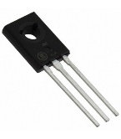
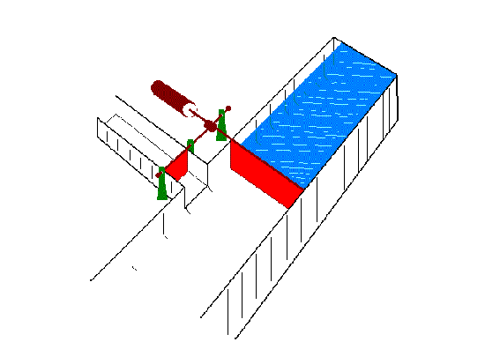
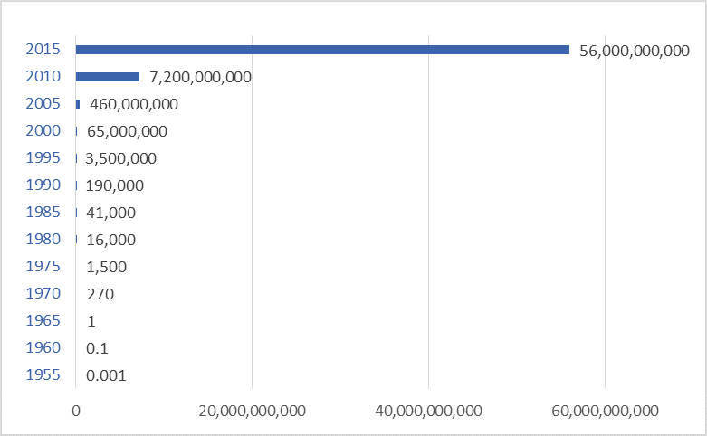
Computing on Bits: Transistors
Transistors are the key active components in practically all modern electronics. The transistor is thus considered to be one of the greatest inventions of the 20th century.
Price, Robert W. (2004). Roadmap to Entrepreneurial Success
Why is it so useful in a computing context?
Because it can be used as an electronic switch!
Source
Gate
Gate
Global Production of Transistors per Capita
(~ 150bn per second in 2015)
Source
Drain
Drain
Compare this to global car production!
(~ 2 per second)
https://www.darrinqualman.com/global-production-transistors/

Slide 7
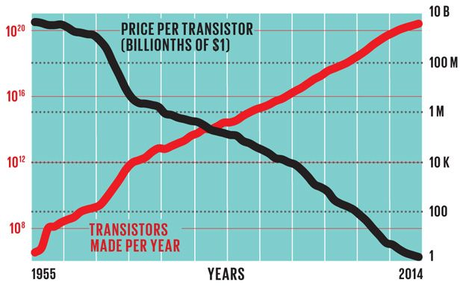
„Economies of Scale“
https://spectrum.ieee.org/transistor-production-has-reached-astronomical-scales

Slide 8
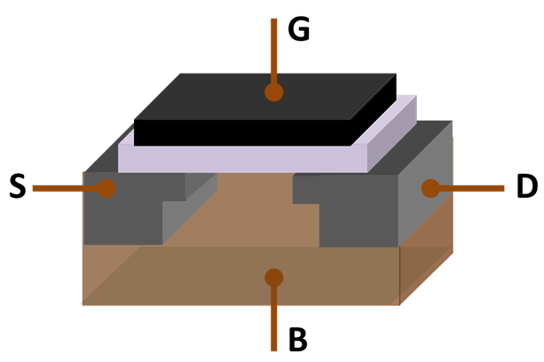
Schematics of a Transistor
Source
Gate
Gate
Source
Drain
Drain
Base
This is key! What is it?
Picture: https://en.wikipedia.org/wiki/Transistor

Slide 9
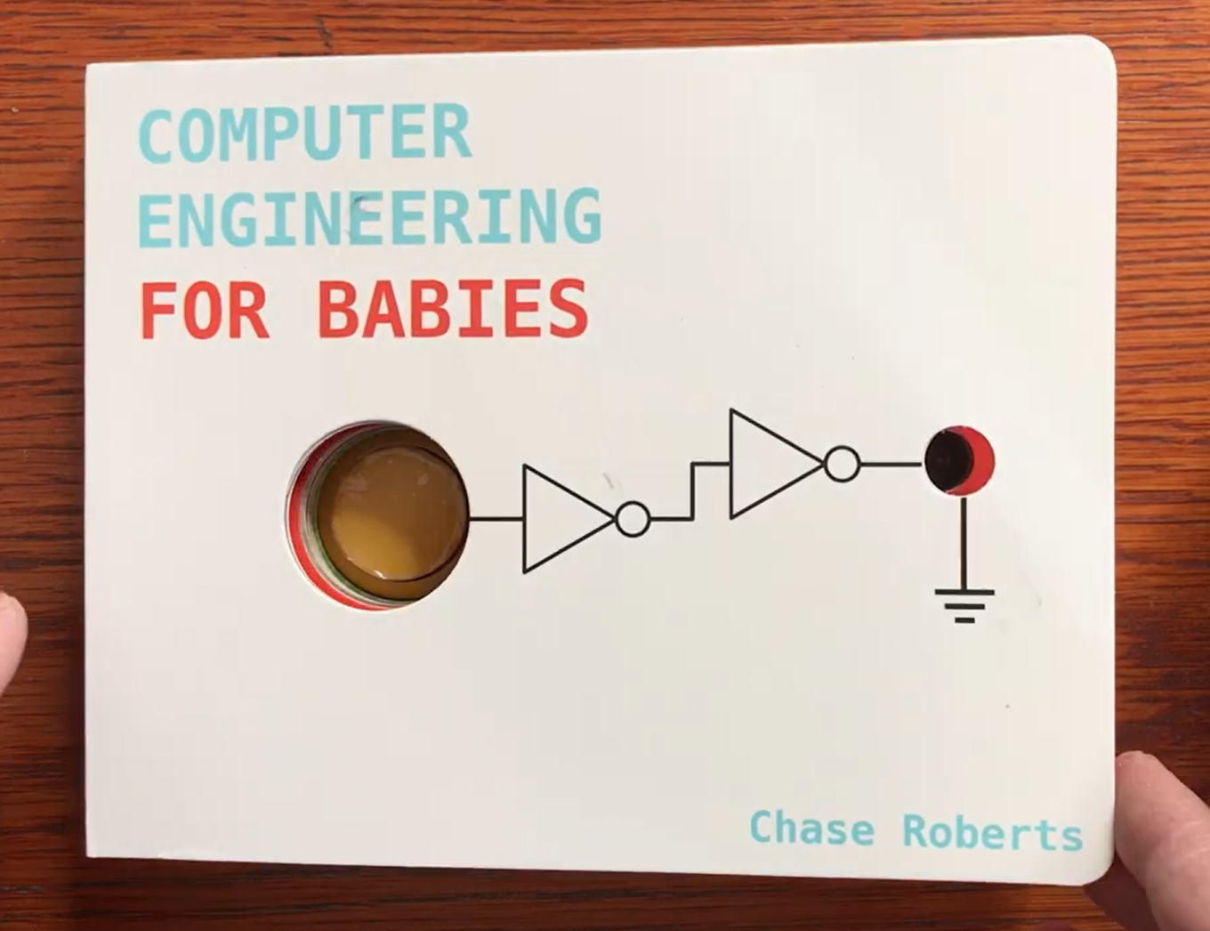
Now we‘re ready to engineer a computer!
https://www.kickstarter.com/projects/babyengineering/computer-engineering-for-babies

Slide 10
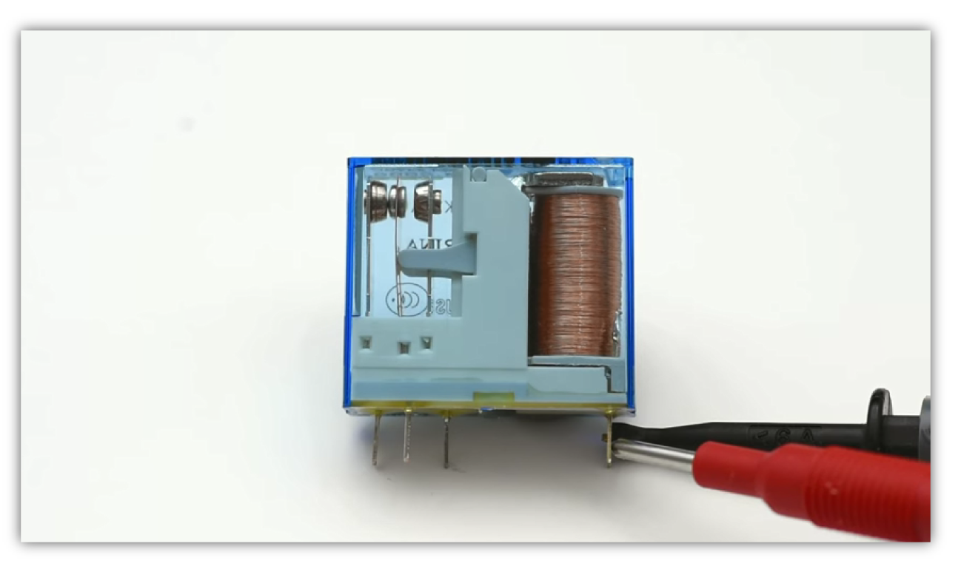
Computing on Bits
boolean x = 1
boolean y = 0
boolean z = 1
George Boole (1815 – 1864): Boolean Algebra
NOT ~x => 0; ~y => 1;
AND (x & y) => 0; (x & z) => 1;
OR (x | y) => 1; (y | y) => 0;
XOR (x ^ y) => 1; (x ^ z) => 0;
Charles Sanders Peirce (1839 – 1914): Logic Operations using Electronic Components
C. Peirce, letter to A. Marquand, 1886: Peirce suggests use of electrically operated switches called relays to achieve “and” and “or” operations.
“(…) it is by no means hopeless (…) to make a machine for really very difficult mathematical problems.”
- Charles S. Peirce
Back then: Relays!
Today: Transistors!
Good that we’re not dealing with electromechanics anymore ;-)

Slide 11
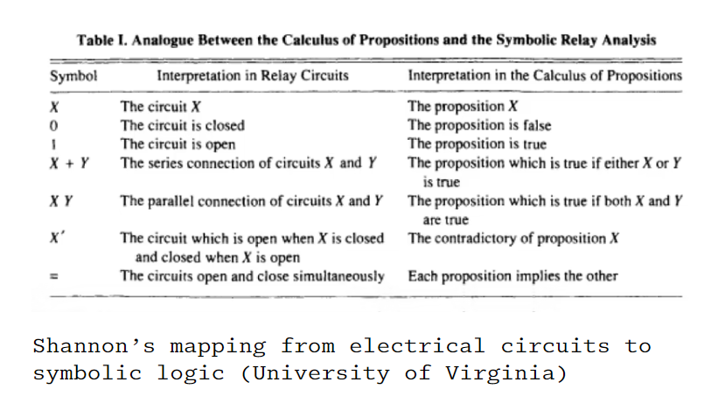
Claude Shannon: Connection of Boolean Algebra and Digital Logic
https://www.theatlantic.com/technology/archive/2017/03/aristotle-computer/518697/
Claude Shannon at MIT: The best master's thesis in history | Neil Gershenfeld and Lex Fridman

Slide 12
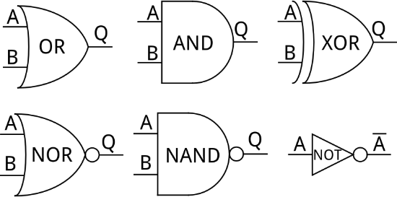
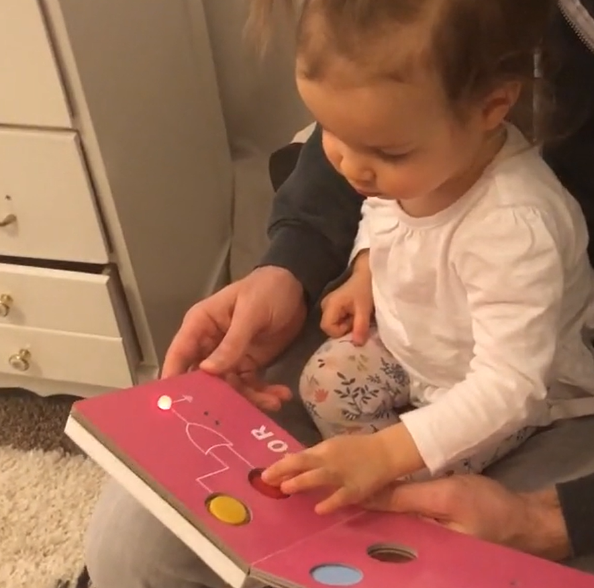
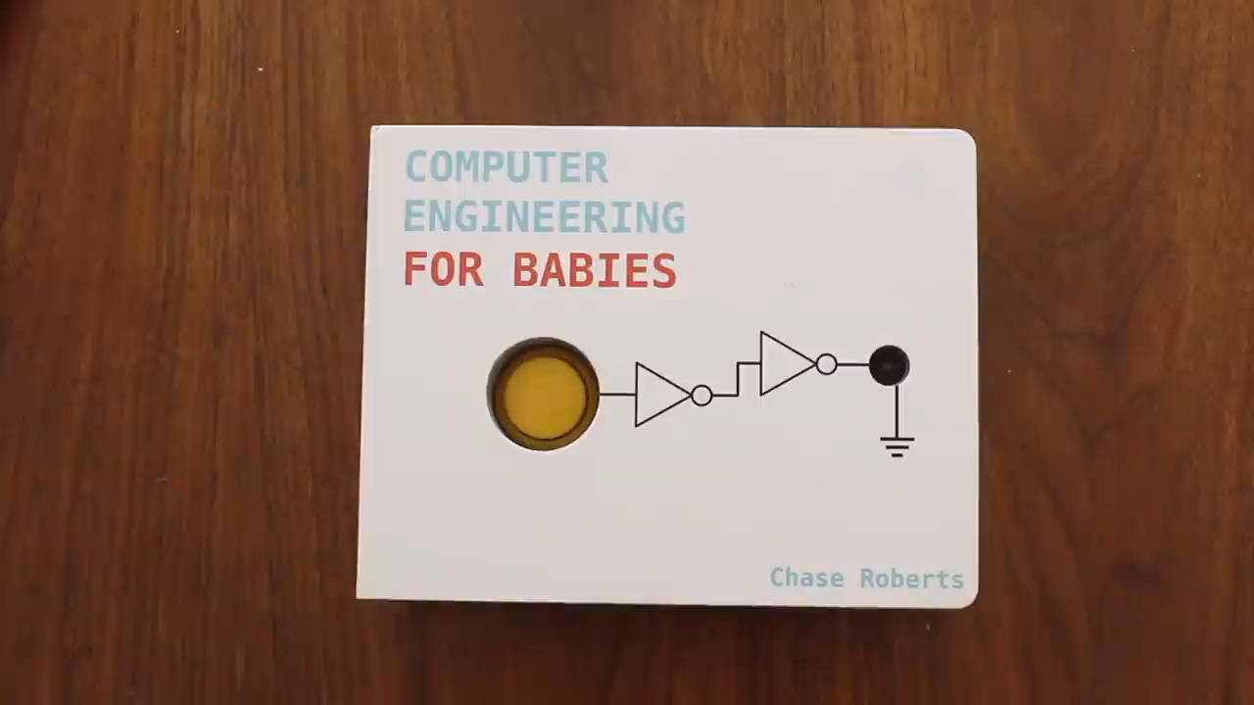
Computing on Bits: Logic Gates
There is a voltage on the “output” Q only if there is a voltage on both “inputs” A and B.
Only if both inputs A and B are set to TRUE, then output Q is set to TRUE.
Example
Symbols for Logic Gates

Slide 13
Logic Gates and Truth Tables
We‘ll need this as well for our computer… ;-)
XOR Function: Q = (A XOR B)
Exclusive Or: “Either A or B, but not both!”
Input | Input | Output
A | B | Q
0 | 0 | ?
0 | 1 | ?
1 | 0 | ?
1 | 1 | ?
0
1
1
0

Slide 14
Computing on Bits: NAND
Henry Sheffer (1882 – 1964): Functional completeness of NAND
All operations over a binary number space can be represented using combinations of gates that compute Not-AND („NAND“). This is equivalent to saying that „all logic operations can be computed using combinations of NAND gates“
Look here for the proofs: https://en.wikipedia.org/wiki/NAND_logic
Example
If a NAND gate receives the same
on both inputs, it computes a NOT
Input | Input | Output
A | B | Q
0 | 0 | 1
0 | 1 | 1
1 | 0 | 1
1 | 1 | 0
These do not matter (inputs different!)

Slide 15
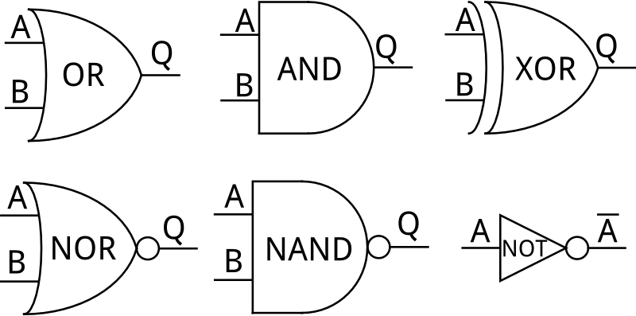
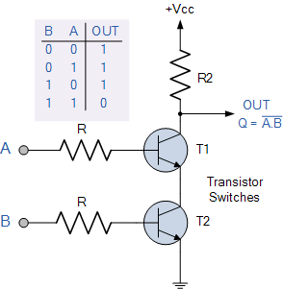
How to Build a NAND Gate?
(Line Voltage Power Supply, e.g. 5 Volts)
Q = A NAND B
A
B
So we need two transistors to produce a NAND. We produce billions of transistors per second…
We can compute with lots of NANDs ;-)
(Ground)

Slide 16
It‘s easier to see than you think!
(Line Voltage Power Supply, e.g. 5 Volts)
Case 1: Neither A nor B carry voltage (i.e., 0)
Both T1 and T2 are open
Q is connected to the supply voltage (via the pull-up resistor)
Q is 1
Case 2: Only A carries voltage
T1 is closed, T2 is open
Q is connected to the supply voltage (via the pull-up resistor)
Q is 1
Case 3: Only B carries voltage
T1 is open, T2 is closed
Q is connected to the supply voltage (via the pull-up resistor)
Q is 1
Case 4: Both A and B carry voltage
Both T1 and T2 are closed
Supply voltage is connected to Ground
Q carries no voltage, i.e. Q is 0
Q = A NAND B
A
B
(Ground)

Slide 17
That‘s what we wanted!!
Case 1: Neither A nor B carry voltage (i.e., 0)
Both T1 and T2 are open
Q is connected to the supply voltage (via the pull-up resistor)
Q is 1
Case 2: Only A carries voltage
T1 is closed, T2 is open
Q is connected to the supply voltage (via the pull-up resistor)
Q is 1
Case 3: Only B carries voltage
T1 is open, T2 is closed
Q is connected to the supply voltage (via the pull-up resistor)
Q is 1
Case 4: Both A and B carry voltage
Both T1 and T2 are closed
Supply voltage is connected to Ground
Q carries no voltage, i.e. Q is 0
NAND Function: Q = (A NAND B)
Input | Input | Output
A | B | Q
0 | 0 | 1
0 | 1 | 1
1 | 0 | 1
1 | 1 | 0

Slide 18
Did you do the homework?
Solve the first five levels of the NAND Game!
https://www.nandgame.com/

Slide 19

Any Questions / Comments / Doubts / Concerns?
Take-Home
Through standard encodings, any symbol can be represented as a binary number
We can (relatively easily and cheaply) create NAND gates
Combinations of NAND gates can express all logic functions
NAND gates can thus express all functions over a binary number space
Any number can be represented as binary
Therefore, we have a universal calculator (or, “computer”)
At least in principle, we’ll build it next ;-)

Slide 20
Our journey so far…
Voilà! This is a Central Processing Unit, or CPU!
Numbers
Information
Text
School Mathematics (Logic, Set Theory)
Context
Registers
Pixels / Colors
Instructions
Instruction Set
Binary Digits
Control Unit
Logic + Arithmetic
Arithmetic/Logic Unit
Electronic Components
(today: Transistors)
Logic Operations
(NOT, NOR, …, NAND)
General-Purpose Calculator!
Function Selector
Adder Circuits
Circuits for other arithmetic functions
Logic Gates

Slide 21
Let‘s build a Calculator!
You actually already know how to do this – however you need to transfer some knowledge from school.
How do we do pen-and-paper additions?
Carry = 0
Carry = 1
Carry = 0₂
Carry = 1₂
6
+ 3
----
6
+ 6
----
0₂
+ 1₂
----
1₂
+ 1₂
----
9
1
«And 1 in mind»
«And 0 in mind»
2
«And 1 in mind»
1₂
«And 0 in mind»
1
0₂
As we have seen, in binary, logic and arithmetic are equivalent.
So we should be able to perform this calculation using a circuit with only NAND gates.

Slide 22

Let‘s build a Calculator!
And if we can add, we can also
Multiply (that’s just repeated adding)
Subtract (that’s just the «opposite» of adding)
Divide (that’s just the «opposite» of multiplying)
Draw roots (that’s just adding and dividing)
….
Do machine learning (that’s just combinations of the above)

Slide 23
Now YOU build a Calculator!
If a bit A and a bit B go in, then S should hold the sum while C should hold the carry.
Example: A=1 and B=1 should yield S=0 and C=1
Carry = 1₂
1₂
+ 1₂
----
A
S
«And 1 in mind»
1
0₂
B
C
The «0» is the «sum» output bit in 1₂ + 1₂
The «1» is the «carry» output bit in 1₂ + 1₂
Teams of Two: What’s the meaning of «Sum» and «Carry» in binary?
You have two inputs, A and B, which are both binary digits
You have two outputs, S(um) and C(arry), which are both binary digits
Walkthrough:
Which value (0/1) does S need to assume if A/B assume the values 0/0, 0/1, 1/0, or 1/1?
With which logical expression can you express the operation S = A ?? B
With which logical expression can you express the operation C = A ?? B
Can you draw your calculator using the logic gate symbols?

Slide 24
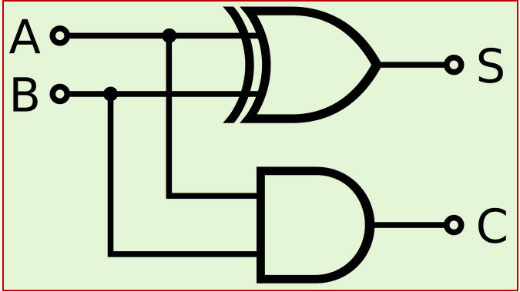
Now YOU build a Calculator!
1₂
+ 1₂
----
XOR
1
0₂
AND
A so-called “Half-Adder” adds two bits and outputs the result.
The Sum output should be 0 if both inputs are 0. It should also be 0 if an overflow occurs.
In other words, it should be 1 if either A or B is 1 (but not both). That’s an Exclusive OR!
The Carry output should be 0 if no overflow occurs, i.e. if not both A and B are 1.
In other words, it should be 1 if both A and B are 1. That’s an AND!

Slide 25
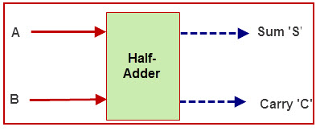
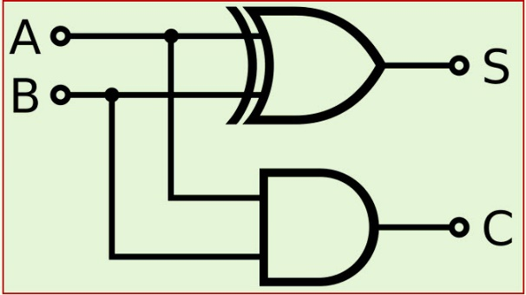
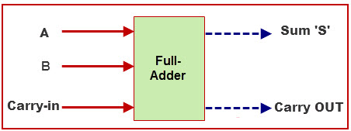
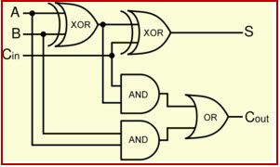
Now YOU build a Calculator!

Slide 26
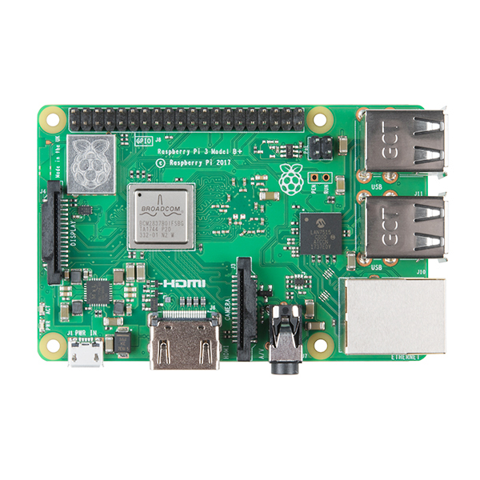
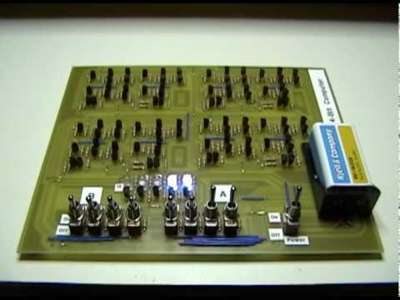
Do it yourself!
Buy transistors: https://www.jameco.com/z/2N3904BU-Major-Brands-Transistor-2N3904-NPN-General-Purpose-bulk-_38359.html
Build a simple 4-bit computer: https://www.youtube.com/watch?v=xISG4nGTQYE (from 4:30)
Here are some kits to get you started you: https://eater.net/8bit
1000000000x more transistors
Or with relays ☺

Slide 27
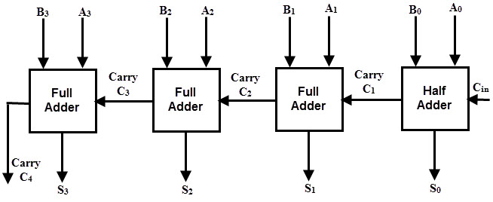
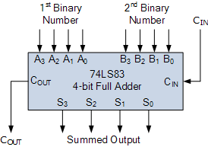
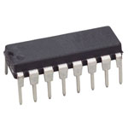
Let‘s build a larger Adder
First 4-bit number: A0 … A3
Second 4-bit number: B0 … B3
Result: S0 … S3
Carry-out: C4
https://www.jameco.com/z/74LS83-Major-Brands-4-Bit-Binary-Full-Adder-DIP-16_48063.html

Slide 28
Illustration: 0110₂ + 0010₂
A = 0010 B = 0110
0
0
1
0
1
1
0
0
Test yourselves: What are C1, C2, C3, C4, S0, S1, S2, S3 ?

Slide 29
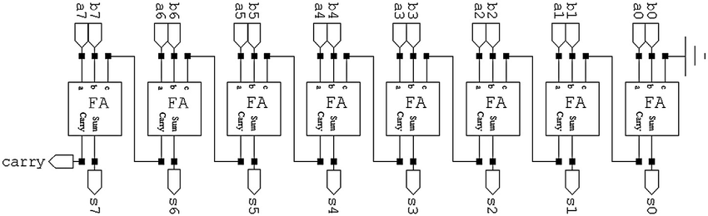
Let‘s build a LARGER Adder
First 8-bit number: a0 … a7
Second 8-bit number: b0 … b7
Result: s0 … s7
Carry-out: carry
What’s the physical size of this circuit (i.e., in cm)?
1x 8-bit adder = 8x 1-bit adders that are connected properly ☺
2x XOR + 2x AND + 1x OR per Full Adder → 40 gates in total → about 80 transistors in total

Slide 30
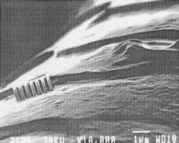
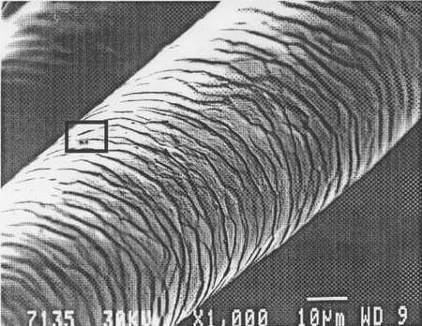
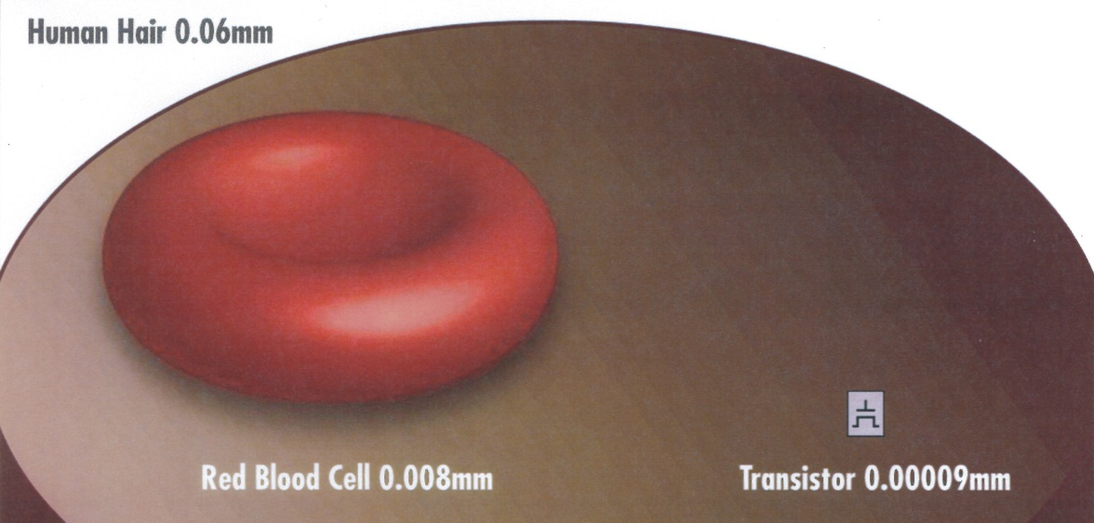
Thank you, Moore!
(in reference to Moore’s law)
This was 20 years ago ;-)
This was 7 years ago ;-)
https://www.latenightim.com/internet-marketing-electrons-and-the-meaning-of-life/
In 2026, leading-edge manufacturing (TSMC N2, Intel 18A) places transistors at a pitch of ~23–45nm. That’s roughly 1/2000th of a human hair.
https://cogentlegal.com/2013/11/understand-spatial-relationships/

Slide 31
Let‘s build a LARGER Adder
8-bit adder circuit
125nm
1x 8-bit adder = 8x 1-bit adders that are connected properly ☺
2x XOR + 2x AND + 1x OR per Full Adder → 40 gates in total → about 80 transistors in total
2000nm if chained in a straight line (+ wiring).
225nm * 225nm if arranged in a 2D grid („rectangle“).
125nm * 125nm * 125nm if arranged in a 3D grid („cube“)

Slide 32

Thank you, Moore!
8-bit adder circuit
125nm
25nm
100nm

Slide 33
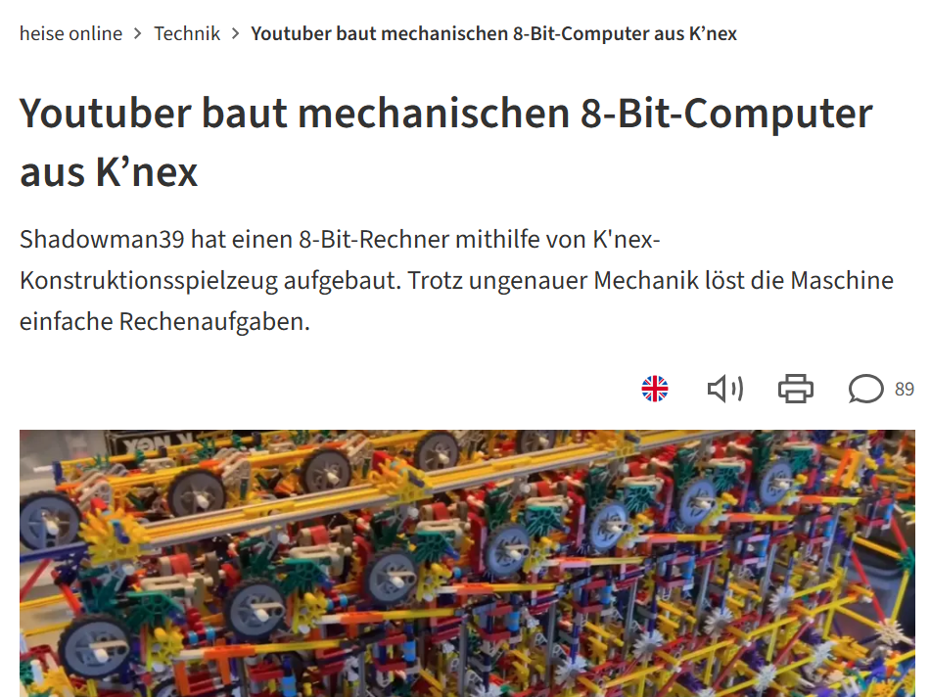
Another Adder…
https://m.youtube.com/watch?v=Fxv3JoS1uY8
https://www.heise.de/news/Youtuber-baut-mechanischen-8-Bit-Computer-aus-K-nex-10495869.html

Slide 34
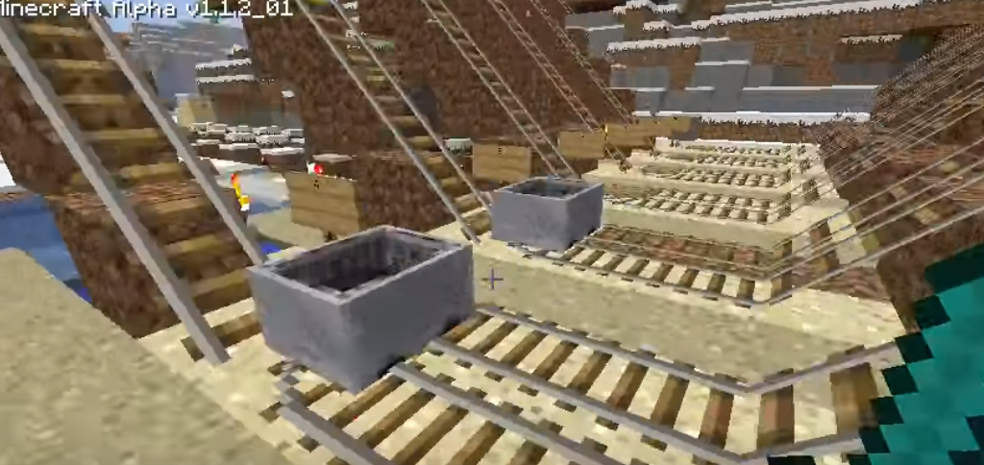
Aaand Another Adder
We’ve been talking about electromechanical (relays) and electronic adders (transistors). Here’s a mechanical adder (that uses just a small gravity trick ;-))
https://www.youtube.com/watch?time_continue=160&v=mrLxnY8Gtfw (from 0:18)
And remember the first lecture about mechanical computers! ;-)

Slide 35

Our journey so far…
Voilà! This is a Central Processing Unit, or CPU!
Numbers
Information
Text
School Mathematics (Logic, Set Theory)
Context
Registers
Pixels / Colors
Instructions
Instruction Set
Binary Digits
Control Unit
Logic + Arithmetic
Arithmetic/Logic Unit
Electronic Components
(today: Transistors)
Logic Operations
(NOT, NOR, …, NAND)
General-Purpose Calculator!
Function Selector
Adder Circuits
Circuits for other arithmetic functions
Logic Gates

Slide 36
Any Questions / Comments / Doubts / Concerns?
Take-Home
Through (smart) combinations of logic gates, we can build adding circuits – and you did this!
Through (smart) combinations of logic gates, we can also build subtractors, multipliers, etc.
These can be produced in mass quantities and at extremely low prices and sizes

Slide 37

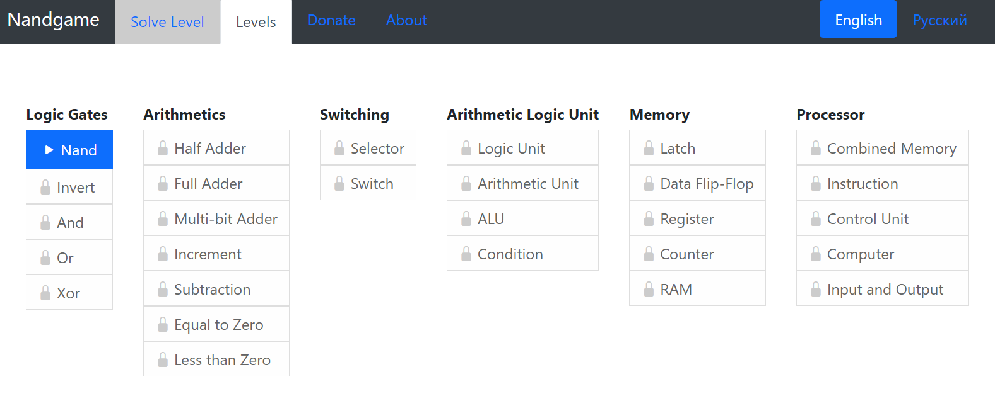
How to Study this Material?
Basic Depth
Play the nandgame.com – and understand it! (I’m serious)
Read up on circuits and logic gates
Understand adder circuits
Keep internalizing number representations, especially hexadecimal
Get prepared for the exercise session (see next slides)
Advanced Depth
Play more levels on the nandgame.com
https://en.wikipedia.org/wiki/Logic_gate
https://en.wikipedia.org/wiki/Adder_(electronics)

