Slide 1
Valence and Arousal
Estimation for
Video Events
Giulia Bertazzini
Niccolò Guiducci
Firenze, 7 Aprile 2023

Slide 2





Goals
Estimate valence and arousal values on video events, obtained with ESIM simulator

Slide 3
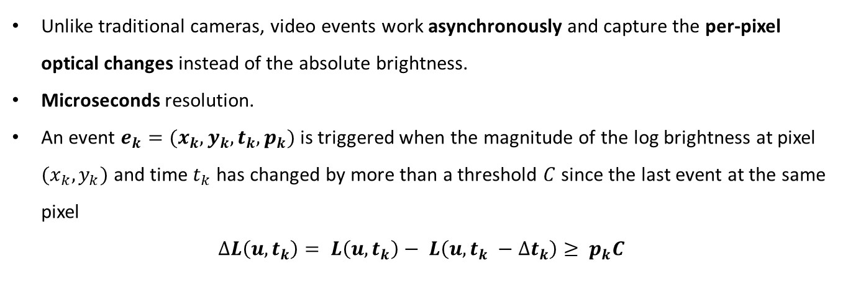
Introduction
Video Events
Unlike traditional cameras, video events work asynchronously and capture the per-pixel optical changes instead of the absolute brightness.
Microseconds resolution.
An event $e_{k}=(x_{k},y_{k},t_{k},p_{k})$ is triggered when the magnitude of the log brightness at pixel $(x_{k},y_{k})$ and time $t_{k}$ has changed by more than a threshold $C$since the last event at the same pixel
$$∆L\left(u, t_{k}\right)= L\left(u, t_{k}\right)− L\left(u, t_{k} −∆t_{k}\right)≥ p_{k}C$$

Slide 4
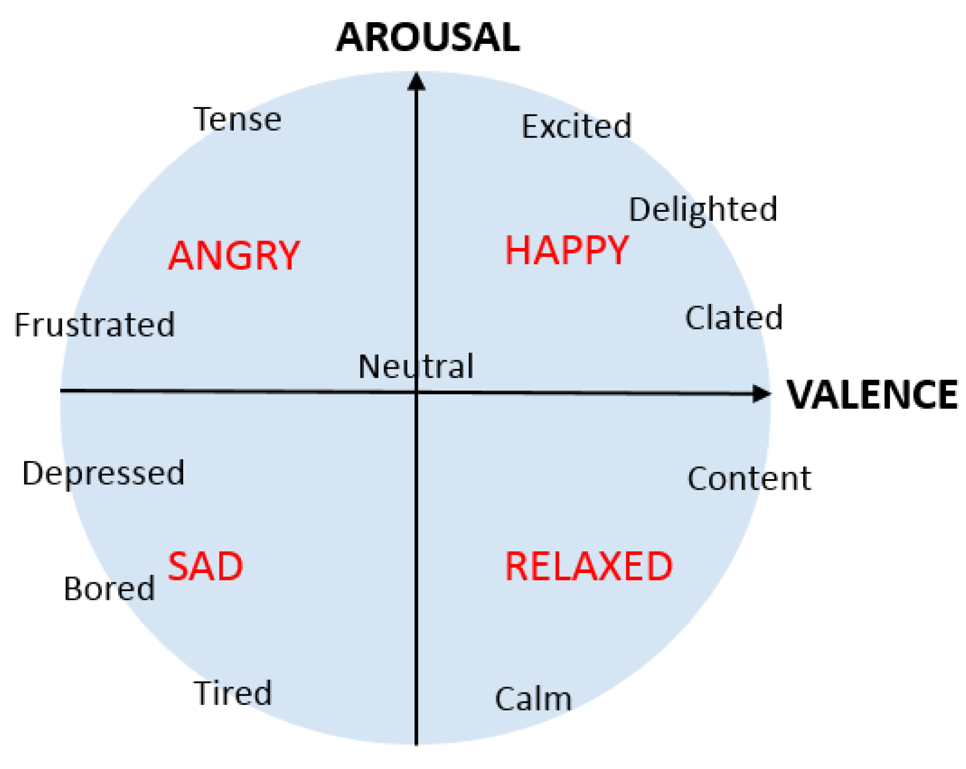
Introduction
Valence and Arousal
Emotional experiences can be described by two terms:
Valence: a scale that measures the positive or negative affectivity (so the pleasantness or unpleasantness of something)
Arousal: is a measure of how calming or exciting the information is

Slide 5


Implementation
In order to estimate valence and arousal on video events, we implemented a model which given an input video event, it returns an estimate of these values on this one
Main Implementation Tools
ESIM Simulator
Python
PyTorch framework

Slide 6
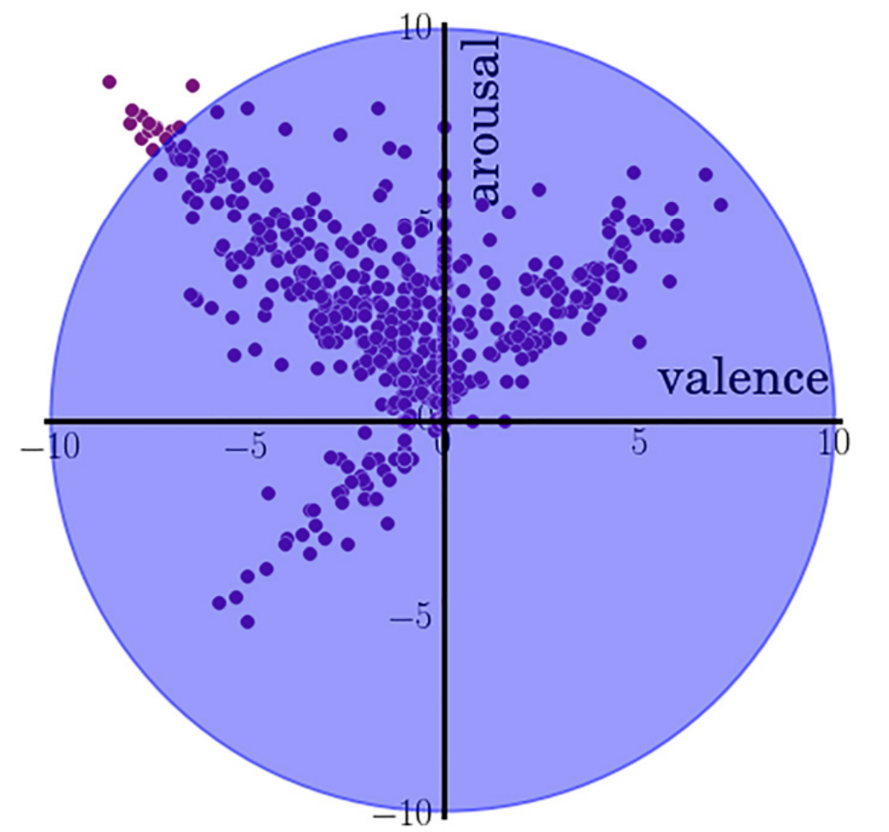
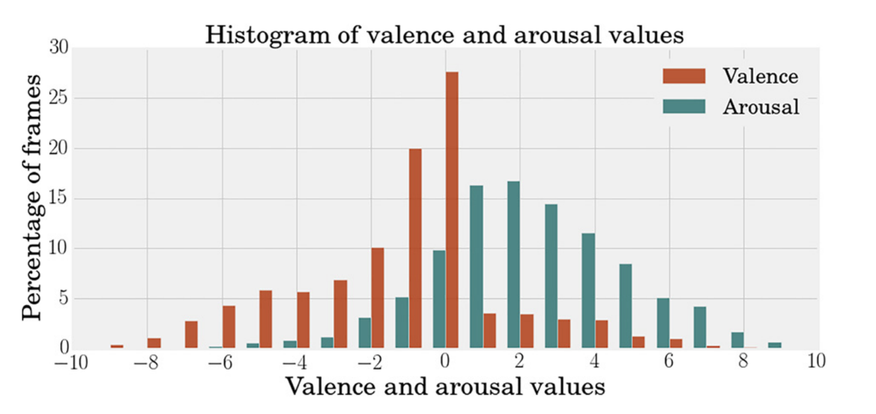
Implementation – Dataset
AFEW-VA Dataset
Collection of 600 RGB videos extracted from features films
Each video contains per-frame annotations levels of valence and arousal (which are discrete values in the range of -10 to 10), along with per-frame annotations of 68 facial landmarks.
Videos range from around 10 frames to longer clips (more than 120 frames); in total, there are 30,000 frames in the entire dataset

Slide 7
Implementation – Video Preprocessing
From RGB Videos to Video Events with ESIM Simulator
Since the goal was to estimate VA on video events and AFEW-VA dataset contains RGB video, thanks to ESIM Simulator, we generate the events for each video
Clearly, this requires to properly labelled each frame of the video events (disegno di come abbiamo assegnato le etichette a ogni evento)
After that we cropped each frame of the video events to 200x200, centered on the face (thanks to the landmarks) and we aligned it

Slide 8
Implementation – Video Preprocessing
Model Architecture

Slide 9
Implementation – Video Preprocessing
Model Architecture – Aligned Compressed Event

Slide 10
Implementation – Video Preprocessing
Model Architecture – Branch Event Net

Slide 11
Experiments and Results
text

Slide 12
Conclusions

Slide 13
Title
Giulia Bertazzini
Niccolò Guiducci
Firenze, 7 Aprile 2023

