Slide 1

Automated Remote Inspection
Training & detection End-to-End process

Slide 2


General idea of the tool
Inspector would use this proposed tool in two ways:
Create a model that learns how to detect certain objects
Use an existing model that can already identify certain objects
TRAINING goal
DETECTION goal

Slide 3
2 processes: Training and detection
Training → is needed for creating the model that will be used to detect objects
This is run only once for each model (or more time for possible future improvement)
Meant to be run on central cloud (VM) that is enabled with GPU and hence, can run very fast
Detection→ uses trained models for processing a video, made by the inspector, in order to find interesting objects. These interesting objects are those that the model has learned to recognize during the training part
This is run once for each video, on the local tablet of the inspector

Slide 4
Training
Training End-to-End process

Slide 5
Training – 2 types of training
Train a new model from scratch
With the training is possible to create from scratch models that can recognize pretty much everything.
The future detections that exploit the trained model, will ‘send’ feedback to the initial model, so that this one can be improved. In this sense, the program will retrain the initial model.
In this case, the inspector would do nothing, because the program will know on its own when there are the conditions to retrain the model.
Retrain an old model (for improvement)

Slide 6
Training a new model

Slide 7
Training a new model - substeps
Collect new data
Choose asset
Launch labeling
Launch training
User records video. The program takes the video and fragment it. Frames are passed to a method that checks that images are not so similar (through cosine similarity). Similarity threshold = 0,9
User chooses asset from a list. Given the asset, a certain number and type of objects are available (nozzles, pipes etc)
Program open the labelingimg tool and the user is ready to label them, given the classes available for the chosen asset
User launch training and in automatic, other subprocesses are run: images split and images augmentation

Slide 8
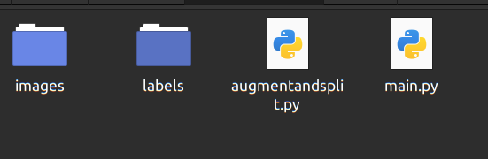
Training and substeps: Preparing Data
First we have to collect images and labe them.
The labeling is done through labelimg tool

Slide 9
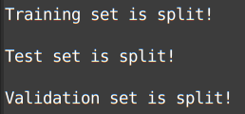
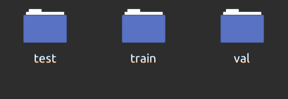
Training and substeps: Auto - Split
Once we got labels and images, the program will run augment and split script.
Split will split the whole data in three different folders (train, val, test)
We can define split ratio, but it is already defined as 0.7 train, 0.2 test 0.1 validation by default
Shell
promt
Data after splitting
Augment will compute some images transformation in order to have at the end different version of the same image
And then it will start augmenting the dataset which is doubling our dataset

Slide 10
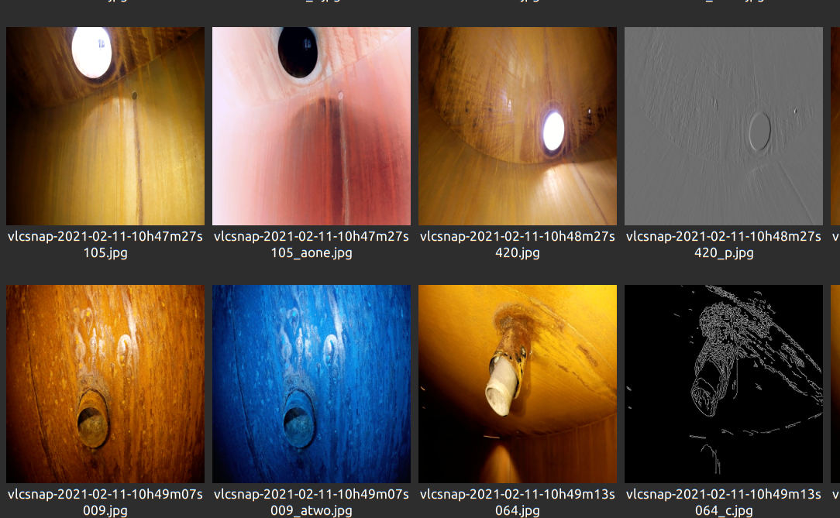

Training and substeps: Auto - Augmentation
When splitting data is done the process automatically augment the training dataset with a random process.
We randomized and weighted augmentation techniques to prevent over-fitting.
It takes approxiamtelty 4 minutes to augment a dataset with 1000 unique images on cloud.
Augmented
Dataset
Shell prompt

Slide 11
Training and substeps: Training w/ new data
Once we prepared our dataset the system will automatically start training on the cloud with our predefined parameters (probabily we won’t need to change them)
All of these processes from collecting new data to train the model are automated.

Slide 12
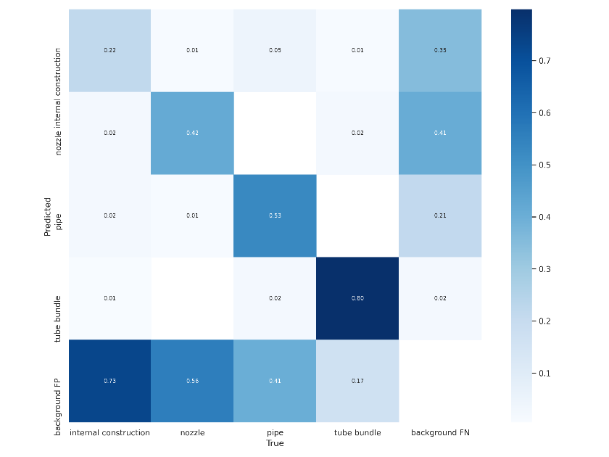
Training and substeps (cntd.): Evaluation
To verify the goodness of the new model, we can check some metrics like:
Mean average accuracy
Precision
Recall
Confusion Matrix
Here we haven’t automated this part yet but every of them except confusion matrix can be automated very quickly because they are only numbers to be checked.
For confusion matrix we will implement a method to read image
To evaluate conf matrix
We need to find ways to read this
Image directly!

Slide 13
Detection
Detection process pipeline
Once we have a model trained to recognize certain objects, we can use this model for processing new videos.

Slide 14
Detection and substeps
With ‘detection’ we mean the capacity to localize interesting objects in the video frame. But we can do more:
We can track objects: meaning that at each object we assign an ID, and as the camera moves and the same object is framed in different positions, that object mantains the same ID. In this way, we obtain at the end of the detection, how many objects of a certain class the model has detected in the video; we are also able to tell to the user in which part of the video those objects have been detected.
We can check image similarity: while the video is processing, the program checks if the frames that he is processing are different than those in the training set; at the end of the detection, the program asks tot he user if he is interested to see and labels those data. In this way, the program uses the the user to improve the model for detection

Slide 15
Detection and substeps (cntd.)
Detection + Tracking + Image similarity are run at the same time.
During the process, the user can stream the results in a Near Real Time (NRT) experience

Slide 16
Detection substeps flow
The program asks to the user to choose which asset to use for running the detection
The program asks the video to process
The program asks to user if it should start detecting in a time different than 0
The program is ready and runs at the same time: detection + tracking + img sim
At the end of video processing, if img sim module has kept some images, the program asks to the user if he wants to see them for labeling
If the user selects yes, the program launches the labeling tool. In automatic the program renders the images with the suggested labels and annotations
END of process
Final video with detected objects
Json files with long and short summary
Suggested images to label

Slide 17
Detection video

Slide 18
Comments
As you can see, the detection starts from inside the storage tank
The video appears not so smooth in some parts, this may be related to the high resolution of the video, that results very heavy to process.
The short json summary reports an extremely high number of nozzles present. This is due to the fact that the same nozzle is recorded in the video multiple times during the entire video. A correct enumeration would be obtained if the single object are framed just once (no 360° turning of camera or turning over)

Slide 19
Processing Time
The whole detection (det + tracking + img similarity) is time consuming
The method in order of time consumption relevance:
method that writes the final video
method that process the frame to output the detection (yolo framework)
The method that checks if the frame of the video is similar to the images of the training set
the method that allows to stream the result of the detection while in execution
The tracking part instead is fast

Slide 20
Processing Time (cntd.)
More in particular, the time required by method that read and write the final video are greatly influenced by the resolution of the video: the highest the resolution, the highest the time to process.

Slide 21
Processing Time (cntd.)
The processing speed really depends on the hardware. In particular, if the machine that runs the detection is GPU enabled, the efficiency of the model is really high:
 | video 3840*2160 w/o GPU | video 3840*2160 w GPU | GPU vs no GPU
detection (10 s) | 108 s | 37 s | 66% faster
detection (5:43 min) | 60 min | 17 min | 70% faster
write | 0,117 s | 0,080 s | 32% faster
read | 0,047 s | 0,020 s | 57% faster
With GPU enabled machines, we can achieve Near Real Time detection, since 1 second of the original video is processed in 2,9 seconds.

Slide 22
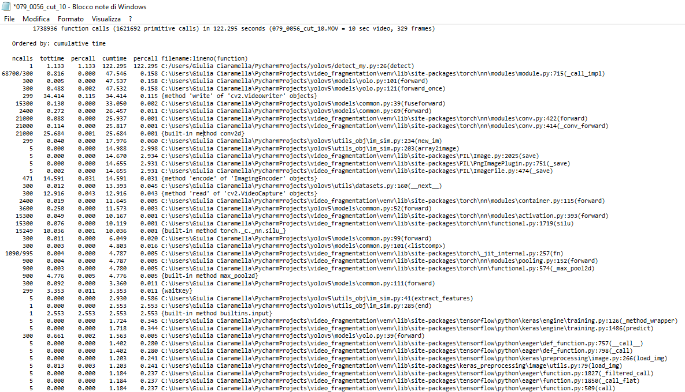
10 seconds video, NO GPU
Initial res
3840*2160 px
Detection res
640*416 px
Detection + tracking + img res
Writing takes 34/122=28% of time
Reading takes 13/122=11% of time
Tracking takes: (0,04+0,04)/122=0,06% of time
Img sim takes: 37/122=30% of time
Tracking takes: (0,813+0,78)/1064=0,15% of time

Slide 23
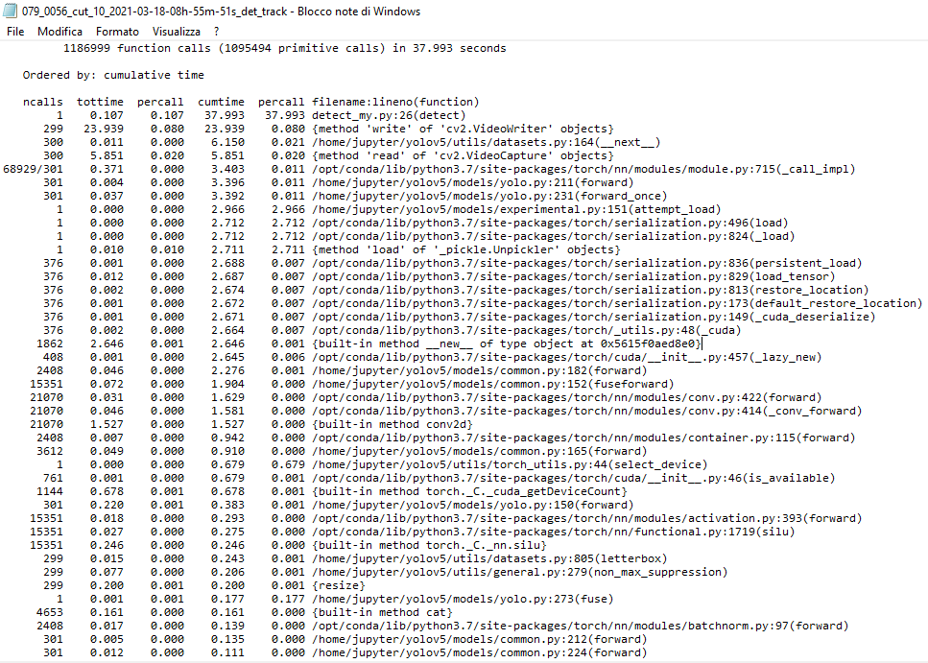
10 seconds video, GPU
Initial res
3840*2160 px
Detection res
640*416 px
VM Detection + tracking
Writing takes 24/38=63% of time
Reading takes 6/38=16% of time
Tracking takes: 0,075/38=0,19% of time

Slide 24
Processing Time – conclusions
There is still something to improve, such as:
The method that measures the image similarity
Indeed for now, it is done by trasnforming the image in a vector through a neural network model (VGG16) but we are going to use the same vector output by yolo during detection. In this way we gain efficiency

Slide 25
Training an old model

Slide 26
Training an old model
Collect new data
Launch training an old model
Evaluate results
Data from past detections are collected in a temporary folder. When a certain condition is met, the program informs the user that the model can be retrained for improvement
User launch training and in automatic, other subprocesses are run: images split and images augmentation

Slide 27
Training an old model – data collection
The images labeled by the inspector after detection are collected in a temporary folder.
When a certain condition is met, the program will ask to the inspector to retrain the model in order to improve it.
The condition to met is the number of new images that can be added to the training set

Slide 28
Training an old model – training step
The training will be done with a technique called ‘freezing layers’ (model fine tuning’). In this way we can partially use the old model, so that the whole process of training will last less.
For this part we still need to do more research in order to find the best parameter

Slide 29
Training an old model: Evaluation
To verify that we got a better model we can check some metrics like:
Mean average accuracy
Precision
Recall
Confusion Matrix
Here we haven’t automated this part yet but every of them except confusion matrix can be automated very quickly because they are only numbers to be checked.
For confusion matrix we will implement a method to read image
To evaluate conf matrix
We need to find ways to read this
Image directly!

