Slide 1
…

Slide 2

Funded by the Horizon 2020 programme
of the European Union
Welcome!
to the
Training on the
Hotmaps database and toolbox
29th June – 17th July 2020, Europe

Slide 3
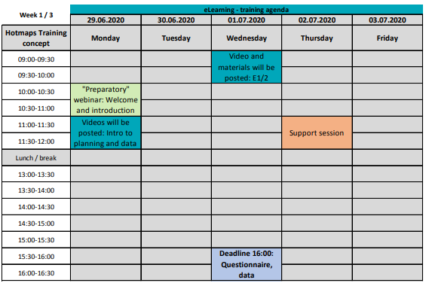

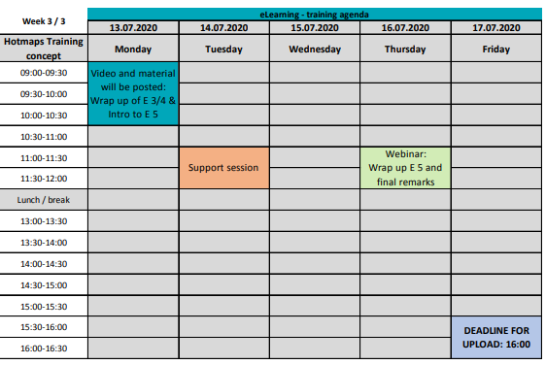
Agenda of the training

Slide 4
Key comments from Support Session
How to change the numbers format in Excel in MAC
Decimal point – dot ‘.’
Thousand indicator – comma ‘,’
Separator – comma ‘,’
https://resrequest.helpspot.com/index.php?pg=kb.page&id=277

Slide 5
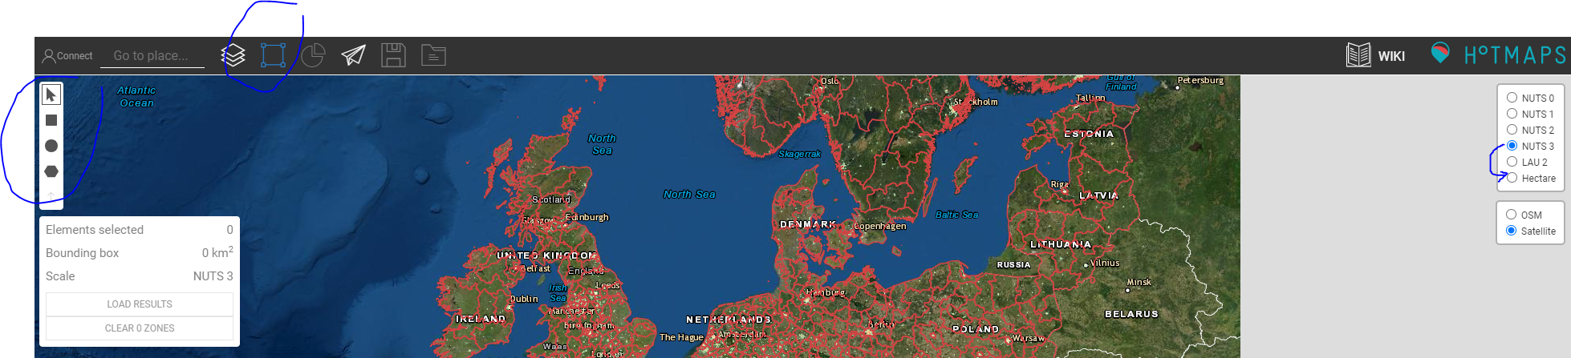
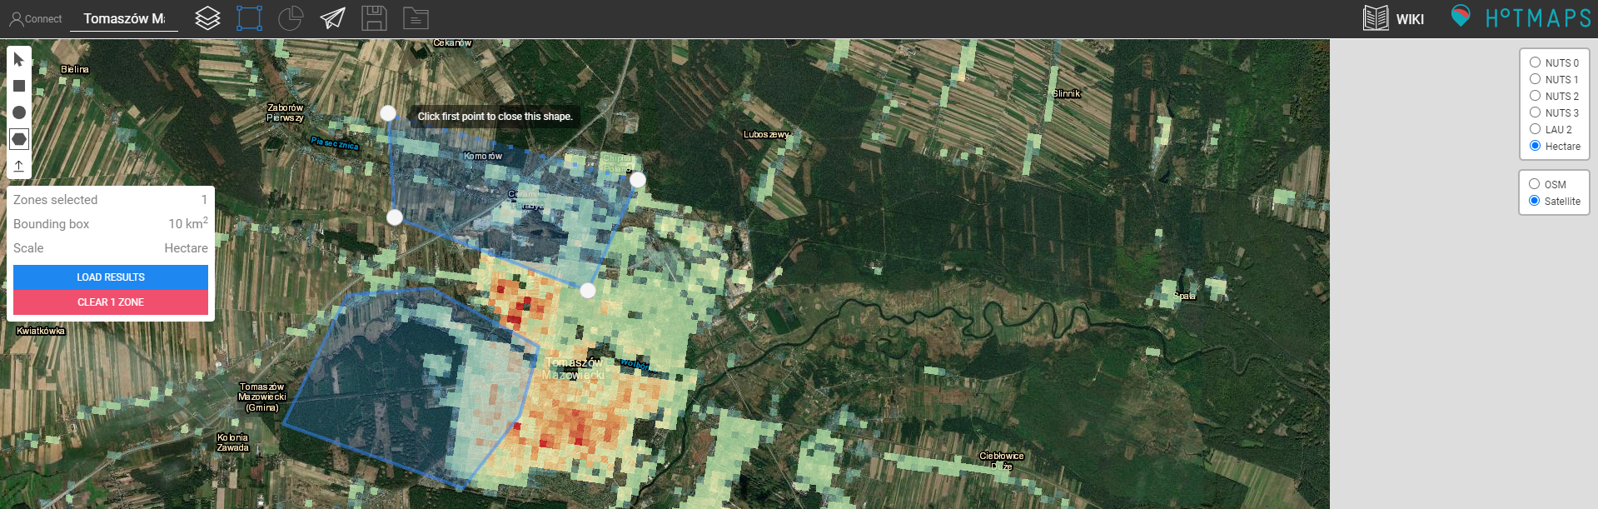
Key comments from Support Session
Personal selection of the area
This can be done only at the Hectare accuracy

Slide 6
Key comments from Support Session
(2.2.3) CM - Decentral heating supply
What price to choose for carbon emission factor
The CO2 price can be chosen randomly. You can look up the current stock price in ETS per tCO2. However, this trading system has repeatedly collapsed, and we currently experience very low prices (around 30€). Many policy makers urge for higher CO2 prices to reflect both a desired market development and a higher ambition in terms of progressively increasing carbon reductions. A typical indicative future price could be 100-250 €/tCO2. You will see later on that the exercise 3.2 uses three CO2 prices: 30€, 50€ and 150€/tCO2, but these are two independent analysis of the CO2 emission costs.

Slide 7
Key comments from Support Session
(2.2.3) CM - Decentral heating supply
How to allocate the share of certain buildings
Having finished the analysis of decentralised (individual) heat supply options per each of a building type these need to be apportioned by how many buildings of a particular type is in the portfolio of the investigated city.
The share should be entered in format of fraction (so for 15% , 0.15 should be entered etc.) and the total of shares needs to end up in 100% (so 1).
A random percentage can be assigned to the different age categories of buildings, depending on which mix better represents the buildings stock in that area.

Slide 8
Key comments from Support Session
(2.2.3) CM - Decentral heating supply
Adapting the average efficiency factor
The average efficiency is used to convert the final energy (fuel consumption) to useful energy (heat production by a energy generation unit to supply needs of the consumer). The energy demand data available in the Hotmaps is the final energy, hence this needs to be converted to the useful energy as this is what we need to know when designing the alternative heat supply options and DH system.
For future projects: If case the measured heat consumption data are available, the average efficiency (cell b110 ) needs to be set to 1.0 so that would not unwittingly modify the already useful consumption.

Slide 9
Key comments from Support Session
(3.2) CM - District heating supply dispatch
Difference between ‘Dispatch’ and ‘Invest’ mode
Dispatch Mode: this mode is used, when a power plant fleet is planned/installed (known installed power and running costs) so is the heat demand; What is to be examined is which power plant can supply the demand in a cheapest possible way (running costs). So the toolbox runs the cost optimisation only for the operation strategy (when to run which unit to produce the cheapest heat). The condition here is to insert enough capacity to cover the peak demand!
Invest Mode: this mode is used, when we want the tool to optimise both, the operation strategy and the installed capacity. So we can even leave the input capacities as 0MW so the toolbox proposes the fleet that should be most cost-effective. We can of course insert some technologies ourselves if for example some unit is already planned to be installed (e.g. we have a waste incineration plant in the proximity that can connect to DH and cover base heat load). The remaining units will be then calculated by the toolbox. The overall capacity of technologies we insert should not exceed the peak demand as the toolbox is not able to reduce the MWs!

Slide 10
Key comments from Support Session
(3.2) CM - District heating supply dispatch
Problem with uploading own heat demand layer
Due to technical issues, the layer uploading functionality was not unavailable in the production environment (PROD). As a temporary solution, it was suggested to move to the development environment (DEV) (https://www.hotmapsdev.hevs.ch/map).

Slide 11
Key comments from Support Session
(3.2) CM - District heating supply dispatch
Errors when running the CM
Following the change from the production server (PROD) to the development server (DEV), the CM generated some errors based on the inserted input parameters from Exercise 3.2. This it due to a discrepancy between energy and cost units on the two servers.
The adjusted spreadsheet file for Exercises 3 and 4 was issued.

Slide 12
Key comments from Support Session
(5) Scenario assessment Exercise 5
Discrepancy in units
Following the issue of the adjusted spreadsheet file for Exercises 3 and 4, a discrepancy in units occurred in the final spreadsheet. This is because Ex.5 combines the results from the previous calculations including 3.2. which was previously altered.
The adjusted spreadsheet file for Exercises 5 was issued.

Slide 13
Exercise 5 – Wrap-up
E1
E2
Transfer of results from the CMs for selected scenarios
Energy Mapping
CM –
Decentral heating supply
E5
SS – CM in/out
SS – Scenario assessment
E2
E4
CM –
Demand projection
CM –
DH potential - economic assessment
Indicators for overall city scenarios
Copy results to respective sheets, or find further information in SS
Use the resulting Heat & floor area density maps 2050
E4
CM –
DH potential – user-defined thresholds
E3
CM –
DH supply dispatch
E3
Optional
CM … Calculation Module
DH … District Heating
SS … Spread Sheet
CM –
Scale Heat and Cool density maps
CM –
Excess heat transport potential
Make a heat density layer reflecting DH demand with the CM
Results already taken into account in the given input values

Slide 14
Scenario Assessment - Interpretation
Presented directly in the Excel spreadsheet

Slide 15
More to analyse
Sensitivity of DH expansion:
Market shares (start / end of period)
Savings in heat demand in the area
Thresholds of average supply costs
Sensitivity of DH supply portfolia:
More portfolia that might be relevant for the area
Energy carrier price developments (especially biomass, electricity and excess heat)
CO2 prices
Sensitivity of decentral supply:
Split of technologies in the different buildings
CO2 prices?
Costs of heat savings:
Include the costs of renovation
Analyse different saving levels for the entire city

Slide 16
Zentrum f. Energiewirtschaft und Umwelt (e-think)
hummel@e-think.ac.at

