Slide 1


ECG signal conditioning by morphological filtering
Biomedical Signal Processing – Unimi Giulia Cuttone

Slide 2

Introduction
Clinically obtained electrocardiographic (ECG) signals are often contaminated with different types of noise and baseline drifting commonly occurs.
A modified morphological filtering (MMF) technique is used for signal conditioning in order to accomplish baseline correction and noise suppression with minimum signal distortion.

Slide 3
Mathematical Morphology
Mathematical morphology (MM) provides an approach to the development of non-linear signal processing methods.
The shape information of a signal can be extracted by using a structuring element to operate on the signal.

Slide 4
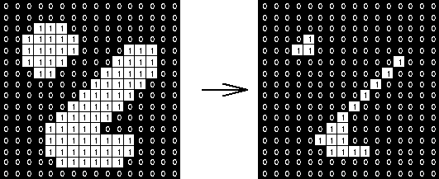
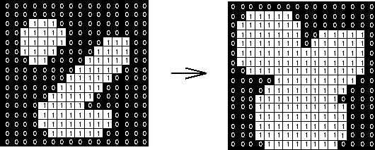
There are two basic morphological operators:
Erosion: removes pixels on object boundaries.
Dilatation:
adds pixels on the object boundaries.

Slide 5
Proposed MMF algorithm for ECG signal conditioning
Original ECG signal (Input)
Add Noise
Baseline Drift signal
Baseline corrected signal
Noise suppression
ECG signal after conditioning (output)

Slide 6
Data extraction
The ECG signals were extracted from MIT–BIH arrhythmia database (physionet.org)
License (for files): Open Data Commons Attribution License v1.0

Slide 7
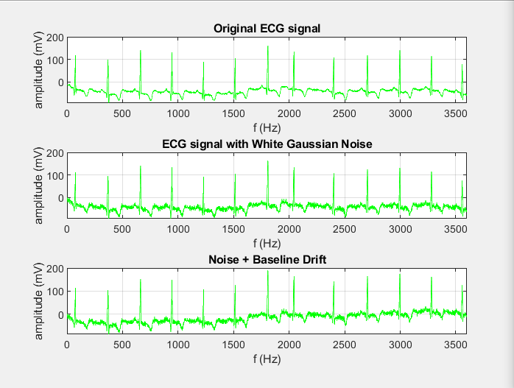
Signal corrupted by adding noise and baseline drift
Baseline drift is simulated by adding a slanted line to a sinusoidal signal

Slide 8
Baseline correction
The correction of baseline is performed by removing the drift in background from the original ECG signal.
It follows Chu’s method
The signal is first opened by a structuring element Bo for removing peaks in the signal.
Than the resultant waveforms with pits are removed by a closing operation using the other structuring element Bc.
The final result is then an estimate of the baseline drift f.
The correction of the baseline is then done by subtracting f from the original signal.

Slide 9
Noise suppression
After baseline correction, noise suppression is performed by processing the data through an opening and a closing operation concurrently.
Then the results are averaged.
Erosion
Dilatation
Opening operation
Dilatation
Erosion
Closing operation
The operations use a structuring element pair​ Bpair = {B1, B2}​ where B1 is different from B2

Slide 10
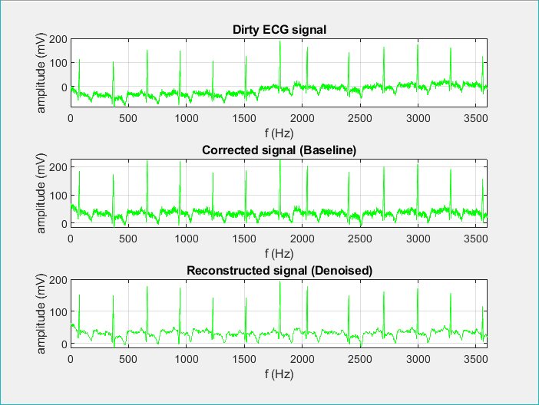
Application of MMF Algorithm

Slide 11

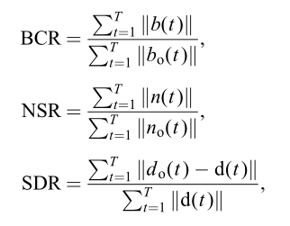
Performance evaluation of signal conditioning
Three parameters are used for algorithm evaluation: - the baseline-correction ratio (BCR), - the noise-suppression ratio (NSR), - and the signal-distortion ratio (SDR)

