Slide 1


ECG signal conditioning by morphological filtering
Biomedical Signal Processing – Unimi Giulia Cuttone

Slide 2

Introduction
Clinically obtained electrocardiographic (ECG) signals are often contaminated with different types of noise and baseline drifting commonly occurs.
A modified morphological filtering (MMF) technique is used for signal conditioning in order to accomplish baseline correction and noise suppression with minimum signal distortion.

Slide 3
Mathematical Morphology
Mathematical morphology (MM) provides an approach to the development of non-linear signal processing methods.
The shape information of a signal can be extracted by using a structuring element to operate on the signal.

Slide 4
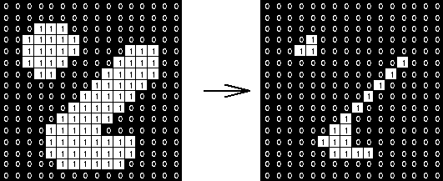
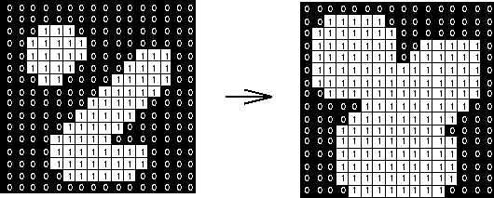
There are two basic morphological operators:
Erosion: removes pixels on object boundaries.
Dilatation:
adds pixels on the object boundaries.

Slide 5
Proposed MMF algorithm for ECG signal conditioning
Corrupted ECG signal (input)
Baseline corrected signal
Noise suppression
ECG signal after conditioning (output)

Slide 6
Algorithm testing using simulated data
The performance of the algorithm could be evaluated by starting with a known signal, corrupting it by adding noise and baseline drift.
Input
Signal
Noise
BaselineDrift
Noise is modelled by a mixture of Gaussian noise.​
Baseline drift is simulated by adding a slanted line to a sinusoidal signal.

Slide 7
Data extraction
The ECG signals were extracted from MIT–BIH arrhythmia database (physionet.org)
License (for files): Open Data Commons Attribution License v1.0

Slide 8
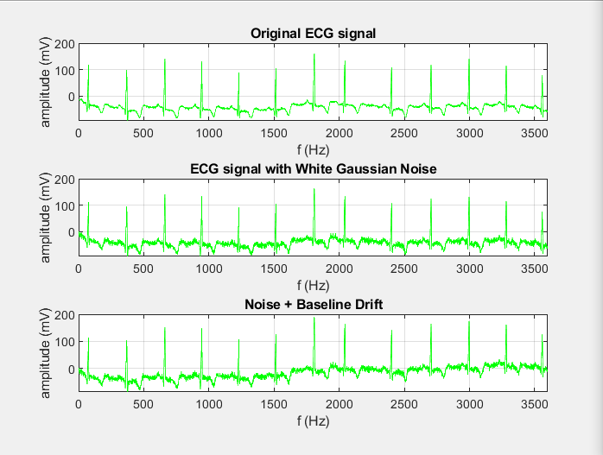
Signal corrupted by adding noise and baseline drift

Slide 9
Baseline correction
The correction of baseline is performed by removing the drift in background from the original ECG signal.
It follows Chu’s method
Bo and Bc are selected as two horizontal line segments of zero amplitude, but with different lengths
The signal is first opened by a structuring element Bo for removing peaks in the signal.
Than the resultant waveforms with pits are removed by a closing operation using the other structuring element Bc.
The final result is then an estimate of the baseline drift f.
The correction of the baseline is then done by subtracting f from the original signal.

Slide 10
Noise suppression
After baseline correction, noise suppression is performed by processing the data through an opening and a closing operation concurrently.
Then the results are averaged.
Erosion
Dilatation
Opening operation
The operations use a structuring element pair​ Bpair = {B1, B2}​ where B1 is different from B2
Dilatation
Erosion
Closing operation

Slide 11
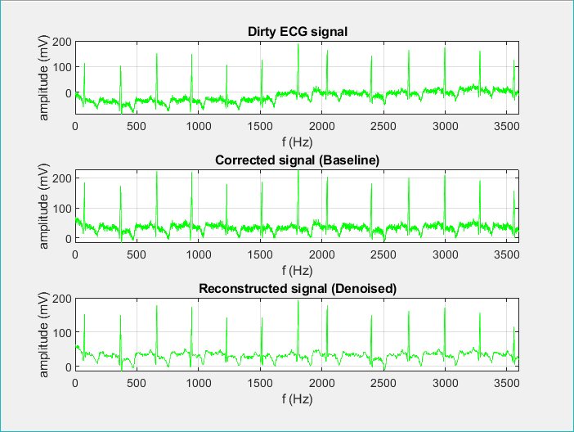
Application of MMF Algorithm

Slide 12

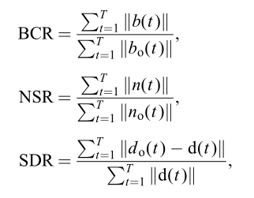
Performance evaluation of signal conditioning
Three parameters are used for algorithm evaluation: - the baseline-correction ratio (BCR), - the noise-suppression ratio (NSR), - and the signal-distortion ratio (SDR)

Slide 13


BCR, NSR and SDR for performance evaluation of signal conditioning
A = 0.8 mV; N = 60; maxDrift = 50; snr = 20
A = 0.2 mV; N = 40; maxDrift = 40; snr = 30

Slide 14
Conclusions
The MMF algorithm can retain the significant characteristic waves and intervals in the ECG signal
which is more important for subsequent processing, such as the ECG characteristic wave or interval detection, or arrhythmia recognition.

