Slide 1


Accelerometer-based Respiratory Rate and Heart Rate Detection
Project by Giulia Demme, 60161A

Slide 2

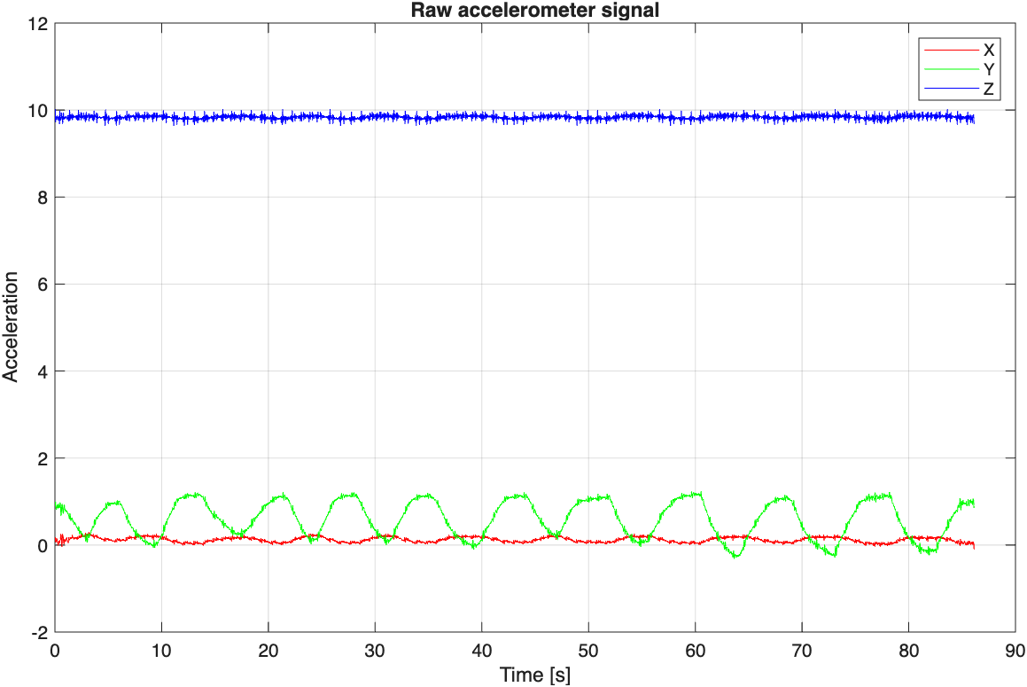
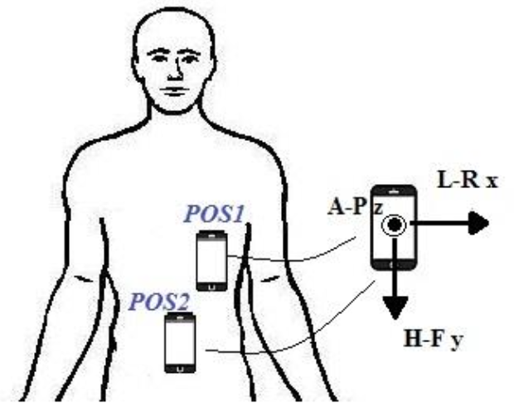

Overview
Dataset
Motivation & Objective
Respiratory and Heart Rate are key vital signs
Simple estimation using a smartphone’s triaxial accelerometer
Non-invasive monitoring
Subjects
3 healthy subjects
Acquisitions
5 recordings per subject
Total: 15 recordings
Breathing conditions
5 breathing conditions:
Spontaneous breathing
Slow breathing
Fast breathing
Breathing with apnea
Breathing with small movement
Experimental Setup
iPhone 15 accelerometer (~100 Hz, Phyphox app)
Subject in supine position, smartphone on chest POS1
Spontaneous breathing +
Controlled breathing at predefined frequencies
Respiration Rate Estimate
Heart Rate Estimate
../data/person2/person2_spontaneous.csv

Slide 3
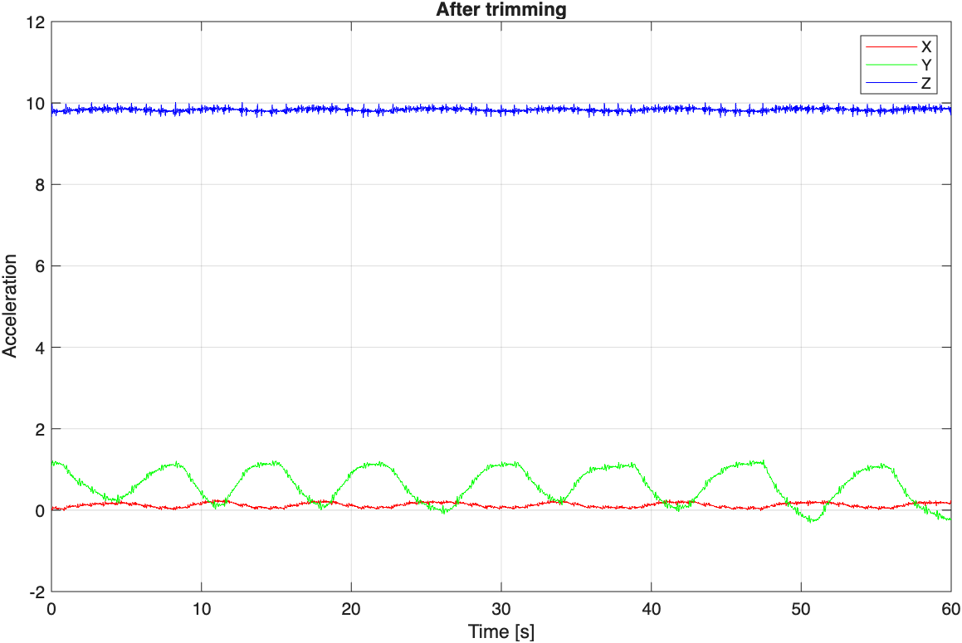
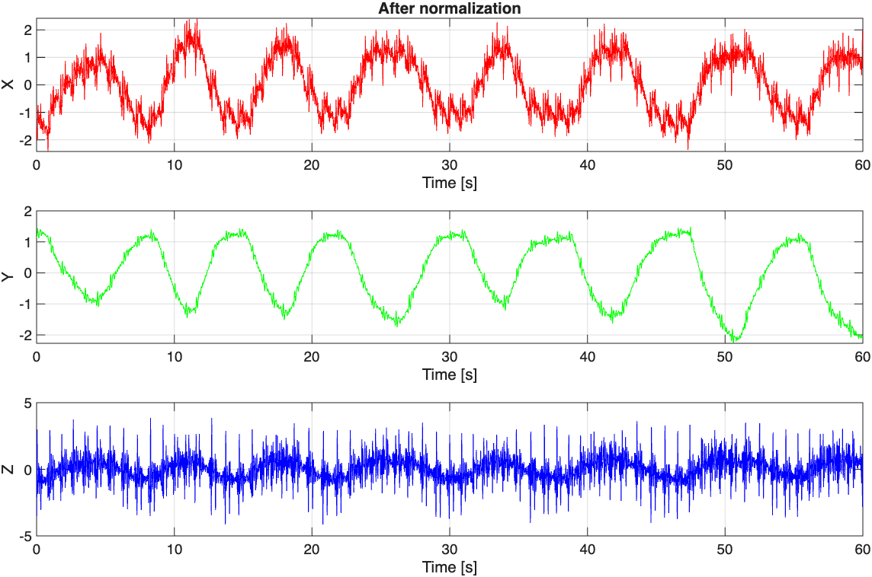

Preprocessing
Format
Triaxial accelerometric signal (3xN)
Estimated fs
≈ 99.7 Hz
Raw accelerometric signal
Trimming
Normalization
Characteristics
Different offsets and amplitudes across axes
Z axis dominated by gravity
Start/end transients
Characteristics
Fixed 60s window
60s * 99.7Hz = 5982 samples
Central segment of the recording
Removes start/end artifacts
Characteristics
Subtract the mean, divide by standard deviation
Puts axes on the same scale

Slide 4
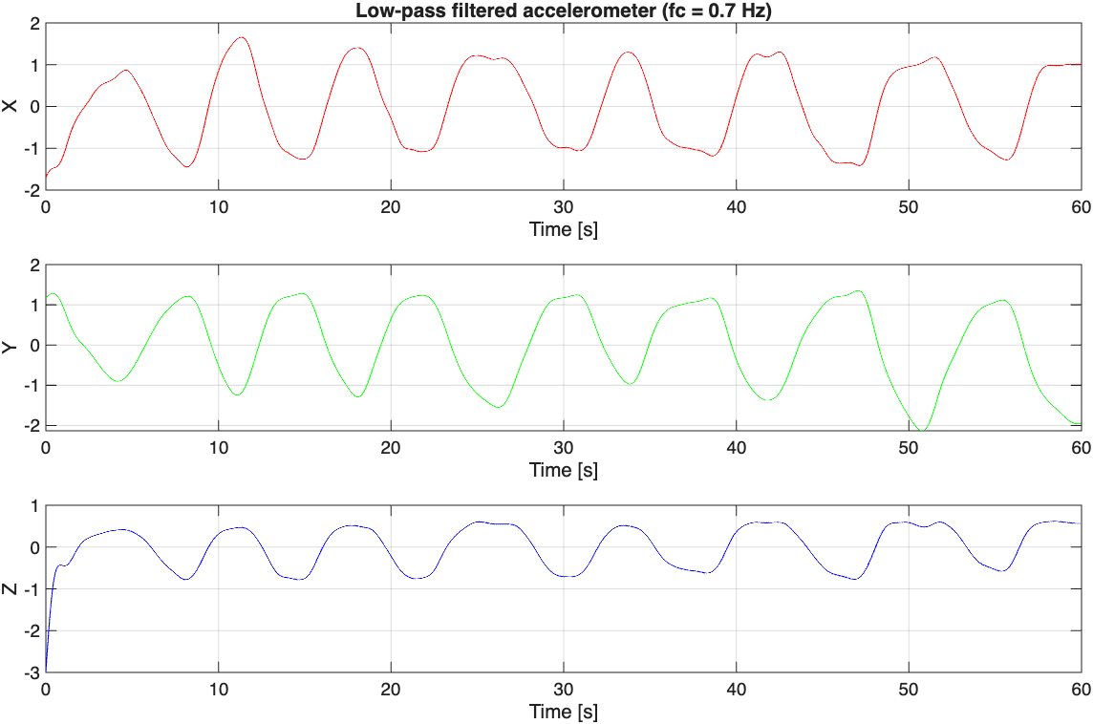
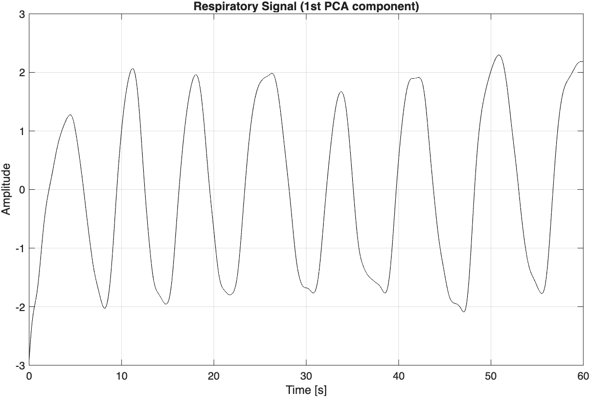
Respiration Rate Detection
Pipeline
Low-pass filter → PCA → Time-domain analysis – Autocorrelation → RR
→ Frequency-domain analysis – Power Spectral Density → Periodogram → RR
→ Welch → RR
Low-pass filter
Respiration is a low-frequency process (typical range: 0.1 – 0.7 Hz, 6 – 42 breaths/min)
4th-order Butterworth low-pass
Zero-phase filtering (filtfilt)
Low-pass filtering
(fc=0.7 Hz)
3x5982 signal
3x5982 signal
PCA
Respiration spread across X, Y, Z axes
PCA combines axes into a single dominant component
PC1 captures maximum shared motion
PCA
3x5982 signal
1x5982 signal
Giulia Demme UNIVERSITA’ DEGLI STUDI DI MILANO

Slide 5
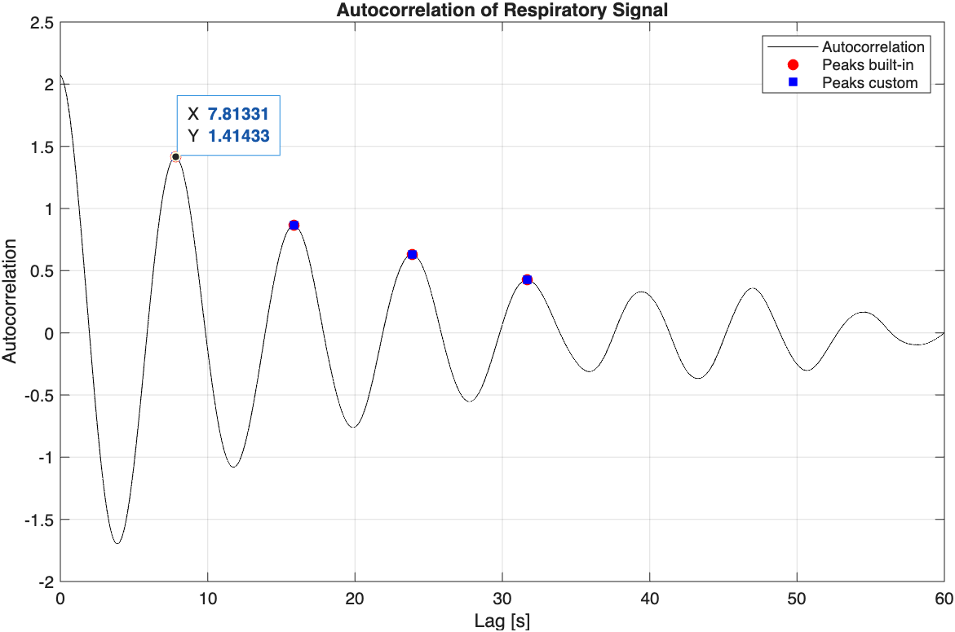
Respiration Rate Detection
Pipeline
Low-pass filter → PCA → Time-domain analysis – Autocorrelation → RR
→ Frequency-domain analysis – Power Spectral Density → Periodogram → RR
→ Welch → RR
Time-domain analysis – Autocorrelation
Autocorrelation
Computed on PCA respiratory signal
Lag 0 discarded (trivial maximum)
Periodic peaks correspond to respiration cycle
2. Peak detection
First non-zero peak → fundamental period
R 1x5981
my_findpeaks
1x5982 signal
my_autocorrelation
lags 1x5981
peaks
locs
Respiratory Rate
Detect the period T of the first peak locs(1)
→ RR = 60 / T
../data/person2/person2_normal.csv
First peak in seconds: 7.8s
in samples: 779
RR: 7.68 breaths/min

Slide 6
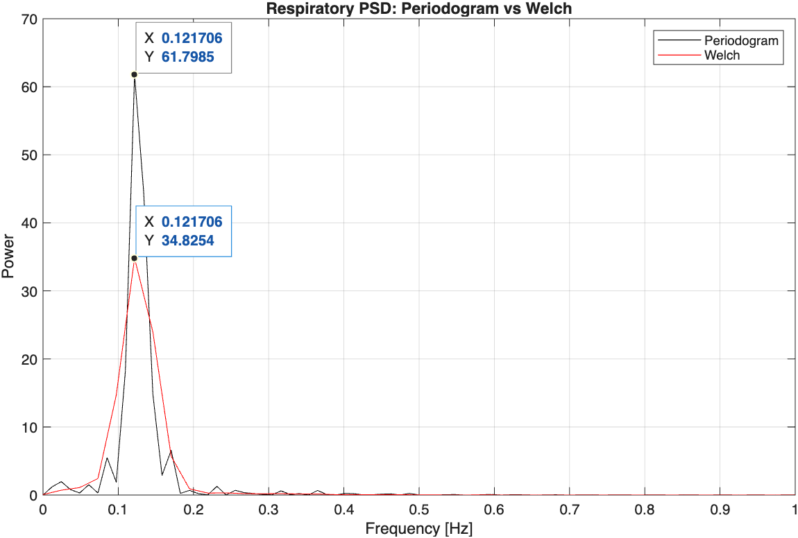
Respiration Rate Detection
Pipeline
Low-pass filter → PCA → Time-domain analysis – Autocorrelation → RR
→ Frequency-domain analysis – Power Spectral Density → Periodogram → RR
→ Welch → RR
Frequency-domain analysis – Power Spectral Density
PSD estimation
Periodogram: high resolution, higher variance
Welch: averaged segments, smoother spectrum
Search band: 0.05 – 0.7 Hz (equivalent to 3-42 breaths/min)
3. Find dominant frequency inside the band f_{resp}
periodogram
f_{dom_per}
1x5982 signal
Band 0.05-0.7 Hz
pwelch
f_{dom_welch}
Respiratory Rate
../data/person2/person2_normal.csv
Frequency of maximum PSD: 0.12 Hz
→ RR: 7.30 breaths/min
4. RR = 60 * f_{resp}

Slide 7
Respiration Rate Detection Results
Pipeline
Low-pass filter → PCA → Time-domain analysis – Autocorrelation → RR
→ Frequency-domain analysis – Power Spectral Density → Periodogram → RR
→ Welch → RR
CBP
People | Slow | Fast | Spontaneous | Apnea | Movements
Person 1 | 6.09 / 5.84 / 6 | 14.88 / 14.60 / 15 | 3.70 / 3.65 | 7.30 / 5.84 | 31.65 / 5.11 / 4.38
Person 2 | 7.58 / 7.30 / 7.5 | 14.92 / 14.60 / 15 | 7.68 / 7.30 | Nan / 3.65 / 4.38 | 17.49 / 17.52 / 17.52
Person 3 | 4.85 / 4.38 / 5 | 30.36 / 29.93 / 30 | 13.00 / 13.14 | 14.8 / Nan / 13.14 | 16.34 / 9.49 / 16.06
Values shown as: Autocorrelation / PSD / Reference
Values shown as: Autocorrelation / PSD or
Autocorrelation / Periodogram / Welch

Slide 8
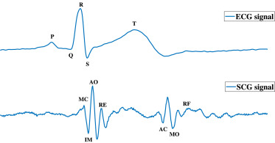
Heart Rate Detection
7/13
SCG signal (seismocardiography)
Mechanical vibrations of the chest wall
Measured by accelerometer
Each heart-beat → characteristic vibration pattern
IVC: low amplitude, noise-sensitive
AO: strong and repeatable peak
AC: smaller and more variable
Beat-to-beat interval → heart rate
Pipeline
Band-pass filter → Find peaks → Build template → Compute cross-correlation → HR

Slide 9
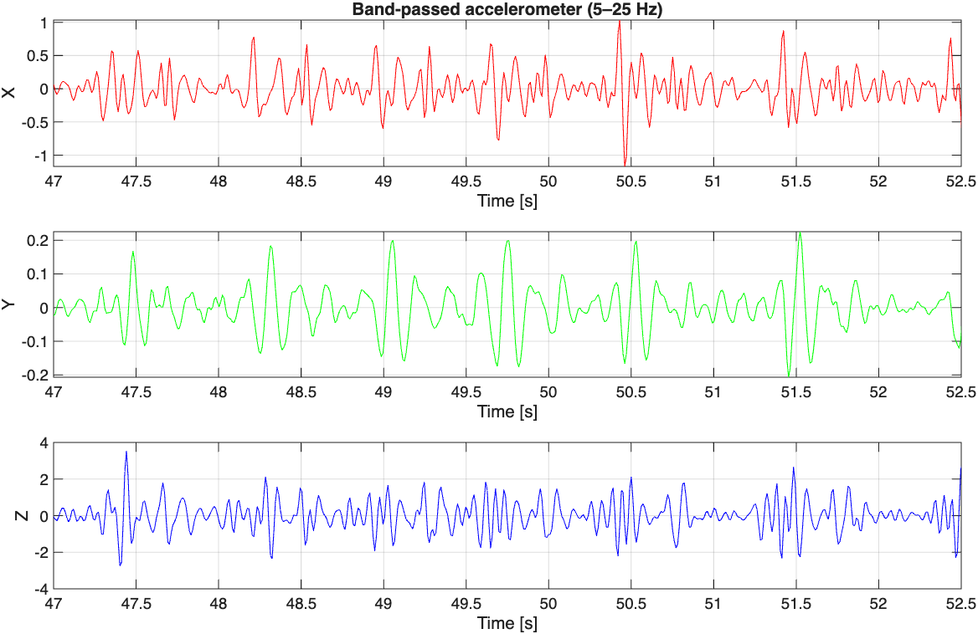
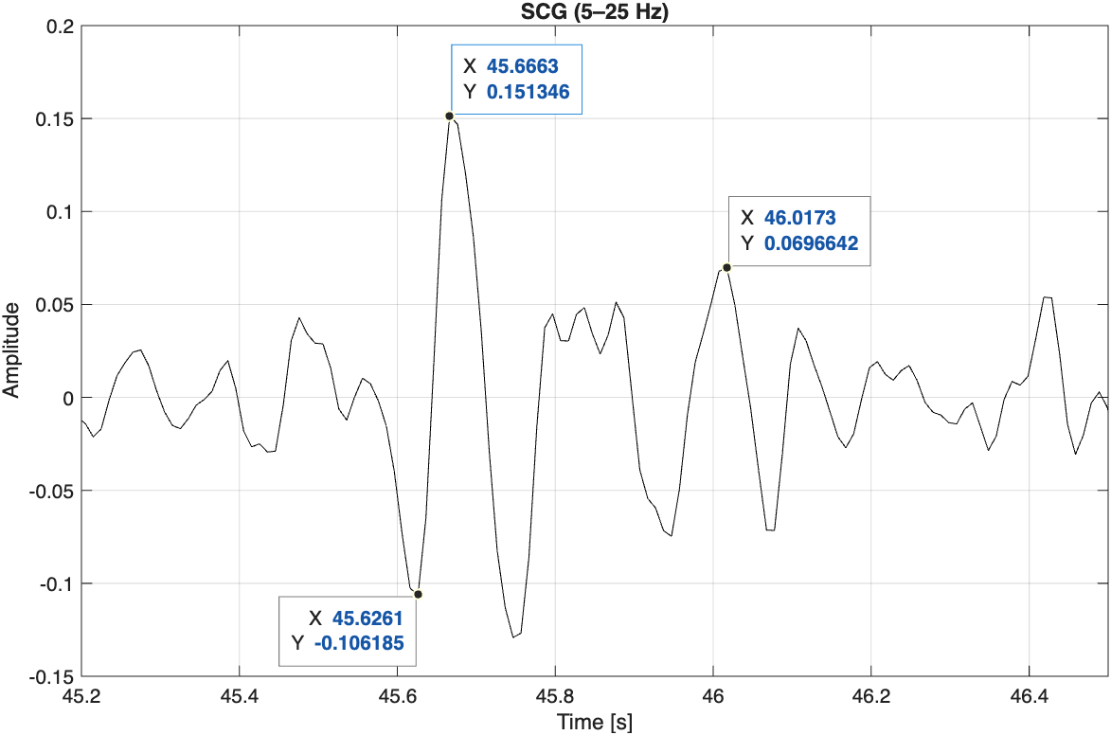
Heart Rate Detection
8/13
Pipeline
Band-pass filter & axis choice
Band-pass filter → Find peaks → Build template → Compute cross-correlation → HR
In this case, the most informative axis is Y
AO
AC
IVC
Band-pass filter design
Butterworth band-pass 5-25 Hz
Removes respiration/motion (<5 Hz)
Removes high-frequency noise (>25 Hz)
Filter X, Y, Z and visually compare
Choose (MANUALLY) the axis with clearest SCG morphology (AO peaks)

Slide 10
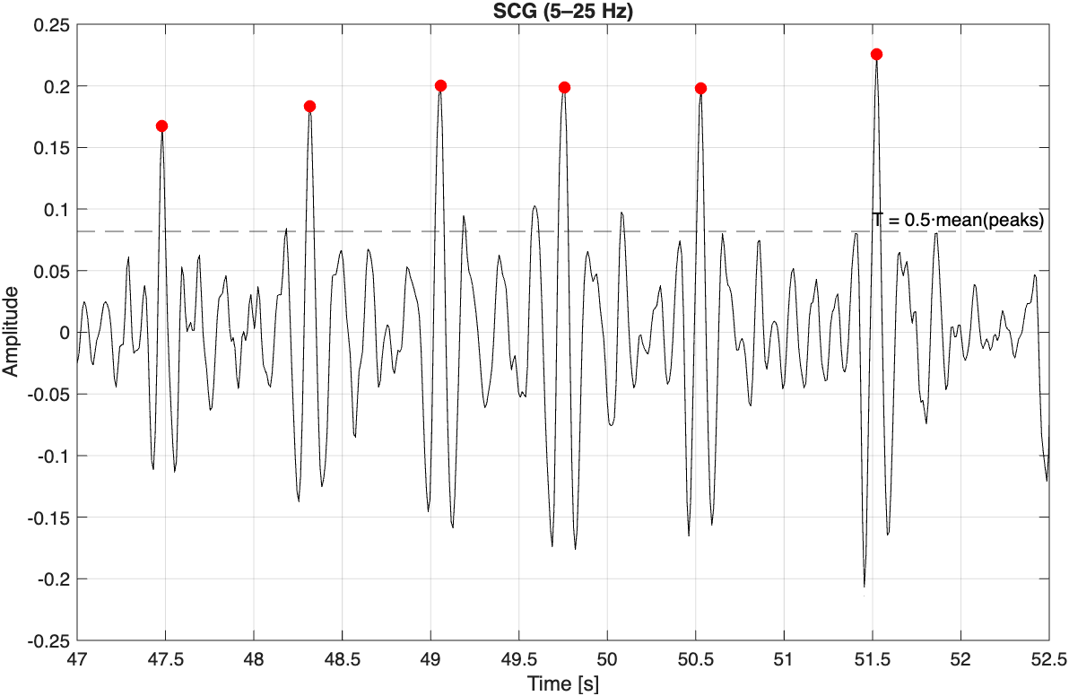
Heart Rate Detection
9/13
Pipeline
Find peaks
Band-pass filter → Find peaks → Build template → Compute cross-correlation → HR
Goal: Detect candidate AO peaks on SCG
SCG (1x5982)
Physiological constraint
maxHR → minPeakDistance
120 bpm → 50 samples
Find peaks
peaks
locs
Threshold T
Keep peaks > T

Slide 11
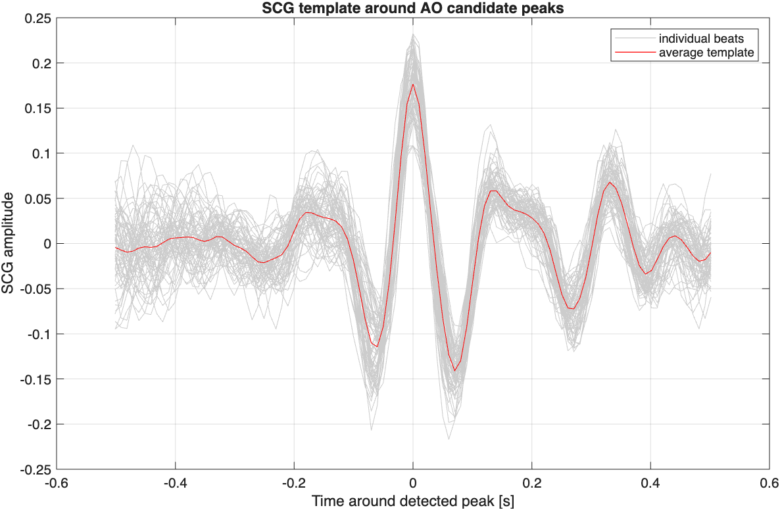
Heart Rate Detection
10/13
Pipeline
Build template & Compute cross-correlation
Band-pass filter → Find peaks → Build template → Compute cross-correlation → HR
peaks
Goal: Peak detection produces false positives
Validate peaks using morphology consistency
Template construction
Extract a fixed window around each candidate peak
Average windows → SCG template
template
Compare each beat segment with the template
Correct AO peak → best match at lag ≈ 0
Cross-correlation
Keep peaks if |lag| < 30 ms

Slide 12
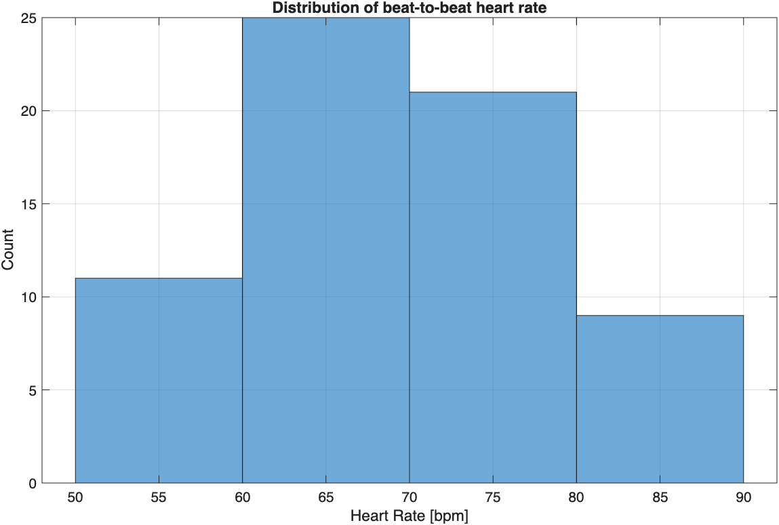
Heart Rate Detection
11/13
Pipeline
Band-pass filter → Find peaks → Build template → Compute cross-correlation → HR
Compute Heart Rate
AO-AO interval → cardiac period
Instantaneous HR → 60 / AO-AO interval
Mean HR → mean of instantaneous HR
Goal: Estimate Heart Rate

Slide 13
Heart Rate Detection Results
Pipeline
Band-pass filter → Find peaks → Build template → Compute cross-correlation → HR
People | Slow | Fast | Spontaneous | Apnea | Movements
Person 1 | Z axis 76.71 bpm | Z axis 74.04 bpm | Z axis 75.57 bpm | Z axis 78.77 bpm | Z axis 73.56 bpm
Person 2 | Z axis 68.71 bpm | Z axis 66.79 bpm | Z axis 69.36 bpm | Z axis 68.06 bpm | Z axis 70.86 bpm
Person 3 | Z axis 71.29 bpm | Z axis 80.72 bpm | Z axis 71.44 bpm | Z axis 71.17 bpm | Z axis 76.14 bpm
Values shown as: Most informative axis / HR

Slide 14
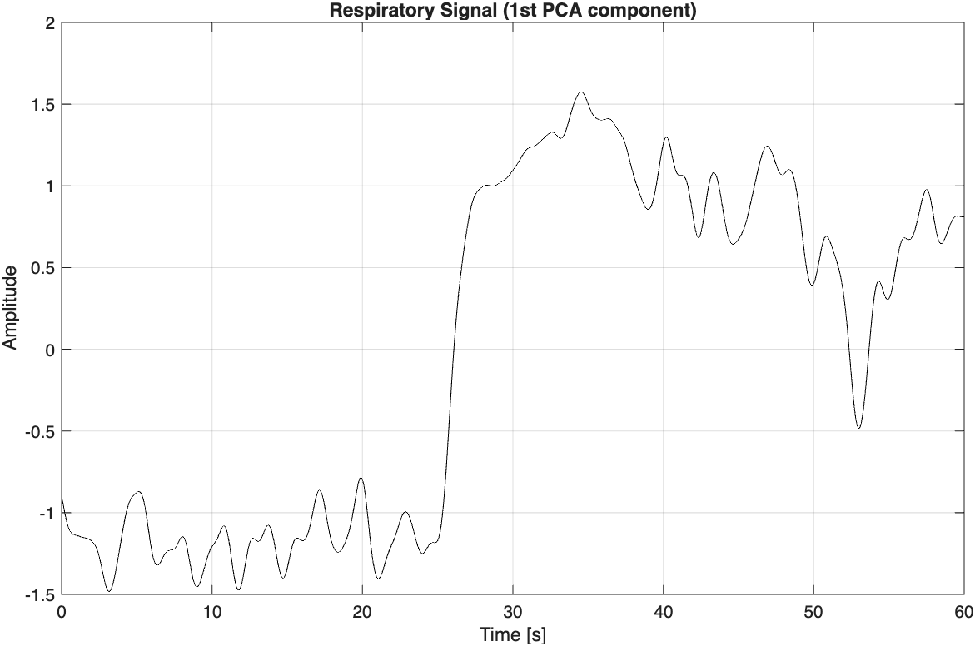
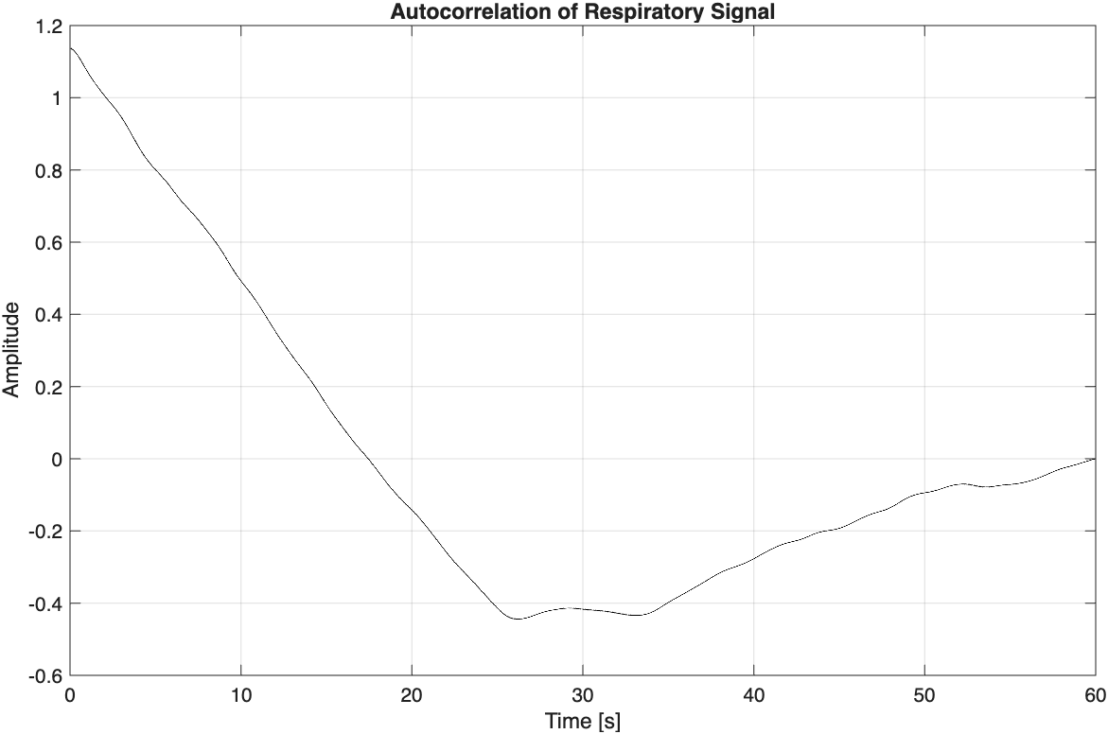
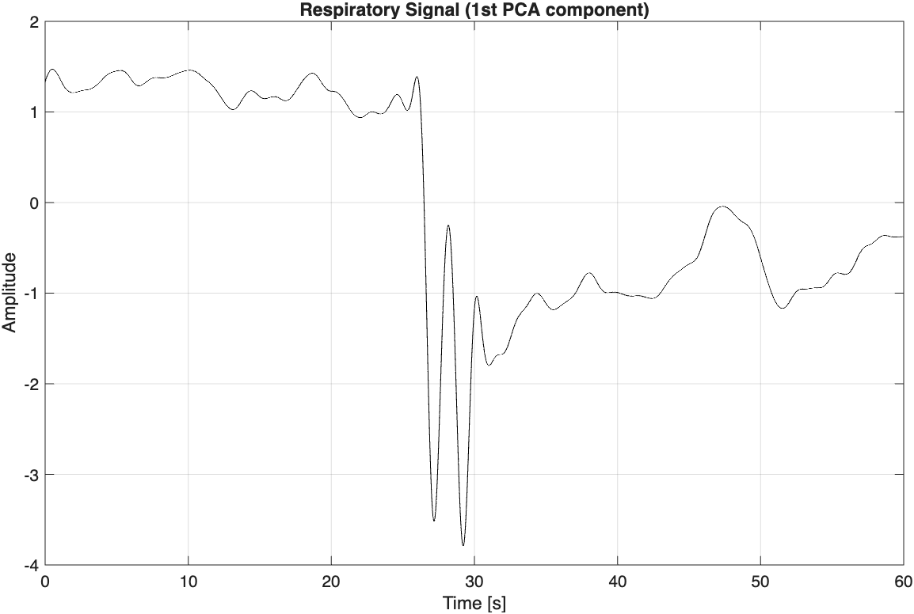
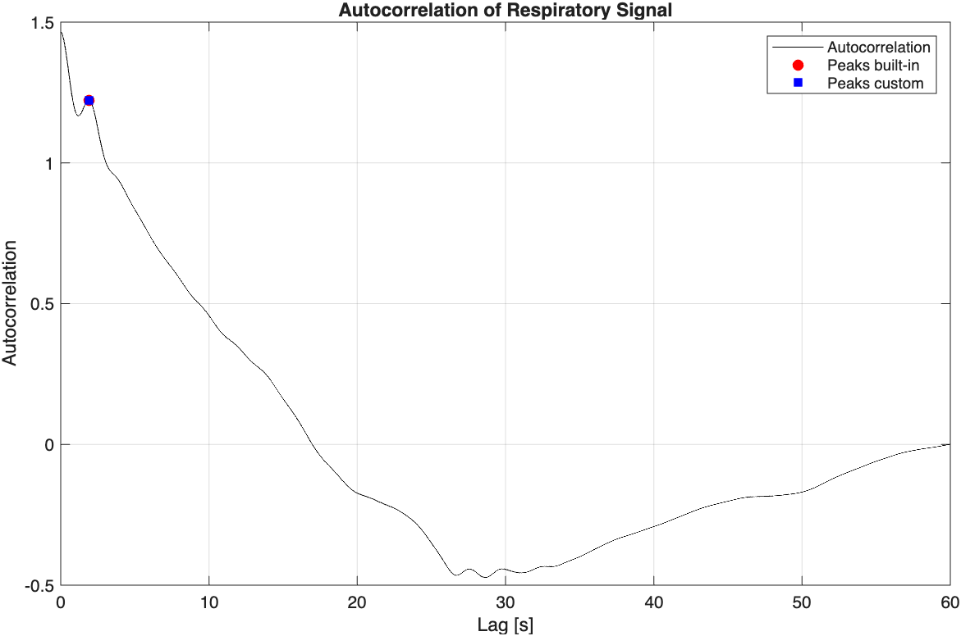
Apnea & Movements – Limitations
../data/person2/person2_apnea.csv
apnea
No peaks
Apnea
No respiratory periodicity
RR undefined
HR estimation remains stable
../data/person1/person1_movements.csv
movement
False RR ≈ 31 bpm
Movements
Spurious periodicity
False RR estimates
HR robust to moderate motion

Slide 15

Thank you
https://github.com/GiuliaDemme/accelerometer-based-rr-hr-estimate

