Slide 1
Bulk RNA-Seq project
Genomics and Transcriptomics course
AY 2021-2022
Giulia Fois

Slide 2
Introduction
The three tissues my analysis was based on are Brain, Liver and Lung. The first sample I evaluated the quality of was the 11th, and I iterated the procedure until I found three «good enough» samples to be my replicates for the three tissues.
Some statistics about my datasets:
Tissue | Male samples | Female samples
Brain | 2095 | 836
Liver | 176 | 75
Lung | 442 | 213
Age / Tissue | Brain | Liver | Lung
20-29 | 93 | 8 | 40
30-39 | 71 | 19 | 44
40-49 | 274 | 44 | 113
50-59 | 863 | 89 | 219
60-69 | 1456 | 85 | 217
70-79 | 174 | 6 | 22
Tissue | Number of samples
Brain | 2931
Liver | 251
Lung | 655

Slide 3
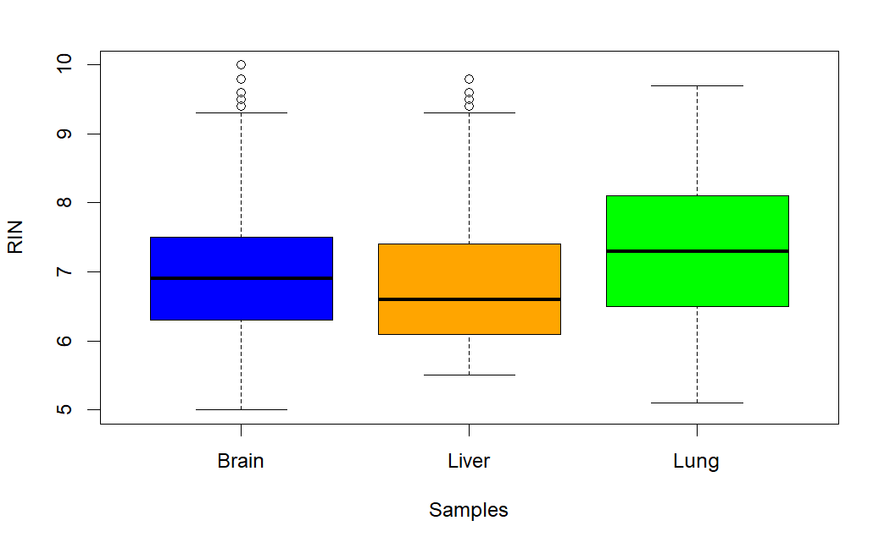
Quality control RIN
I discarded samples having RIN score < 7

Slide 4
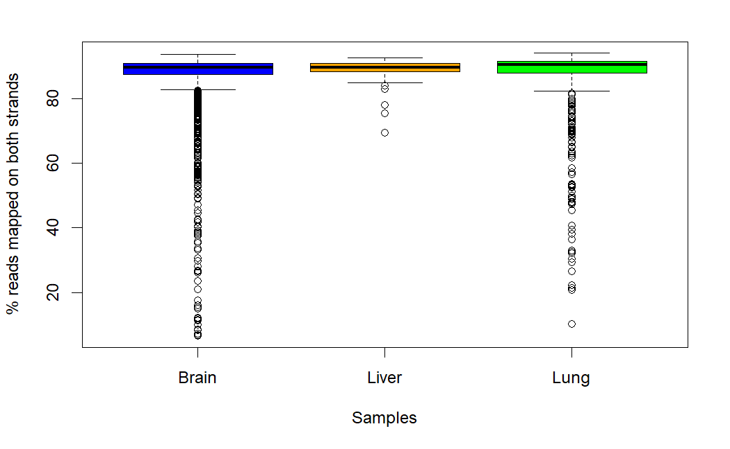
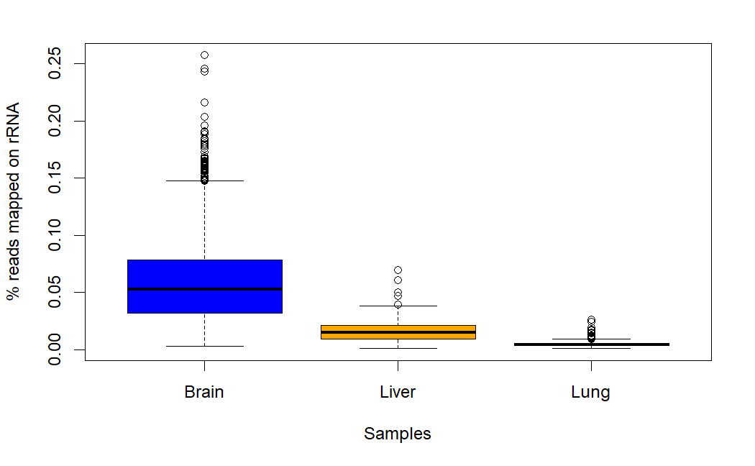
Quality control Reads mapped unambiguously on both strands and reads mapped on rRNA
I discarded samples having
% reads mapped unambiguously
on both strands < 85%
I discarded samples having % reads mapped on rRNA > 10%

Slide 5
Sample selection and filtering
I chose the samples by applying the quality control parameters explained in the previous slides
I also filtered out genes located outside of canonical chromosomes, and genes having 0 counts in all the 9 columns, and genes having really low count values
The following table summarizes the three replicates retrieved for each tissue
 | Brain |  |  | Liver |  |  | Lung
Sample n° | 12 | 13 | 15 | 11 | 12 | 14 | 11 | 14 | 15
RIN | 7.5 | 7.1 | 8.1 | 8.2 | 8.5 | 7.3 | 7.7 | 7.9 | 7.2
% mapped reads | 91.3% | 89.8% | 92.1% | 89.1% | 90.7% | 89.2% | 90.6% | 91.6% | 92.2%
% reads on rRNA | 1% | 5% | 2% | 0.9% | 0.9% | 0.7% | 0.3% | 0.2% | 0.3%

Slide 6
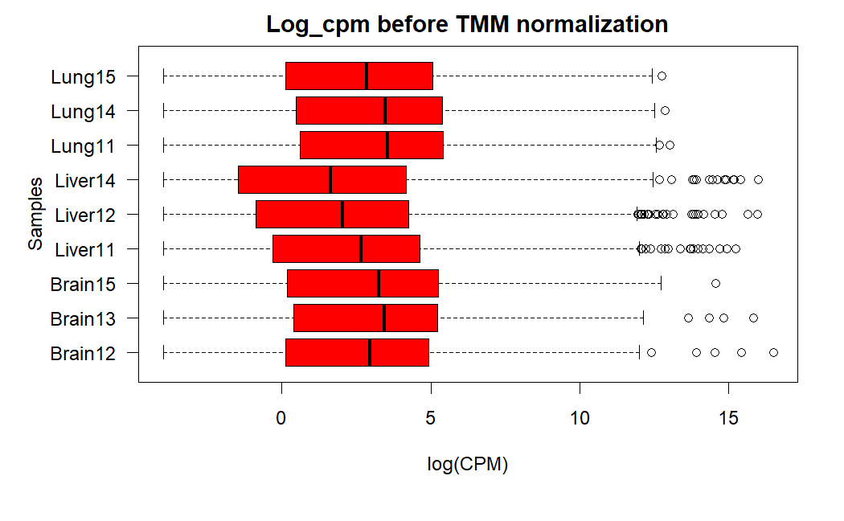
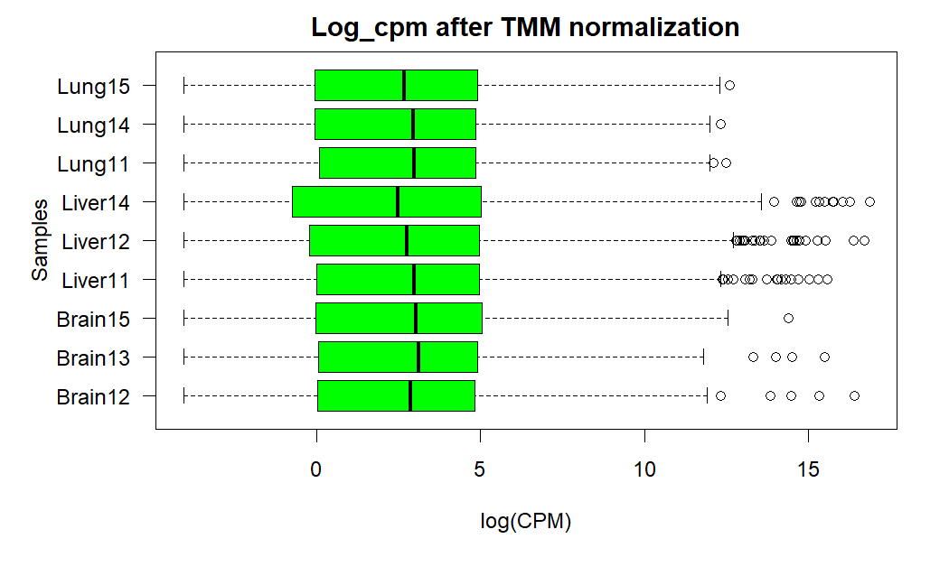
Normalization
The mean expression values of the samples are shifted towards each others

Slide 7
Normalization factors after TMM
Sample | Normalization factor
Brain – 12 | 1.0684309
Brain – 13 | 1.2632176
Brain – 15 | 1.1537478
Liver – 11 | 0.7959404
Liver – 12 | 0.6049420
Liver – 14 | 0.5505837
Lung – 11 | 1.4822744
Lung – 14 | 1.4576542
Lung – 15 | 1.1211501

Slide 8
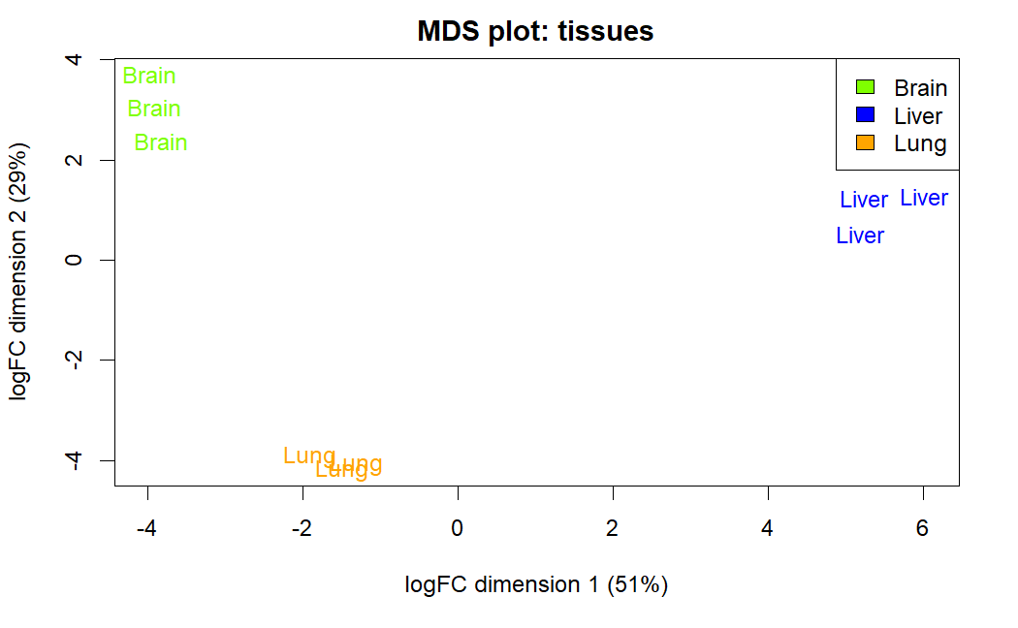
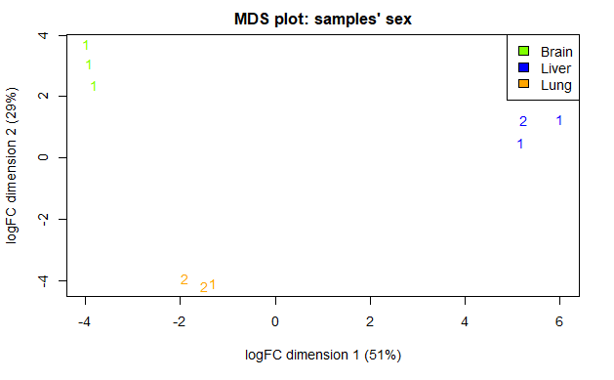
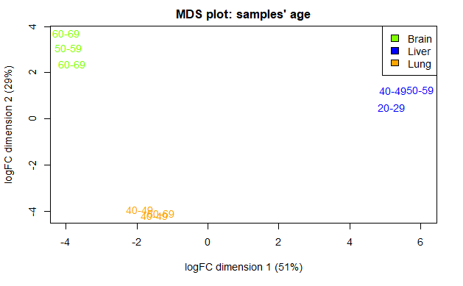
Replicates MDS projection
There is no evidence of any factors grouping replicates in other ways that are different than the grouping by tissue

Slide 9
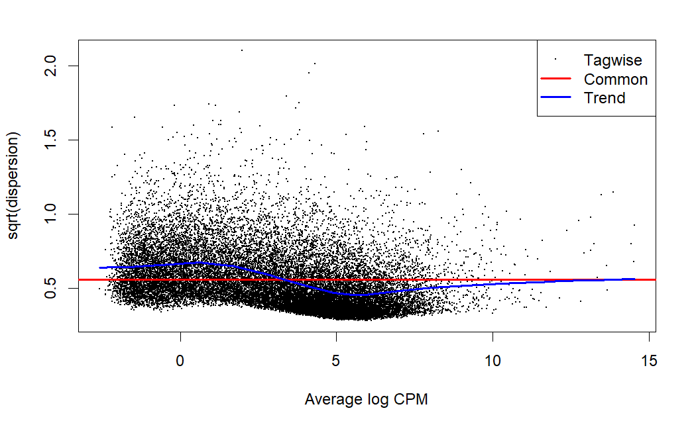
Estimation of dispersion – BCV plot
Dispersion of each gene is shrinked towards the blue trend line

Slide 10
Differentially expressed genes
This is an overview of the genes that are differentially expressed in each comparison
I filtered them by imposing a corrected p-value of at most 0.01, a logFC of at least 1 (in absolute value), and a logCPM of at least 0 (we want at least 1 count per million)
Genes over-expressed in Brain vs | Liver | Lung
 | 2501 | 1636
Genes over-expressed in Liver vs | Brain | Lung
 | 2048 | 1314
Genes over-expressed in Lung vs | Brain | Liver
 | 1408 | 825
Brain | Liver | Lung
1068 | 880 | 291
Genes over-expressed in one tissue with respect to the other two

Slide 11
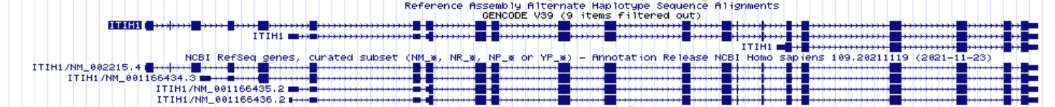
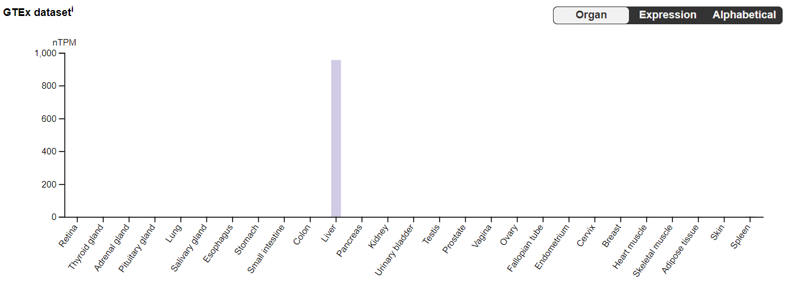
Genome Browser – ITIH1
Alternative splicing events generated multiple TSS
Human Protein Atlas gives us the confirmation that ITIH1 is indeed primarily expressed in liver
It encodes a protein in the family of inter-alpha-trypsins inhibitors, that are plasma proteins with protease inhibitor function.
They also often bind with hyaluronan, forming a complex found in very high concentration in rheumatoid arthritic synovial fluid.

Slide 12
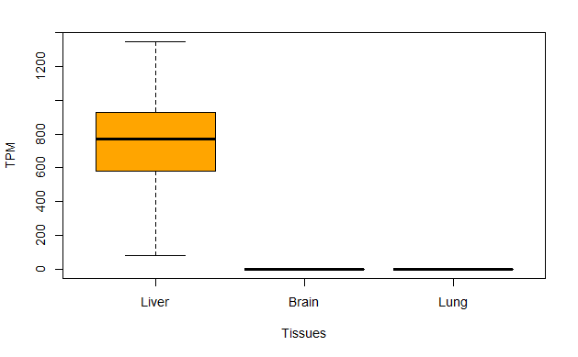
ITIH1 – Tissue expression comparison
This is the TPM distribution for gene ITIH1 across all samples of the three tissues. We can see that it is indeed over-expressed in liver with respect to brain and lung
By performing a Wilcoxon test, I confirmed the significance of this result: for both comparisons Liver-Brain and Liver-Lung I obtained a p-value of 2e-16

Slide 13
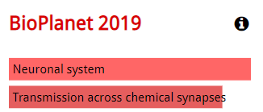

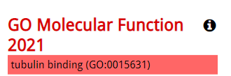
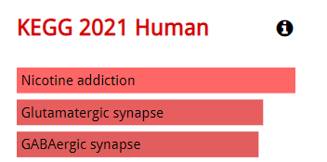
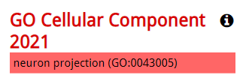
ENRICHR - Brain
Pathways
Ontologies
Glutamatergic synapses are the main excitatory synapses in the brain Nicotine addiction pathway is brain-characteristic
GABAergic neurons, that are cortical neurons, are involved in GABAergic synapses
Microtubules are composed of tubulin proteins, essential for generation and development of neurons
Neuron projections are prolongations extending from nerve cells, such as axons or dendrites

Slide 14
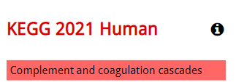

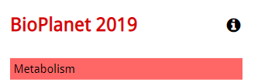


ENRICHR - Liver
Pathways
Ontologies
Many metabolism pathways, such as the ones for glucose, fatty acids and cholesterol, are in the liver The complement system plays an important role in mediating both acquired and innate responses to defend against microbial infection, and in disposing immunoglobins and apoptotic cells. The liver is responsible for biosynthesis of about 80-90% of plasma complement components and expresses a variety of complement receptors.
Qin, Xuebin, and Bin Gao. "The complement system in liver diseases." Cell Mol Immunol 3.5 (2006): 333-340.
Glucuronosyltransferase is a metabolic liver enzyme

Slide 15




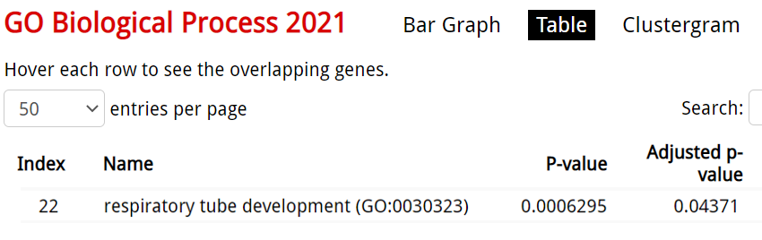

ENRICHR - Lung
Pathways
Ontologies
Lamellar bodies are secretory organelles found in type II alveolar cells in the lungs

