Slide 1
scRNA-Seq project
Genomics and Transcriptomics course
AY 2021-2022
Giulia Fois

Slide 2
About the dataset
This dataset is part of the SRA667466 single read archive, whose related study was aimed at producing single-cell sequencing of the adult mouse brain
The related count table contains 6875 cells
The reference publication is
Zeisel, Amit, et al. "Molecular architecture of the mouse nervous system." Cell 174.4 (2018): 999-1014.
whose goal was to define, through a single-cell experiment, the taxonomy and hierarchical organization of molecular cell types, as well as identifying cellular diversity across brain regions

Slide 3
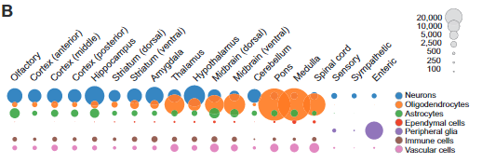
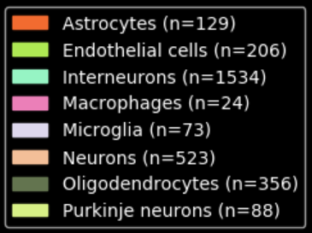
Cell types – publication and PanglaoDB
The following figure, that I took from the publication, reports the cell types identified by the study
If we focus on the Cortex, we see that the main group is the one of Neurons, followed by Astrocytes and Oligodendrocytes
The study separated Neurons into Interneurons, Inhibitory and Excitatory Neurons
These are the putative cell types found by PanglaoDB.
As we can see, there are a few cell types that were not reported in the original study

Slide 4
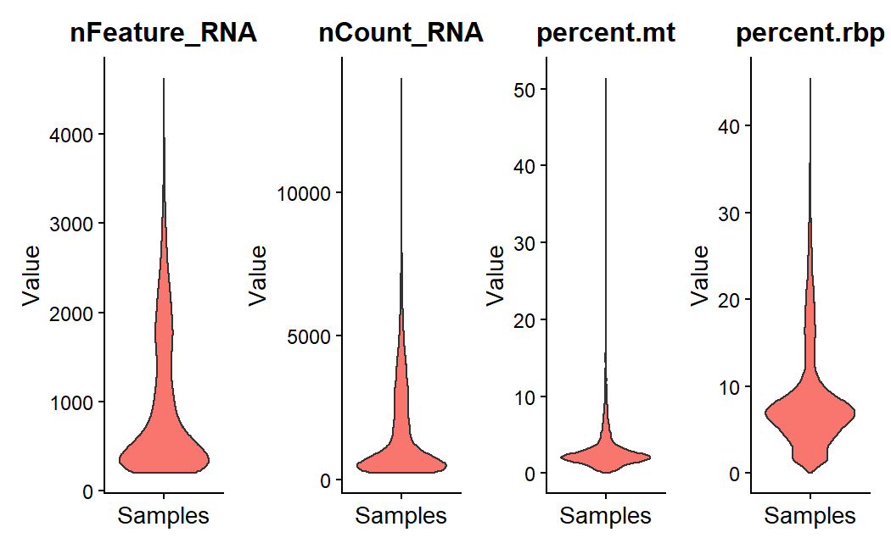
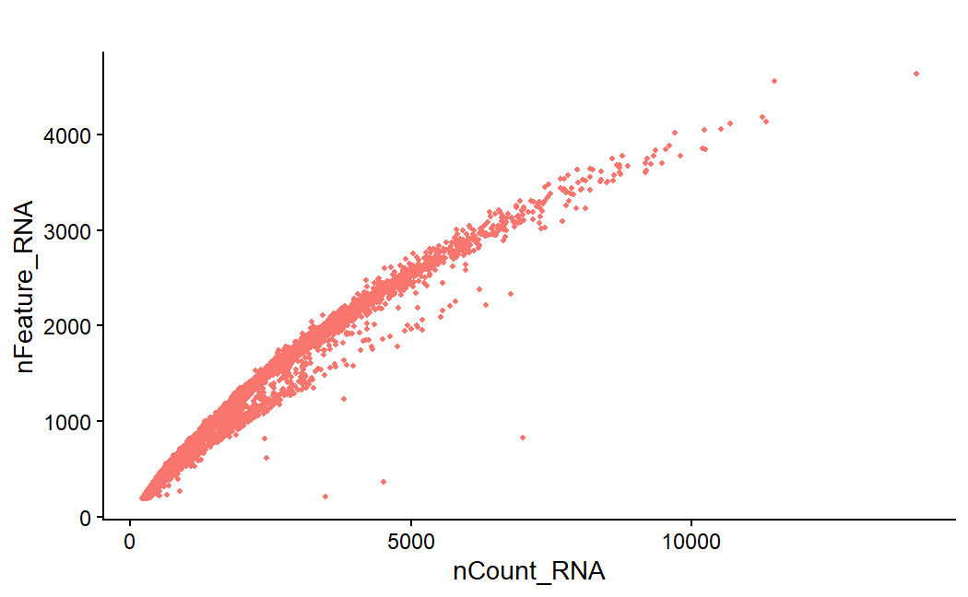
Cell quality analysis
As expected, the total number of reads of the samples is correlated to the number of genes that appear to be transcribed
We cut out outliers according to the following criteria:
nFeature_RNA < 3500
percent.mt < 5
Cutting out 289 cells out of 6875

Slide 5
Principal Components - Most variable genes
Principal Component | Most variable genes
PC1 | Syt1, Rtn1, Slc17a7, Olfm1, Nrgn
PC2 | Sparc, Cldn5, Ly6c1, Flt1, Igfbp7
PC3 | Cldn5, Ly6c1, Flt1, Igfbp7, Itm2a
PC4 | Atp1a2, Aldoc, Mt1, Gpr37l1, Slc1a3
PC5 | C1ql1, Pdgfra, Gpr17, Cacng4, Olig1
By looking for the top 5 genes for PC1 and PC2 on Tabula Muris, I found out that PC1 most variable genes are reported to be expressed in Neurons, while the ones of PC2 in Endothelial cells.

Slide 6
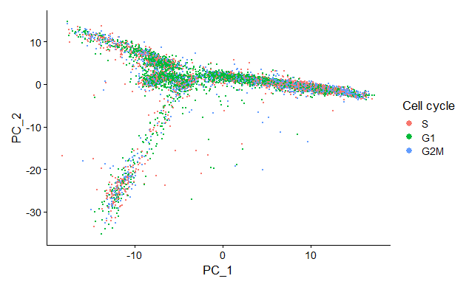
PC1 and PC2 – Cell cycle
Cells projected onto the first 2 principal components do not group according to cell cycle

Slide 7
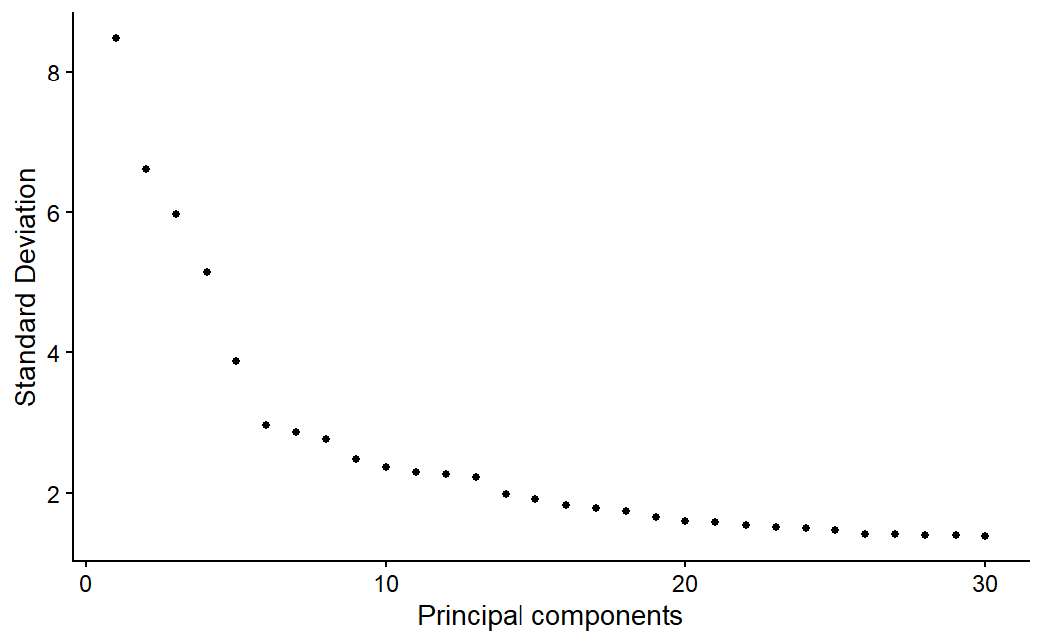
Number of PCs to employ (elbow plot)
According to the elbow plot, the plateau is reached around 14, where the standard deviation goes down to 2
I also computed the number of PCs explaining 75% of the variance, that was 13
Since the two values were really close, I decided to use 10 as an alternative to 14
It is between 14 and the value where the standard deviation starts to drop

Slide 8
Clustering parameters
With a higher number of principal components, I expected variance to be explained better and thus to have more granularity in clustering (that is, to find more and smaller clusters)
The following are the parameters employed for 4 different clustering rounds:
N. Principal Components | Resolution
10 | 0.5
10 | 0.7
14 | 0.4
14 | 0.6

Slide 9
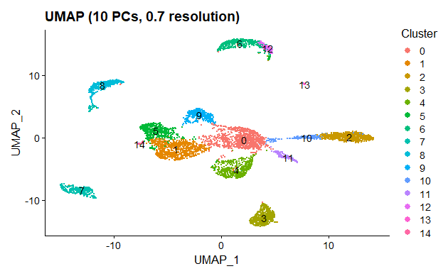
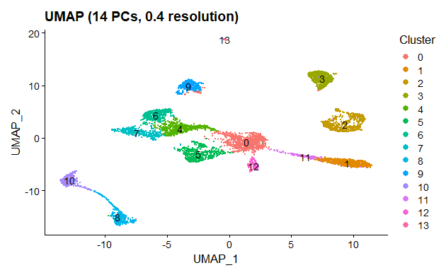
10 PCs, 0.7 resolution
Clustering results
14 PCs, 0.4 resolution
Cluster 12 seems to overlap cluster 6
Points in clusters 0, 1 and 4 seem to be a bit more distant
Points belonging to the same cluster are close to each other
There is a better inter-cluster separation

Slide 10
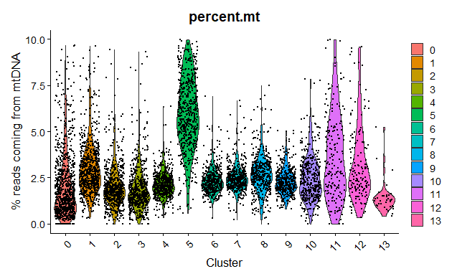
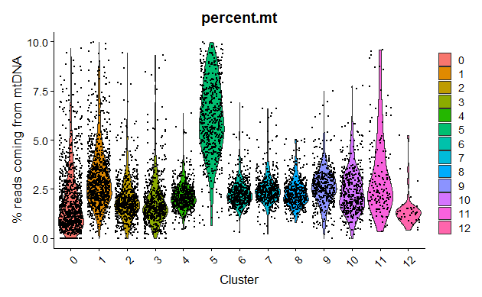
Clustering – reads on mtDNA
AFTER
BEFORE
Cluster 5 and 11 seem to have a non-negligible amount of cells having higher % of reads coming from mtDNA
I tried re-scaling the original object regressing by percent.mt and indeed cluster 11 was eliminated → cells were grouped in cluster 11 because they shared variability on mtDNA percentage

Slide 11
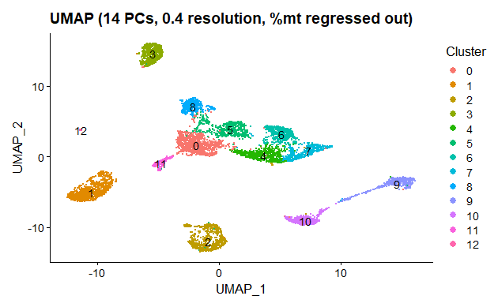
Clustering – the final choice
Cluster | N° cells
0 | 993
1 | 893
2 | 657
3 | 584
4 | 544
5 | 538
6 | 472
7 | 454
8 | 426
9 | 423
10 | 411
11 | 155
12 | 36

Slide 12
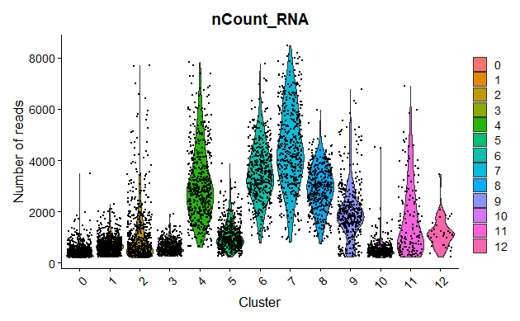
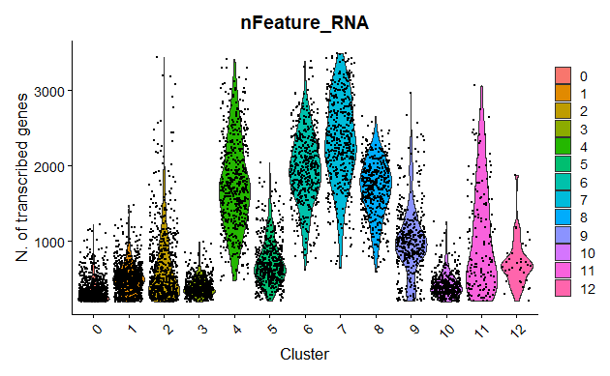
Some features in the clusters
Clusters 4, 6, 7 are the ones that seem to have a greater library size (and in turn, as expected, a greater number of expressed genes)

Slide 13
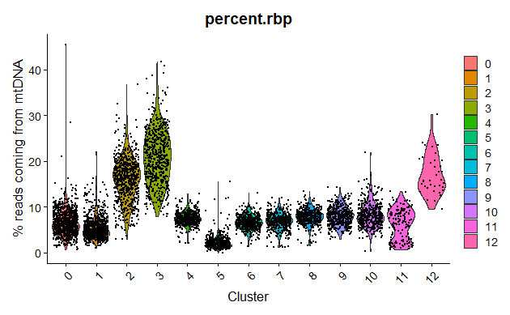
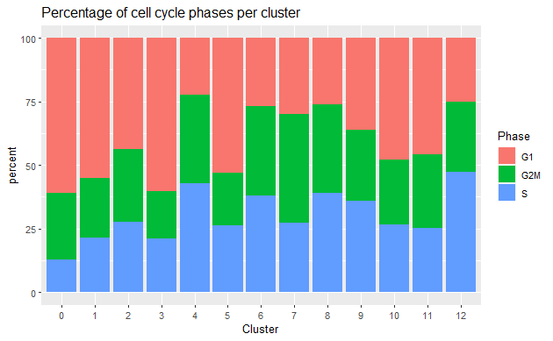
Some features in the clusters - 2
There is a quite uniform distribution of cell cycles in the various clusters
Cluster 3, 4 and 12 seem to have cells with a higher % of reads mapped on rbRNA

Slide 14
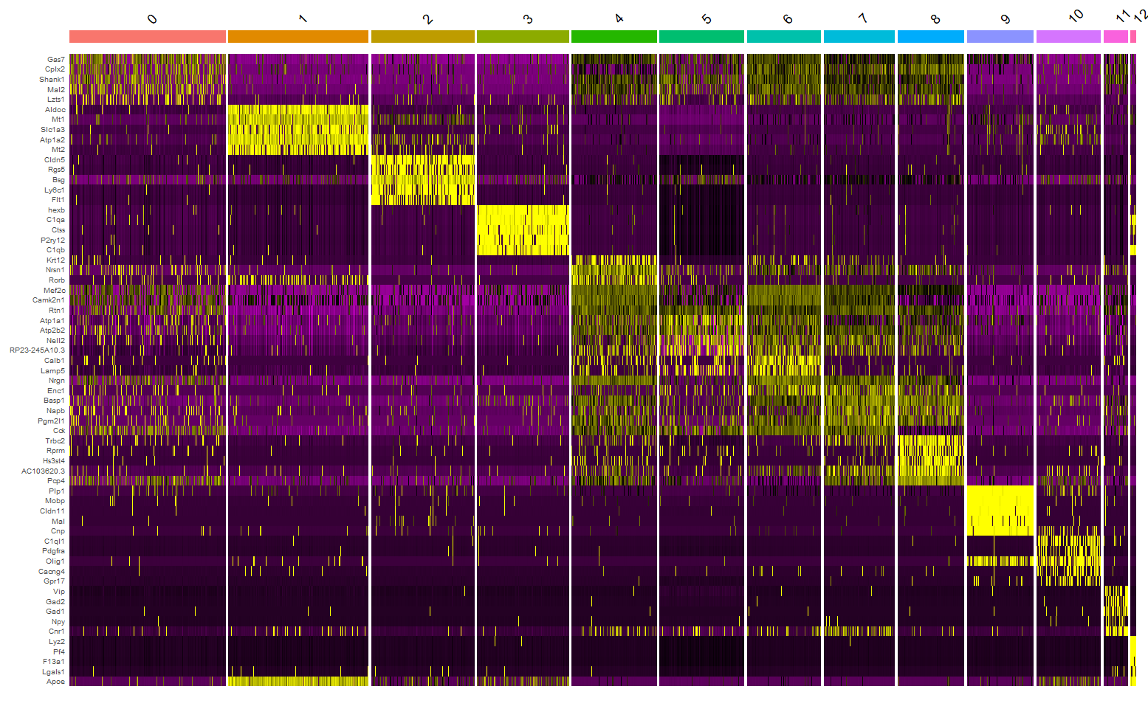
Top genes in the clusters - Heatmap
According to this heatmap, there seem to be a non-negligible similarity (in terms of top genes) among clusters 4-5-6-7-8

Slide 15
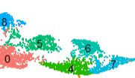
Comparison: 4-5-6-7-8 vs all
They are also close to each other in the UMAP plot: could they be merged?
The top 5 genes obtained by comparing these clusters against all the others are Slc17a7, Meg3, Grin2b, Olfm1, Atp2b2
By looking on Tabula Muris, we see that they are all usually overexpressed in neurons
Let’s see if, by comparing each single cluster against the others in this subset, we find some interesting genes that could identify a neuron subtype

Slide 16
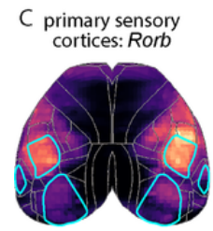
Comparison: 4 vs 5-6-7-8
The top gene in this comparison appears to be Rorb.
According to
Weed, Natalie, et al. "Identification of genetic markers for cortical areas using a Random Forest classification routine and the Allen Mouse Brain Atlas." PloS one 14.9 (2019): e0212898.
Rorb “was also identified as a potential marker, specifically for primary sensory cortices”. So, we can infer that cluster 4 is specialized in Sensory Neurons.
Comparison: 5 vs 4-6-7-8
Gene | pct.1 | pct.2
Atp1a1 | 0.861 | 0.771
Psap | 0.810 | 0.763
Glg1 | 0.565 | 0.452
App | 0.885 | 0.860
Mir124a-1hg | 0.608 | 0.516
We don't find particular differences in expression between cluster 5 and the others: the values in pct.1 and pct.2 are really close for all the top genes.
Therefore, since its top genes in the 5-vs-all comparison are also largely expressed in neurons, I assigned Neuron as putative cell type.

Slide 17
Comparison: 6 vs 4-5-7-8
Among the top genes, we find Calb1 and Rasgrf2 that according to
Tyssowski, Kelsey M., et al. "Different neuronal activity patterns induce different gene expression programs." Neuron 98.3 (2018): 530-546.
by studying the visual cortex-located neuronal response
“genes with greater expression in SUSTAINED neurons included … markers, such as Calb1, Cux1,and Rasgrf2”
We can thus associate these two genes again to sensorial activity, and infer the cell type to be Sensory Neurons
Comparison: 7 vs 4-5-6-8
An interesting gene, Basp1, is over-expressed in Stem Cells according to
Manganas, Louis N., et al. "BASP1 labels neural stem cells in the neurogenic niches of mammalian brain." Scientific reports 11.1 (2021): 1-18.
It is however expressed in 70% of the cells of the other clusters as well.
Another candidate marker, Hs3st2, according to the publication’s wiki, is a marker gene for Excitatory Neurons: that will be our cell type choice for this cluster.

Slide 18
Comparison: 8 vs 4-5-6-7
We find Rprm and Hs3st4, that according to the publication are marker genes for Excitatory Neurons.
We can now start to assign some putative cell types to these first 5 clusters.
Cluster | Putative marker gene | Putative cell type
4 | Rorb | Sensory neuron
5 | Atp1a1 | Neuron
6 | Calb1 | Sensory neuron
7 | Hs3st2 | Excitatory neuron
8 | Rprm | Excitatory neuron
Cluster 4 and 6 contain cells of the same (putative) type and are really close in the UMAP plot. Merging them could make sense.

Slide 19
Comparison: 0 vs all
The top genes of cluster 0 are also expressed with similar cell percentages in the other clusters as well, by looking at the heatmap they are quite similar to the ones of the aforementioned subset composed of clusters 4, 5, 6, 7 and 8.
Since its top genes are all proven to be over-expressed in neurons (according to Tabula Muris), we can infer Neurons as cluster 0’s cell type. It could hypothetically be merged to cluster 5.
Comparison: 1 vs all
Aldoc, the top gene for cluster 1, is considered to be a marker for Purkinje Cells of the cerebellar cortex according to
Fujita, Hirofumi, et al. "Detailed expression pattern of aldolase C (Aldoc) in the cerebellum, retina and other areas of the CNS studied in Aldoc-Venus knock-in mice." PLoS One 9.1 (2014): e86679.

Slide 20
Comparison: 2 vs all
I selected Cldn5 as the putative marker for this cluster, and assigned the Endothelial Cells cell type: this is supported both by Tabula Muris and by the paper
Greene, C., Hanley, N. & Campbell, M. Claudin-5: gatekeeper of neurological function. Fluids Barriers CNS 16, 3 (2019)
Comparison: 3 vs all
The most expressed gene of this cluster is hexb, that is a signature gene for Microglia Cells according to
Masuda, T., Amann, L., Sankowski, R. et al. Novel Hexb-based tools for studying microglia in the CNS. Nat Immunol 21, 802–815 (2020)
Comparison: 9 vs all
The Mobp gene, one of the putative markers for cluster 9, is considered to be largely expressed in Oligodendrocytes according to
Holz, Andreas & Schwab, M. (1997). Developmental expression of the myelin gene MOBP in the rat nervous system. Journal of neurocytology. 26. 467-77. 10.1023/A:1018529323734.

Slide 21


Comparison: 10 vs all
The Pdgfra gene was found in the study’s wiki to be expressed in Oligodendrocyte Precursor cells.
Comparison: 11 vs all
I easily found a result in the study’s wiki for this cluster as well. The top gene is in fact Vip, that is associated to Interneurons.
Comparison: 12 vs all
I selected the Lyz2 gene, that is indicated as over-expressed in Astrocytes on Tabula Muris.

Slide 22
Putative marker genes and cell types
Cluster | Marker gene | Cell type
0 | Gas7 | Neurons
1 | Aldoc | Purkinje Cells
2 | Cldn5 | Endothelial Cells
3 | hexb | Microglia Cells
4 | Rorb | Sensory Neurons
5 | Atp1a1 | Neurons
6 | Calb1 | Sensory Neurons
7 | Hs3st2 | Excitatory Neurons
8 | Rprm | Excitatory Neurons
9 | Mobp | Oligodendrocytes
10 | Pdgfra | Oligodendrocyte Precursor Cells
11 | Vip | Interneurons
12 | Lyz2 | Astrocytes

Slide 23
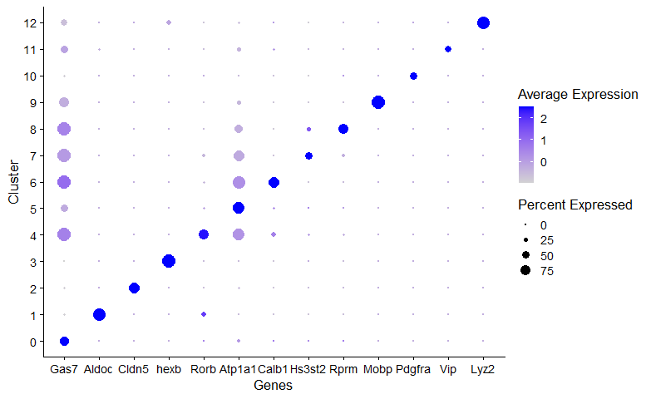
Putative marker genes – DotPlot

Slide 24
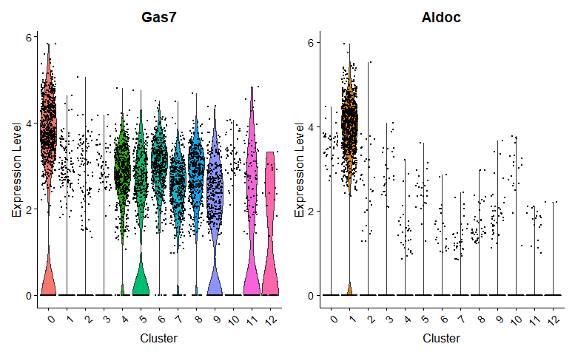
Putative marker genes - VlnPlot
Cluster 0
Cluster 1

Slide 25
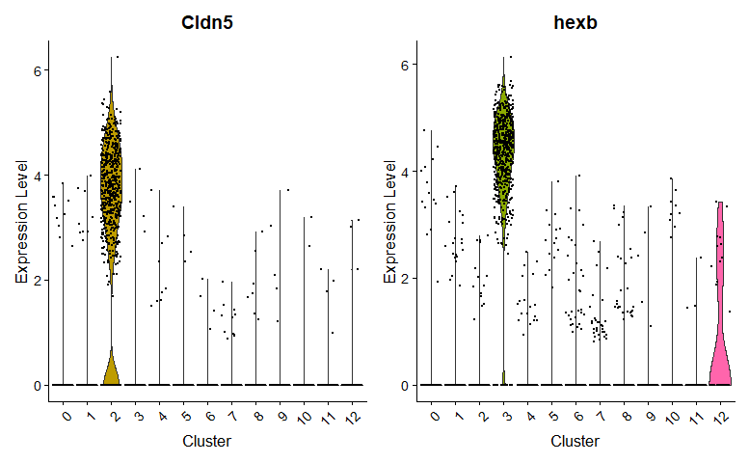
Putative marker genes - VlnPlot
Cluster 2
Cluster 3

Slide 26
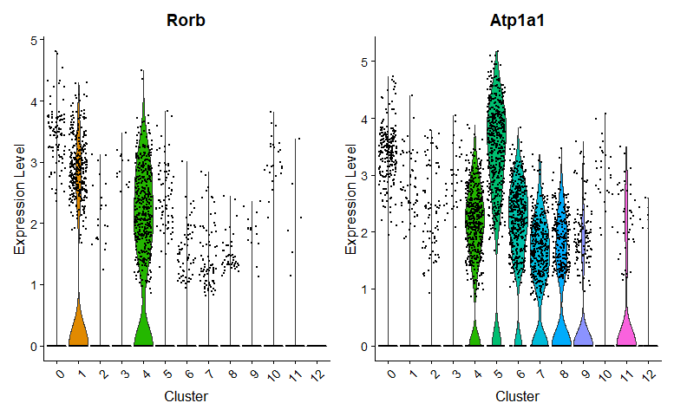
Putative marker genes - VlnPlot
Cluster 4
Cluster 5

Slide 27
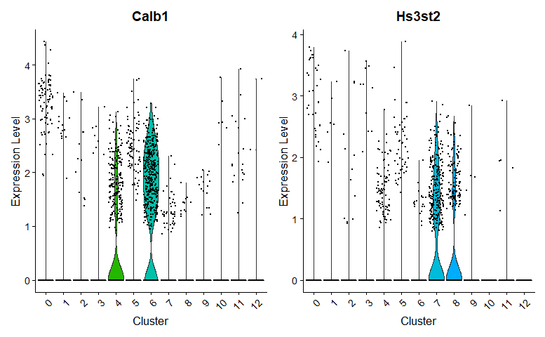
Putative marker genes - VlnPlot
Cluster 6
Cluster 7

Slide 28
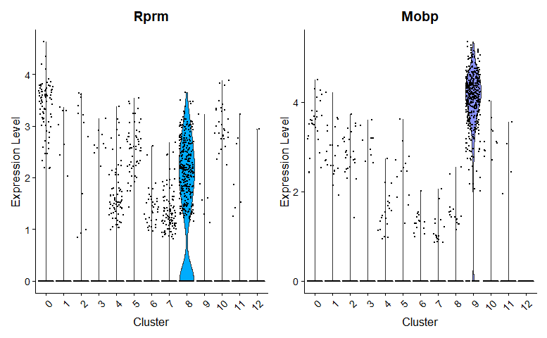
Putative marker genes - VlnPlot
Cluster 8
Cluster 9

Slide 29
Putative marker genes - VlnPlot
Cluster 8
Cluster 9

Slide 30
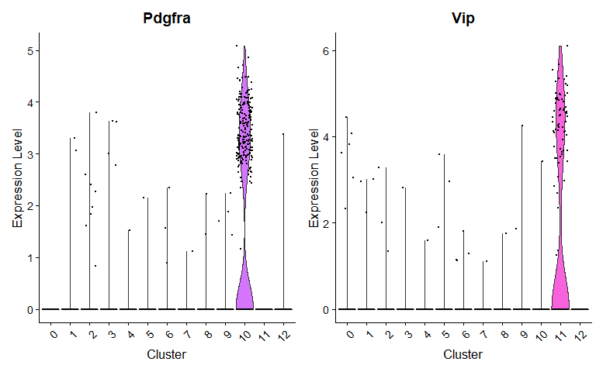
Putative marker genes - VlnPlot
Cluster 10
Cluster 11

Slide 31
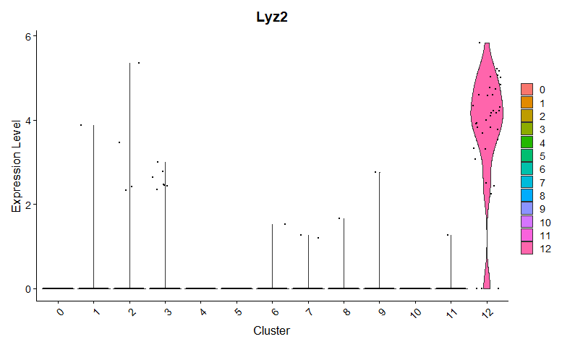
Putative marker genes - VlnPlot
Cluster 12

Slide 32
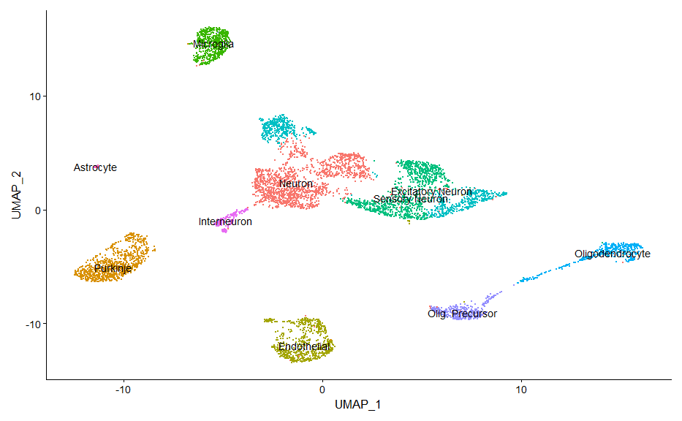
Discussion
My results differ a bit from the ones of the study. Two of the possible reasons could be the different techinque employed for clustering (they used a dendogram-based technique) and the criteria they employed to determine if a gene was over/under-expressed (trinarization, based on a Bayesian model)
Furthermore, I managed to find almost all the putative cell types reported on PanglaoDB, apart from Macrophages. The distribution of the cells in the cluster is however much different.

