Slide 1
NDDL projects
Giulia Moreni - PhD student
November 2023

Slide 2
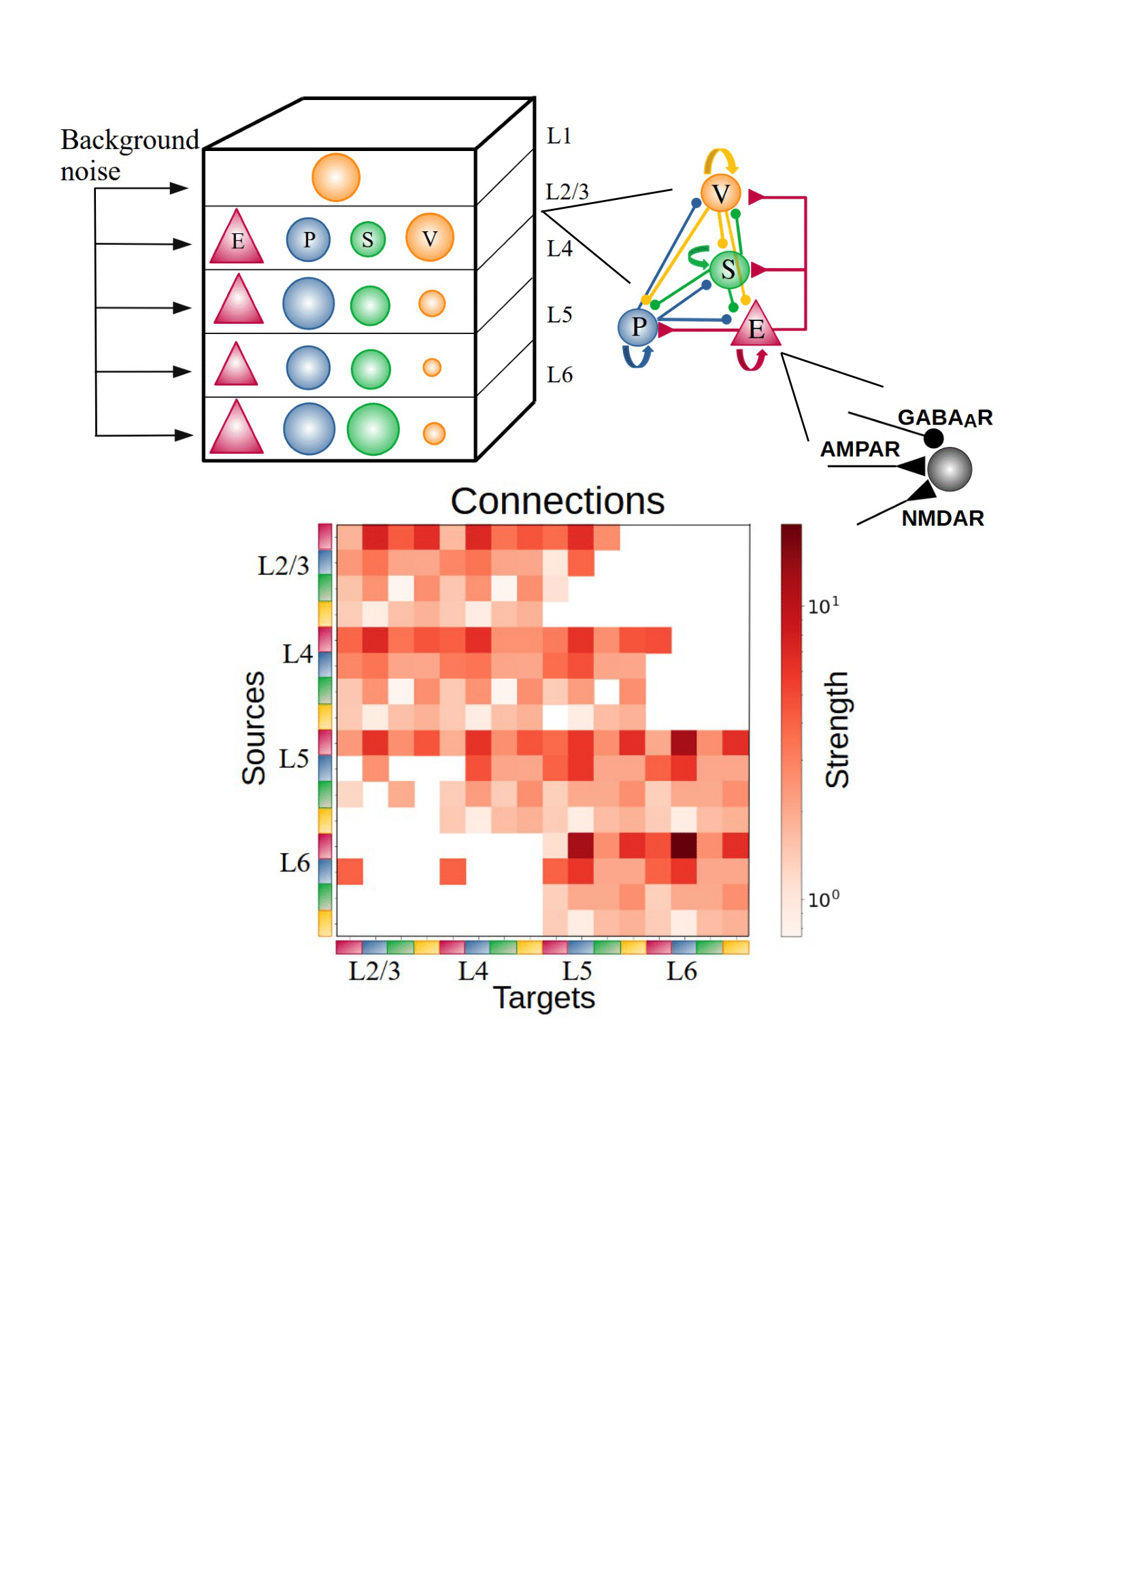
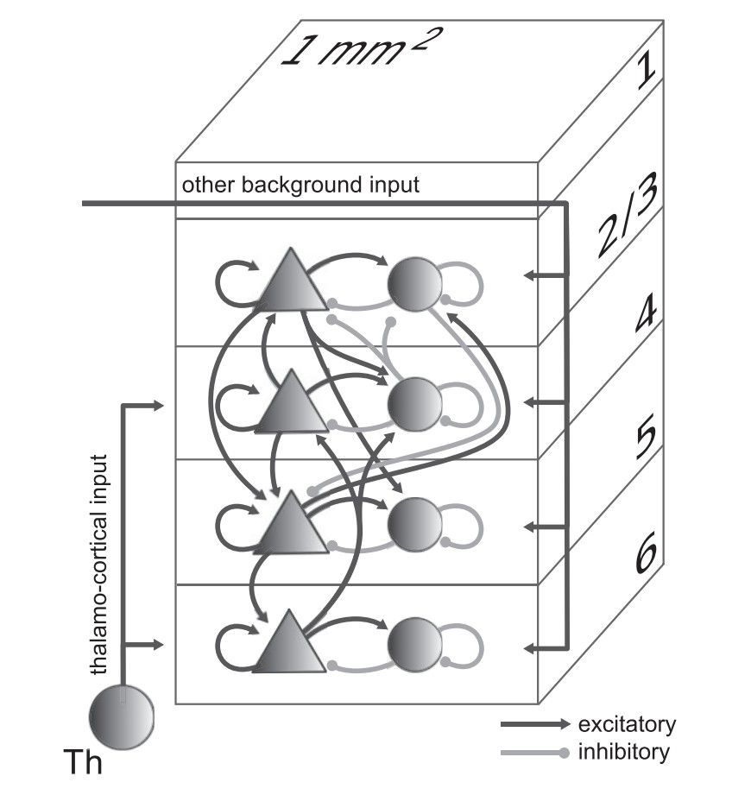
The model
Potjans, T. C. & Diesmann, M.
The cell-type specific cortical microcircuit: relating structure and activity in a full-scale spiking network model. Cereb. Cortex 2014
Moreni, G., Pennartz, C. M. A. & Mejias, J. F.
Synaptic plasticity is required for oscillations in a V1 cortical column model with multiple interneuron types. Preprint 2023

Slide 3
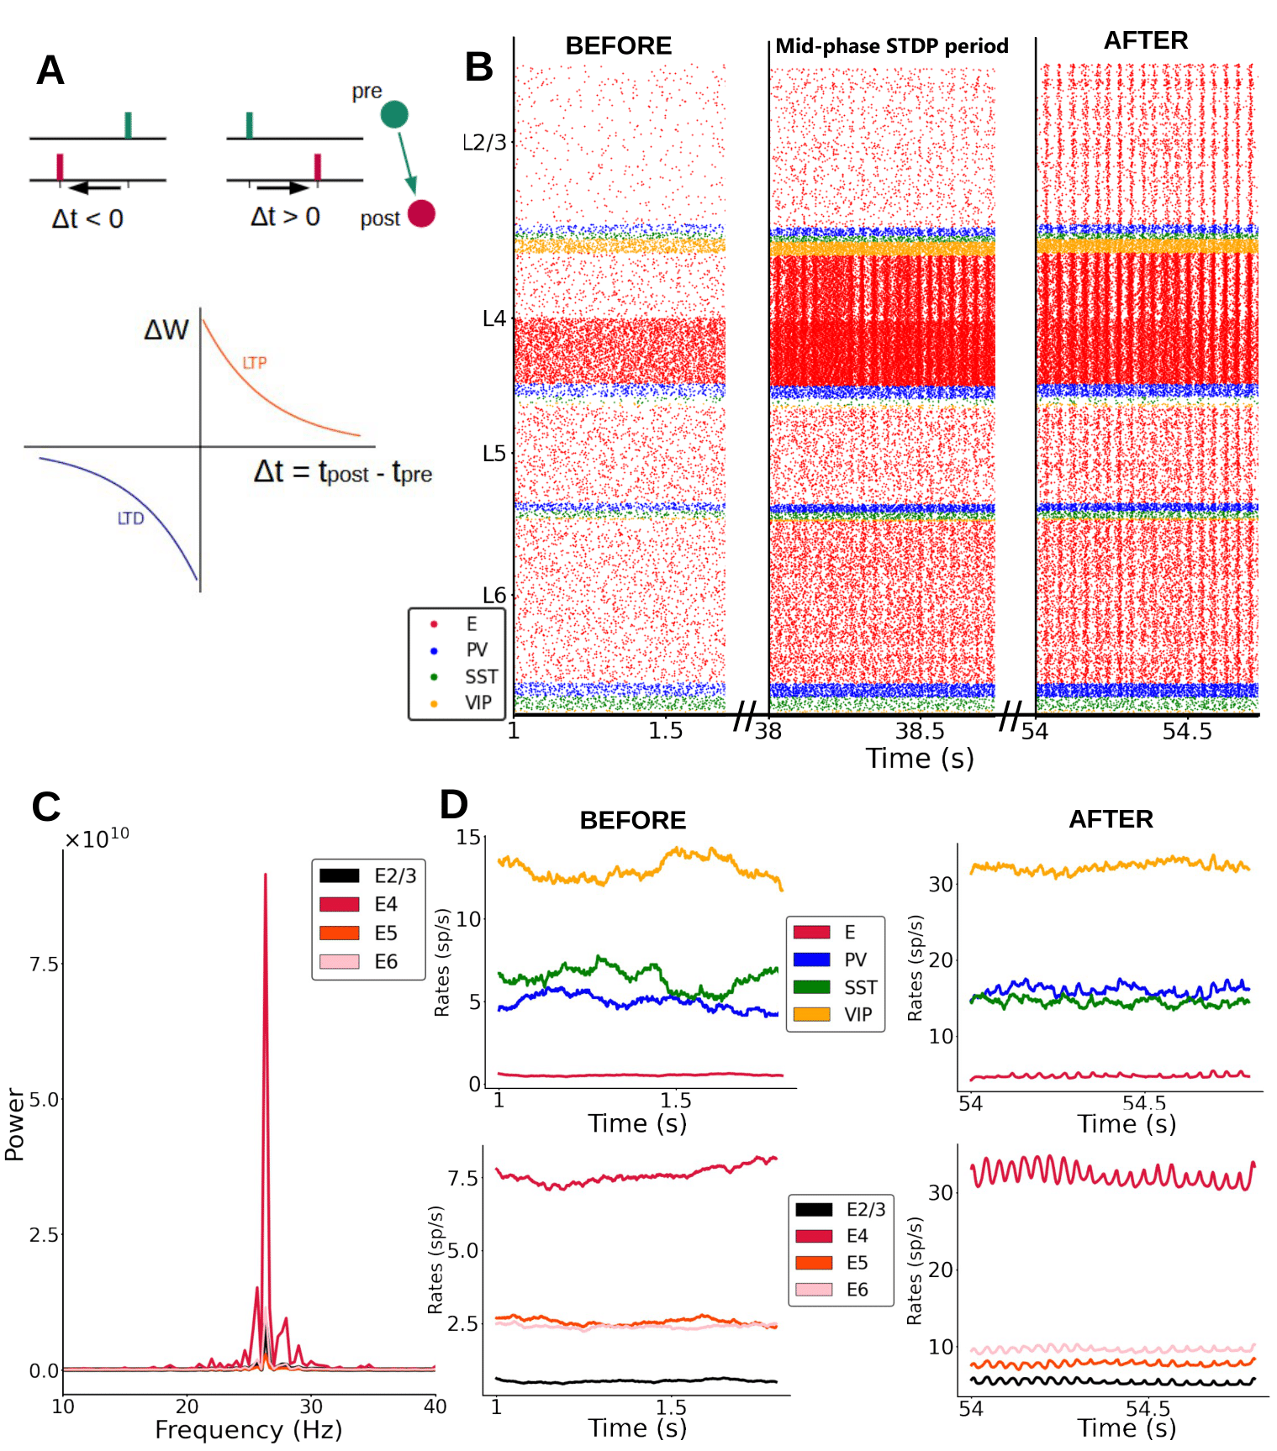
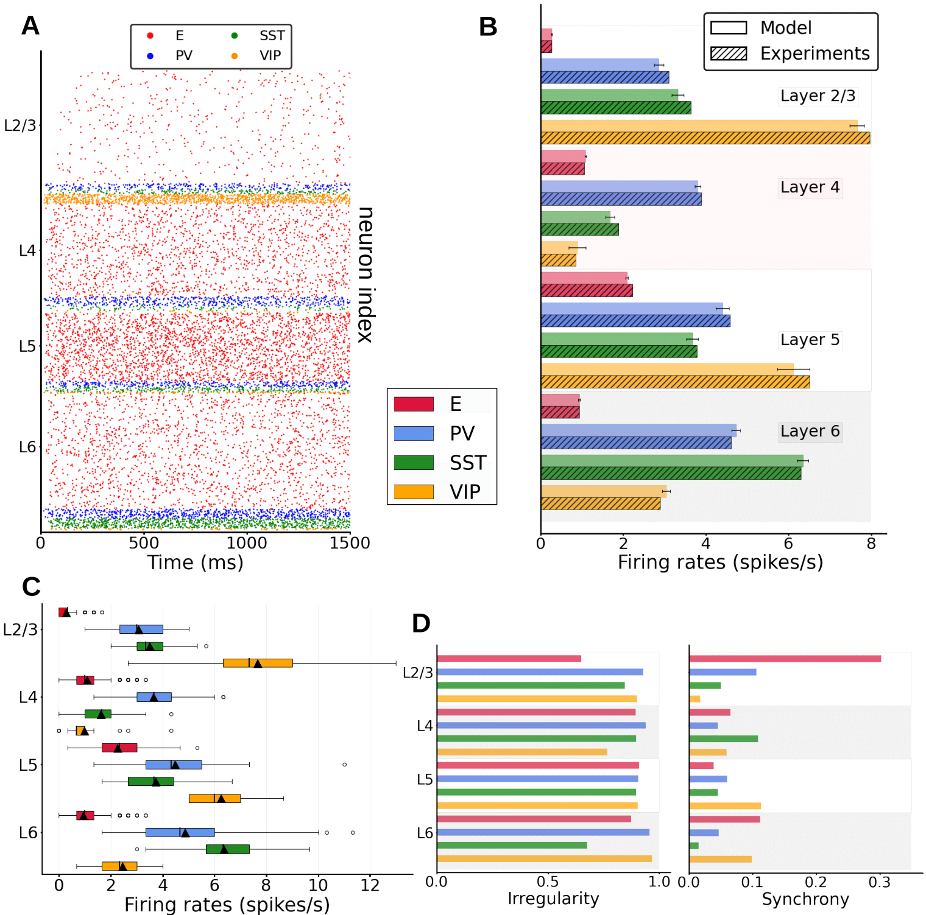
The model

Slide 4
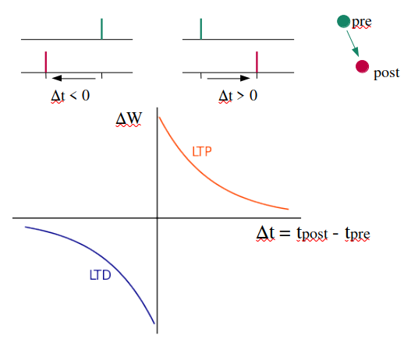
Aim of the project
Reproduce the results of the paper using the available code
Modify the model to study interesting features:
Change ratio of AMPA and NMDA receptors
Introduce plasticity in the model with different learning rules (STDP, triplet rule)
Send different types of input to the model to understand dynamics
- Send Poisson instead of constant
- Sinusoidal input (during training and also during stimulus evoked)
- Send inputs to check the oscillations effect
- See if the input frequency matches the one of the model output

Slide 5
Code & resources
https://pubmed.ncbi.nlm.nih.gov/23203991/
https://www.biorxiv.org/content/10.1101/2023.08.27.555009v1

