Slide 1
NMDA and AMPA receptors
Giulia Moreni – PhD 01/08/2021
Supervisors: Cyriel Pennartz, Jorge Mejias

Slide 2
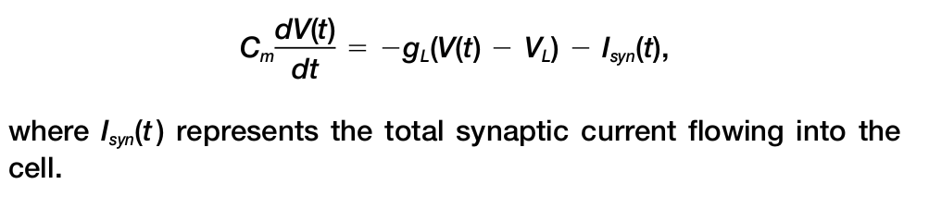
Modeling NMDA, AMPA, GABA receptors with exact equations
AMPA
The equations describing the model are:
E
NMDA
GABA

Slide 3
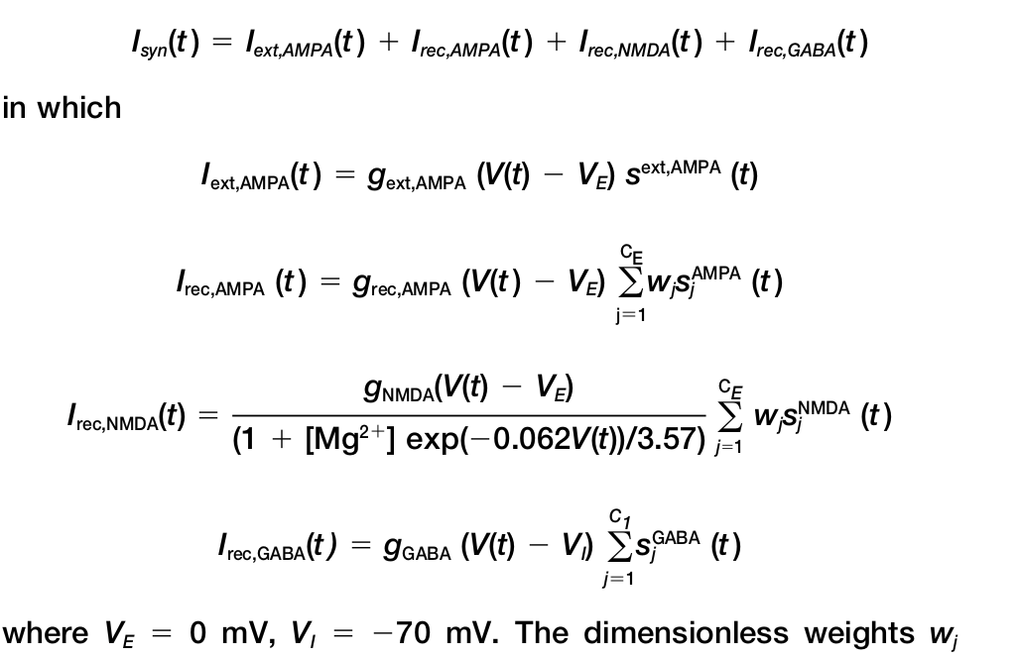

Slide 4
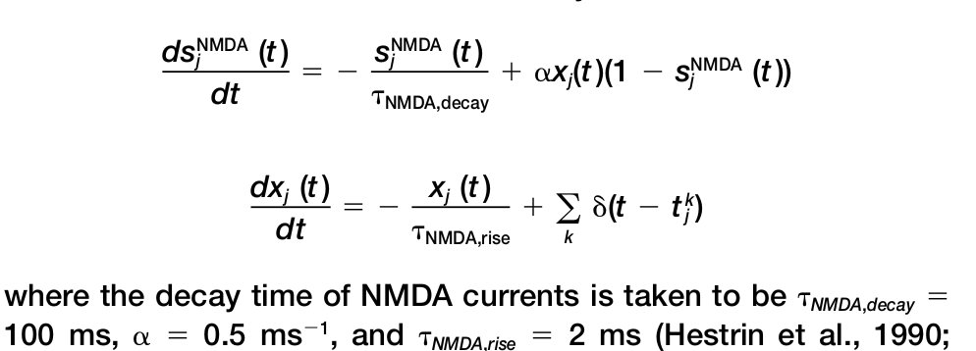
We need to solve these differential equations

Slide 5
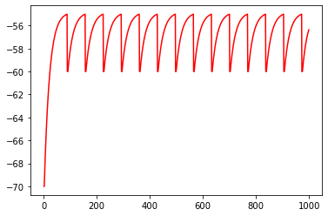
Model in a simple situation.
Neuron4:
Recives input through ONLY NMDA receptors. I have one equation dx(t)/dt for each presynaptic neuron, each has his own receptor.
w1
w2
x1 → s1
x2 → s2
x3 → s3
w3
After solving each x(t) and so having 3 s(t) solutions we should sum them together.
In this case w1=w2=w3 and the 3 sending neurons behave exactly the same so the three solution of the 3 differential equations are the same. We just need to multuply s*3.
w1*s1+w2*s2+w3*s3
= 3*w1*s1
t_spikes=[ 89. 157. 225. 293. 361. 429. 497. 565. 633. 701. 769. 837. 905. 973.]
The 3 neurons are spiking at the exact same times.

Slide 6
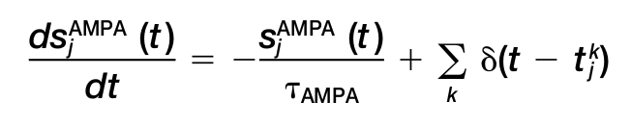
AMPA receptors equations.
1
w1
ds1/dt → s1
ds2/dt → s2
ds3/dt → s3
w2
2
w3
s1+s2+s3
3
The GABA are exactly the same.
t_spikes=[ 89. 157. 225. 293. 361. 429. 497. 565. 633. 701. 769. 837. 905. 973.]

