Slide 1
Summer school
20/06/2022
Giulia Moreni

Slide 2
Program of today
Introduction (< 1h):
Goal of the workshops
Introduction on LIF neuron
Tutorial on LIF neurons (3h):
1 LIF neuron: understanding the equation
LIF neurons using Nest
Connect a simple network of LIF neurons and study its behavior
Presentation of my PhD project (concrete example of LIF network)

Slide 3
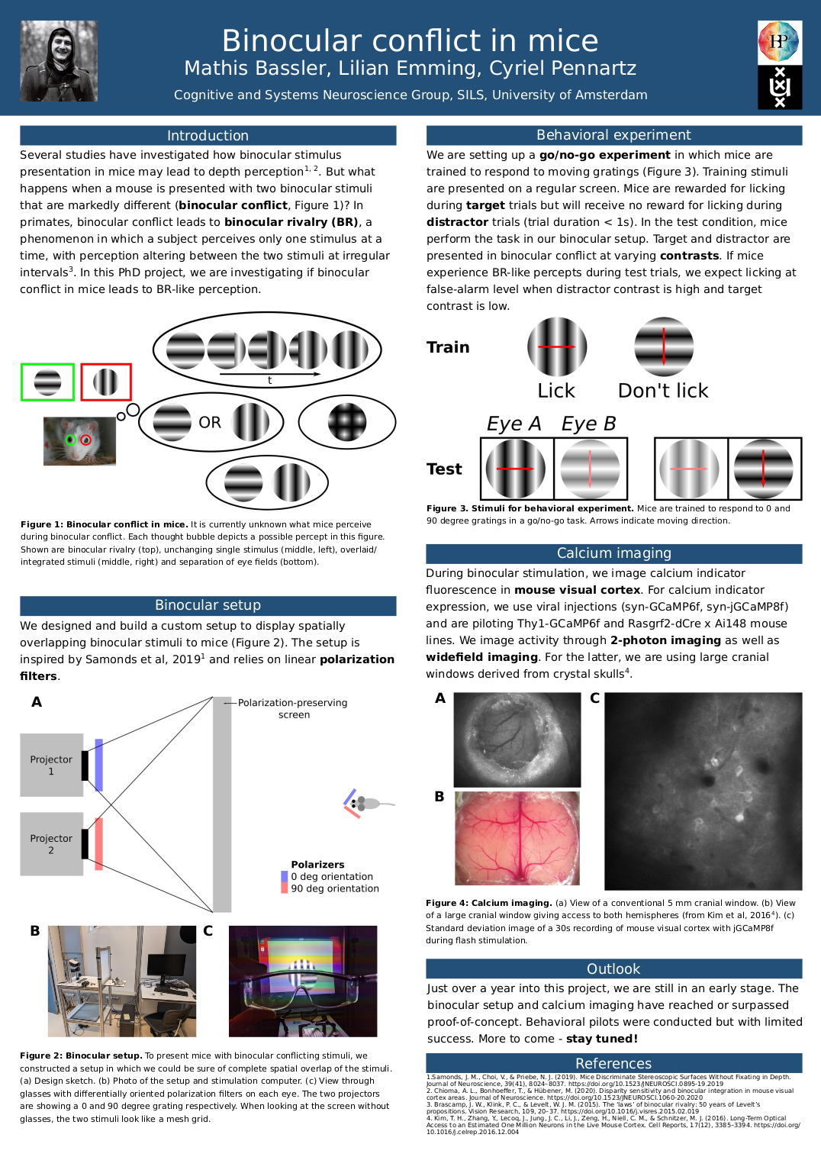
Research proposal
Develop your own research proposal
Poster to be presented the last day (01/07)
The poster should include:
- Introduction (background and hypothesis)
- Methods
- Results (expectations)
- Conclusion

Slide 4
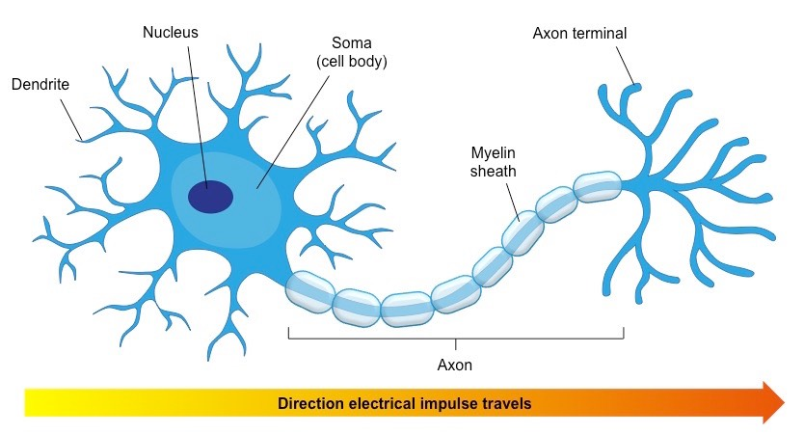
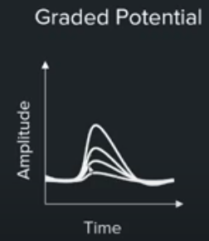
Neuron – the basics

Slide 5
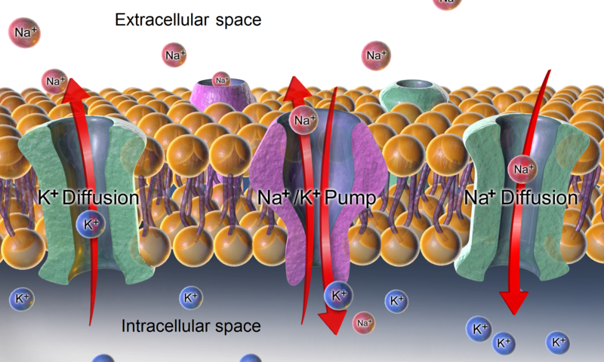
Action potentials are rapid changes in polarity of membrane potentials
e
Na+
Differential distribution of ions on either side of the membrane creates a membrane potential
The influx of Na+ ions and subsequent efflux of K+ ions underlie action potential
Action potentials are “all-or-nothing”
Action potentials have set amplitude and duration.
+ + + + + + + + + + + +
-70 mV
– – – – – – – – –
i
K+

Slide 6
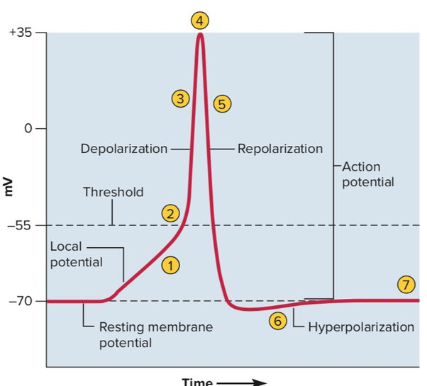
How can we model the membrane potential evolution over time?
LIF neuron!

Slide 7
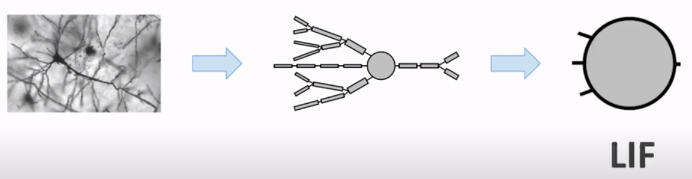
Neuron model

Slide 8
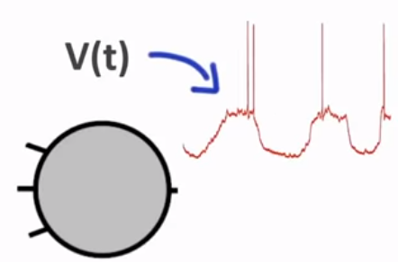


LIF neuron - the membrane equation
-Membrane potential voltage
-Leak term
-It can spike
Time evolution
Leak term
synaptic input

Slide 9
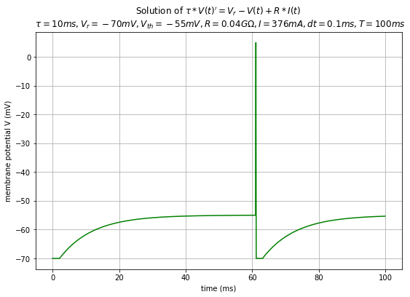
Modeling the spike

Slide 10

It’s time for coding!

Slide 11
Tutorial 1. LIF_neuron
To start the tutorial:
Link to the folder: https://drive.google.com/drive/folders/1ZzkPdZRKM9P2iV1ckmM240s3E9l4dR6-?usp=sharing
1. Open your terminal and type “Jupyter notebook”
2. Open LIF_neuron.ipynb (it should be in the folder of the Summer school you downloaded)
3. Start the tutorial and ask me questions when something is not clear!

Slide 12
Tutorial 2. 2_LIF_neuron_nest
To start the tutorial:
1. Open your terminal and type “Jupyter notebook”
2. Open 2_LIF_neuron_nest.ipynb (it should be in the folder of the Summer school you downloaded)
3. Start the tutorial and ask me questions when something is not clear!

Slide 13
Tutorial 3. Populations_LIF_nest
To start the tutorial:
1. Open your terminal and type “Jupyter notebook”
2. Open Populations_LIF_nest.ipynb (it should be in the folder of the Summer school you downloaded)
3. Start the tutorial and ask me questions when something is not clear!

