Slide 1
Summer school
23/06/2022
Giulia Moreni

Slide 2
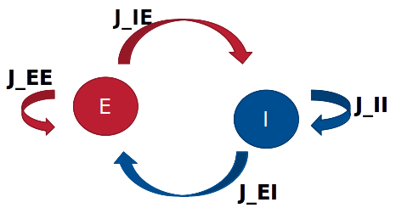
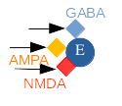
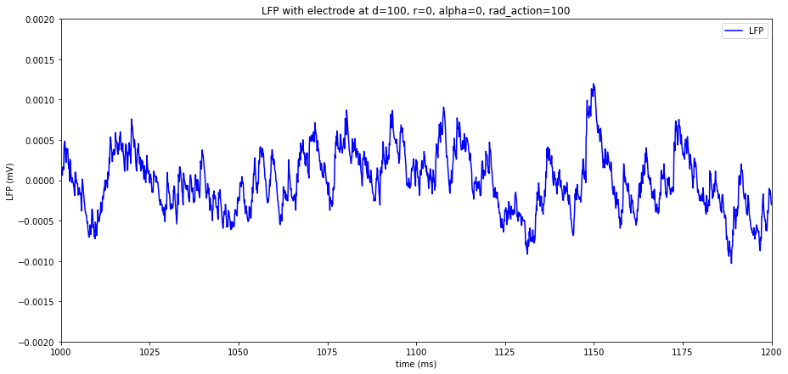
Program of today
Tutorial on LIF neurons (4h):
- Inhibitory and excitatory populations: change weights between them to observe behavior
- Add receptors (GABA and AMPA NMDA) – More realistic neuron!
- Simulate LFP

Slide 3
Tutorial 3. Populations_LIF_nest
To start the tutorial:
Link to the folder: https://drive.google.com/drive/folders/1ZzkPdZRKM9P2iV1ckmM240s3E9l4dR6-?usp=sharing
1. Open your terminal and type “Jupyter notebook”
2. Open Populations_LIF_nest.ipynb (it should be in the folder of the Summer school you downloaded)
3. Start the tutorial and ask me questions when something is not clear!

Slide 4
Tutorial 3. Populations_LIF_nest
Excitatory and inhibitory population
Effect of the weights?

Slide 5
Tutorial 4. LIF_evolution_and_LFP_simulation
To start the tutorial:
1. Open your terminal and type “Jupyter notebook”
2. Open LIF_evolution_and_LFP_simulation.ipynb (it should be in the folder of the Summer school you downloaded)
3. Start the tutorial and ask me questions when something is not clear!

Slide 6
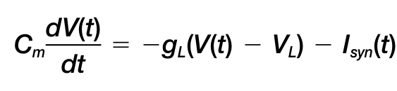
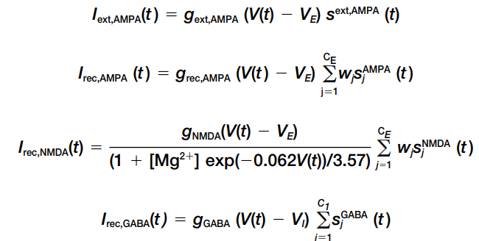
More realistic neuron, adding receptors

Slide 7
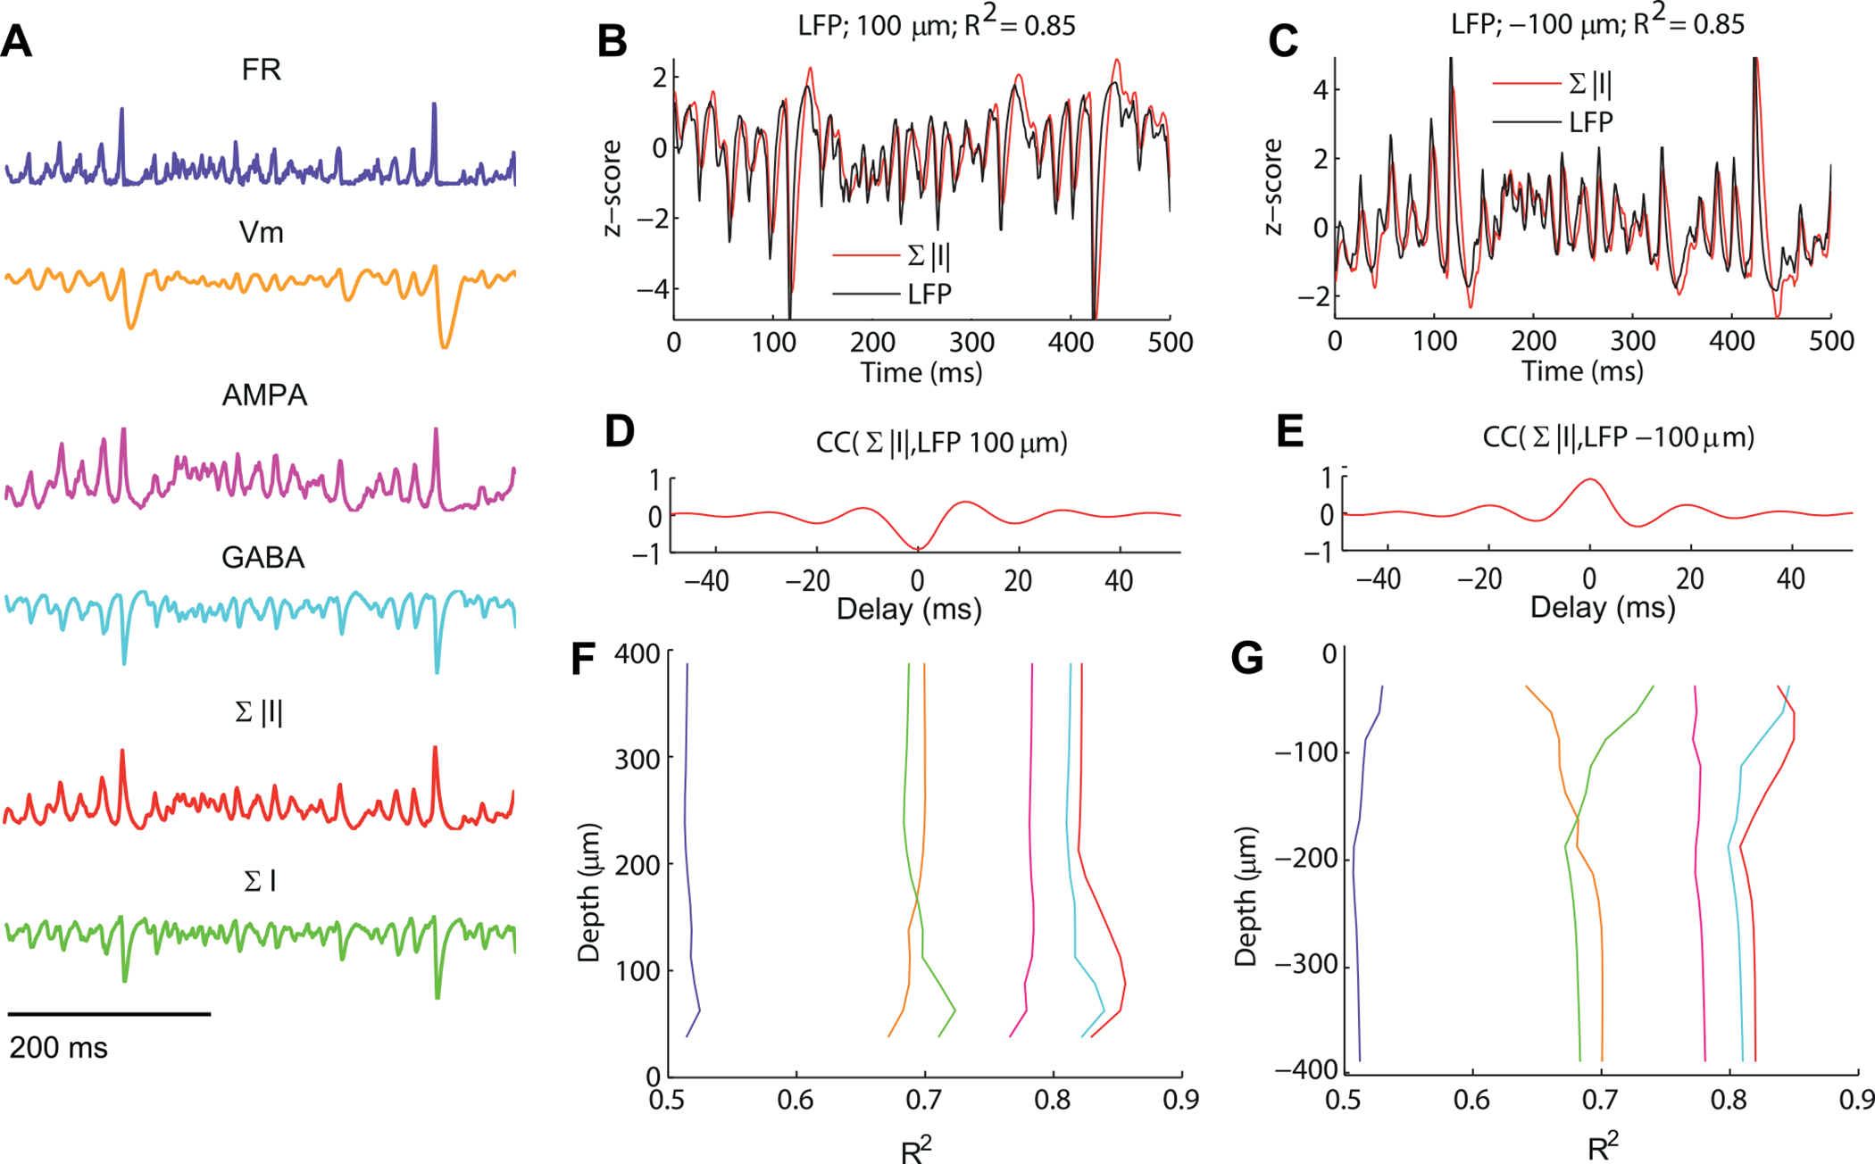
LFP simulation
Computing the LFP from Integrate-and-Fire Network Models.
(Mazzoni et al. 2015)

Slide 8
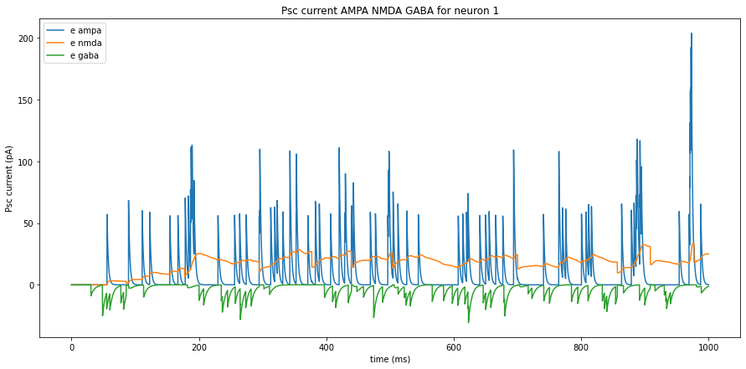
+ ]

Slide 9
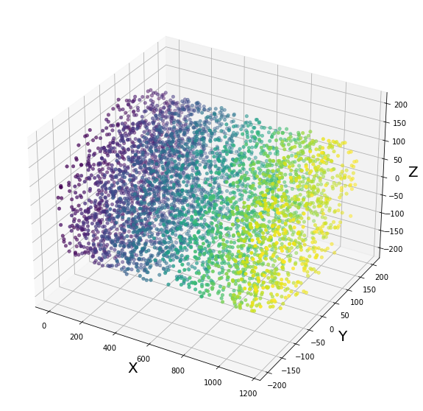
LFP simulation approach – more realisitc
Each time series has its own weight depending on the distance of the neuron from the electrode.
r=0
L2/3
L4
L5
L6
d
We can chose:
depth of the recording, d
distance from the center of the column, r
extension of the sphere where the electrode is sensitive, radaction
We count how many neurons we have in the sphere and record only from those. Compute their distance to the electrode to get the wi.
rad

Slide 10
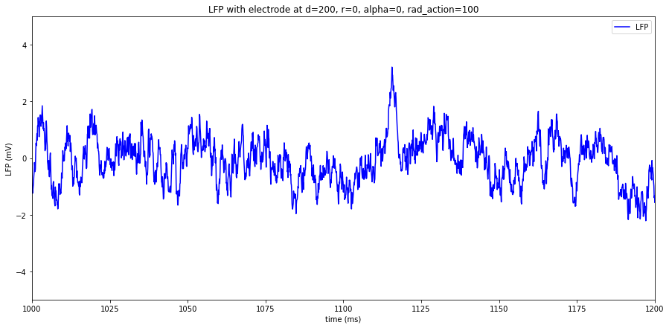
New LFP simulation approach
r=0
Layers of my column
L23_min=0 μm
L23_max=250 μm
L4_max=450 μm
L5_max=775 μm
L6_max=1150 μm
d
L2/3
L4
L5
With the current choice:
I am recording from 143 neurons in layer2_3 and
28 neurons in layer_4
L6

