Slide 1
Fowler Flap Angle Study and Animation
By Cameron Parvini

Slide 2
Fowler Flap History
Theorized in 1924 by Harlan D. Fowler
One orientation among many created at the time
Primary objective: devise a method to add variable lift control
Tested in 1927 by Fowler & Crewfoot
Approved by NACA several years later
Still in use today:
Boeing 707, 737, 747
Lockheed Martin C-130
Northrop-Grumman E-2C
Etc.

Slide 3
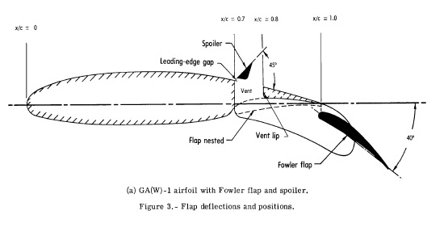
Geometry
Paulson, John W. Jr., *"Wind-Tunnel Investigation of a Fowler Flap and Spoiler for an Advanced General Aviation Wing,"* Langley Research Center, Hampton, VA 23665. June 1976. NASA TN D-8236.

Slide 4
Changes to Legacy Code
The following functions were altered to accept two foils:
build_rhs( ); additional index for our second Kutta Condition
build_matrix( ); reformatted to complete all the math without the use of as many functions.
get_tangential_velocity( ); additional argument for A_{ij}^{t}
New functions:
init( ); Initialization function for the animation
animate( ); Script for plotting each frame of the animation

Slide 5
Results
C_{P} appears within reason for the first several steps
Breaks down at higher flap angles, as expected
Lift and Accuracy calculations are reasonable compared to previous notebooks & OpenEdX assignment 3
Action required to both slide and rotate the flap proved “choppy” and imprecise – scrapped instead to focus on flap angle.
Animation functions took time, but the resulting video is very clean
Could improve by increasing steps and decreasing the change in flap angle.
Issues mainly with the time to render all of the steps.

Slide 6
Moving Forward
Could add functionality to slide flap out into position
Time required to render all the steps is terrible, and should be improved
Code looks clean, but doesn’t operate quickly.
Could be a great spot for GPU processing and/or parallel computing with PyCUDA or Numba due to the similarity of each calculation set.
Animating the intrados/extrados plots based on step
Extension could be made to 3-body flow, with considerable changes to the methods for referencing indices. Tuples might come in handy here.

