Slide 1
GUARD
Greenfield Urban Air Reconnaissance Drones
Final assignment for 2023/2024 edition of course Distributed and Pervasive Systems
Università degli Studi di Milano

Slide 2
Mutual exclusion
Implementation of Ricart and Agrawala algorithm

Slide 3
Basic Ricart and Agrawala
Permission based: when in need to go to the mechanic the process send requests to all active peers (in parallel)
Peers that are not interested in accessing a resource respond immediately
Peers that want to access the resource or are currently accessing it
Won’t respond if their timestamp is lower (if equal the robot id is used for determining precedence) → will respond when they are finished accessing the resource
Will respond with an ACK otherwise

Slide 4
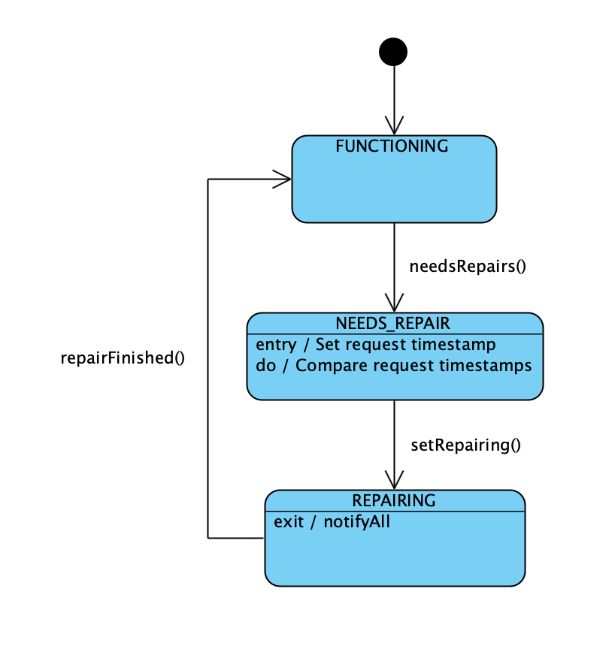
RobotRepairStatus & RequestService logic
Compare and adjust the logical clock (Lamport – Optional part 2)
If the robot is not in “FUNCTIONING” state then
Compare the timestamps
If the timestamp in the received request is higher then wait on the repair status: it will notify when the status changes from “REPAIRING” to “FUNCTIONING”
Send back the ACK response with the robot id and the current timestamp

Slide 5
Notes on the implementation
Since gRPC creates an instance of the service for each request (aka for each peer) there is no need to keep a list of requests that are deferred – the ack is sent when the thread is notified.
The requests are sent out in parallel through the creation of separate threads → only for the creation of the threads the robot synchronizes on the current list of active peers
As suggested by the gRPC documentation, ManagedChannels and stubs are re-used instead of re-initialised every time

Slide 6
Insertion of new robot during mutual exclusion
Every robot process has a list (internally implemented as a HashMap) of active peers that is initialized with the list that the server gives back upon successful registration.
KEY | VALUE
1 | Peer{id=1, ipAddress=“localhost”, port=9991}
2 | Peer{id=2, ipAddress=“localhost”, port=9992}
3 | Peer{id=3, ipAddress=“localhost”, port=9993}
… | …
The class P2PServiceManager encapsulates the logic for sending out p2p service requests through gRPC.
It sends out requests in parallel when there are 2 or more peers.
For this reason it is necessary to synchronize on the active peers when:
New robots must be added (introduction request received)
Requests for mutual exclusion coordination must be sent out

Slide 7


Introduction stub
Robot process 1
introduceMe()
2
Introduction requests are handled in parallel
introduceMe()
3
KEY | VALUE
KEY | VALUE
2 | Peer{…}
KEY | VALUE
2 | Peer{…}
KEY | VALUE
2 | Peer{…}
Put operations on the map are synchronized
KEY | VALUE
2 | Peer{…}
3 | Peer{…}
KEY | VALUE
2 | Peer{…}
3 | Peer{…}

Slide 8
P2PServiceManager
Robot process 1
Introduction stub
Depending on the order of execution the number of threads created changes
introduceMe()
4
Create 2 threads
KEY | VALUE
2 | Peer{…}
3 | Peer{…}
4 | Peer{…}
Thread 1
Thread 2
KEY | VALUE
2 | Peer{…}
3 | Peer{…}
Unlock
KEY | VALUE
2 | Peer{…}
3 | Peer{…}
KEY | VALUE
2 | Peer{…}
3 | Peer{…}
4 | Peer{…}
.start()
Repair request
Repair request
2
3

Slide 9
A1. (Concurrently) – repair requests
1
2
2 Responds immediately with ok, since it’s not interested in the resource and ends its participation.
1 and 3 send out requests.
1000
2000
1000
A. Beginning: 1 and 3 are interested in the resource, 2 is not. 4 Is not participating (insertion).
2000
3
4
1
2
A2. (Concurrently) – introduction
3
4
1
2
During mutual exclusion any process can respond with ACK to an introduction message.
3
4

Slide 10
3 different scenarios based on the status of the process that receives the introduction message
A1. (Concurrently) – repair requests
The process is accessing the resource (POV: 1)
Respond with OK
The process is not accessing the resource (waiting for it) (POV: 3)
Respond with OK
Immediately send a repair request
The process is not interested in accessing the resource (POV: 2)
Respond with OK
1 more ACK required
1
2
1000
2000
1000
2000
3
4
A2. (Concurrently) – introduction
1
2
3
4
2000

Slide 11
Scenario 1: 4 keeps being uninterested in accessing the resource
B. 1 accesses the resource, 3 waits, 4 responds OK
B1. 1 releases the resource and sends ack to 3
C1. 3 accesses the resource - end
A1. (Concurrently) – repair requests
1
2
1
2
1
2
1
2
1000
2000
1000
2000
3
4
3
4
3
4
3
4
Scenario 2: 4 is interested in accessing the resource
A2. (Concurrently) – introduction
B2. 4 sends out the requests
C2. 1 releases the resource, 3 accesses
D2. 3 releases, 4 accesses - end
1
2
1
2
1
2
1
2
1500
1500
3
4
3
4
3
4
3
4
2000
1500

Slide 12
Time/process | 1 | 2 | 3 | 4
t1 | Sends out repair request to 2 and 3 with timestamp 1000. It sees only 3 processes (4 not inserted yet). |  | Sends out repair request to 1 and 2 with timestamp 2000. It sees only 3 processes (4 not inserted yet).
t2 |  | Receives request from 1, answers with OK | Receives request from 1, answers with OK
t3 | Receives OK from 2 (1/2) | Receives request from 3, answers with OK
t4 | Receives OK from 3 (2/2) -> ACCESS RESOURCE |  | Receives OK from 2 (1/2) | Sends introduction message to 1, 2 and 3
t5 | Receives introduction from 4, answers ACK | Receives introduction from 4, answers ACK | Receives introduction from 4, answers ACK. Since not accessing resource but waiting -> send request to 4 | Sends out repair request to 1, 2 and 3 with timestamp 1500

Slide 13
Time/process | 1 | 2 | 3 | 4
t6 | Receives repair request from 4, doesn’t answer | Receives repair request from 4, answers OK | Receives repair request from 4, answers OK | Receives repair request from 3, doesn’t answer
t7 | Receives repair request from 3, doesn’t answer |  |  | Receives OK from 2 (1/3)
t8 | Releases resource, answer ok to 3 and 4 |  |  | Receives OK from 3 (2/3)
t9 |  |  | Receives OK from 1 (2/3) | Receives OK from 1 (3/3) -> ACCESS RESOURCE
t10 |  |  |  | Releases resource, answer ok to 3
 |  |  | Receives OK from 4 (3/3) -> ACCESS RESOURCE

Slide 14
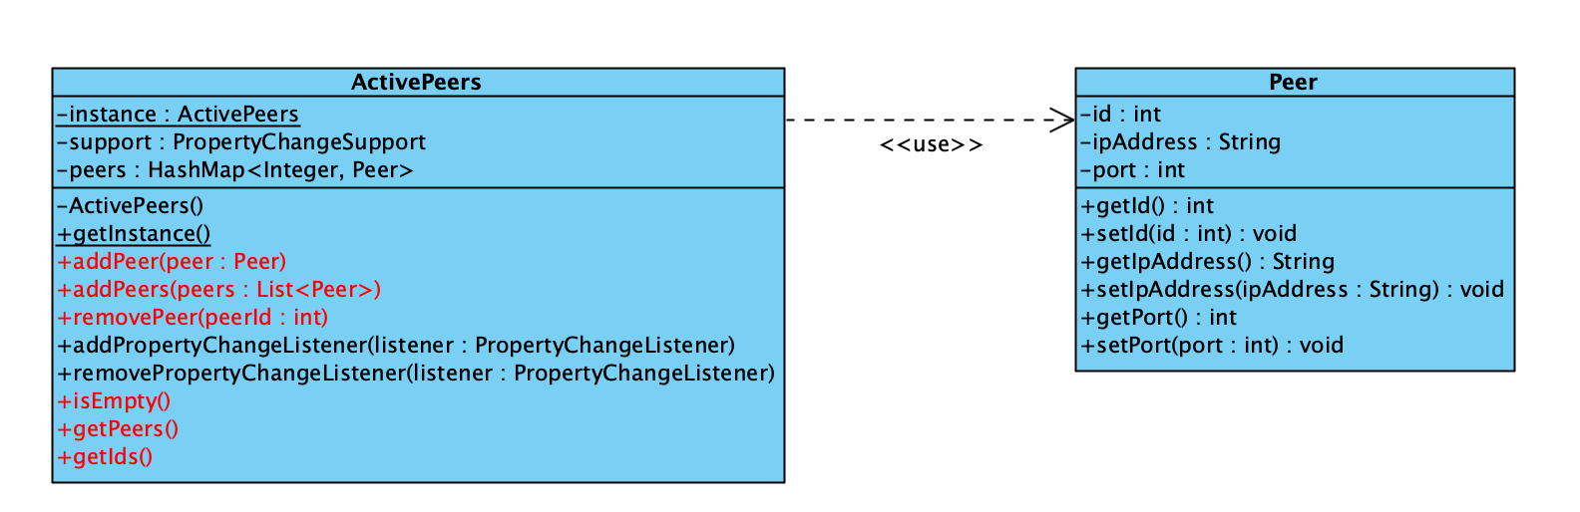
Requests in response to insertion of a new peer while mutual exclusion is ongoing are handled through a mechanism of notifications (Observer pattern): when a new peer is inserted and the status of the robot is NEEDS_REPAIRS a notification to the listers is sent out.

Slide 15
Crash detection and handling
How crashes are detected and handled in the P2P network?

Slide 16
Crash detection
In general, a robot process can detect that another process has crashed via gRPC while
Sending the introduction requests
Sending the repair requests
During load balancing
By using blocking stubs, the process waits for a response message or an exception to be raised
If an exception is raised with one of the following codes, the process may have crashed: UNAVAILABLE, UNKNOWN, INTERNAL, DEADLINE_EXCEEDED, ABORTED, CANCELLED
Before assuming the process crashed, we re-try a fixed amount of times with an exponential backoff strategy --> this might solve temporary brief disconnections from the network

Slide 17
START
retryCount = 0
backoffTime = 1000ms
Success = false
Send request
retryCount < MAX_RETRY?
Exception raised?
NO
YES
NO
Success = true
Sleep(backoffTime)
Success = true?
NO
Ack = -1
backoffTime *= 2
YES
Ack = 1
retryCount++
END

Slide 18
ID | ACK
1 | 1
2 | -1
3 | 1
4 | 1
Process is assumed to be crashed after 3 attempts failed
NOTE: since we are sending multiple request via gRPC, it can happen that, if the process responds after a previous failed attempt, the server may receive multiple identical requests (for example because of a delay in responding). For this reason it is important to ensure that the actions in response to the requests are idempotent!

Slide 19
Idempotency for introduction requests
When duplicated introduction requests are received
No duplicates are introduced in the ActivePeers structure, since it is implemented as an HashMap -> put with same key and same value have no effect
No property change events are fired since old value and new value for the same key are equal -> no additional requests during mutual exclusion are sent

Slide 20
Idempotency for repair requests
When duplicated repair request are received
On the server side there is no difference, the same request is treated as any other request
On the client side only one response is received

Slide 21
Crash detection during mutual exclusion
If mutual exclusion is ongoing we have one additional issue: how can we detect if a process that is currently accessing the resource crashes?

Slide 22
Approaches
Setting a fixed timeout
Setting up a temporary additional monitoring system
NOT FEASIBLE
Requires knowing in advance the order of precedence to access the resource
The order can only be inferred AFTER receiving ACKS
Insertion can happen at any time
When a process accesses the resource
Draws 3 peers at random from the active list (or all the peers if the list is smaller)
Sets up temporary communication channels and sends an “access” message
If the process crashes one of the connected peers is notified
Communicating with 3 peers instead of 1 tolerates the crash of 2 robots

Slide 23
If the process doesn’t crash, the protocol progresses as normal
2
2
Is about to access the resource
Launch timer thread (12s)
access(1, t1)
3
Is about to release the resource
release(1, t2)
3
access(1, t1)
Launch timer thread (12s)
1
4
release(1, t2)
1
4
access(1, t1)
5
release(1, t2)
5
6
Launch timer thread (12s)
6

Slide 24

If the process crashes it is removed and other process are signaled, the next process in queue accesses the resource
2
2
Is about to access the resource
Launch timer thread (12s)
Crashed (3, 1, t3)
access(1, t1)
3
The process crashes
3
Timer Expires
access(1, t1)
Launch timer thread (12s)
1
4
1
Crashed (3, 1, t3)
4
Timer Expires
access(1, t1)
5
5
6
Launch timer thread (12s)
6
Timer Expires
Possibly duplicated crashed messages are simply ignored

Slide 25
Crash detection during mutual exclusion
If mutual exclusion is ongoing we have one additional issue: how can we detect if a process that is currently accessing the resource crashes?
Temporary access timers on selected peers
What happens if a process waiting to access crashes?
The crash is detected as a normal crash as previously described by the process that is releasing the resource -> when sending out the response gRPC raises an exception

Slide 26
Handling the crashes: important assumptions
In the context of this project we DON’T deal with some complex behavior that might arise in real distributed systems, in particular
We don’t deal with network partitions --> Detection and handling of this kind of issues requires the implementation of more complex algorithms such as Paxos or Raft and are out of the scope of the project
We deal only with crash behavior

Slide 27
Handling the crashes: how
Done via a producer-consumer model
We use 2 separate CrashEventMonitor objects
One to handle events that are detected by the current process and have to be notified to other peers and the server
One to handle solely events that are received from other peers
Multiple different producer threads
Main cleaning robot thread via calls to P2PServiceManager -> outgoing crashes
RepairService service side – when monitoring process accessing the resource -> outgoing
CrashRecovery service server side -> incoming

Slide 28
CrashEventMonitorIncoming
CrashEventMonitorIncoming
Producers
Consumers
Producers
Consumers
Server-side gRPC crash recovery service
When receiving a crashed message from another robot
Crash handler (incoming): when receiving a message, it pings the allegedly crashed robot – if pinging succeeds it signals the peer as NOT crashed and does nothing. If the ping fails it removes the robot from the active list.
Server-side gRPC repair service
When monitoring the peer that is accessing the resource and the timer expires
Crash handler (outgoing): if all responses to the requests confirmed the crash, removes peer from the list, sends a DELETE message to the server via REST and evaluates the need for load balancing on the districts
Client-side gRPC repair service
When sending out the requests
Client-side gRPC introduction service
When sending out the requests

Slide 29
Load balancing
Re-distributing robots across districts

Slide 30
Load balancing ensures that when a robot enters or leaves Greenfield, the districts are assigned a balanced amount of robots
Insertion-time load balancing is taken care server-side: the initial district and position is communicated when a new process robot is initialising
Removal-time load balancing is done p2p network side via GRPC

Slide 31
Load balancing on robot side
Invoked when a robot crashes or leaves Greenfield gracefully
Makes use of a LoadBalancingMonitor with 3 states

Slide 32
LoadBalancingMonitor states
STEADY
Steady is the default state.
A dedicated thread, LoadBalancer, waits for a notification of state change.
REBALANCING
EVALUATING

Slide 33
LoadBalancingMonitor states
STEADY
When a crash is detected or a robot leaves Greenfield gracefully, the status of the monitor is set to EVALUATING by the competent thread.
This notifies the LoadBalancer that wakes up and initiates the first phase of the process.
REBALANCING
EVALUATING

Slide 34

Load Balancing Phase I - Initiation
When in the EVALUATING state, the process, if there are active peers besides itself, sends out INIT requests
An INIT message simply contains the id of the robot that is starting the process and the logical timestamp
The message is broadcasted (in parallel) to every other robot in the grid at that moment
The robots that receive an INIT message respond with their id, a logical timestamp, their current position (district, x, y coord) and a flag that signals the robot if it’s allowed or not to proceed with the next phase
The flag is necessary to prevent more than one process to proceed to phase 2: in particular the flag is set to false only if the receiving process is either in REBALANCING state or is in EVALUATING state and its request timestamp is lower than the received one

Slide 35
Robots in steady state
In this example, two robots are in the EVALUATING state.
They both send out requests to initiate load balancing.
Robots in evaluating state
2000
Init(3, 2000)
Init(3, 2000)
Init(3, 2000)
Init(4, 3500)
Init(4, 3500)
Init(4, 3500)
3500

Slide 36
Robots in steady state
Since robot 3 sent the request with a lower timestamp, it responds negatively to robot 4. Robot 3 can then proceed to phase 2 as it received all the acks required, while robot 4 falls back to steady state.
Robots in evaluating state
2000
(1, t1, pos, TRUE)
(2, t2, pos, TRUE)
(1, t1, pos, TRUE)
(2, t2, pos, TRUE)
(3, t3, pos, FALSE)
(4, t4, pos, TRUE)
3500

Slide 37
LoadBalancingMonitor states
STEADY
When the process receives all required acks it can proceed to phase 2 and decide how the grid is going to change.
REBALANCING
EVALUATING

Slide 38
Load Balancing Phase II
In this stage the process evaluates the grid states and determines if there is a need for moving any robots
If changes are to be made, new random positions for the robots that have to move are generated and the list of changes is broadcasted to all the robots
If no changes are needed the process terminates immediately (no messages exchanged further)
Finally, if changes occurred, the server is notified via REST api (PUT)

Slide 39
Load Balancing Phase II
The termination messages, if exchanged, contain the following:
The robot id
The logical timestamp
A list of changes (containing the robot id, the new district and the new coordinates)
A robot, when receiving a termination message
Updates the status of the grid
If its id is contained in the list of changes it proceeds with changing its MQTT topic
Responds with an ACK (containing robot id and timestamp)

Slide 40

Robots in steady state
Robot 3 has detected that there are 2 robots in district 1 and none in district 4, so it decides robot 2 has to move to district 4.
Robot 2 moves to district 4 and changes its MQTT topic.
Once finished robot 3 falls back to steady state.
Robots in rebalancing state
Termination message
PUT
robotId: 3,
Timestamp: 3000,
Changes: [
id: 2,
newDistrict: 4,
newX: …,
newY: …
]

Slide 41
Sliding window for sensor data
Implementation

Slide 42
Specs
Buffer interface provided as an external package
Sensor data is simulated at a fixed frequency and must be processed with a sliding window technique considering a buffer of 8 measurements and a 50% overlap.

Slide 43


Implementation: producer-consumer pattern
Internally represented as a linked list of measurements
The consumer waits on the buffer until it is notified the buffer is full (8 measurements)
If the buffer is full the consumer thread wakes, takes all 8 measurements (snapshot) and removes the oldest 4 measurements
All methods are synchronised
Producer
Consumer
Adds new measurements in the buffer as they are produced
Takes all measurements in the buffer when full, computes average and removes the 4 oldest

Slide 44
Notes
The producing thread never waits: the linked list can contain more than 8 elements but the consumer is notified at 8 and will take the snapshot of only 8 measurements
New elements are added in the tail, old elements are removed from the head
The list is passed to a specialised thread that has the responsibility to compute the average, put them in a list and communicating this list every 15 seconds to the server via MQTT

Slide 45
