Slide 1
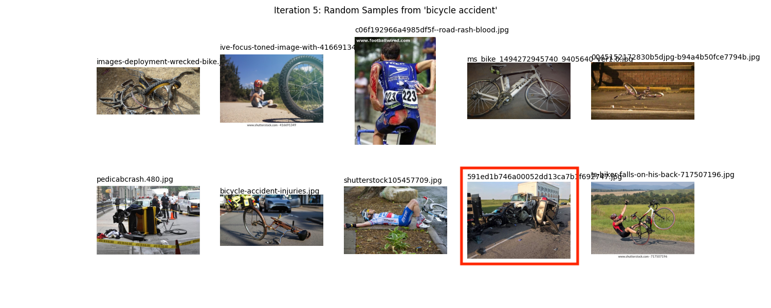
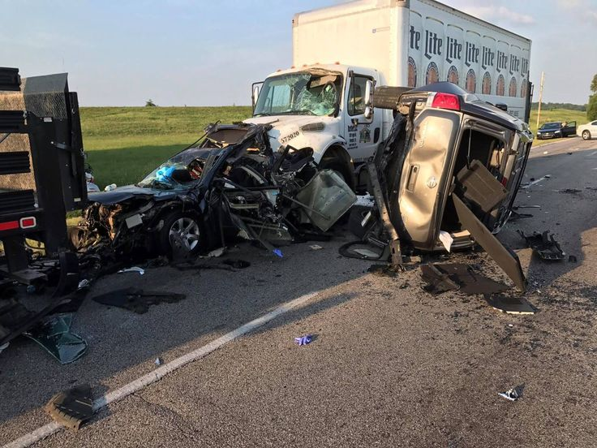
Figure 1. File 591ed1b746a00052dd13ca7b1f692747.jpg labelled “bicycle accident”, but should be labelled “car accident”.

Slide 2
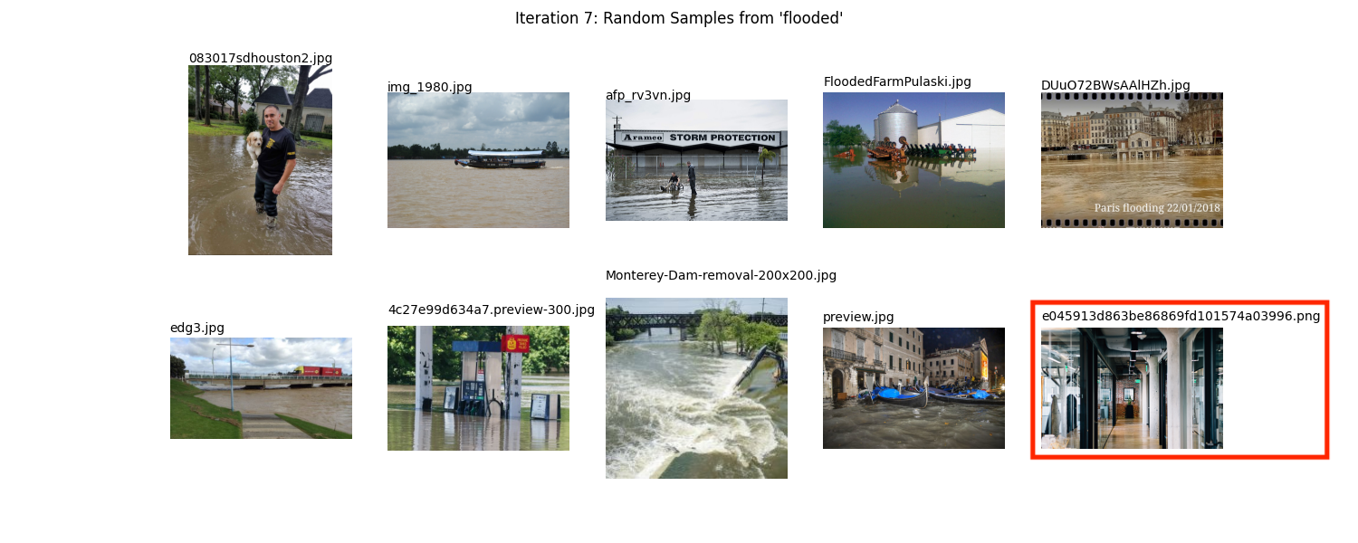

Figure 2. File e045913d863be86869fd101574a03996.png labelled “flooded”, when it does not depict any relevant incident.

Slide 3
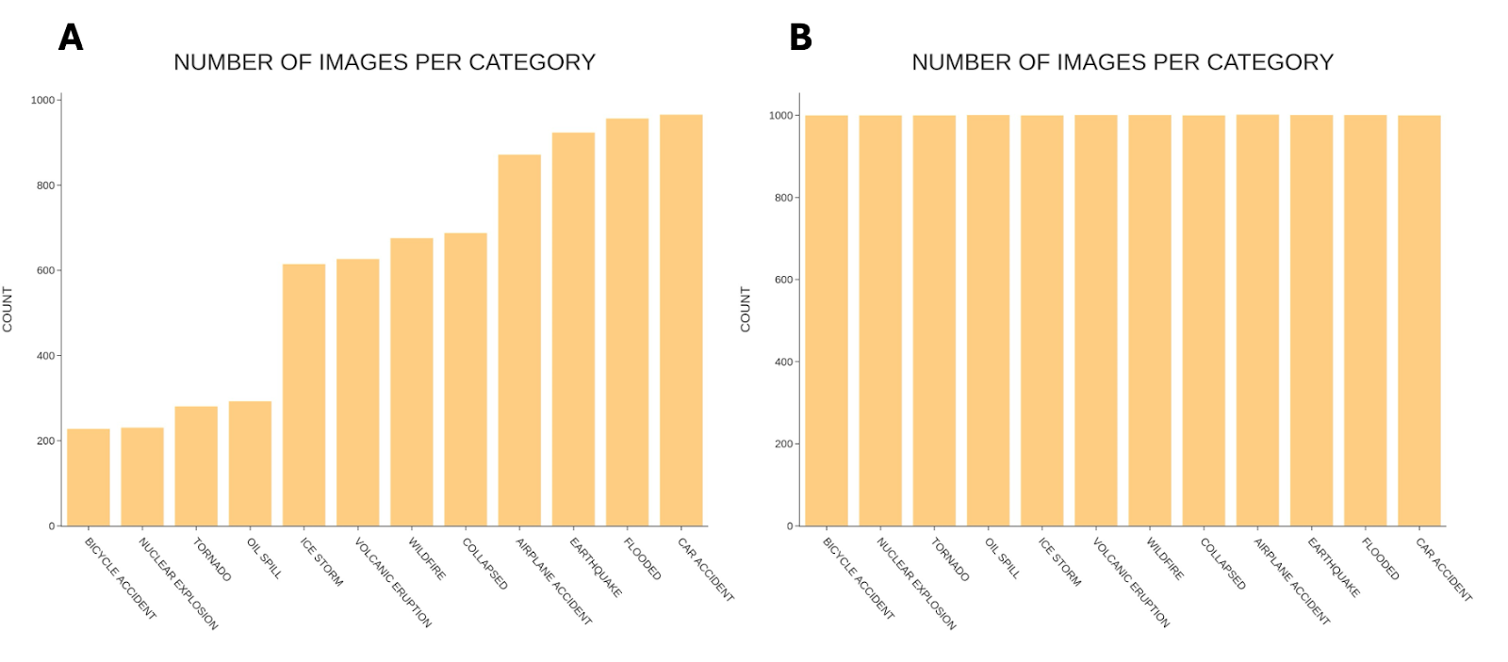
Figure 3. Overview of category abundances A) before data augmentation and B) after data augmentation.

Slide 4
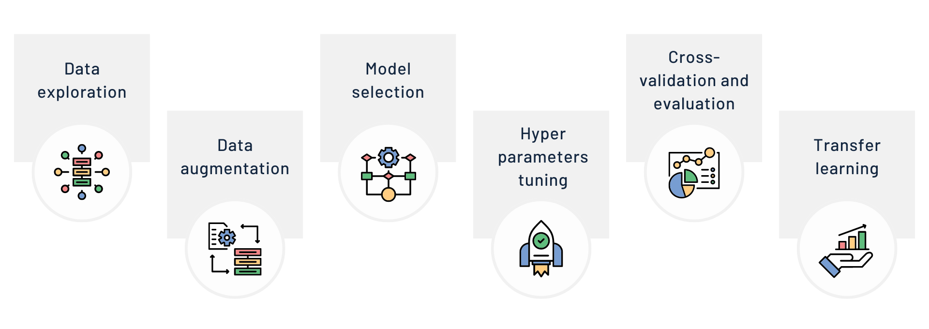
Figure 4. Graphical representation of all the steps followed in our methodology.

Slide 5
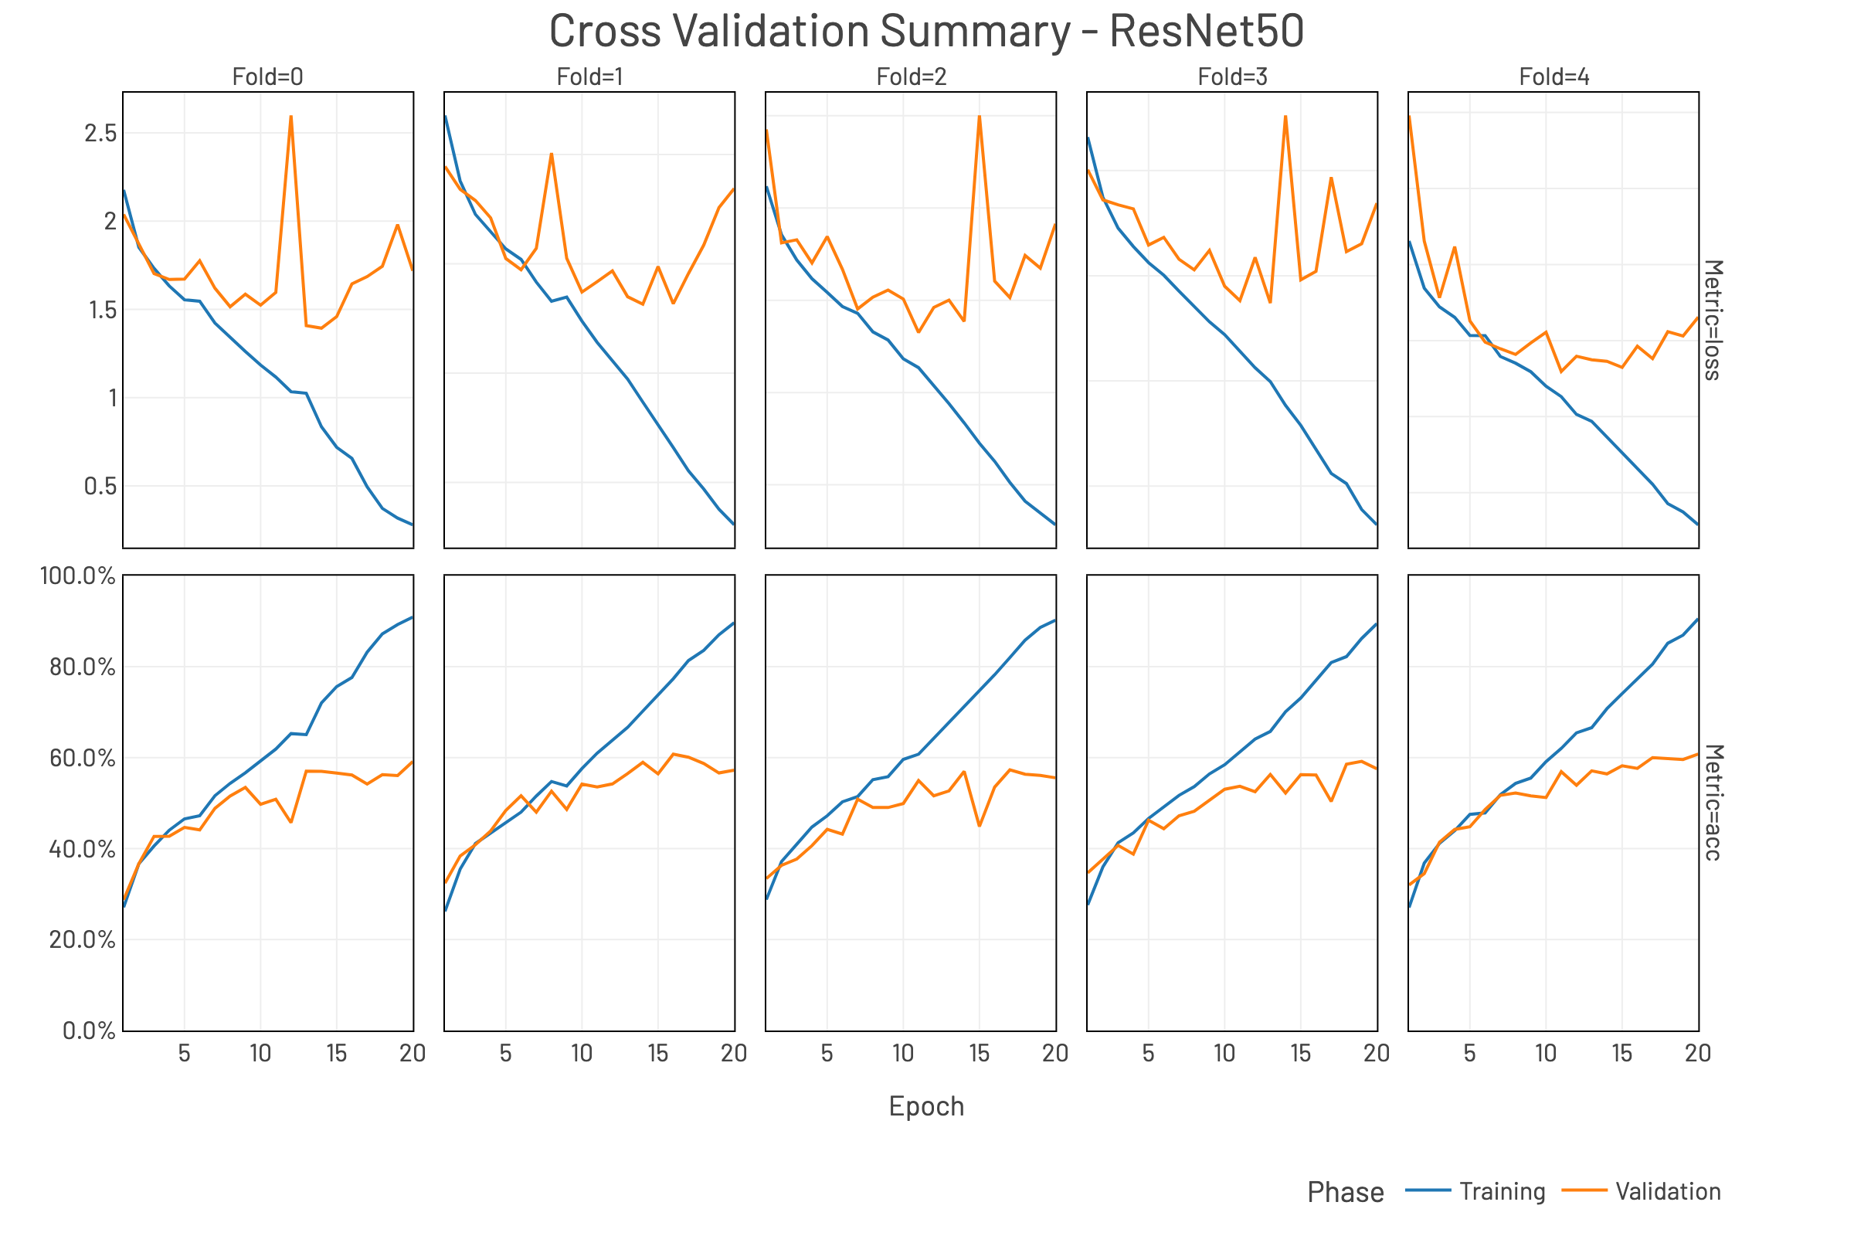
Figure 5. Overview of the 5-fold cross validation process on ResNet50. Plotted in the first row, for each separate fold are the curves for training and validation cross entropy loss for each epoch; plotted on the second row the curves for the training and validation accuracy for each epoch. We can observe that the general trend is very similar in all the folds, suggesting that performance does not depend on a particular split of the dataset, and all folds indicate clearly the presence of overfitting.

Slide 6
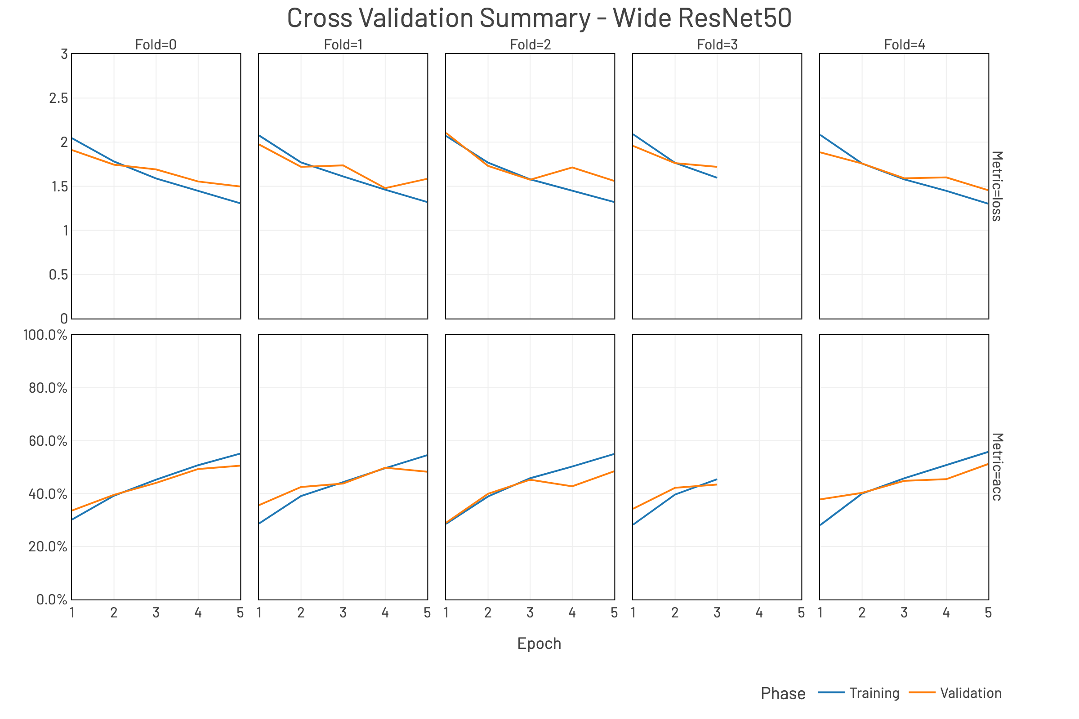
Figure 6. Overview of the 5-fold cross validation process on Wide ResNet50. Plotted in the first row, for each separate fold are the curves for training and validation cross entropy loss for each epoch; plotted on the second row the curves for the training and validation accuracy for each epoch. Some data points are missing for fold 3, presumably due to errors when persisting the result files. The model shows clear signs of underfitting.

Slide 7
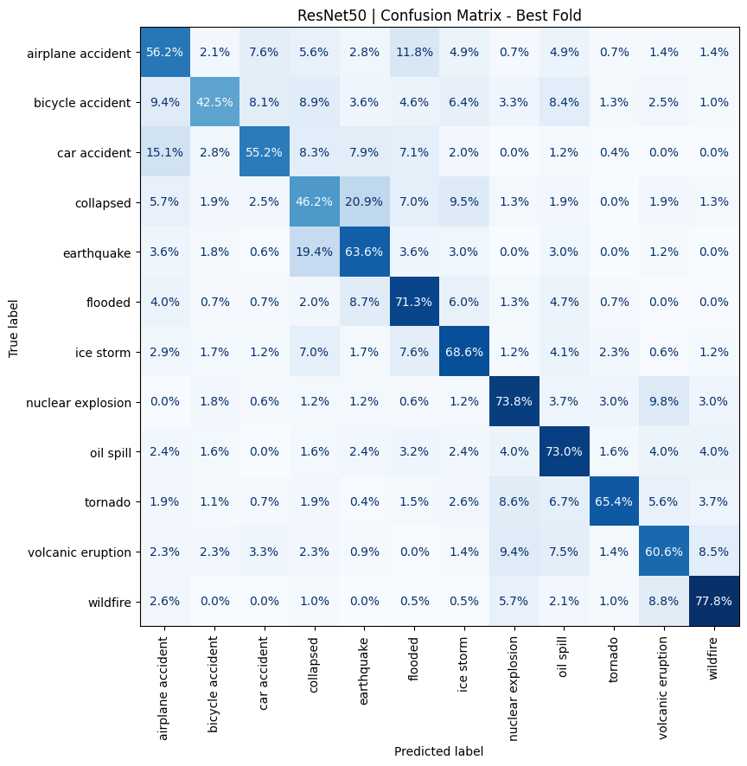
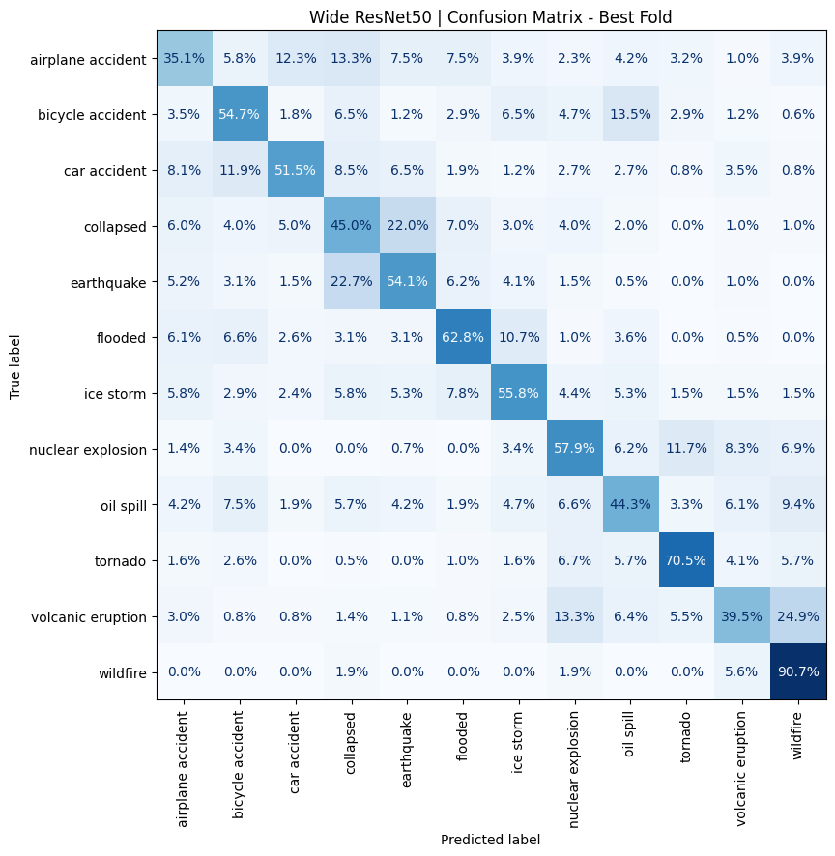
A
B
Figure 7. Confusion matrices for the best folds based on maximum accuracy for ResNet50 (A) and Wide ResNet50 (B). In A we can observe that some classes have a lower accuracy, but counter-intuitively, this does not interest solely the original under-represented classes but also well-represented ones like “car accident”. This might suggest lack of variety of the presence of mislabelled samples for that category.

Slide 8
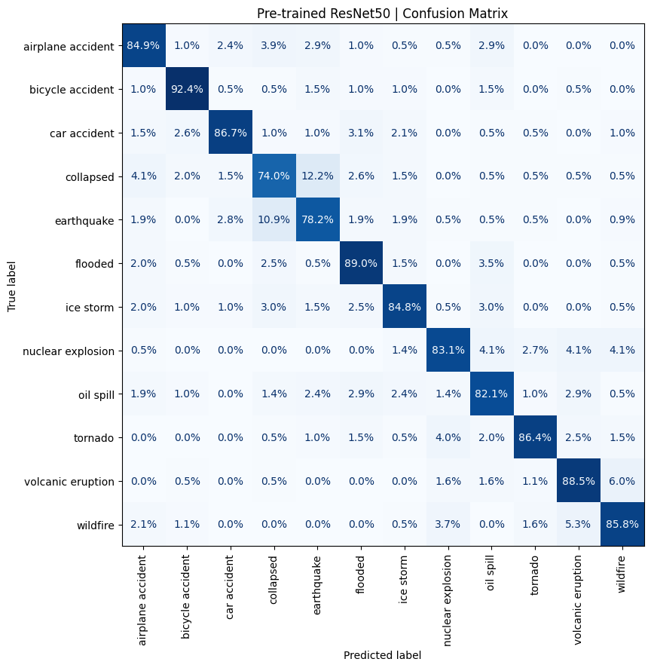
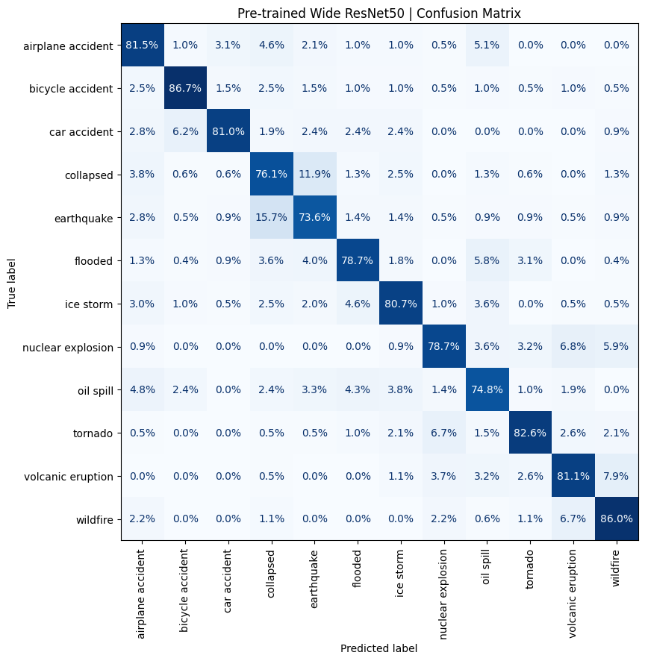
A
B
Figure 8. Confusion matrices for the pre-trained ResNet50 (A) and Wide ResNet50 (B). Accuracy of all classes improved quite significantly, especially classes like “bicycle accident” and “car accident”.

Slide 9
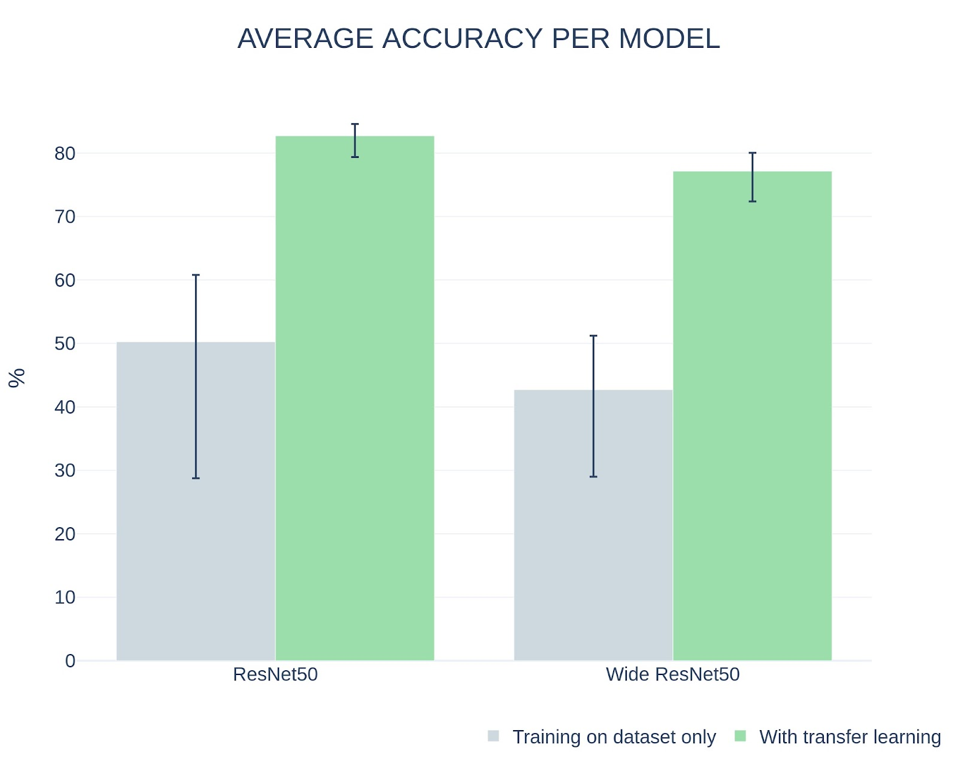
Figure 9. Comparison side by side of the accuracy of both models without transfer learning (in grey) and with transfer learning (in green). The reported accuracy for the no-transfer learning approach is the average on 5 folds, with the error bars indicating the minimum and maximum respectively. The reported accuracy for the transfer-learning approach is the average over all epochs, with error bars indicating minimum and maximum respectively.

