Slide 1
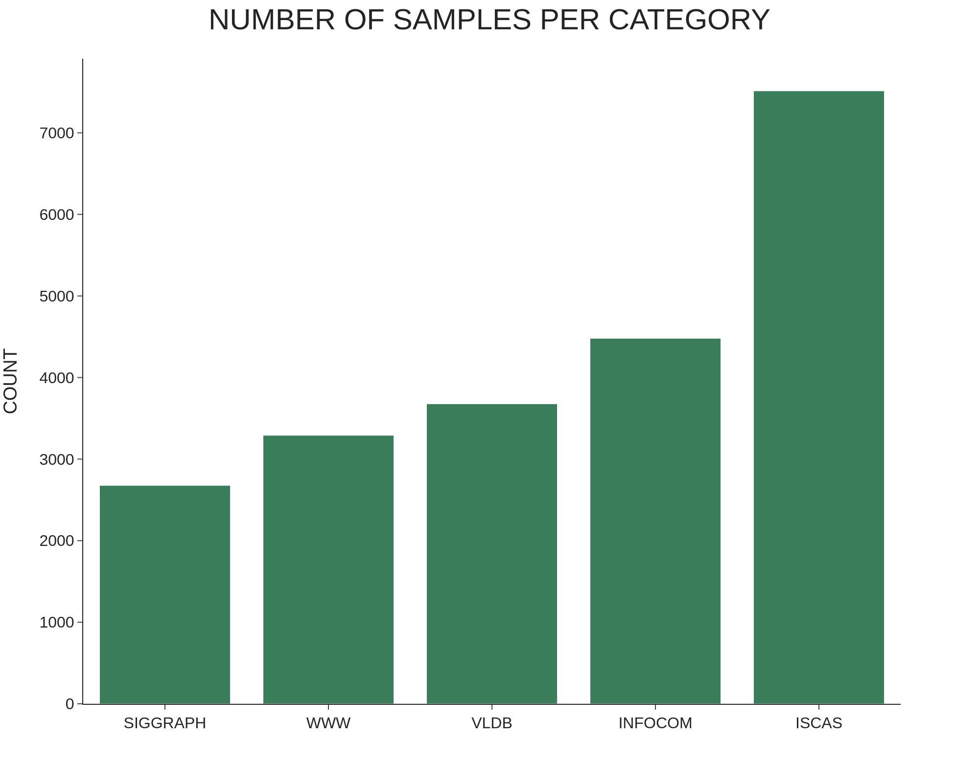
Figure 1. Distribution of samples across different categories.

Slide 2
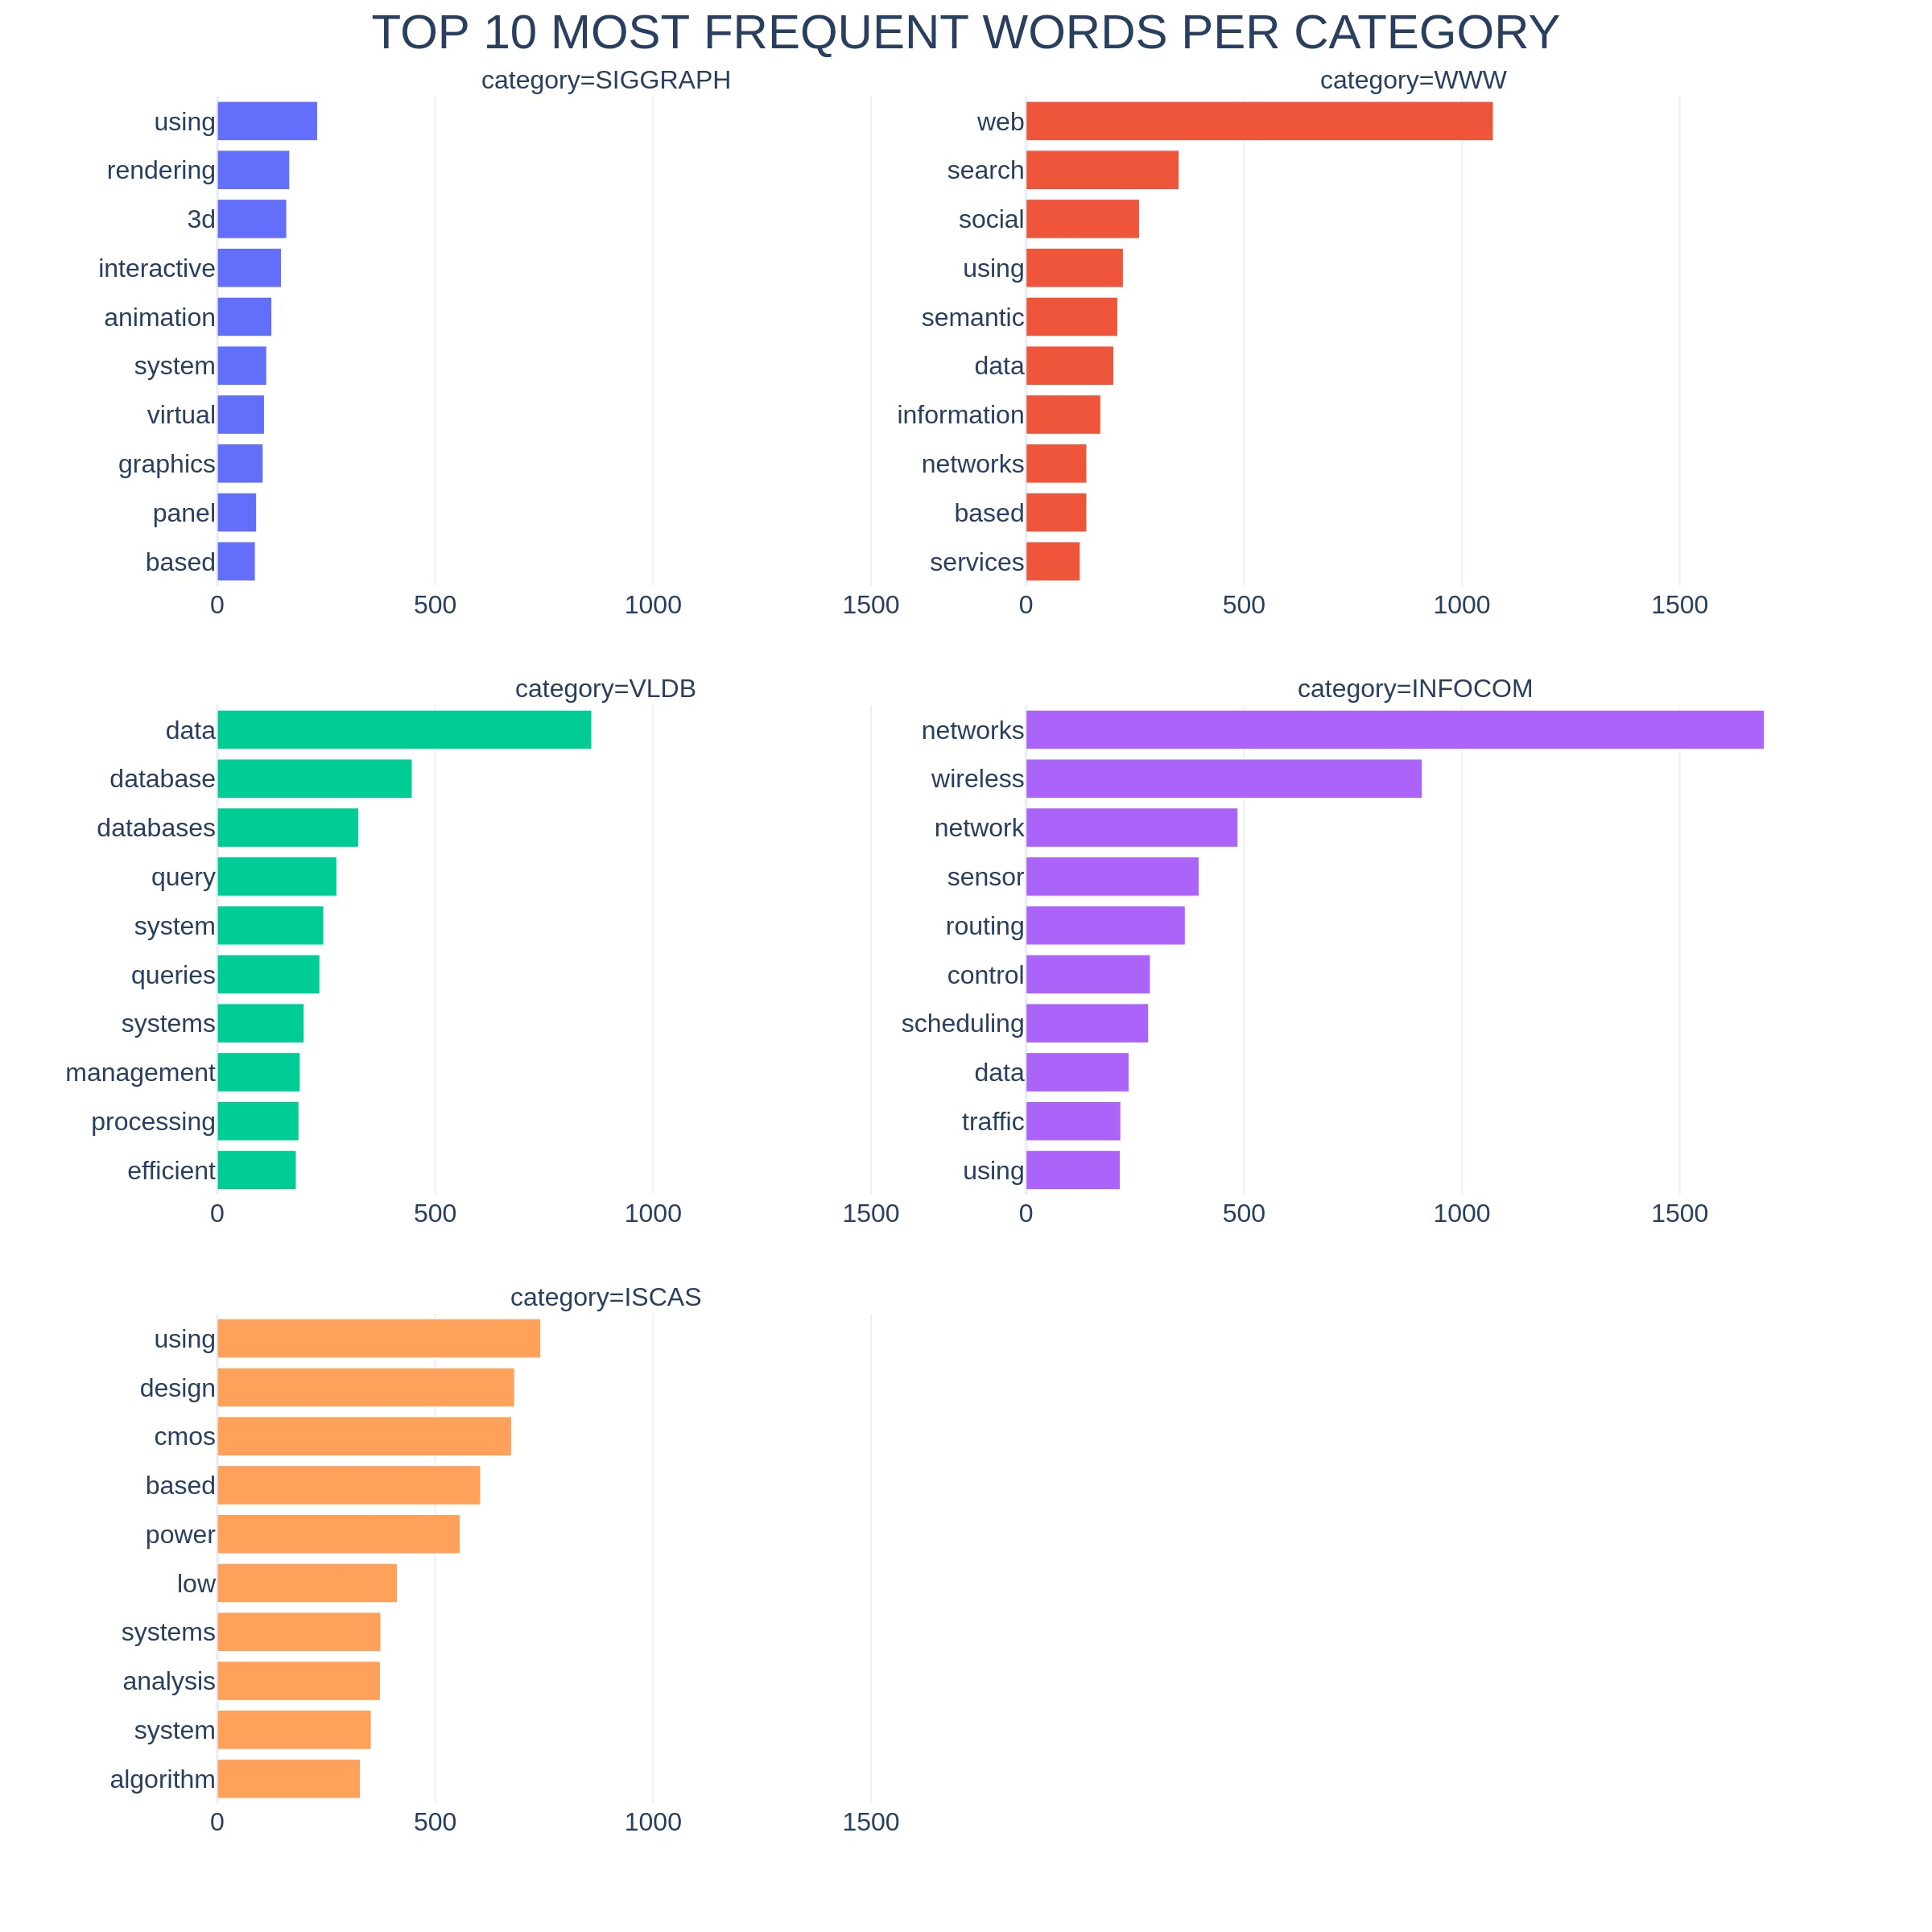
Figure 2. Top 10 most frequent words per category. The ranking does not include common English stopwords.

Slide 3
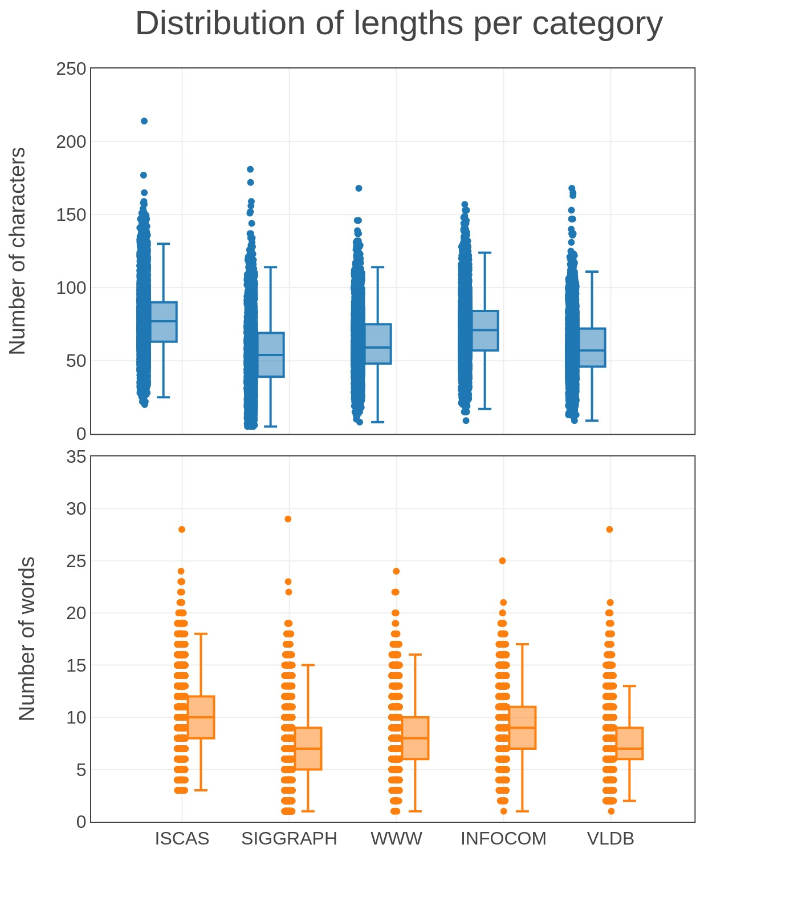
A
B
Figure 3. Distribution of data points by length in terms of number of characters (A) and number of words (B) for each category.

Slide 4
Data exploration
Data pre-processing and encoding
Model selection
Hyper parameters tuning
Complement Naive Bayes
k-NN
SVM
Random Forest
5-Fold Cross validation
Retrain and evaluation on test set
Improvements and advanced approaches
BERT
Figure 4. Graphical representation of the steps followed in our metodology.

Slide 5
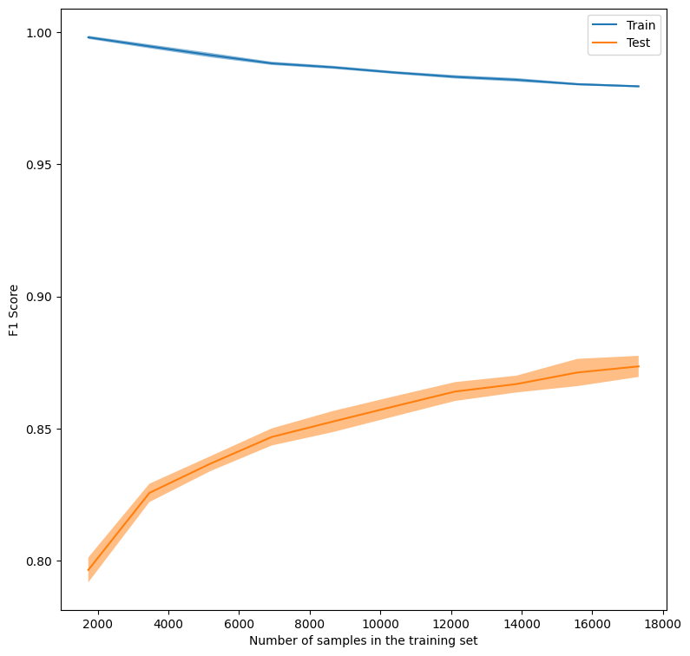
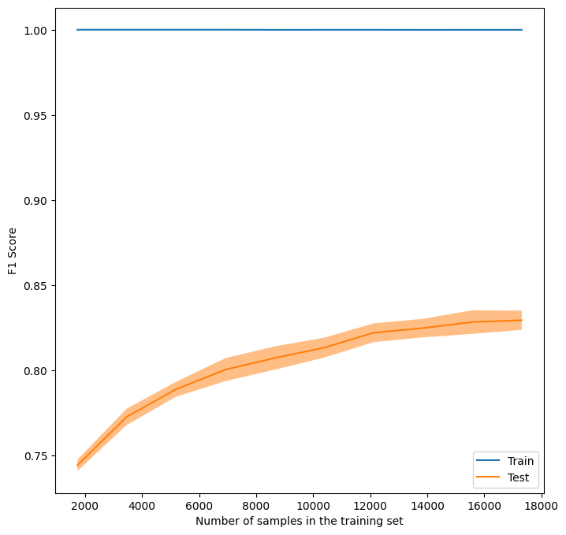
Complement Naive Bayes
K-NN

Slide 6
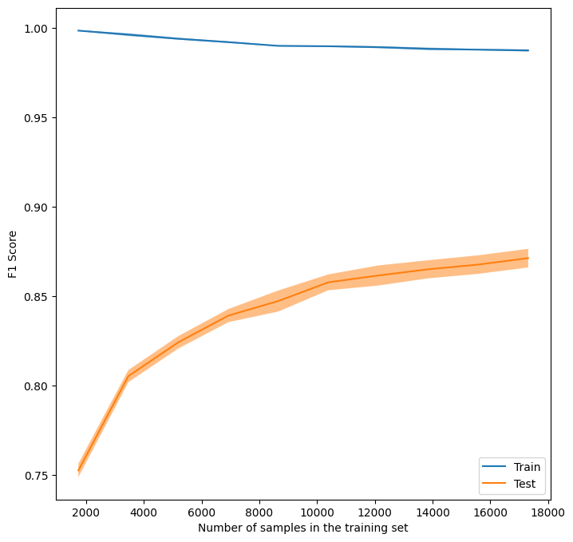
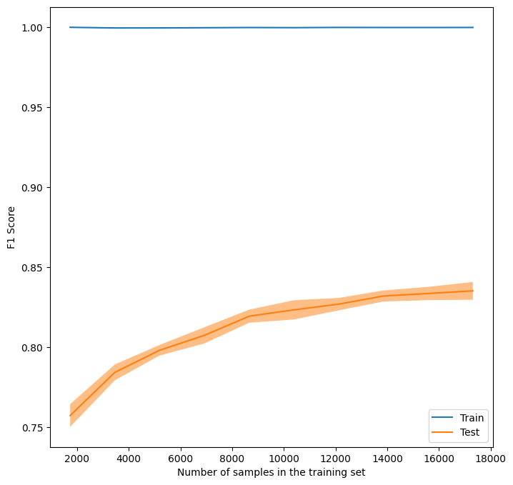
SVM
Random Forest
Figure 5. Learning curves for the four models. All models show signs of overfitting, with training score being systematically higher than test score and a typical plateau tendency of the test curve, more pronounced in K-NN and Random Forest with overall worse scores.

Slide 7
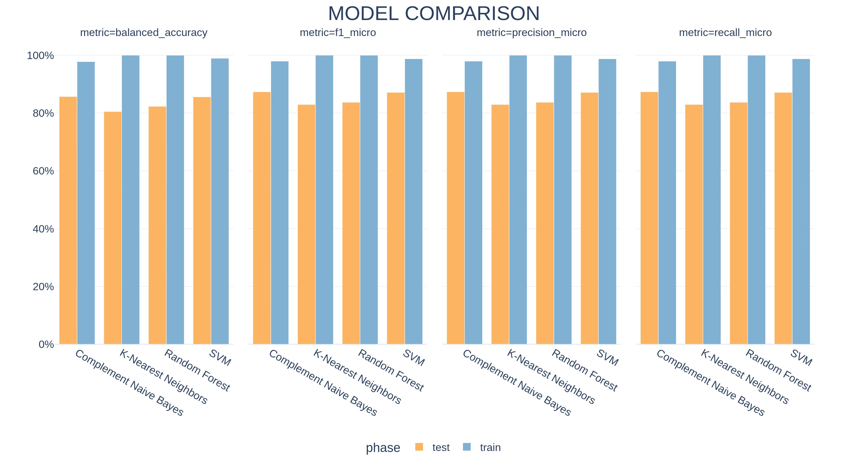
Figure 6. Comparison of the four models with four different metrics. Reported values are averages across the 5-folds of cross validation, for both train (blue) and validation (orange).

Slide 8
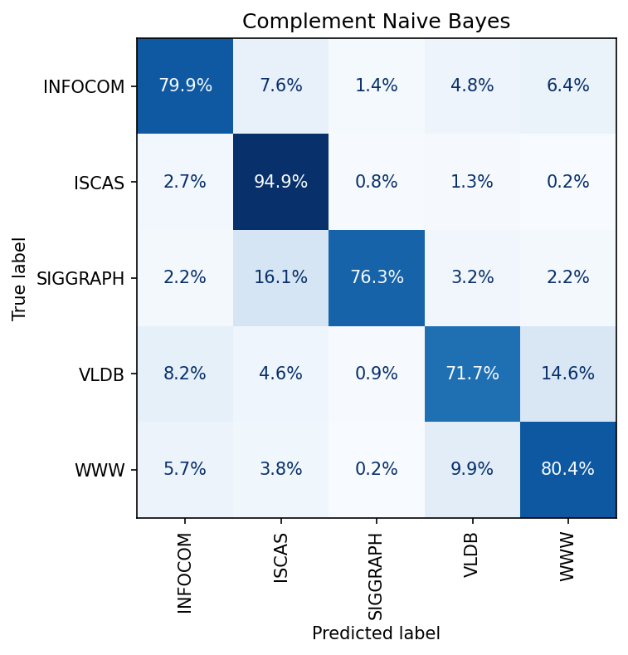
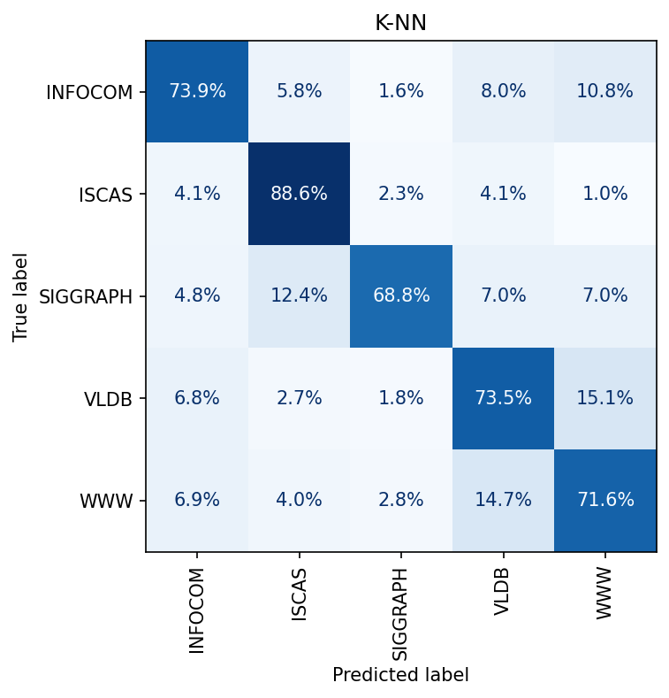

Slide 9
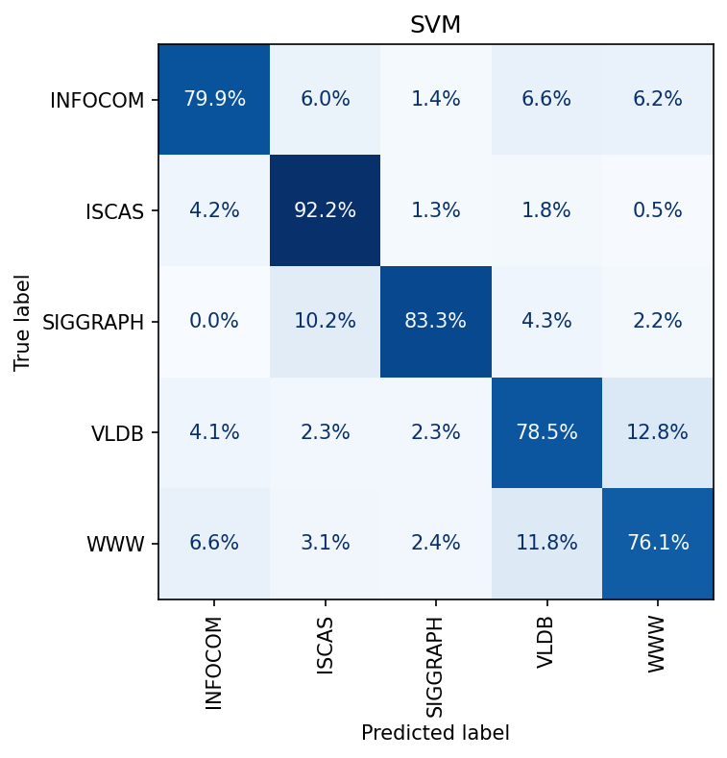
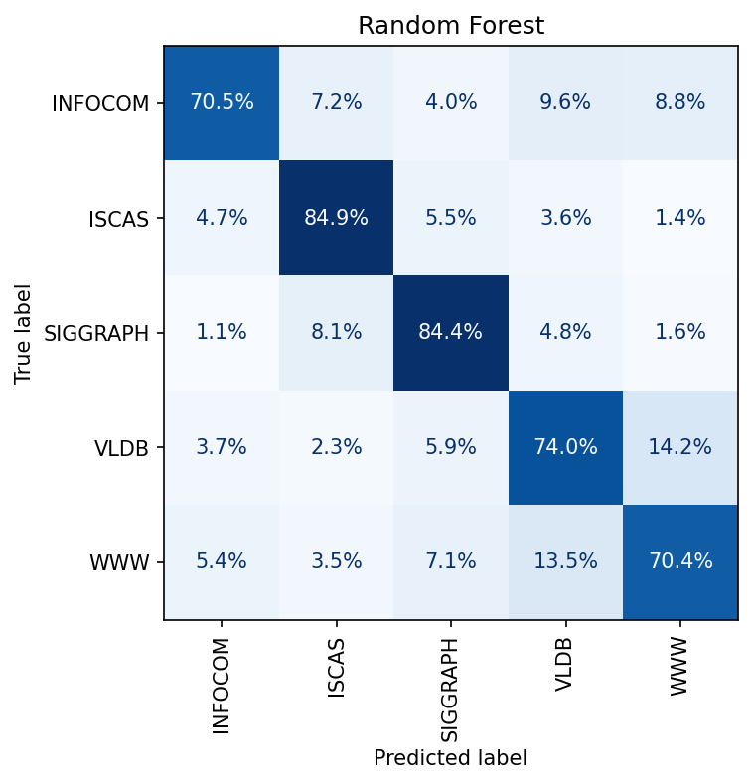
Figure 7. Confusion matrices for the four models re-trained on the whole training set and tested on a separate test set.

Slide 10
Balanced accuracy | Precision (micro) | Recall (micro) | F1 Score (micro) | Model
80.64% | 88.32% | 88.32% | 88.32% | CNB
75.30% | 82.24% | 82.24% | 82.24% | KNN
82.02% | 86.98% | 86.98% | 86.98% | SVM
76.84% | 80.20% | 80.20% | 80.20% | RF
Table 1. Performance scores for the four models re-trained on the whole training set and tested on a separate test set.

Slide 11
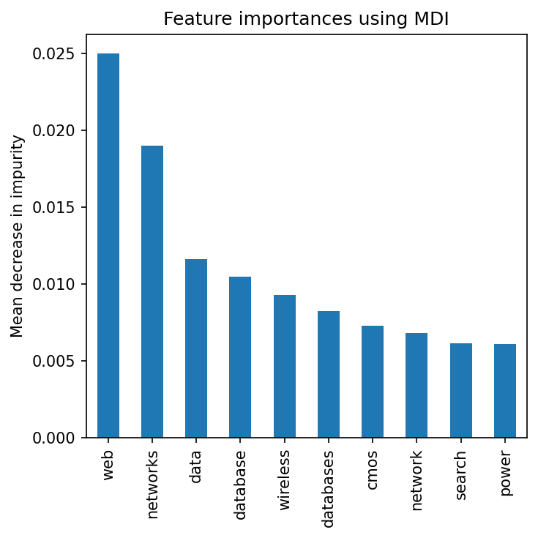
Figure 8. Feature importances extracted from the Random Forest model. Here we report only the top 10 most important features by mean decrease in impurity.

