Slide 1
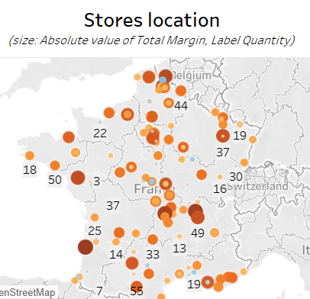
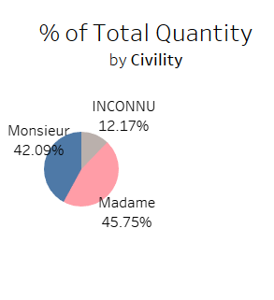
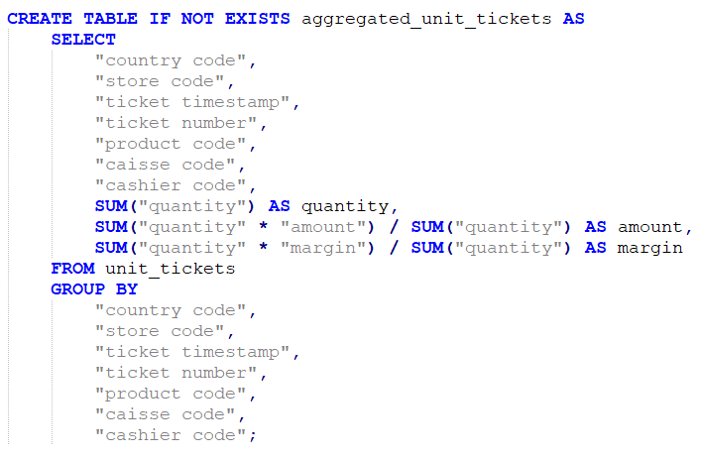
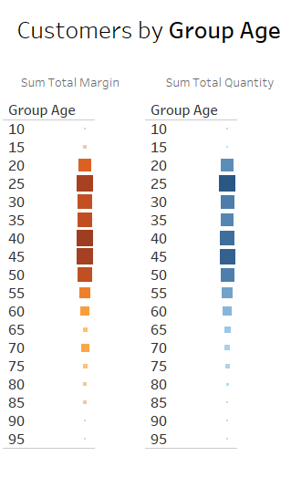
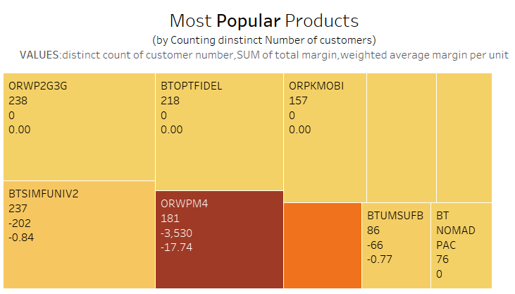
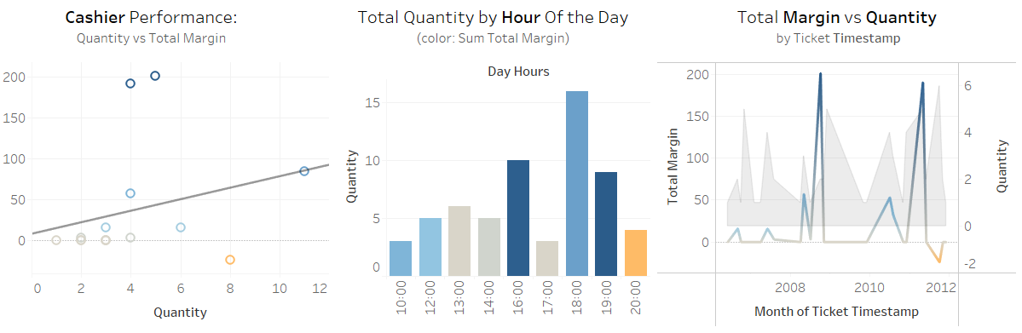
BI1-Project
Authors: Giulia Rossi
Academic year: 2024-2025
Who and What Contributed to the Margin Reduction?

Slide 2
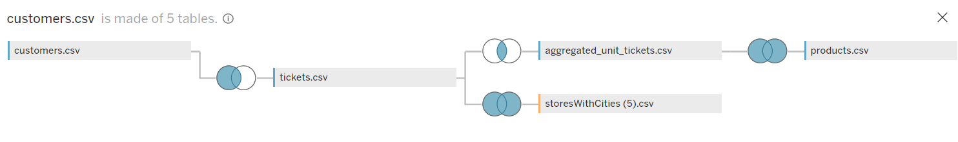
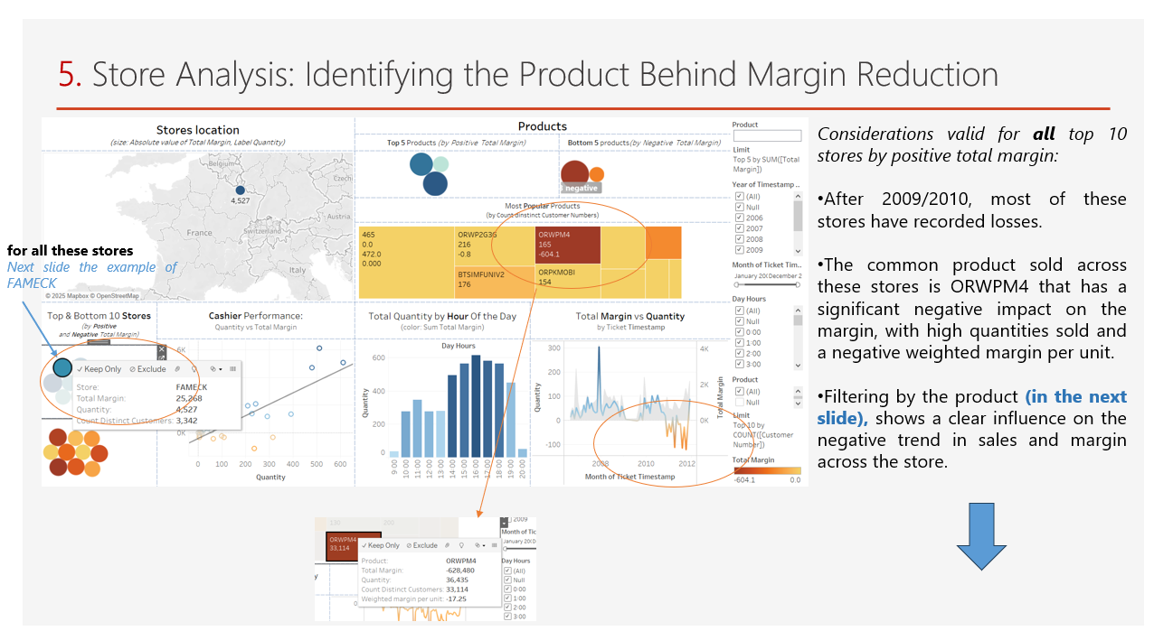
Introduction
1
Join Reasons
2
Brief explanation of the modified unit_tickets table
3
Goal of the analysis and Introduction to the Dashboards
4
Indicators:
4.1. Key indicators
4.2. Stores and Products indicators
4.3. Customer indicators
5
Interactive Storytelling->Identifying the Causes of Margin Reduction
6
Conclusion

Slide 3

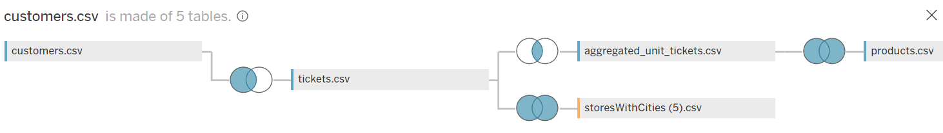



1. Join Reasons
?
The analysis focuses on customers, products and stores
INNER JOIN: Tickets not associated with unit_tickets and viceversa will not be analyzed
FULL OUTER JOINs are used to ensure that all stores and all products are preserved, even if they were not sold or associated with a ticket
CUSTOMERS
“country code , "customer number“ , "civility“ , "first name“ , "birthday“ , "store code creation“ , "store code attachment
PRODUCTS
“product code” ,"product"
STORES
“country code” , "store code“ , "store"
TICKETS
“country code” , "store code“ , "timestamp ticket“ , "ticket number“ , "customer number"
UNIT_TICKETS
“country code” , "store code“ , "ticket timestamp“ , "ticket number“ , "line number“ , "product code“ , "caisse code“ , "cashier code“ , "quantity“ , "amount“ , "margin"
Each customer is associated with at least one ticket, and vice versa
Not all tickets are associated with unit_ticket

Slide 4
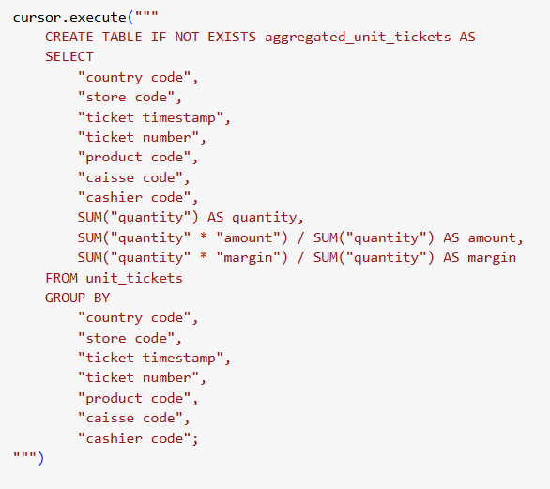
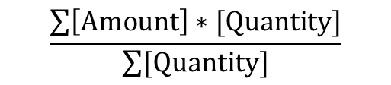
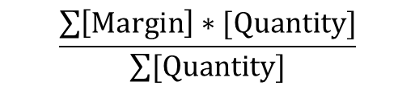
2. Reduce unit_tickets table
It aggregates the same product appearing multiple times in the same ticket
Associate a weighted average to the amount and margin
$$\frac{\sum{\left[Amount\right]∗[Quantity]}}{\sum{[Quantity]}}$$
$$\frac{\sum{\left[Margin\right]∗[Quantity]}}{\sum{[Quantity]}}$$

Slide 5
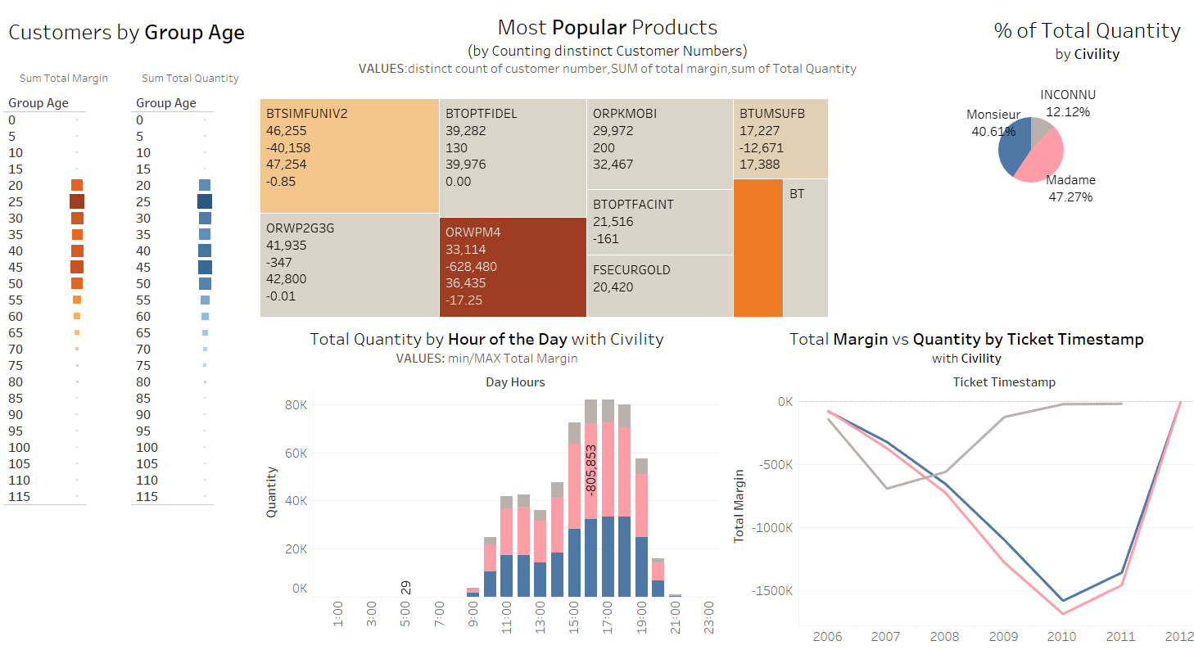
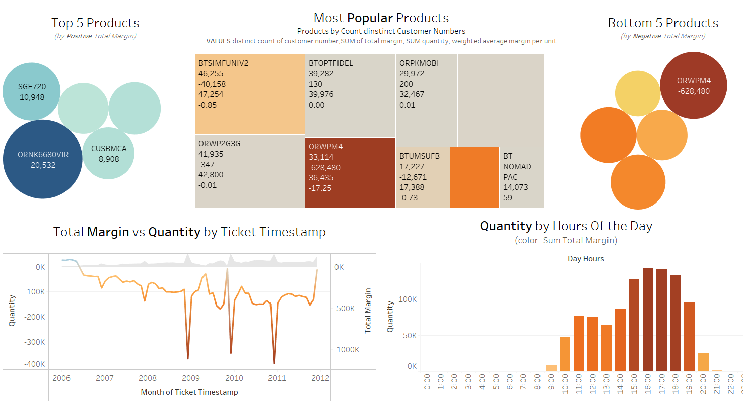
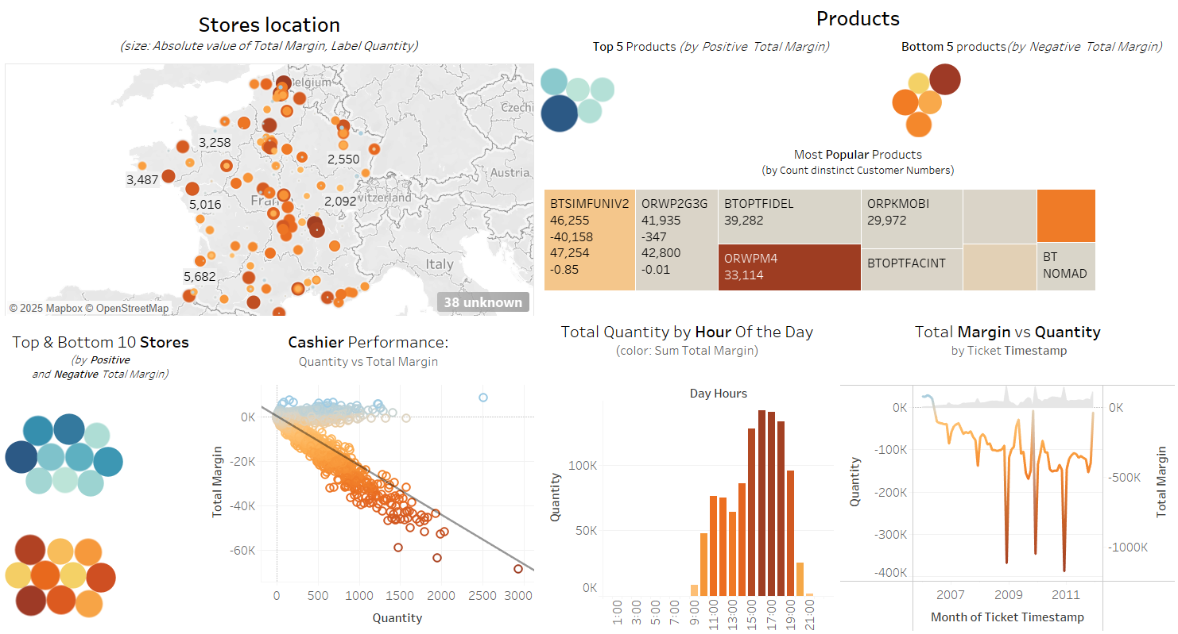
3. Goal
The analysis focuses on 3 aspects: products, stores and customers, aiming to identify how the sale of certain products has impacted the overall margin.
There are 3 dashboards, each dedicated to one of these elements.
1
Customers
2
Products
3
Stores

Slide 6
3. Dashboards
The indicators are divided into key indicators, product indicators, customer indicators, and store indicators.
1
Customers
2
Products
3
Stores
The same product indicators and key indicators are present on all 3 dashboards
The key indicators on the customer dashboard differ only in color (by Civility), but analyze the same aspects as on the other dashboards.

Slide 7

4. Introduction to the Indicators
All indicators in the 3 dashboards (except 3 indicators for the analysis of the customers)
are colored by: Total margin sum
Blue for Positive Total Margin
Orange for Negative Total Margin
Why?
to visually highlight losses and gains
Next the explanation of the indicators:
Key indicators
Product and Store indicators
Customer Indicators
Followed by the analysis

Slide 8
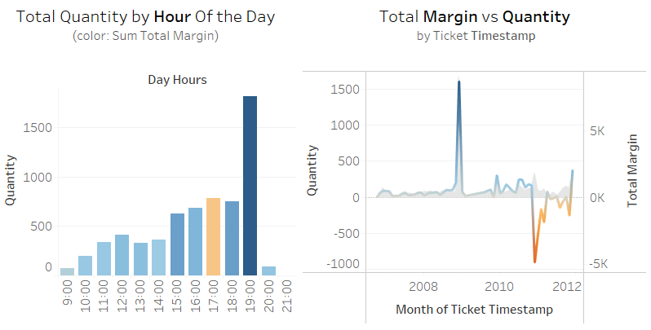
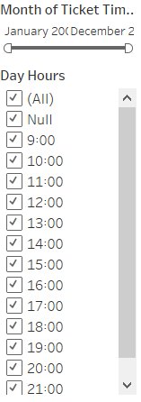
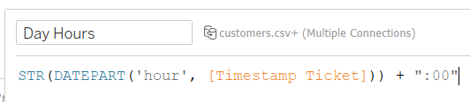
4.1. Key Indicators
These 2 indicators are present on all 3 dashboards and allow for analyzing the margin and quantity sold across different products, stores, age groups ,civilities and cashiers.
Quantity
Filters that allow analyzing data by months of the year or by hours of the day
Why use the dual axis?
In some cases, the total margin is zero. It helps determine whether this is due to a lack of sales during that period or because there was no profit despite the sales
Margin

Slide 9
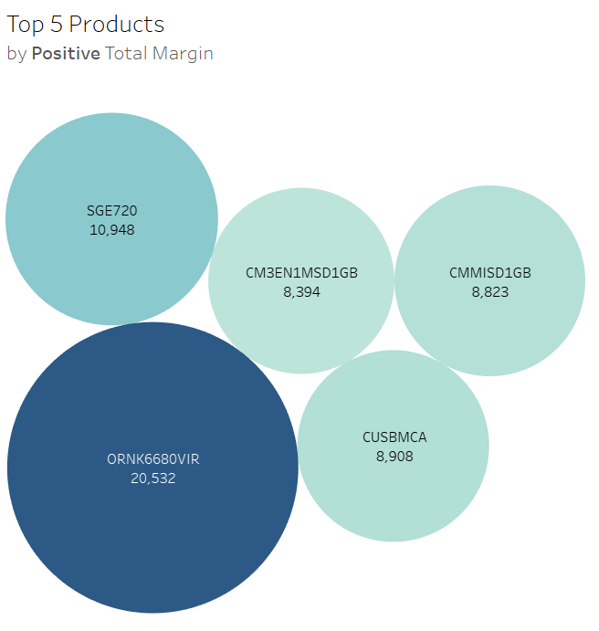
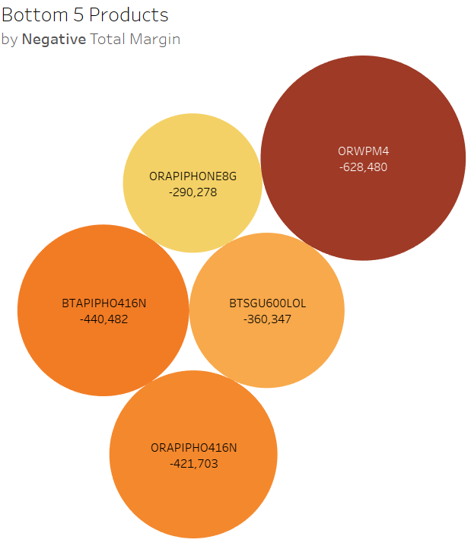
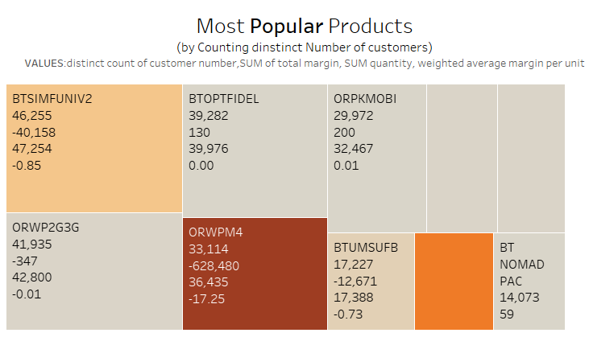
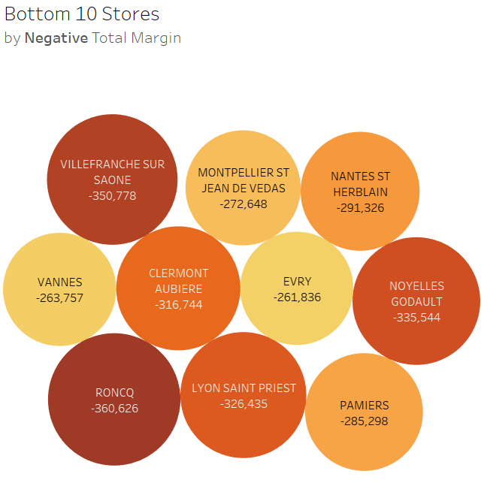
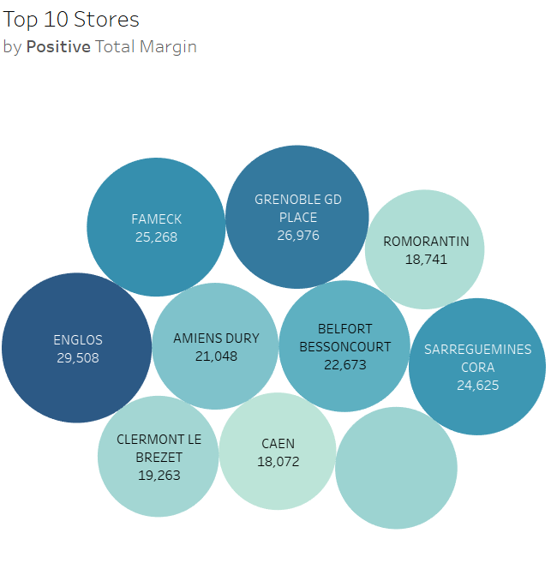
4.2. Products and Stores Indicators
4 Bubble charts:
Size: Sum total margin
Used to analyze the products and stores that generated the highest positive margins and the lowest negative margins
1 Treemap:
Size: Count Distinct Customer Number
Used to analyze the products purchased by the highest number of distinct customers, “Popular products”.

Slide 10
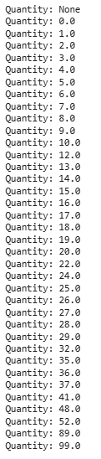
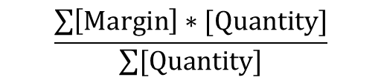
4.2. Product Indicator: Treemap
1. Count distinct Customer Numbers
2. Total Margin
3. Sum Quantity
4. Weighted margin per unit
$$\frac{\sum{\left[Margin\right]∗[Quantity]}}{\sum{[Quantity]}}$$
product quantities can vary, it allows for a precise evaluation of profitability

Slide 11
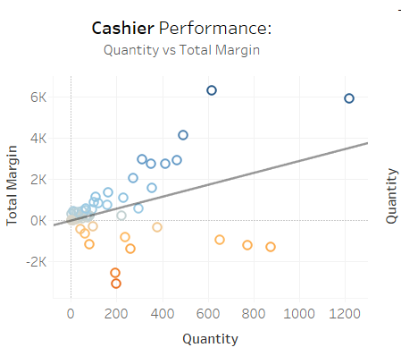
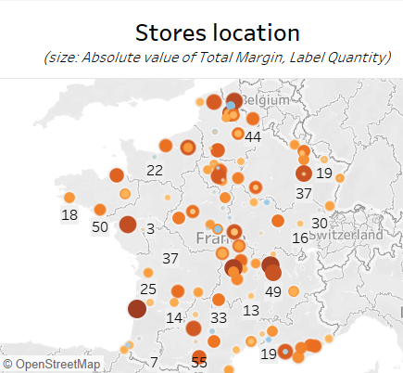
4.2. Store Indicators
Map:
Size: absolute value of the total margin
Color: sum of the total margin.
Label: sum of the quantity
Allows to analyze where the products have been sold and identifies areas with more negative margins
1. It allows identifying which cashiers generate the highest and lowest margin relative to the quantities sold.
2. When compared with the main indicator for "margin by hours of the day," it helps assess a specific cashier's performance throughout the day
3. It is possible to identify cashiers who have sold a specific product or work at a specific store by using the previous indicators as filters

Slide 12
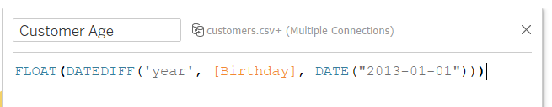
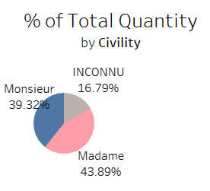
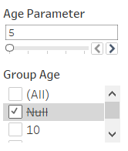
4.3. Customer Indicators
1. Customer age calculated from January 2013, since the latest recorded sales are from the beginning of 2012
2. Also used as filter
Pie chart :
shows the percentage of total quantity sold based on civility

Slide 13
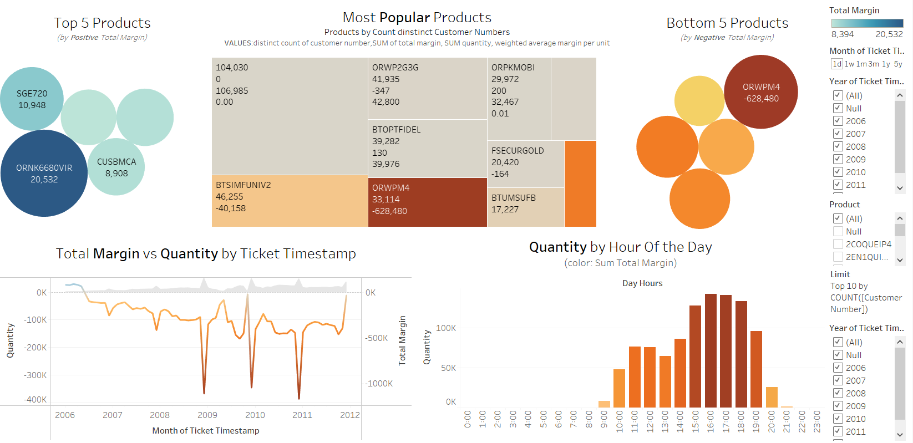
5. General Consideration for the analysis
Considering all products, all customers, and all stores, the overall margin is negative.
Starting with a positive margin in 2006, it has shown negative peaks in subsequent years.
One of the product that have had the greatest impact is ORWPM4:
Purchased by the majority of distinct customers (popular product)
Sold by most stores (including those with the highest positive total margin)
Has the most negative margin
In contrast, the products with the highest positive total margin:
had sales limited to 2006.
showed lower quantities sold compared to other products.
In the following slides, the behavior of the products with the highest margins is analyzed to understand how they have influenced the total margin. Subsequently, the product ORPWM4 is analyzed, along with its distribution across stores and the types of customers who purchased it.

Slide 14
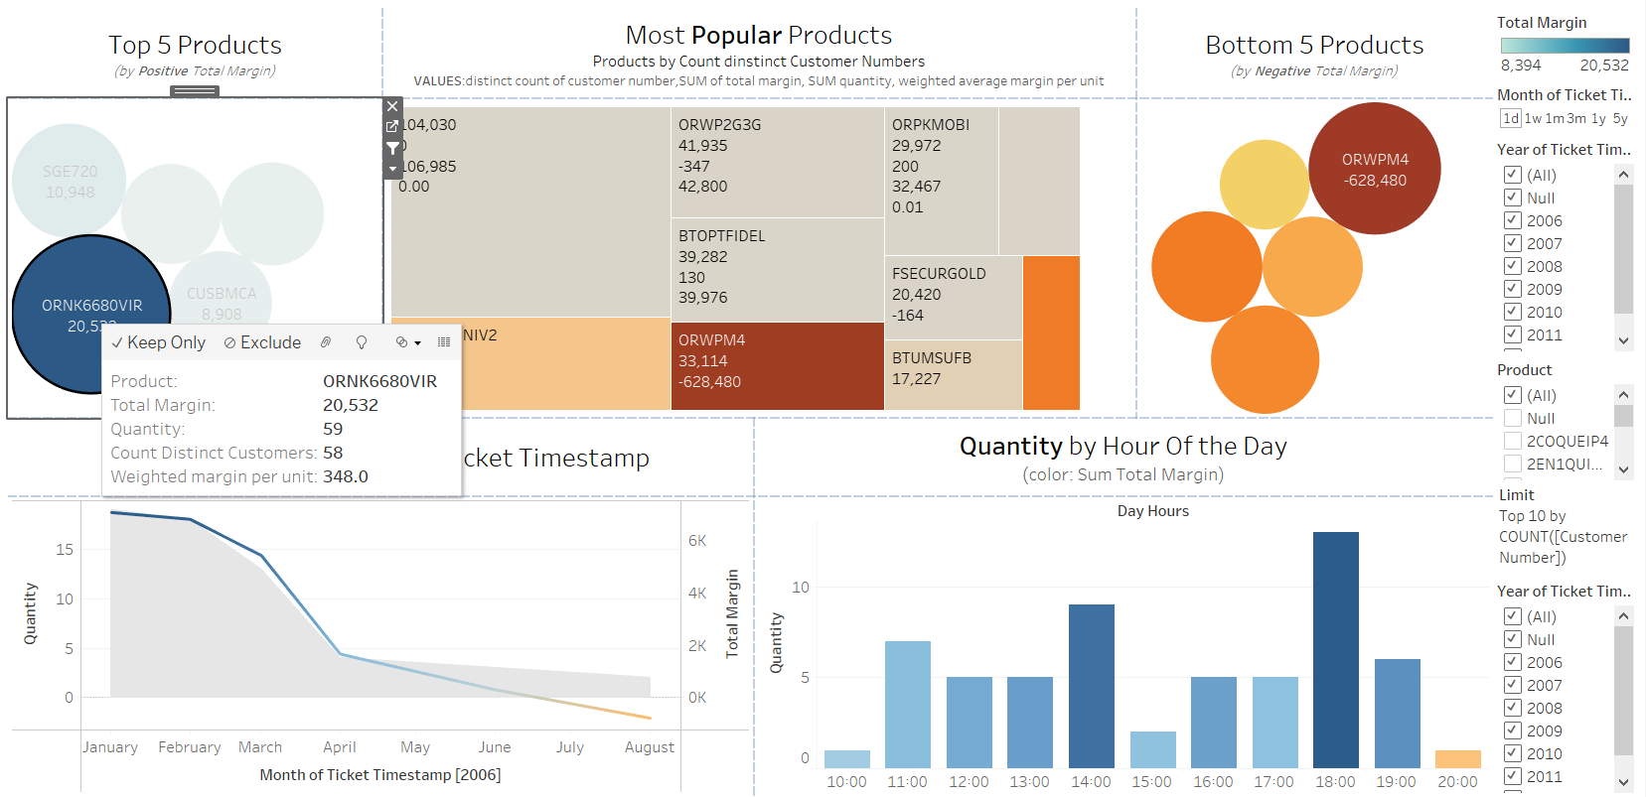
5. Analysis of Products with the Highest Positive Margin
The two products with the highest Total Margin behave similarly:
1.After August/September 2006 they are no longer sold.
2.In late evening 20:00/21:00, the margin becomes negative
3.The quantities sold are significantly lower compared to the other products.
4.The margin decreases over time until it becomes negative
5.They have a high weighted margin per unit-> probably the reason why are in the top 5 by Total Margin
The product with the second highest total margin is in the next slide

Slide 15
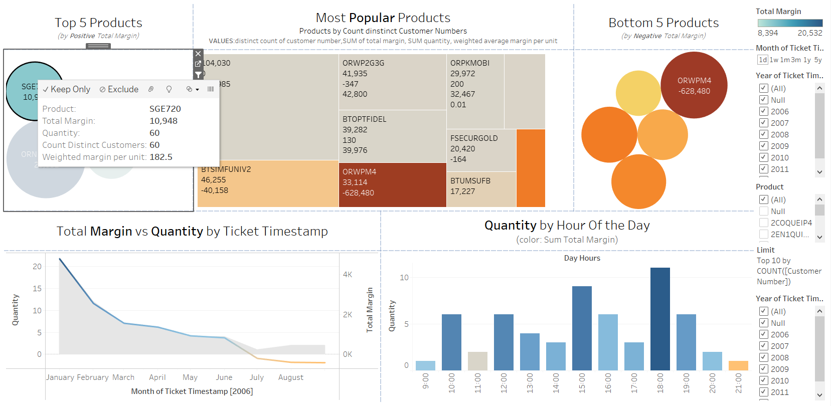
5. Analysis of Products with the Highest Positive Margin

Slide 16
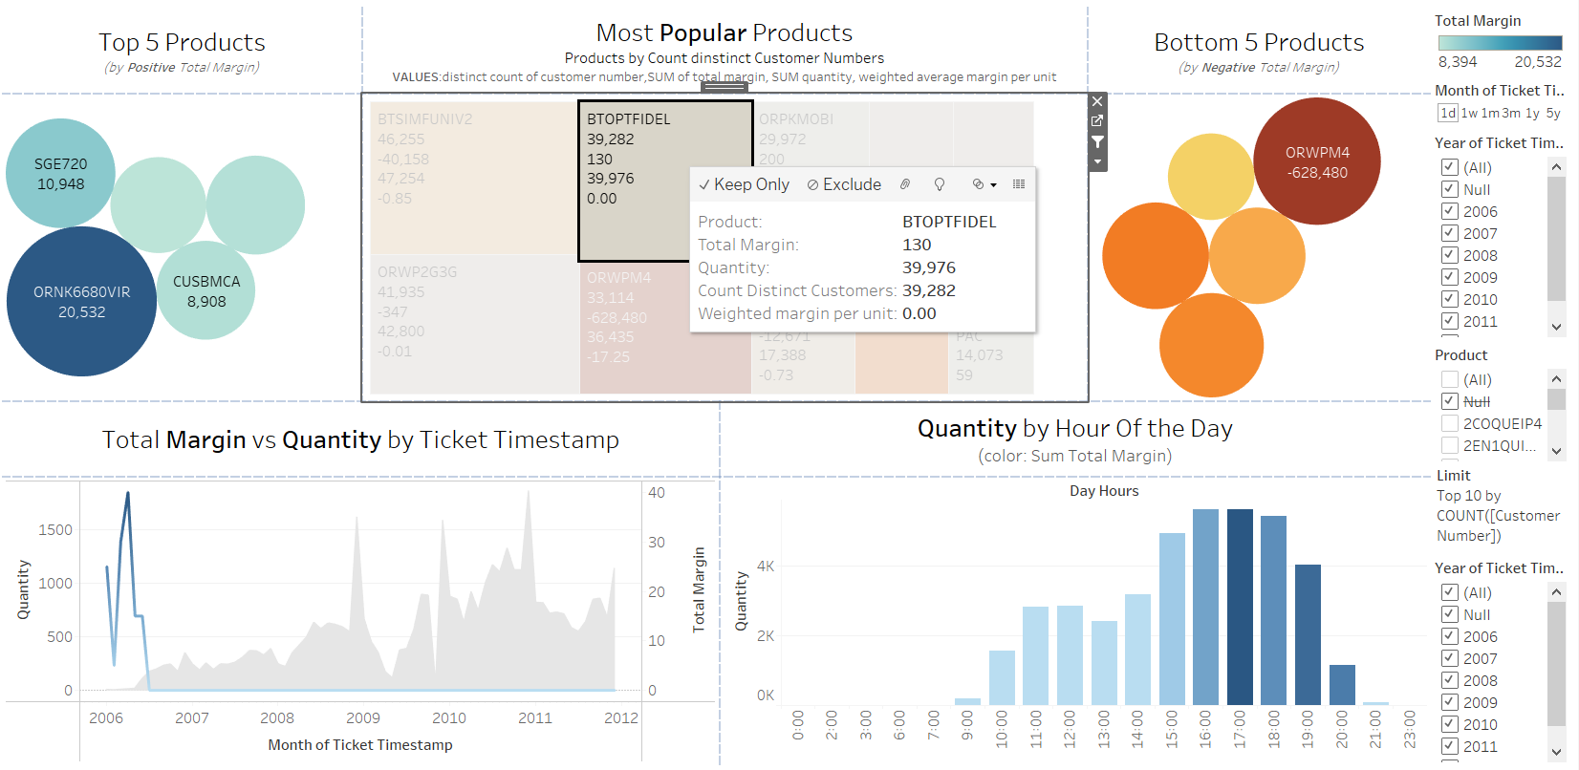
5. Analysis of the Most Popular Products Among Customers
Between the most popular products there are products with zero margin but with quantities sold, which means that even though these products are not generating profit, they are still being sold in some quantity.
Other Example in the next slide
Quantity positive
Margin 0

Slide 17
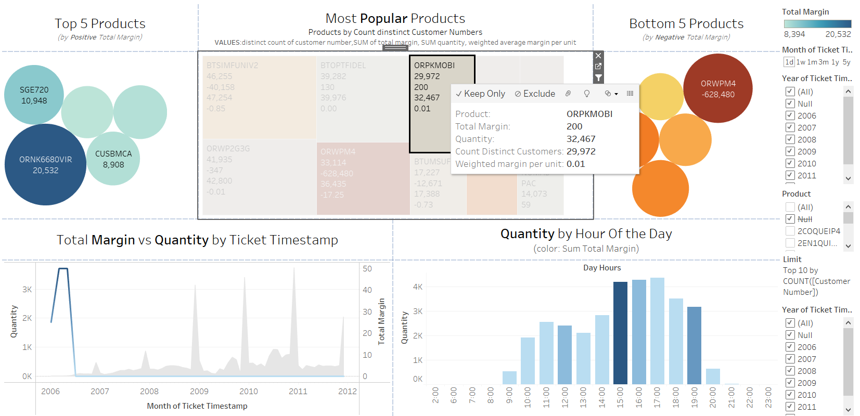
5. Analysis of the Most Popular Products Among Customers
Quantity positive
Margin 0

Slide 18
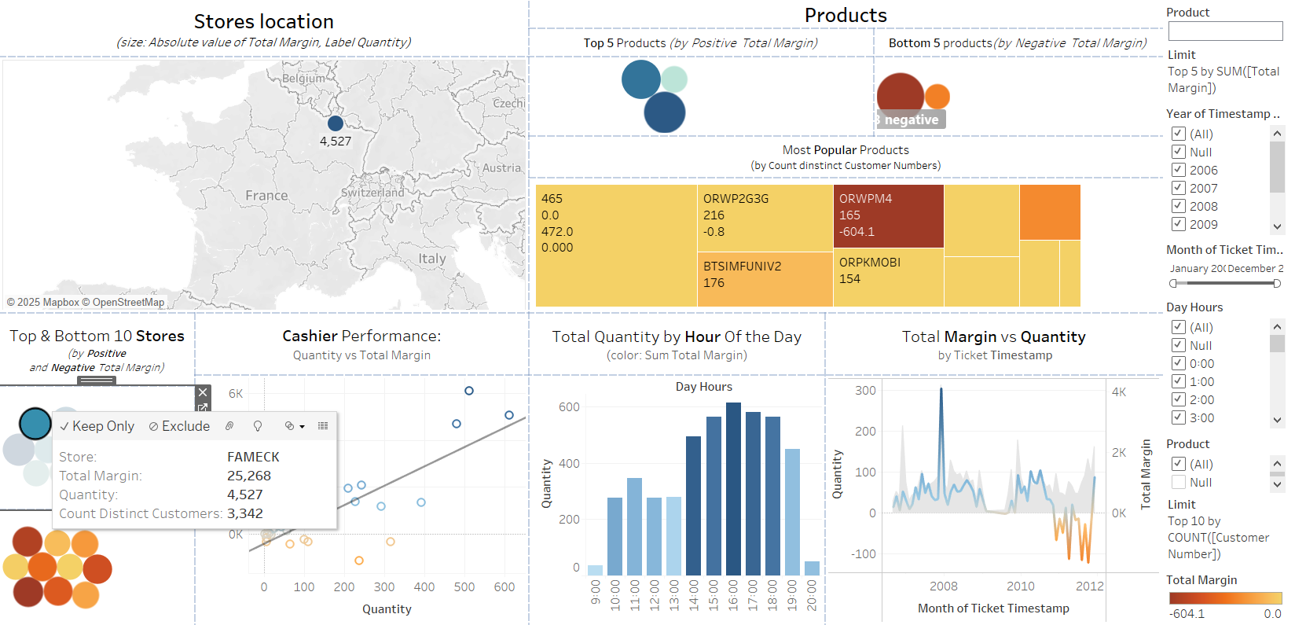
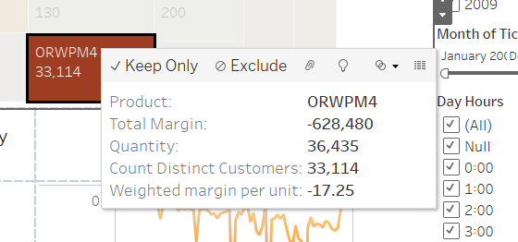
5. Store Analysis: Identifying the Product Behind Margin Reduction
Considerations valid for all top 10 stores by positive total margin:
After 2009/2010, most of these stores have recorded losses.
The common product sold across these stores is ORWPM4 that has a significant negative impact on the margin, with high quantities sold and a negative weighted margin per unit.
Filtering by the product (in the next slide), shows a clear influence on the negative trend in sales and margin across the store.
for all these stores
Next slide the example of FAMECK

Slide 19
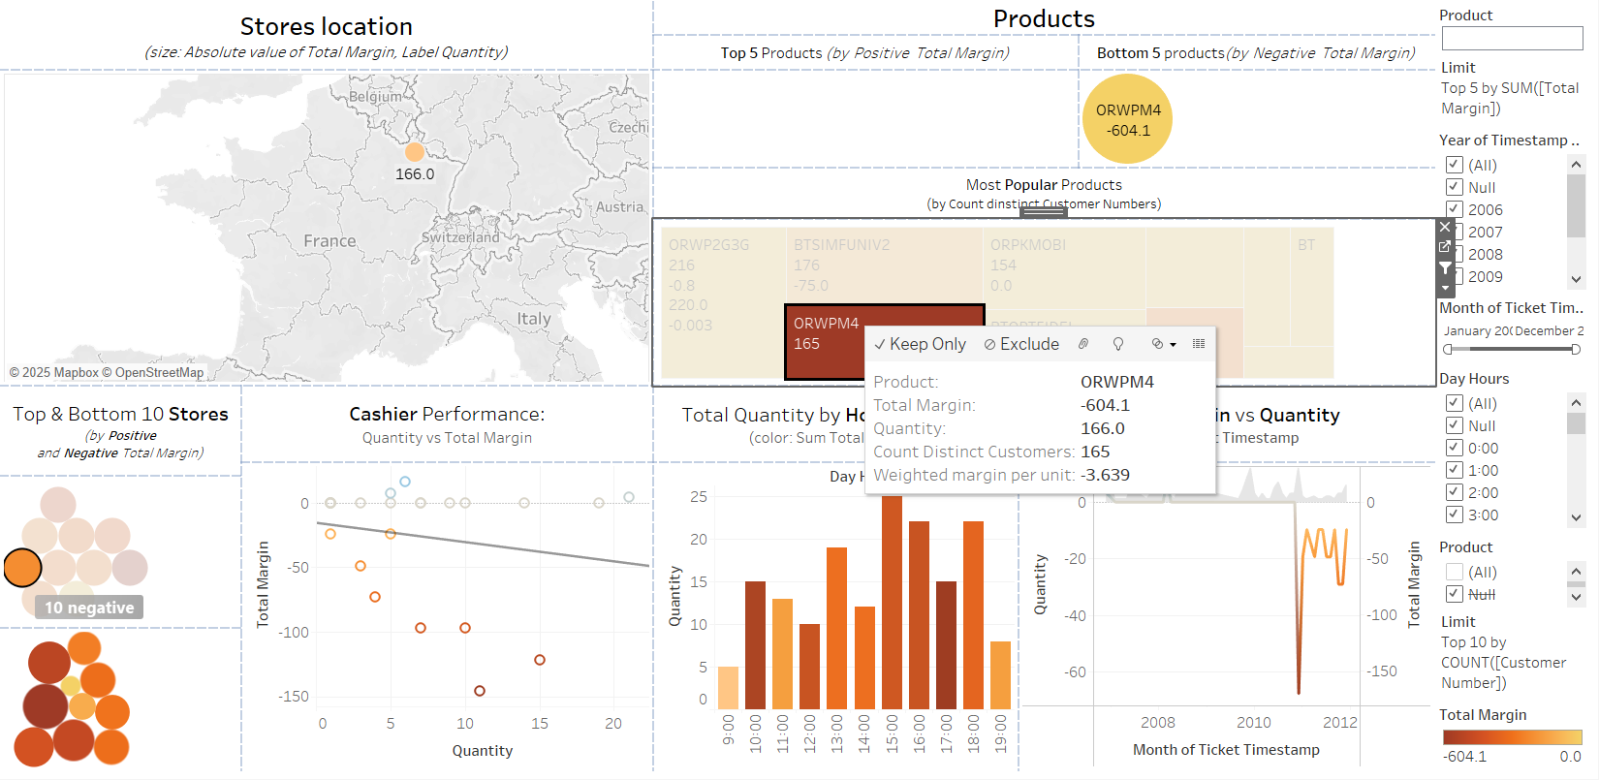
5. Example of the impact of ORPWPM4 in a Store
Filtered by both store (FAMECK) and product (ORWPM4):
Quantity sold of this product in the store: 166 units
Weighted margin per unit in the store for this product: -3.639
Purchased by 165 distinct customers
FAMECK

Slide 20
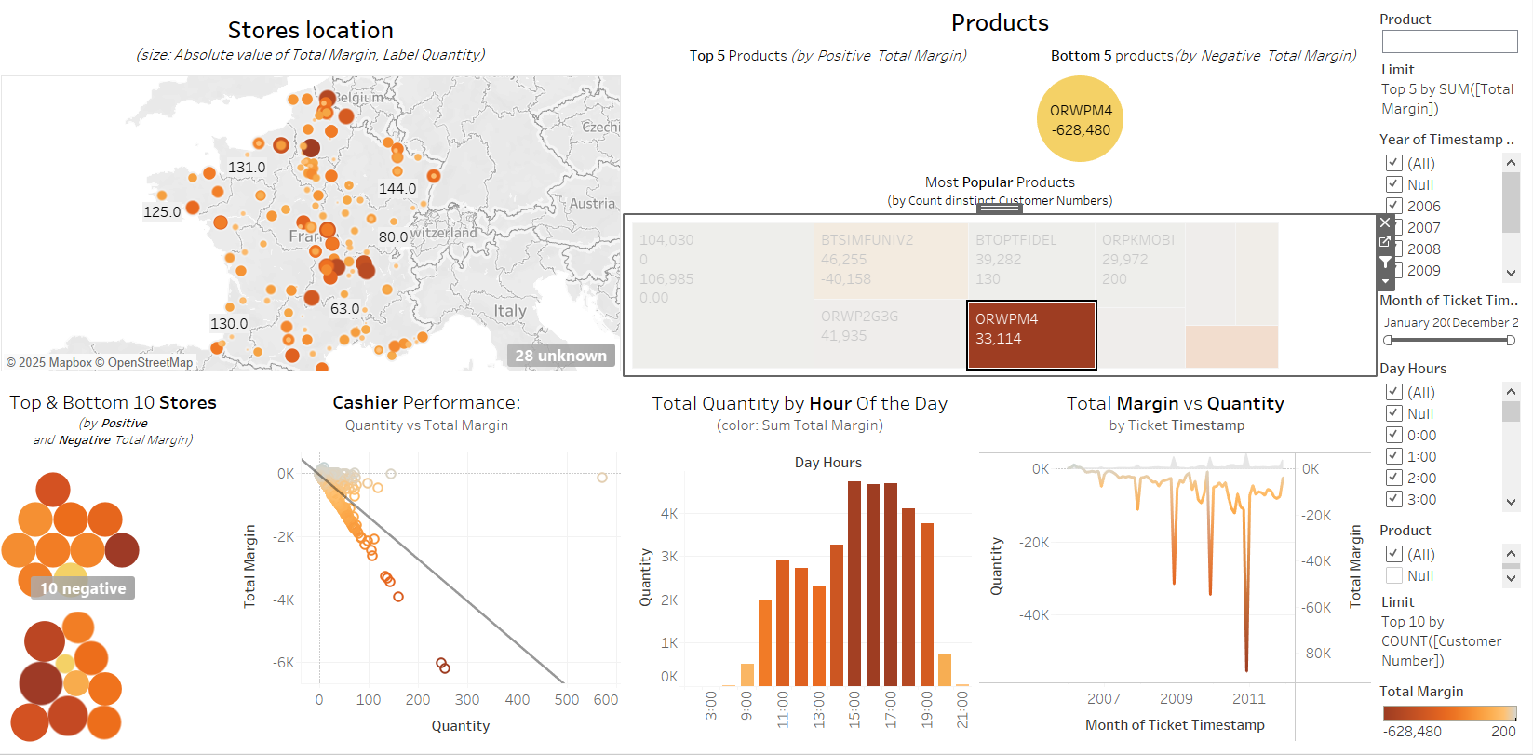
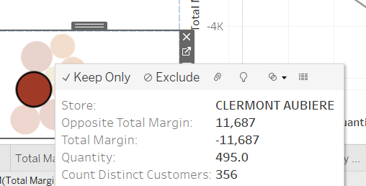
5. ORPWM4 across the stores
While first filtering by the product and then by the store, it can be observed that among the stores with both most positive and most negative margins for the product, all margins are negative (all red).
The lowest negative margin is from the store Clermont Aubière
From the map it can be observed how the product is widely distributed
Size: Sum Total Margin is used -> 10 negative indicates that there are no stores with a positive margin for this product

Slide 21
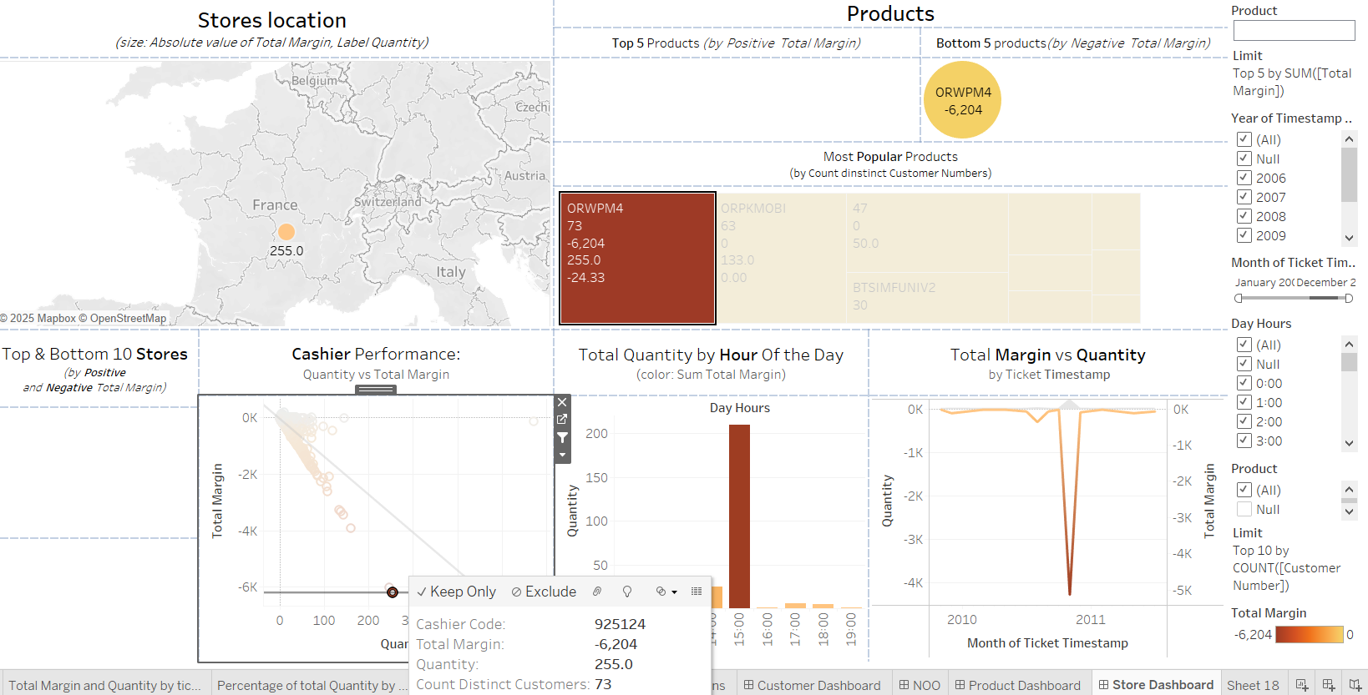
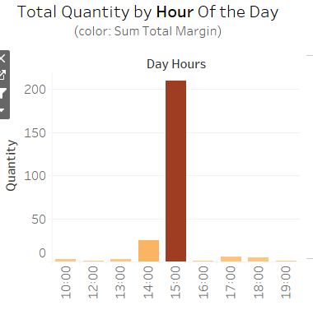
5. And the cashiers?
It can be observed that the cashier who generated the most negative margin for this product mainly sold it at 3 PM.

Slide 22
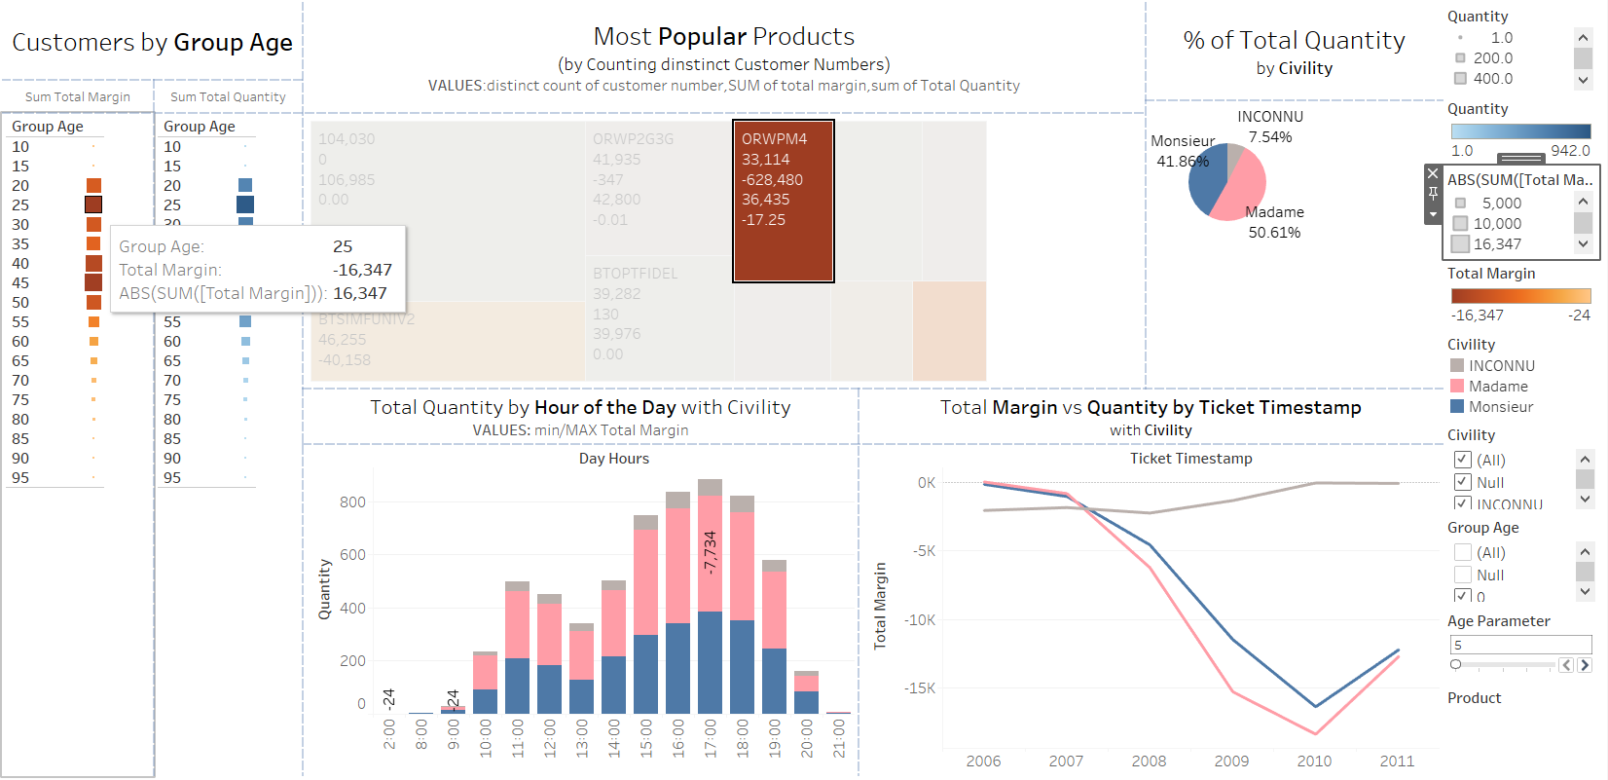
5. ORWPM4 by customers
The 25 to 30 age group generated the highest total negative margin of the product
Even though, in terms of quantity, this product was bought more by the 45 to 50 age group.
Women have had a greater impact on the negative margin of the product

Slide 23
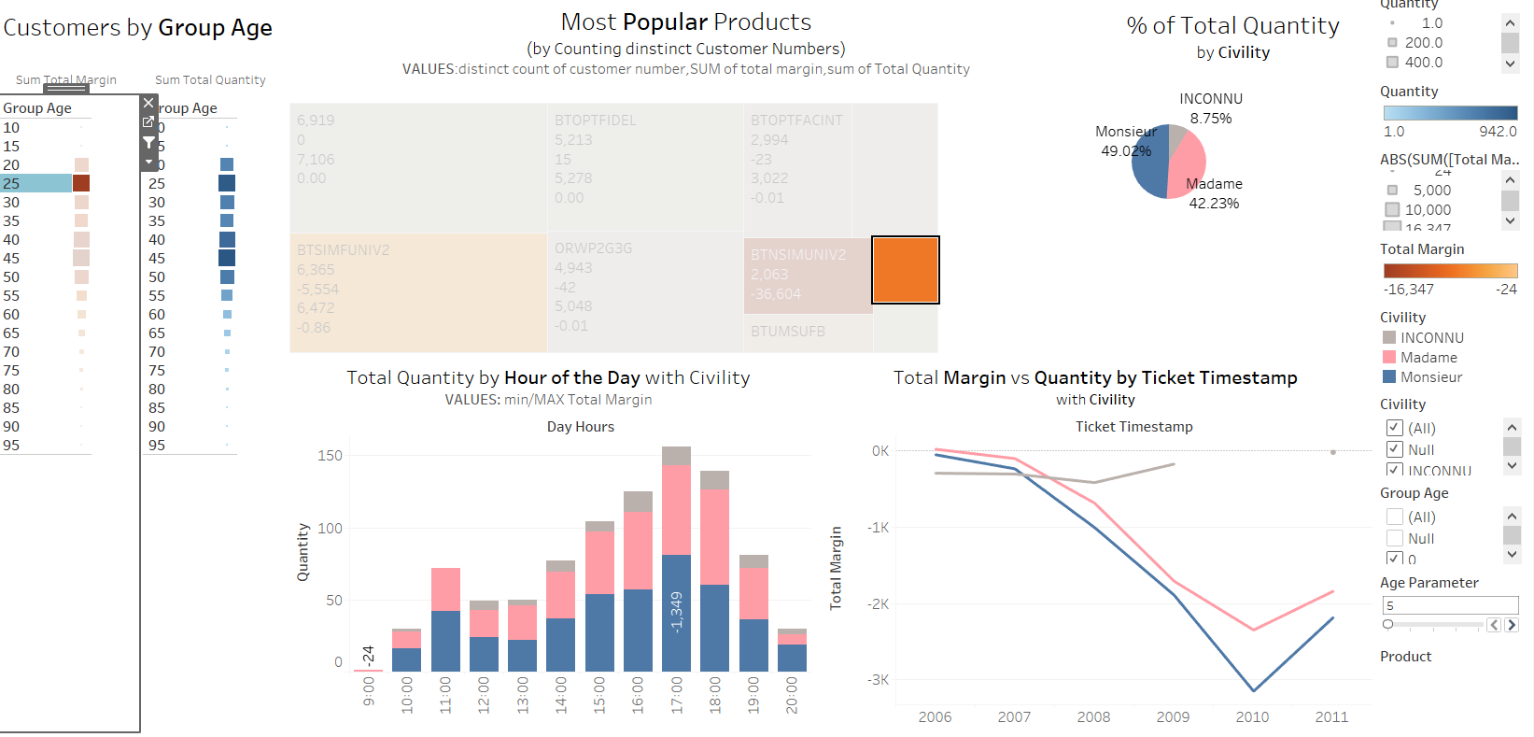
5. ORWPM4 by 25-30 group Age
However, when filtering by both product and the 25-30 age group, it is the males who have contributed the most to the negative margin in this age range.
(Additionally, it is evident that another product has generated a greater negative margin in this age group.)
In the next slide, it can be seen how the male customers in the 25-30 age group who purchased ORWPM4 have influenced the margin.

Slide 24
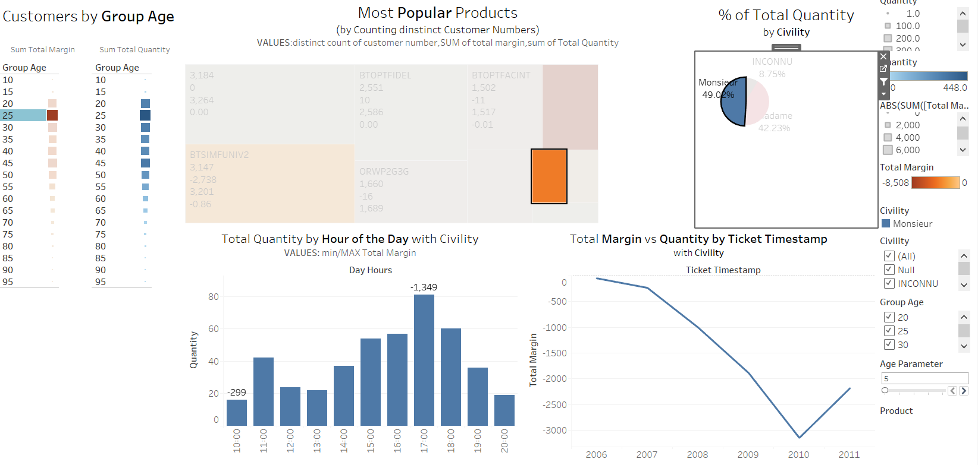
5. ORWPM4 by 25-30 Group age by Male

Slide 25
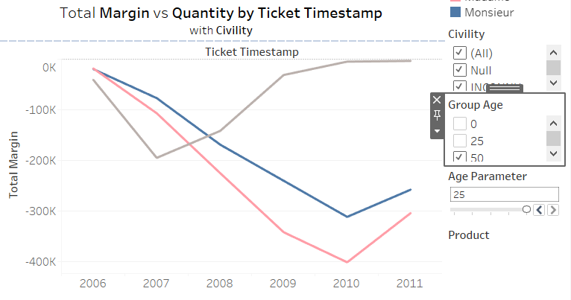
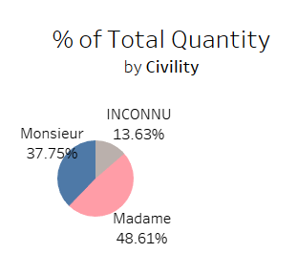
5. Age Group across all products
In general women and men have similar behaviour but considering the age group >=50
1. women contribute the most to the negative sales margin
2. purchasing a higher percentage of products compared to men

Slide 26
6. Conclusion
The analysis focused on identifying the causes of margin reduction.
First, products with the highest positive total margin were examined, with sales limited to 2006 and low quantities sold, showing only a high weighted margin per unit.
Next, the most purchased products by distinct customers were analyzed, revealing some with a zero margin despite positive quantities sold.
The analysis shifted to stores, investigating whether a common product was contributing to the margin decrease. Once one of the potential product was identified, the store with the lowest negative margin for that product was found, and the cashier responsible for the lowest margin at that store was analyzed.
Then, the focus moved to the customers of that product, exploring correlations with Civility and Age Group. It was found that women contributed the most to the lowest margin of the product, and the 25-30 age group had the lowest margin (of the product). However, when analyzing the 25-30 age group for this product, it was the men who caused the lowest margin.
This analysis highlights the key factors across products, stores, and customers that could have contributed to the reduction in margin over time

