Slide 1

Music Generation from Textual Input
Giulia Saresini, Vanessa Maeder

Slide 2
Motivation
Can a neural network truly understand and create music like human?
Music is an intricate form of expression, rich in patterns, emotions, and creativity. This project explores how neural networks can interpret and process musical structures and whether they can generate original compositions from scratch.

Slide 3
Approach to the Problem
Textual Input
To address the question, we adopted a pipeline that begins with a Word2Vec NLP model to process textual input. This output is then passed through a conditional GAN trained to generate piano compositions, using the MAESTRO dataset as the foundation for learning musical patterns.
Word2Vec
key
tempo
cGAN
Music (MIDI)

Slide 4
Word2Vec
en_core_web_lg (spacy)
Key
text vector
text
major, slow
Tempo
Key
Minor
Major
Tempo
Slow
Moderate
Fast

Slide 5
Conditional GAN - MAESTRO
To train the conditional GAN, we decided to work with the MAESTRO dataset, a large collection of MIDI and audio recordings of classical piano performances.
This dataset provides rich temporal and dynamic information, making it ideal for training models to generate realistic and expressive music.

Slide 6
Conditional GAN - STRUCTURE
To generate music, we provided our model with sequences containing the following elements:
Pitches: the specific notes in a musical scale, defining the melody.
Velocity: the intensity or force of a note, influencing its loudness and expression.
Key: indicates whether the composition is in a Major or Minor scale, defining its mood and tonality.
Noise
Labels
Real
Generator
Generated
Pitches-Velocities
Discriminator
Predicted Labels

Slide 7

Word2Vec - CHALLENGES
Ambiguity in musical terms: the "moderate" tempo was not being predicted unless it was explicitly mentioned in the textual input.
Influence of common words: frequent words like "and", "to", etc., can affect the quality of the learned representations.
Handling negations: Word2Vec struggles with understanding negations, which can alter the meaning of musical descriptions.

Slide 8
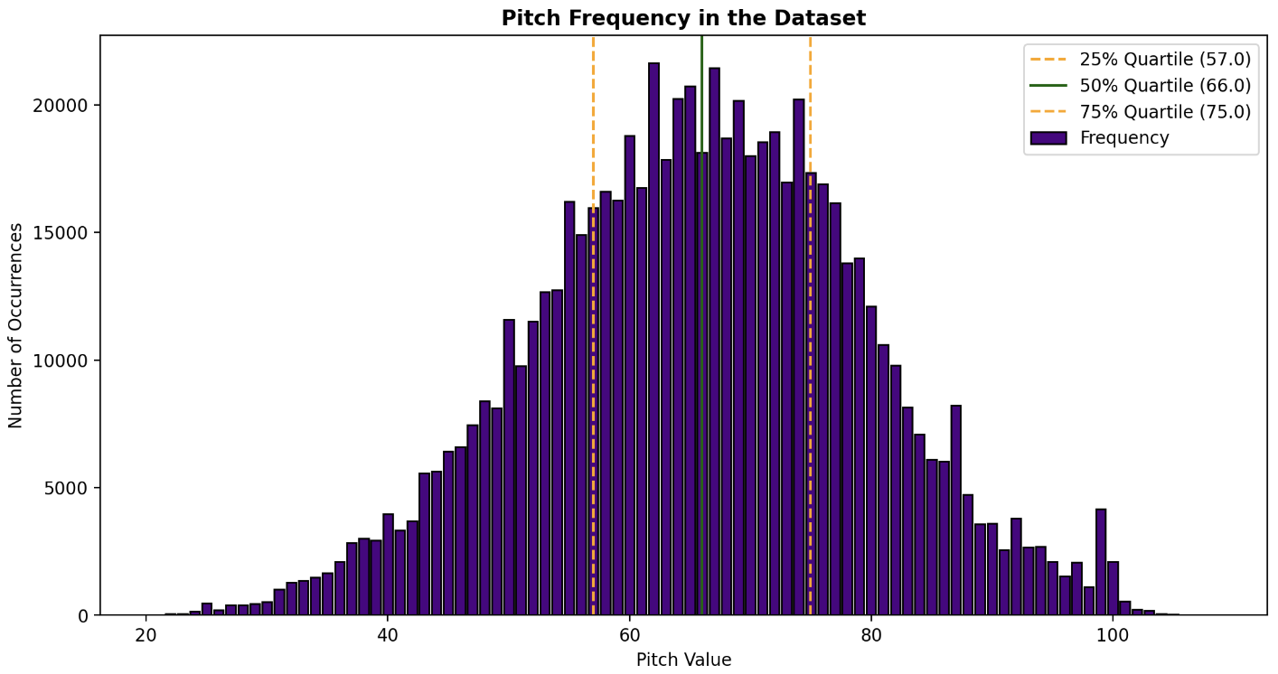
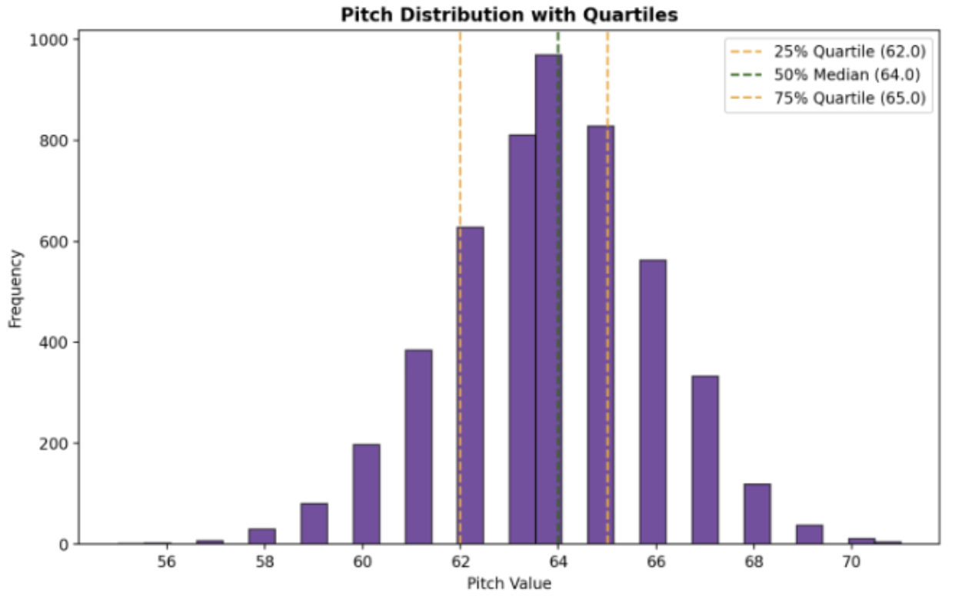
cGAN – RESULTS and CHALLENGES
What was our model able to do?

Slide 9
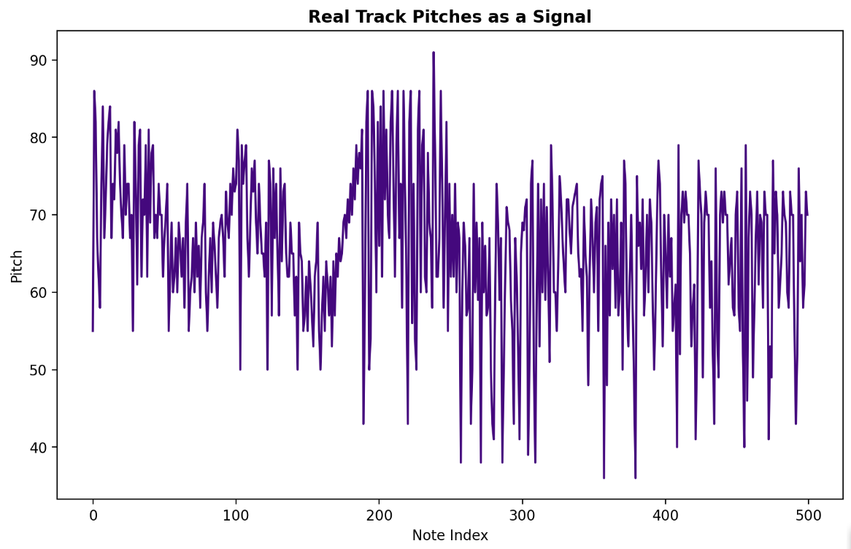
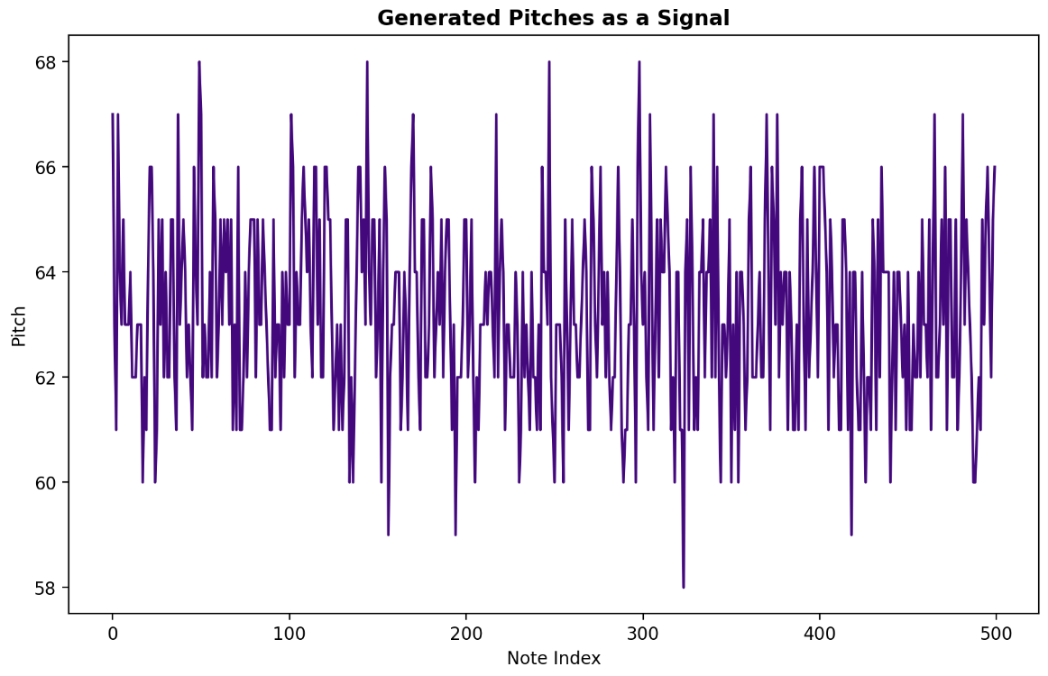
cGAN – RESULTS and CHALLENGES
What weren’t we able to accomplish?

Slide 10
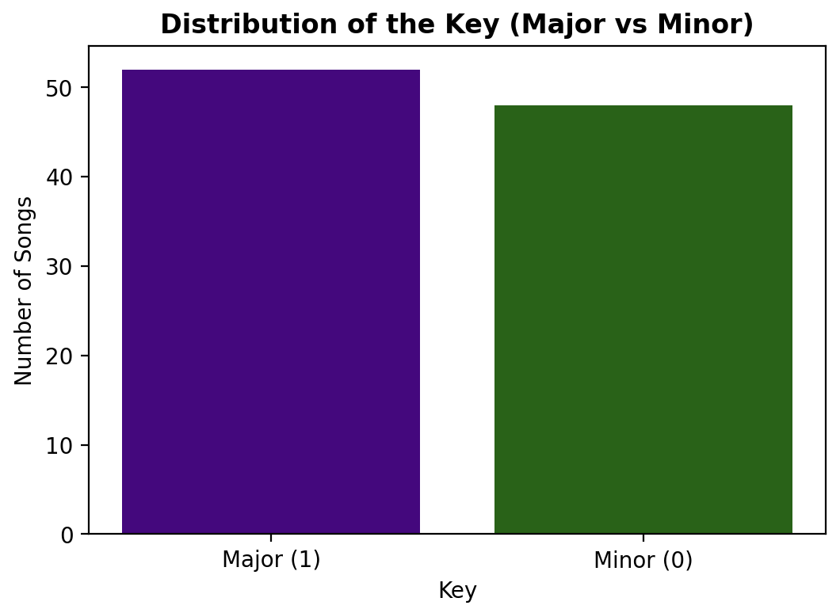
cGAN – RESULTS and CHALLENGES
Unfortunatly…There is more
It is worth noting that the experiment involving key conditioning also did not yield successful results.

Slide 11



cGAN – RESULTS and CHALLENGES
Just to give you a concrete example:
?!

Slide 12
Thank you for your Attention! Any Question?

