Slide 1
Master's Degree Course in Health Informatics
A. A. 2024/2025
Elective activities-Project​
UniSR/OSR Artificial Intelligence Center "AI-HUB"​
Giulia Caffi, Elisa Merigo, Anna Uberti
Automatic Anatomical Landmark Detection in Medical Images​
Notes:
Questo template è stato creato per agevolare la produzione di slide e presentazioni a scopo didattico, è pensato inoltre per rendere il contenuto ben fruibile.

Slide 2
Problem Introduction
Identifying anatomical landmarks in medical images is a fundamental step in many image analysis applications, including organ segmentation, image registration and landmark-based alignment
Fast and accurate automatic landmark localization methods can eliminate the need for manual identification and are particularly beneficial for precise multi-landmark detection
However, landmark detection remains challenging due to anatomical variability, spatial dependencies, high computational costs for 3D localization, and limited annotated training data
Our work focused on detecting the right and left coronary ostia.
Notes:
Sono presenti 20 tipologie di slide differenti, si possono scegliere dal pannello Layout. Ogni slide ha lo scopo di evidenziare il differente contenuto nel modo migliore.

Slide 3
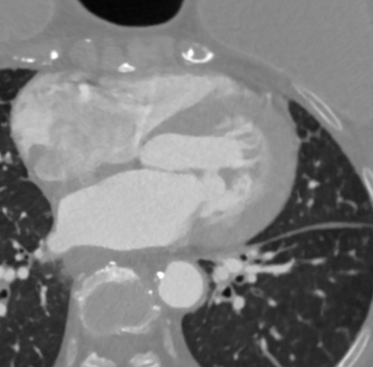
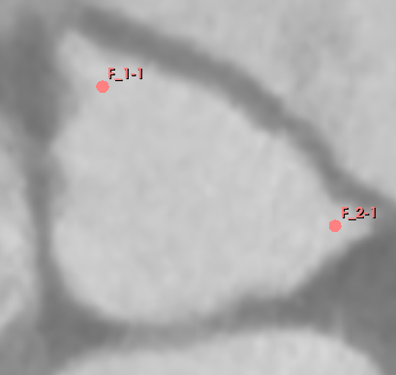


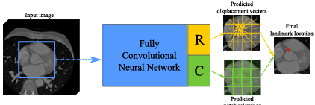
Project Outline and Objective
1
State of the Art and Key Techniques in Landmark Detection
3
Development of Software for Automatic Landmark Detection
Activities:
Review relevant studies on landmark detection
Explore open-source implementations and tools
Identify ongoing research and approaches
Objective:
Make key decisions on methods and techniques for landmark detection, including network architectures and sample size.
Time:
3 weeks (12h)
Activities:
Implement and integrate the selected network architecture for landmark detection
Test and optimize the software with sample data
Objective:
Develop/adapt software for accurate automatic anatomical landmark detection using the selected network architecture.
Time:
4 weeks (32h)
Activities:
Determine the number of cases needed for training
Manually annotate images using the selected software
Objective:
Prepare data in the required format for network training, ensuring compatibility with the selected network.
Time:
3 weeks (12h)
2
Manual Annotation of San Raffaele Hospital Dataset Images

Slide 4
Bibliography: possible ways of approaching the problem
 | MARL-for-ALD | H3DE-Net | Rl-medical | Rl-medical
Extended title | Multiple anatomical landmark detection using multiagent RL. | H3DE-Net: Efficient and Accurate 3D Landmark Detection in Medical Imaging | RL-Medical: Multiagent Deep Reinforcement Learning for Anatomical Landmark Detection. | RL-Medical: Deep Reinforcement Learning (DRL) agents applied to medical images.
Description | Novel method for automatically detecting anatomical landmarks in 3D medical images using Multi-Agent Reinforcement Learning (MARL). Goal: improve the accuracy and efficiency. | Aim: accurately localize anatomical landmarks in 3D medical images. It uses a Supervised algorithm, which combines Convolutional Neural Network (CNN) and Transformers. | This project implements a novel communicative multi-agent reinforcement learning (C-MARL) system to automatically detect landmarks in 3D medical images. | It explores the application of Deep Reinforcement Learning (DRL) to 3D medical imagine analysis. Goal: automate complex clinical tasks.
Data | Cardiac MRI | Cranial CT | Cardiac MRI | Cardiac MRI

Slide 5
Selected Approach: H3DE-Net
Data Used
The model is trained and evaluated on a public cranial CT scans, each annotated with 14 mandibular anatomical landmarks.
Performance Evaluation Metrics
Deep Learning Architecture
H3DE-Net is a hybrid architecture combining:
Pre-processing Applied
Voxel intensities in all CT scans are normalized to the range [0, 255], allowing the model to be less affected by imaging artifacts or variations in intensity scaling.
- CNN layers for efficient extraction of local features
- 3D BiFormer module that captures global context with low computational cost.
- Feature fusion model that enhances the model’s robustness and precision.
MRE$±$SD (mm): the mean radial error represents the average Euclidean distance between the predicted and true values.
MRE±SD (mm): the mean radial error represents the average Euclidean distance between the predicted and true values.
SDR: successful detection rate measures the accuracy of the detected landmarks at difference distances (2mm, 2.5mm, 3mm, 4mm).
Since 3D CT images are very large, the authors divided the volume into smaller 3D patches by extracting a geometrically centred crop from the middle of the volume, where the mandible, mandibular landmarks, and the centre of the skull are typically located. Training is performed on these subregions instead of the entire scan.
Extensive experiments on a public dataset demonstrate that H3DE-Net significantly outperforms existing methods, as accuracy and robustness. The proposed model excels in challenging scenarios, such as missing landmarks or complex anatomical variations, making it a promising approach for real world clinical applications.

Slide 6
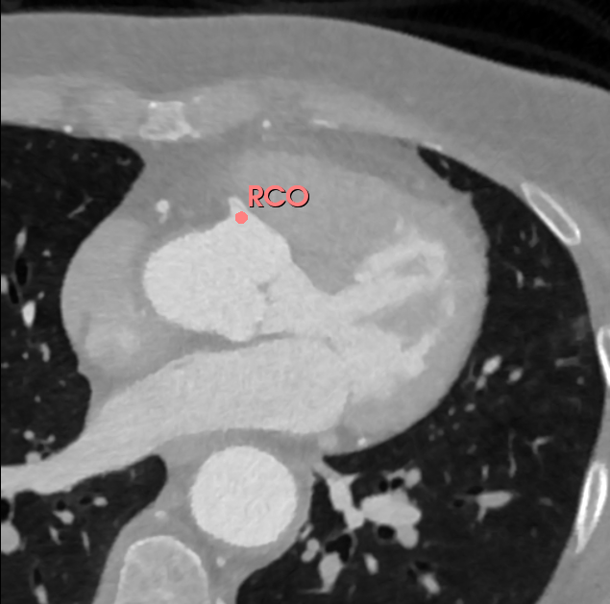
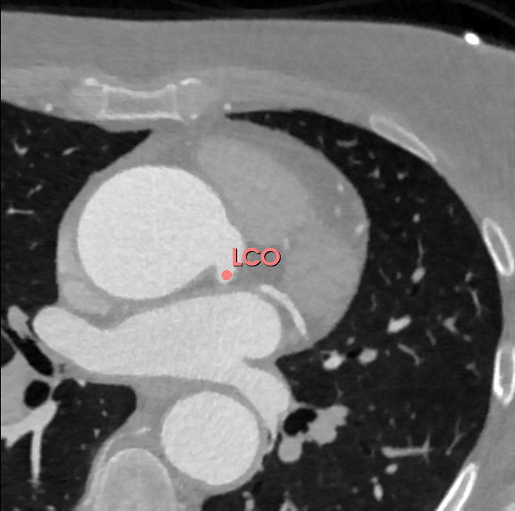
Data collection (3D slicer)
Each of the 200 CT scans was manually annotated using 3D Slicer.
Both the left and right coronary ostia were identified and marked as anatomical landmarks.

Slide 7
Data conversion
Anatomical landmarks are converted from
mm to voxel using the image spacing.
Landmarks from .json are transformed in .npy format.
LANDMARK
IMAGE
Each TC in .nii.gz format is converted in .nrrd
TRAIN/TEST SPLIT
160 train set, 20 validation set, 20 test set
Notes:
The preprocessing pipeline involves two main tasks: converting anatomical landmarks from physical space to voxel space, and reformatting volumetric images for further analysis.
For the landmark processing, we start from .mrk.json files that contain anatomical coordinates defined in millimeters. These are matched with their corresponding .nii.gz images, which are read using ITK. We extract the image spacing and use it to convert the physical (millimeter-based) positions into voxel indices through the TransformPhysicalPointToIndex method. The resulting voxel coordinates, reordered to follow the (z, y, x) convention, are saved in .npy format under the landmark_voxel/ directory. The spacing itself is also stored for future reference as a separate .npy file.
In parallel, we handle the image conversion step. Each volumetric scan in .nii.gz format is re-saved in .nrrd format using ITK. This ensures compatibility with external tools or pipelines that require .nrrd as input. The converted images are stored in the immagini_nrrd/ directory.
Overall, this process standardizes both the image format and landmark coordinates, preparing the data for downstream tasks such as training, inference, or visualization in voxel space.

Slide 8
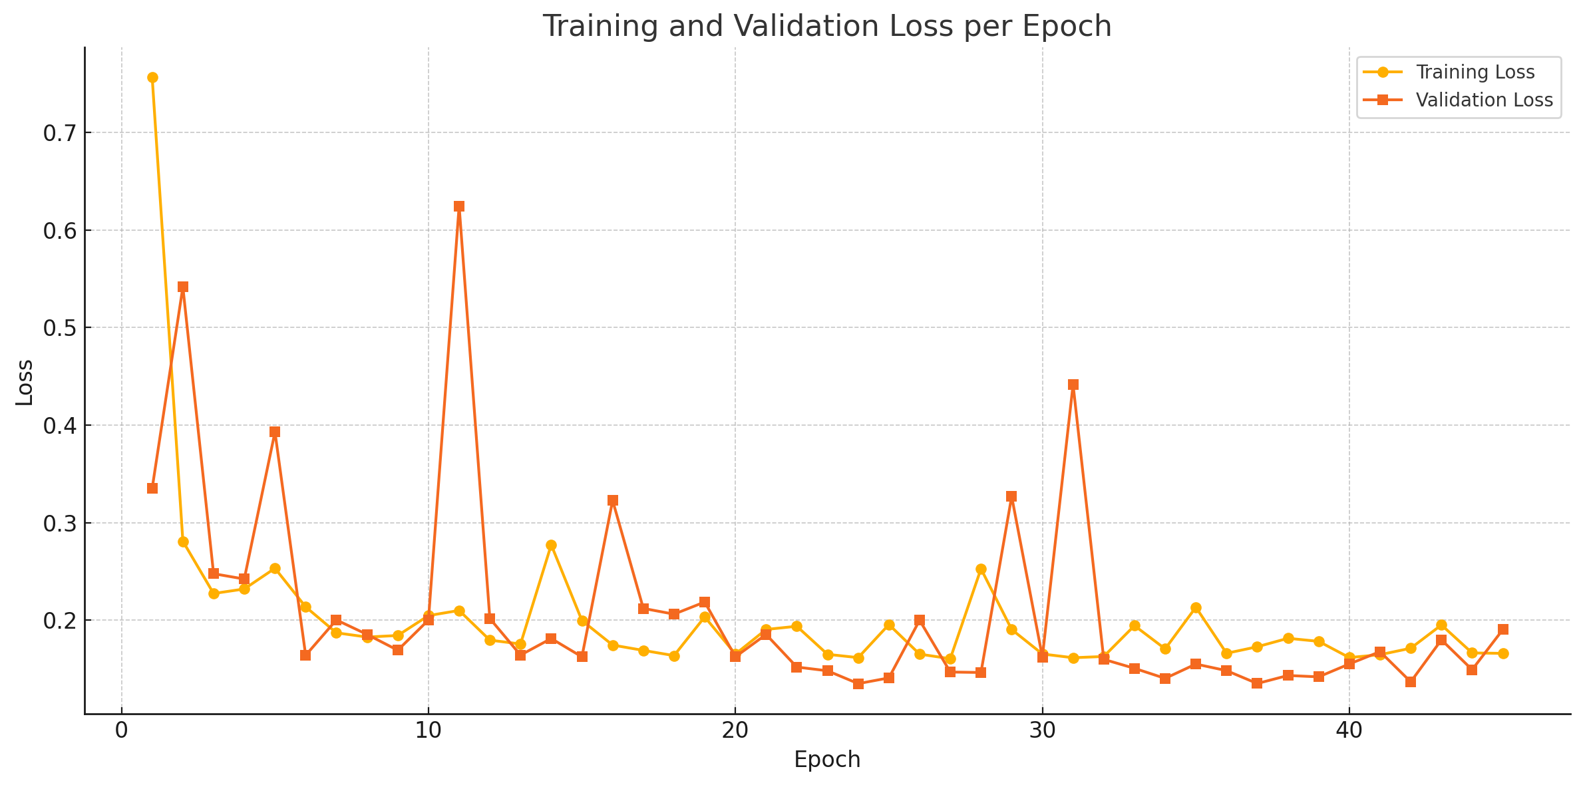
Model Training Overview
Architecture: PBiFormer-Unet
Loss Function: HNM + Propagation Map
Optimizer: Adam (learning rate: 0.001, weight decay: 0.0005)
Batch Size: 4
Epochs: 200 (early stopping after 20 epochs without improvement)
Anchors: [0.5, 0.75, 1.0, 1.25]
Shrink Factor: 4
The training loss decreased rapidly in the first epochs, then gradually stabilized.
The validation loss showed fluctuations, indicating overfitting risks in some phases.
Loss per epoch – training vs validation

Slide 9
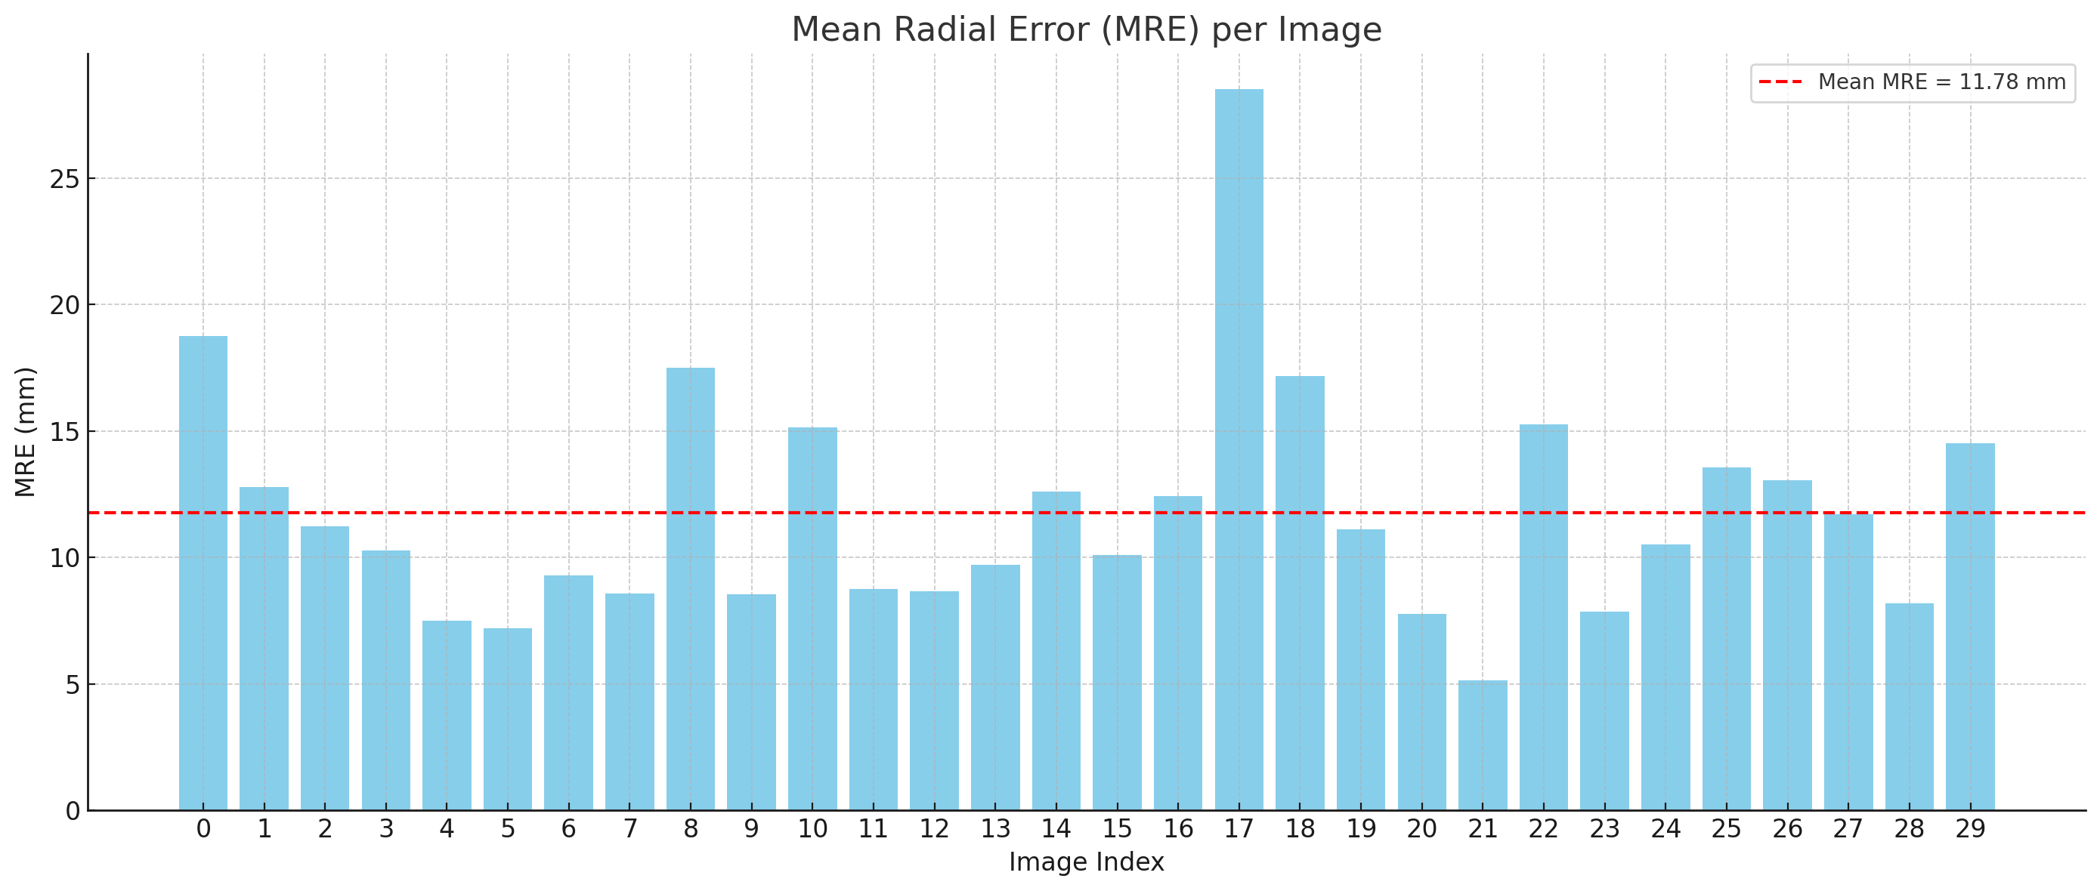
Model Performance Summary
Mean Radial Error (MRE): 11.78 mm
Standard Deviation (SD): 4.60 mm
Accuracy within tolerance:
≤ 2.0 mm: 0%
≤ 2.5 mm: 0%
≤ 3.0 mm: 1.7%
≤ 4.0 mm: 5.0%

Slide 10
Identified Issues
PATCH EXTRACTION
The original H3DE-Net training was designed for mandibular CT scans, where the anatomical region of interest is typically located at the center of the volume. In coronary CT scans, however, the right and left coronary ostia are often off-center. As a result, the original cropping method, which extracted patches centered in the middle of the volume, frequently excluded the coronary ostia.
DATA LOADING INEFFICIENCY
Multiple file formats led to slow and error-prone data loading during training.
Notes:
Esempio di come può essere utilizzata la slide di testo.

Slide 11
Solutions
Voxel Preprocessing
Patch extraction
Data conversion
Implementation of the extraction of a 128×128×64 crop centered at the midpoint between the right and left coronary ostia.
The CT remains in .nii.gz format.
The landmarks are stored in LPS (physical coordinates) and IJK (image coordinates) formats,.
All saved in a .csv file, which is directly split into training, validation, and test sets
All volumes are going to be processed to ensure a fixed isotropic voxel size of 1 mm.
The landmark coordinates in the IJK system for the resampled volumes are also saved in the .csv file.
Notes:
Bisogna fare
MONAI

Slide 12
Pipeline
To support efficient and standardized data handling, a custom data pipeline could be developed using MONAI (Medical Open Network for AI) framework to:
Load CT volumes and landmark annotations
Apply preprocessing steps
Extract patch and generate proposals within each patch based on ground-truth coordinates
To ensure the integrity and effectiveness of the preprocessing pipeline, custom debugging modules could be implemented. These modules could intercept and store intermediate outputs for qualitative evaluation, including:
Extracted patches
Proposal coordinates derived from both ground-truth and model predictions.
Notes:
MONAI (Medical Open Network for AI) is an open-source PyTorch-based framework specifically designed for developing deep learning models in medical imaging. It provides tools for:
Loading medical image formats (like .nii.gz)
Applying medical-specific transforms (e.g., resampling, intensity normalization)
Managing data efficiently with Dataset and DataLoader objects
Facilitating patch-based training (especially for 3D data)
💡 In your case, MONAI is being used to:
Load CT images and landmarks from disk.
Apply preprocessing transforms, like:
Resampling to isotropic voxel size (1 mm)
Normalizing intensities (if needed)
Extract 3D patches of size 128×128×64 from the full volumes.
Generate proposals (i.e., candidate landmark positions) from ground-truth IJK coordinates, within each patch.
Wrap all of this into standardized Dataset and DataLoader classes, enabling clean and efficient use during training/validation.
Additionally, you implemented debug hooks into the pipeline that:
Save intermediate outputs (patches and proposals)
Allow visual or qualitative inspection
Compare ground-truth vs. model predictions
This helps in verifying that the data fed into the model is accurate and meaningful.

Slide 13
Reference
MARL-for-ALD: https://github.com/thanosvlo/MARL-for-Anatomical-Landmark-Detection
H3DE-Net: https://github.com/ECNUACRush/H3DE-Net
Rl-medical (Alansary): https://github.com/amiralansary/rl-medical
Rl-medical (gml16): https://github.com/gml16/rl-medical

Slide 14
Thank you!
Università Vita-Salute San Raffaele

