Slide 1
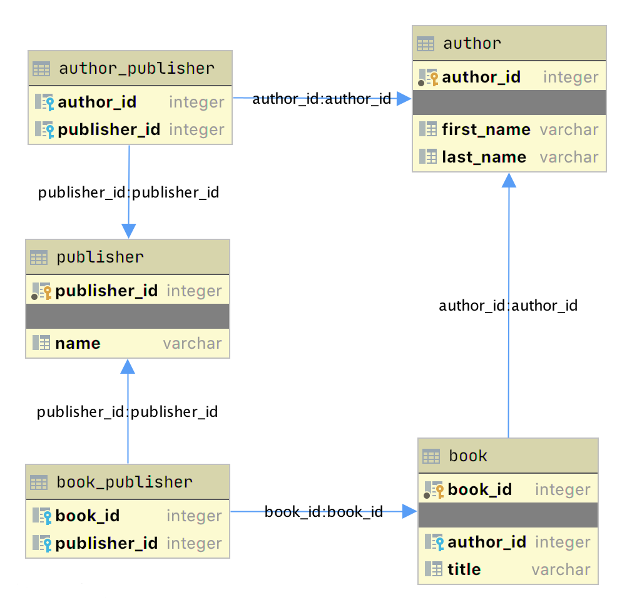
https://realpython.com/python-sqlite-sqlalchemy/#structuring-a-database-with-sql

