Slide 1
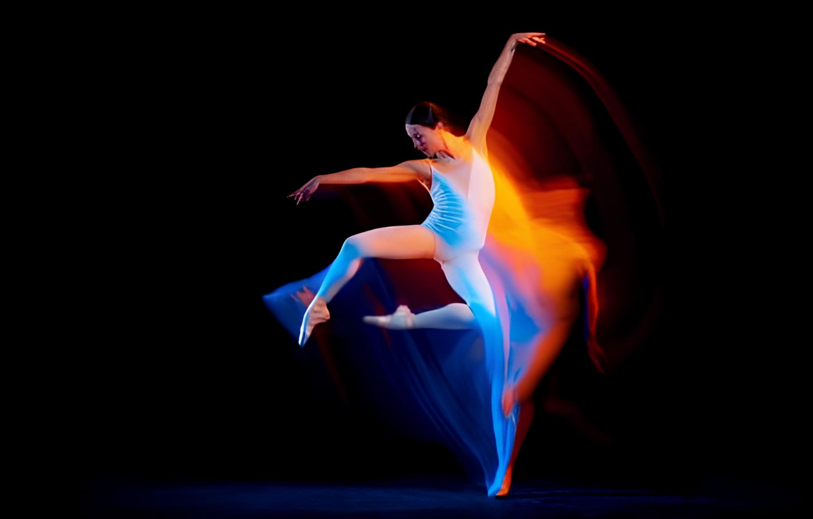

COLM DANCE DESIGNER
Jacob Supercollier
PRESENTS
Cagnetta Angelica
Di Lorenzo Giuliano
Mugnaini Nicola
Ouali Ernest
CMLS 23/24 – Prof. Fabio Antonacci

Slide 2
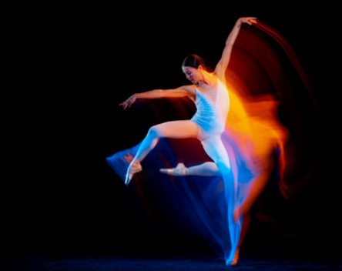

Overview
The main idea
Components
Interaction
Final results
CMLS 23/24 – Prof. Fabio Antonacci

Slide 3

The main idea
How?
By defining the sound synthesis
By applying sound effects
By changing through sensors the sound behaviour
COLM is a computer music system that allows you to deeply connect body and music by providing dance-based interactive sound synthesis for MIDI instruments.
CMLS 23/24 – Prof. Fabio Antonacci

Slide 4
Components
CMLS 23/24 – Prof. Fabio Antonacci

Slide 5
Interaction
CMLS 23/24 – Prof. Fabio Antonacci

Slide 6
Final results
CMLS 23/24 – Prof. Fabio Antonacci

Slide 7
Thanks for the attention!
Angelica Cagnetta
Giuliano Di Lorenzo
Nicola Mugnaini
Ernest Ouali
CMLS 23/24 – Prof. Fabio Antonacci

