Slide 1

MERGE-SORT
On VHDL
LOTTO GIULIO

Slide 2
DIVIDE
MERGE

Slide 3
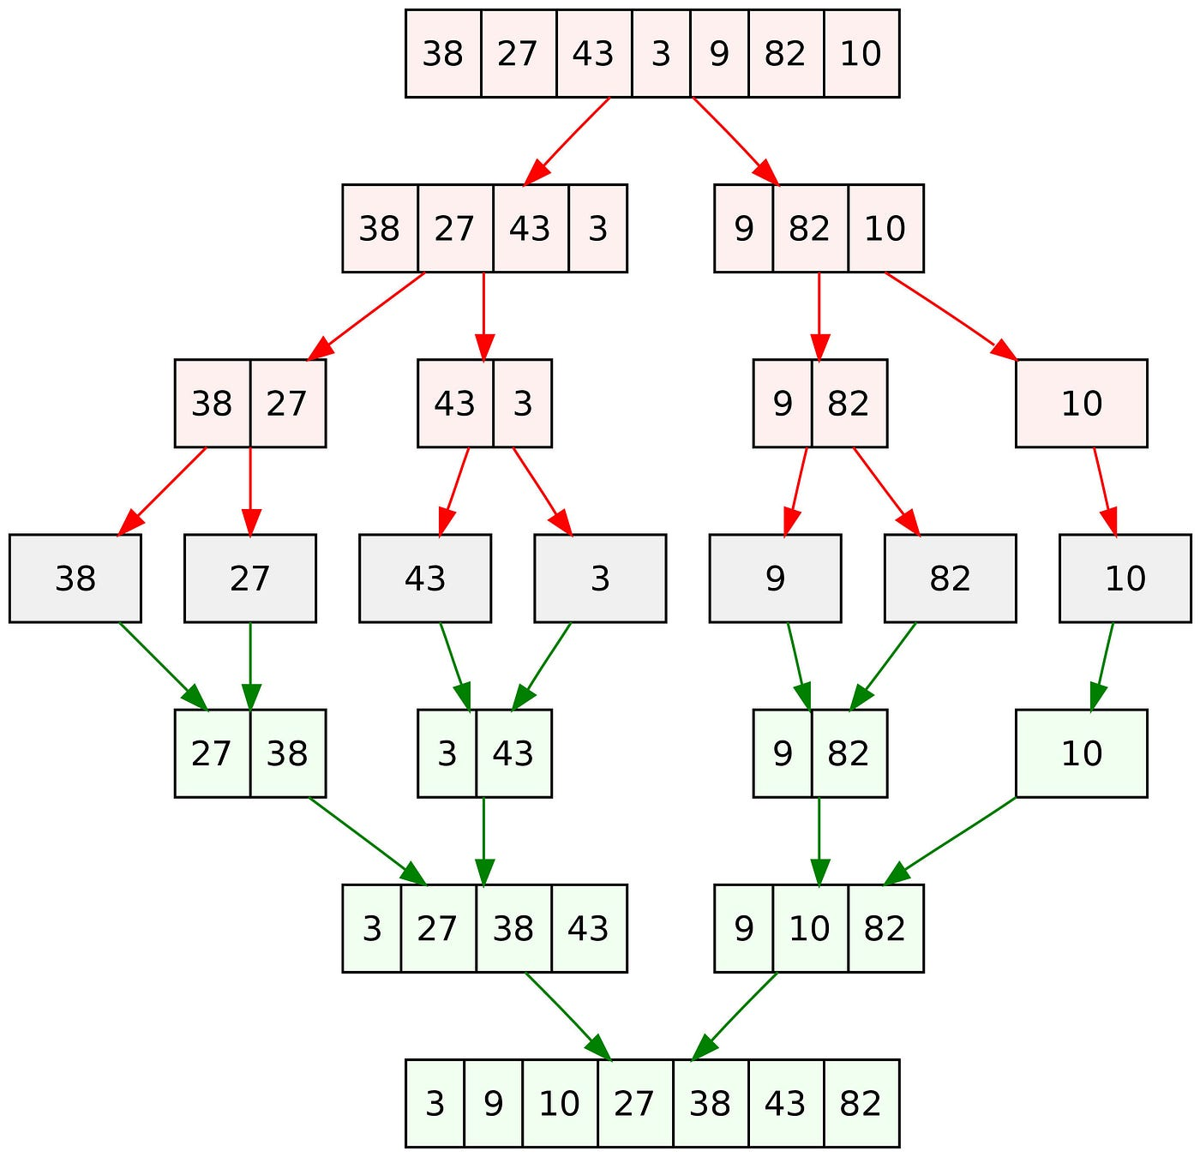
Merge-Sort Tree

Slide 4
HOW CAN WE DO THAT?

Slide 5
AXI-SLAVE
MERGE BLOCK
AXI-MASTER
SIPO
MERGE ALGORITHM
PISO

Slide 6
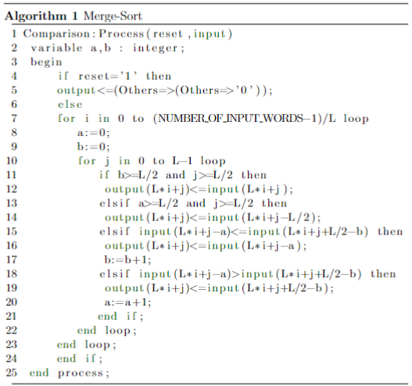
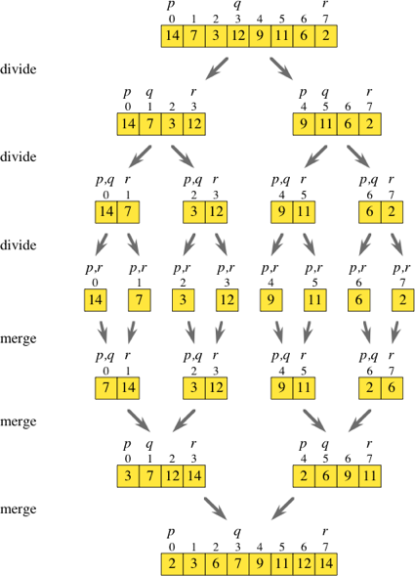
THE ALGORITHM

Slide 7
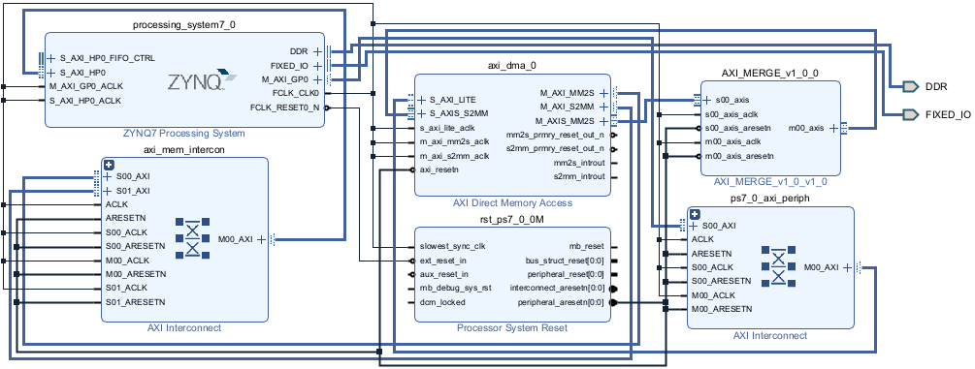
BLOCK DESIGN

Slide 8
GOAL :1024 NUMBERS
RESULT…..

Slide 9
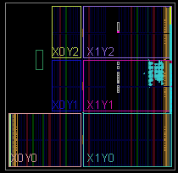
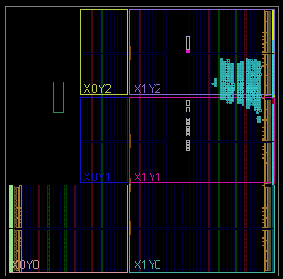
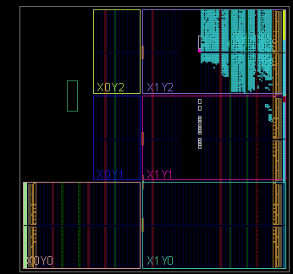
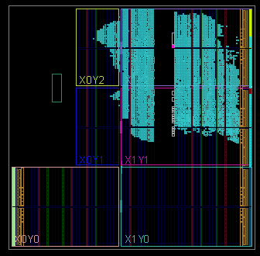
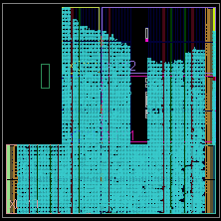
IMPLEMENTATIONS
2 NUMBERS
4 NUMBERS
8 NUMBERS
16 NUMBERS
32 NUMBERS

Slide 10
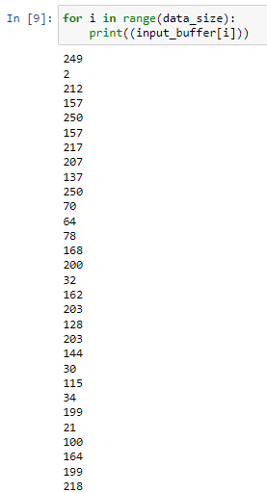
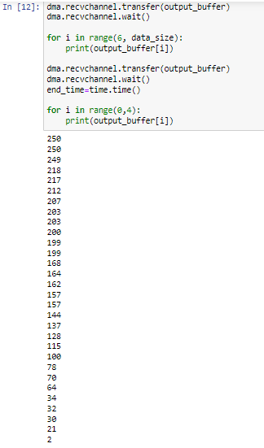

Slide 11
FINAL CONSIDERATIONS
However, the algorithm's computational demands surpass the board's capabilities
To Sort 1024 numbers with a Merge-Sort approach a different algorithm is needed

