Slide 1


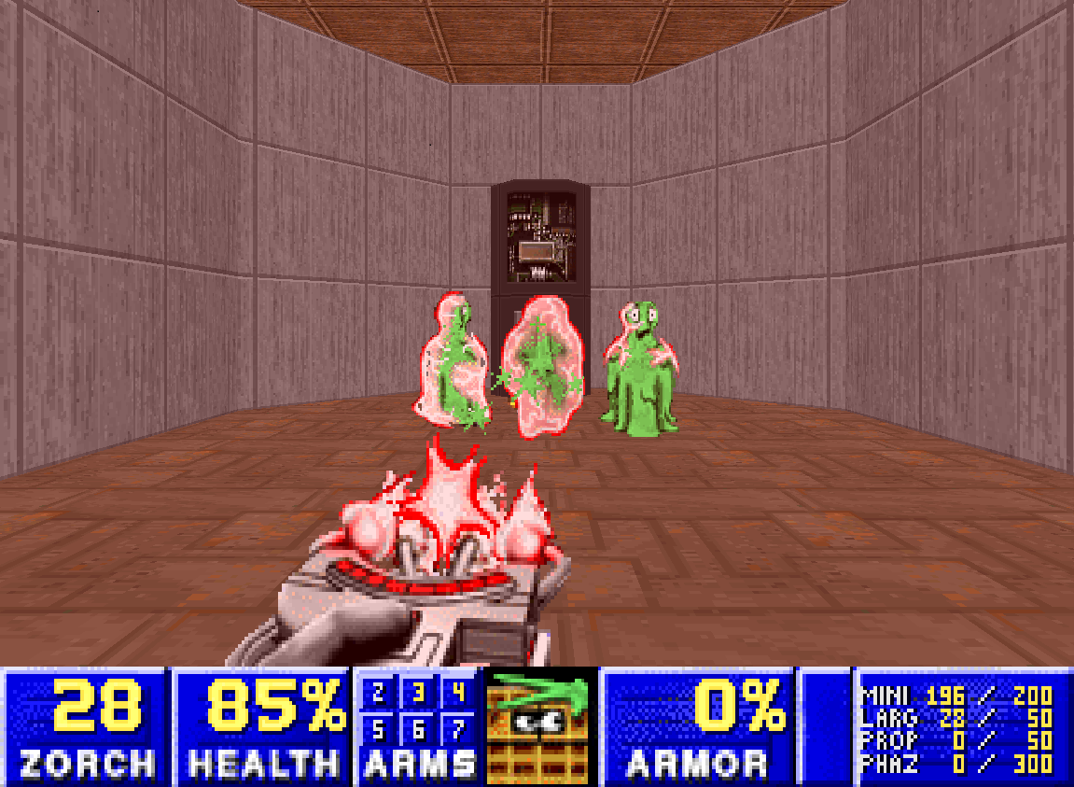
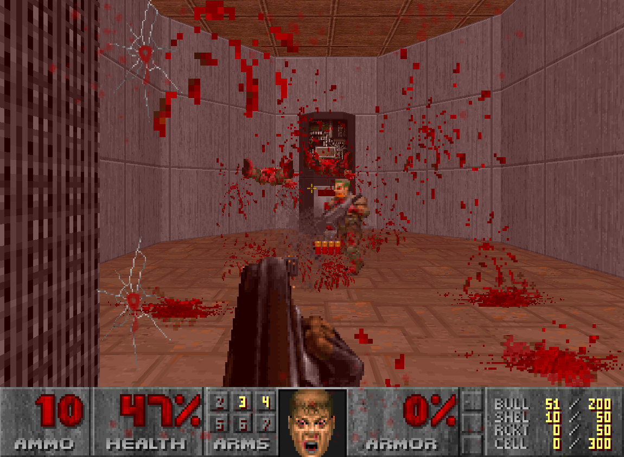
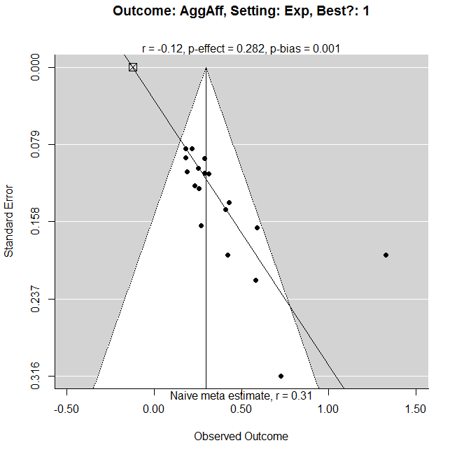
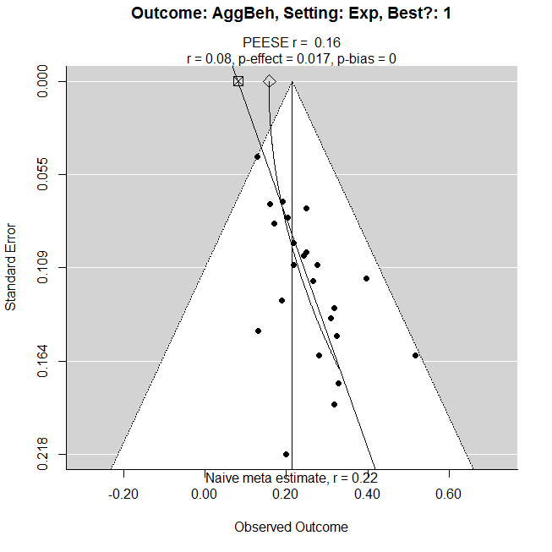
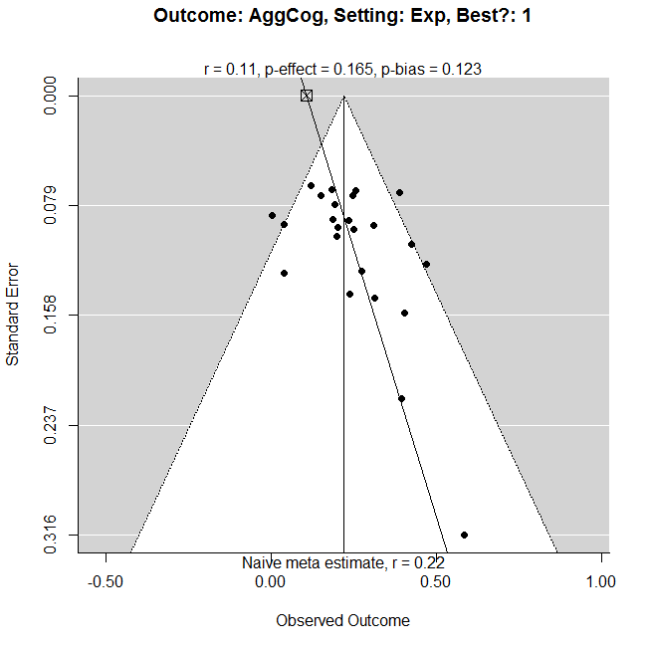
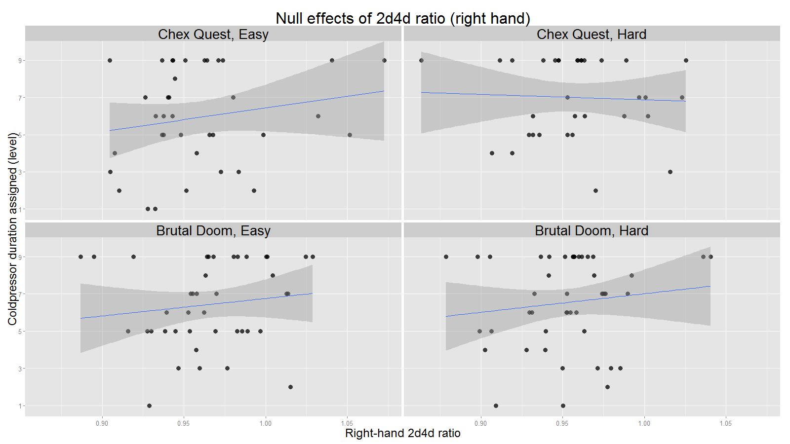
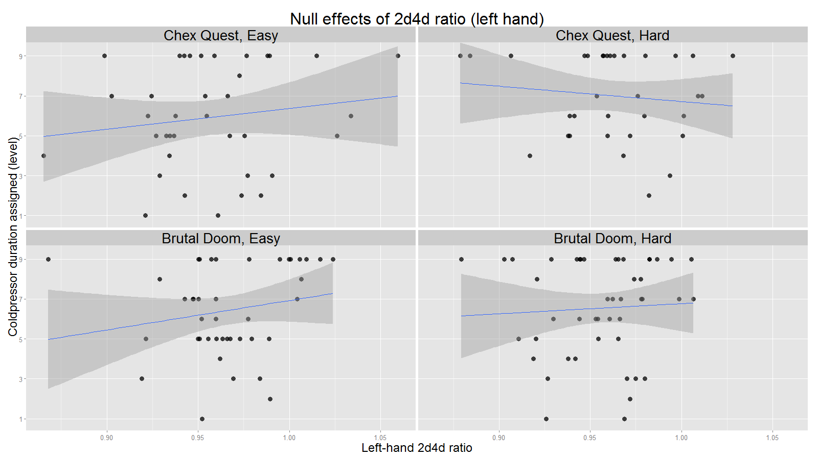
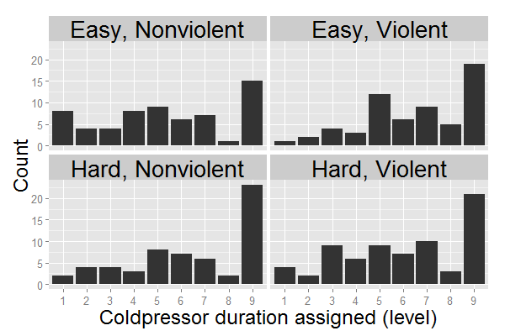
Digit Ratio Measures of Prenatal Testosterone Exposure in Predicting Provoked Aggression
Joseph Hilgard, Christopher R. Engelhardt, Bruce D. Bartholow, & Ines Segert
University of Missouri
Background
The ratio of lengths of index and ring fingers (2d4d ratio) is thought to measure prenatal testosterone exposure (Lutchmaya et al., 2004; Manning et al., 1998).
While greater testosterone exposure would be expected to predict more aggressive behavior, the literature of 2d4d effects on aggressive behavior has been mixed. It has been suggested that 2d4d ratio may only be associated with aggression in response to provocation (Millet, 2011).
Additionally, decades of research have indicated a modest but reliable causal relationship between violent video games and increased aggressive behavior (see Anderson et al., 2010).
However, prior research has often lacked appropriate controls, comparing violent and nonviolent video games that differ in numerous ways (e.g., comparing racing games against shooter games; Hasan et al., 2013).
It has been suggested that this practice introduces confounds, such as changes in difficulty, which may be responsible for observed effects on aggressive behavior (Adachi & Willoughby, 2011; Przybylski et al., 2013).
The present research attempts to extend previous findings but in a novel, closely-matched video game paradigm using two modified versions of the same game.
Small-Study Effects in Previous Research
While previous meta-analytic efforts have been hailed as decisive, inspection of the funnel plots reveals substantial asymmetry in experimental research, suggesting publication or selection bias.
PET-PEESE adjustment for publication bias suggests smaller effects: r = .16, .11, and .00 for aggressive behavior, cognitions, and affect, respectively.
Contrary to findings of Anderson et al. (2010), “best-practices” studies seem to reflect greater bias, not larger true effect.
Previous research has done poor job of controlling for confounds (e.g. matching stimuli on basis of p > .05,
Chex Quest (Non-Violent Game)
Player uses an electronic tool to teleport aliens back to their home.
Brutal Doom (Violent Game)
Player uses guns to kill enemies with extreme violence & gore.
Results
Neither right-hand nor left-hand 2d4d ratio predicted provoked aggression.
If anything, estimated effect sizes indicated lower 2d4d ratio was associated with less aggressive behavior (Figures 1 & 2).
Bayes Factors gave evidence of 2.4 : 1 and 3.4 : 1 for the null, left and right 2d4d, respectively.
Purpose
This study tests the effects of video game violence, video game difficulty, and prenatal testosterone on provoked aggressive behavior. Furthermore, it tests the media effects in an experimental paradigm that does not confound differences in gameplay with differences in violent content.
Effects of game contents were also inspected via 2 (Violence) x 2 (Difficulty) ANOVA, which indicated:
A small effect of difficulty, t(197) = 1.99, r = .14, [.00, .27]
A small effect of violence, t(197) = 1.96, r = .14, [.00, .27]
A difficulty*violence interaction, t(197) = -1.77, r = -.13, [-.26, .01]
However, Bayes Factors model comparisons favored the null hypothesis over each of the more complex models:
3.18 : 1 against a violence-only model
4.16 : 1 against a difficulty-only model
14.1 : 1 against additive effects of violence and difficulty, and
4.16 : 1 against the full model with interactive effects of violence and difficulty.
Methods
Participants to date are 308 male undergraduates participating for partial course credit (preregistered final n=450).
During the experiment, the participant:
Scans his hands for later measurement of 2d4d ratio.
Writes an essay of his views on abortion and exchanges this essay with a partner (experimental confederate) for evaluation. The partner’s essay takes the opposite stance.
Plays a video game for 15 minutes. The game is modified so as to be violent or nonviolent, easy or difficult.
Receives insulting essay feedback from the experimental confederate, thereby being provoked.
Is informed that next task measures the ability to do a computer task while being distracted by holding a hand in painfully cold ice water
Samples ice water himself for 5 seconds
Is invited to assign the partner’s duration of ice water immersion (1-9 scale, 0-80 sec), “to prevent experimenter bias.” This is the “cold pressor task” often used in laboratory pain research (see Rutchick & Slepian, 2013).
A funneled debriefing checks for failures of deception.
Figure 1. Right-hand 2d4d ratio did not influence aggressive behavior, t(155) = 1.36, p = .175, r = .11, 95% CI [-.05, .26], Bayes Factor = 2.48 : 1 in favor of null. Higher-order interactions of right 2d4d and game contents were not supported by the data.
Discussion
Results provide some evidence that 2d4d ratio does not predict aggressive behavior, even in the context of provocation.
Note that setting a larger prior expectation on effect size would increase the evidence’s preference for the null.
Results are equivocal with regard to effects of violent and difficult game contents.
Conventional statistics indicate small effects, but only if the interaction is included in the model. Bayes Factors, on the other hand, concludes support for the null.
It is possible that the effects of violent games on aggression are smaller than typically reported in meta-analysis (r = .21, Anderson et al., 2010), at least when games are very closely matched in structural features and game content other than violence.
The current results are speculative, and final conclusions cannot be drawn until the full sample size is collected.
Figure 3. Histogram of coldpressor assignment per condition.
Figure 2. Left-hand 2d4d ratio did not influence aggressive behavior, t(155) = 1.09, p = .277, r = .09, 95% CI [-.07, .24], Bayes Factor = 3.36 : 1 in favor of null. Higher-order interactions of left 2d4d and game contents were not supported by the data.
Analysis
Many participants indicated not being deceived, and others’ data are still being entered and analyzed. Thus, the sample size used for current analyses is 157 for 2d4d ratio analyses, 201 for other analyses.
In addition to effect sizes and confidence intervals, the present research uses Bayes Factors to quantify the strength of evidence for or against the alternative hypothesis of a small effect (R package ‘BayesFactor’ with rscaleFixed = .21; Morey et al., 2014).
References
Anderson, C.A., Akiko, S., Ihori, N., Swing, E.L., Bushman, B.J., Sakamoto, A., Rothstein, H.R., & Saleem, M. (2010) Violent video game effects on aggression, empathy, and prosocial behavior in Eastern and Western countries: A meta-analytic review. Psychological Bulletin, 136, 151-173.
Adachi, P.J.C., & Willoughby, T. (2011) The effect of violent video games on aggression: Is it more than just the violence? Aggression and Violent Behavior, 16, 55-62.
Hasan, Y., Begue, L., Scharkow, M., & Bushman, B.J. (2013) The more you play, the more aggressive you become: A long-term experimental study of cumulative violent video game effects on hostile expectations and aggressive behavior. Journal of Experimental Social Psychology, 49, 224-227.
Millet, K. (2011) An interactionist perspective on the relation between 2D:4D and behavior: An overview of (moderated) relationships between 2D:4D and economic decision making. Personality and Individual Differences, 51, 397-401.
Morey, R. D., Rouder, J.N., & Jamil, T. (2014). BayesFactor: Computation of Bayes factors for common designs. R package version 0.9.8.
Pryzyblski, A.K., Deci, E.L., Rigby, C.S., & Ryan, R.M. (2014) Competence-impeding electronic games and players’ aggressive feelings, thoughts, and behaviors. JPSP, 106, 441-457

