Slide 1


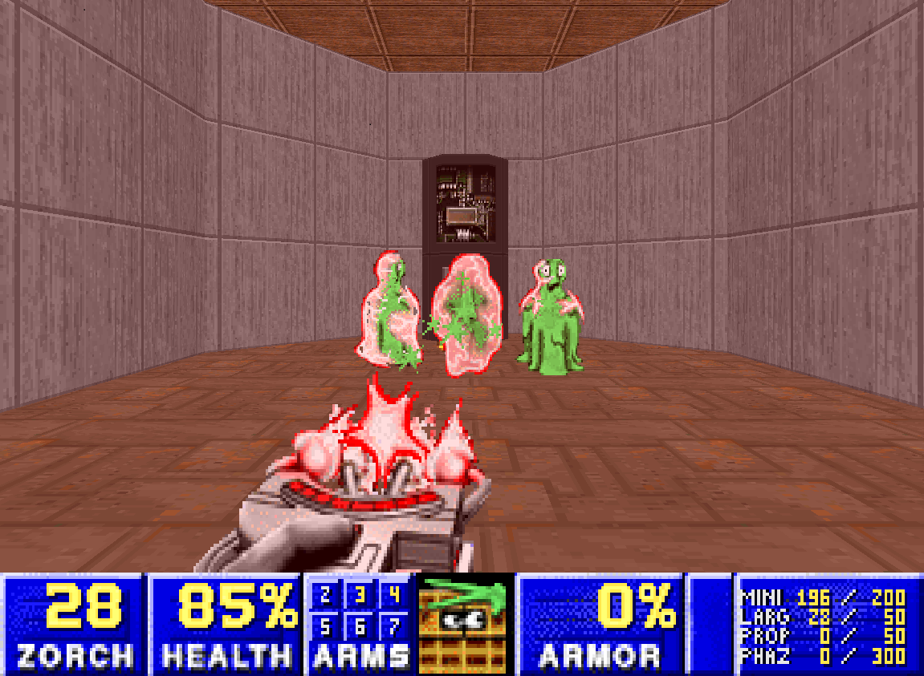
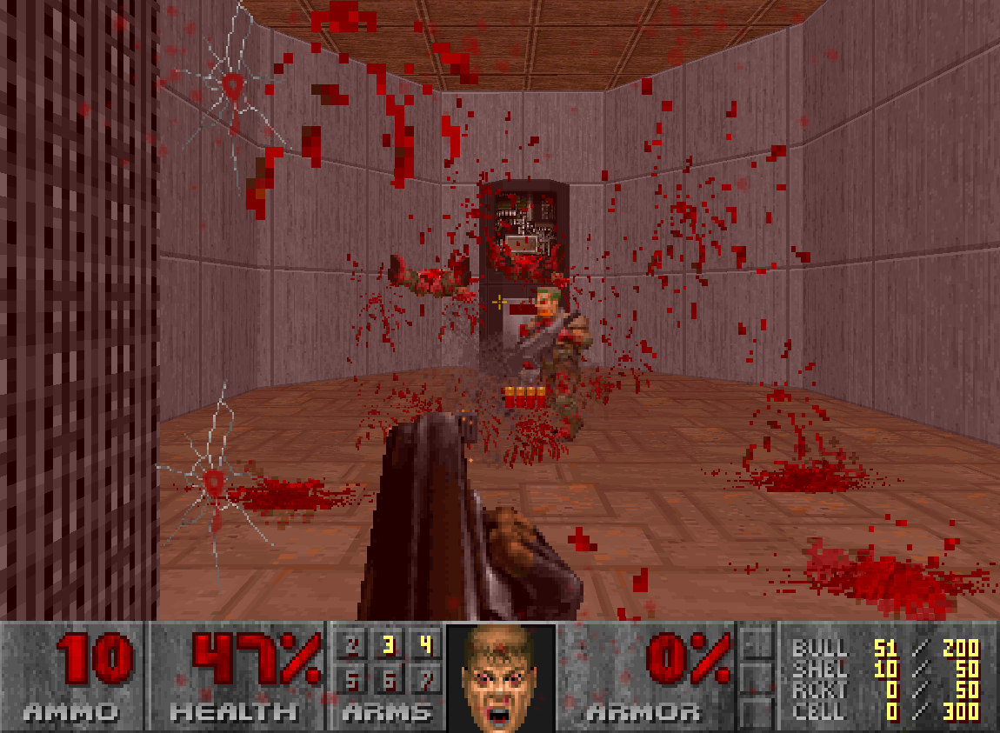
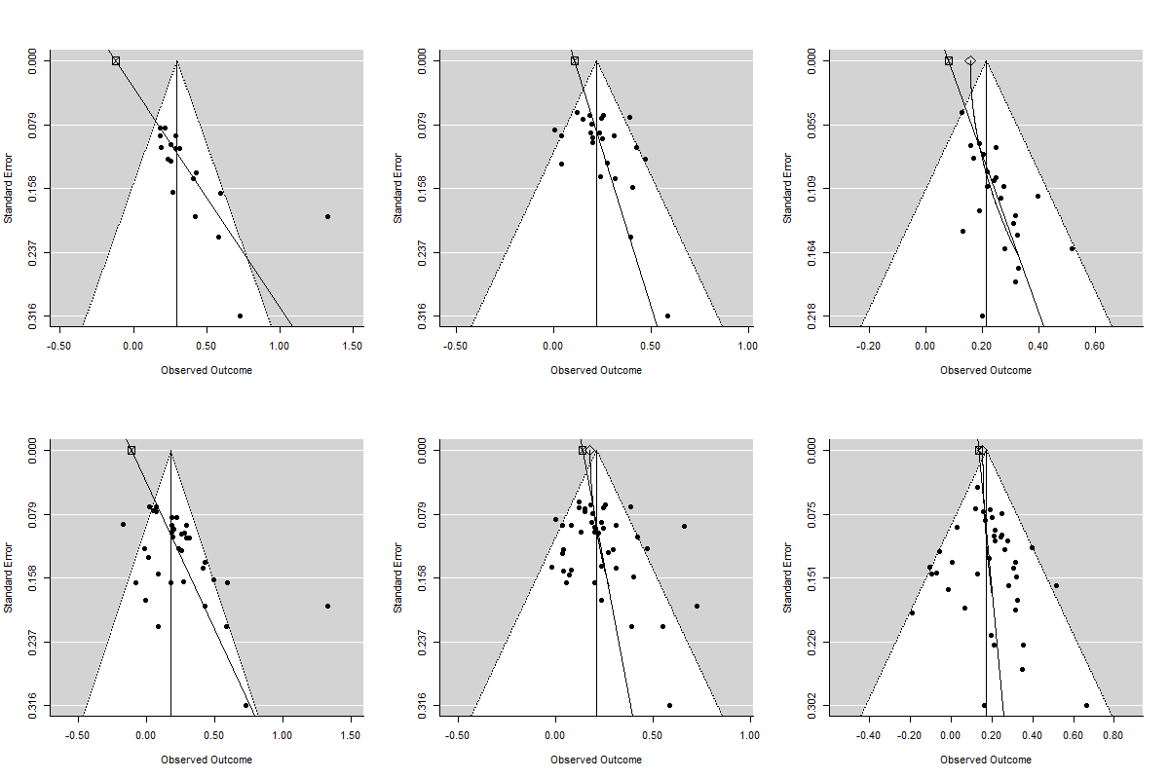
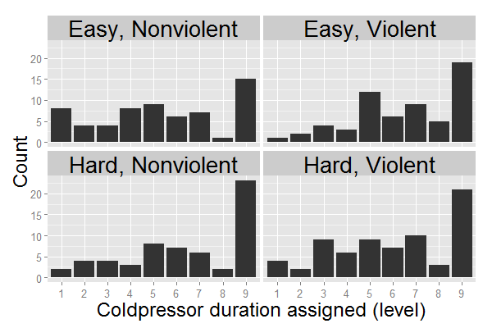
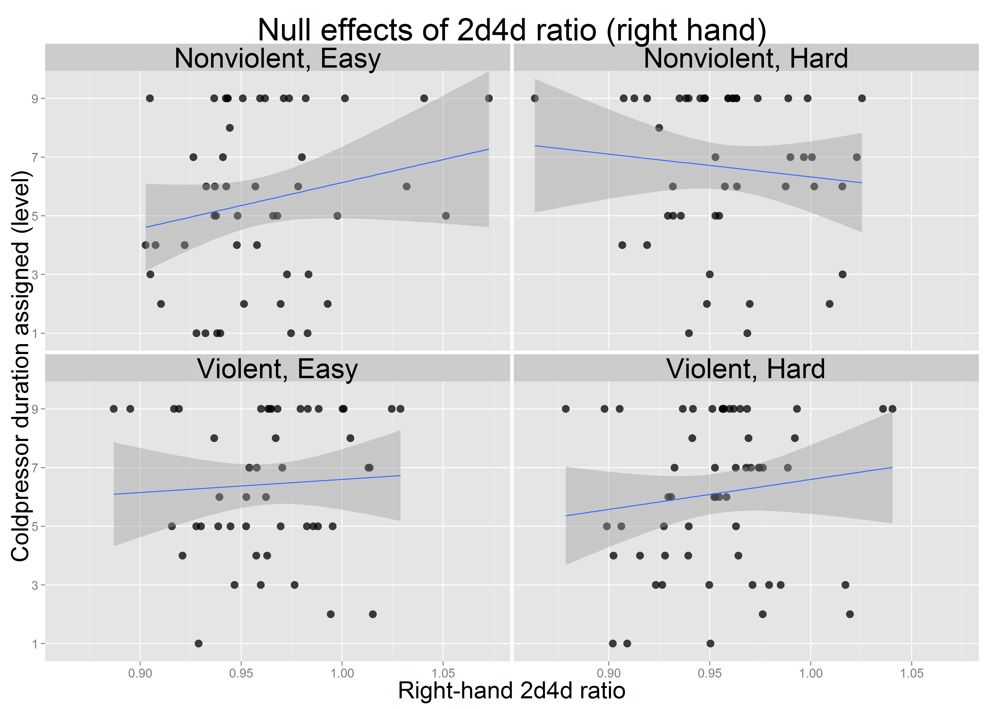
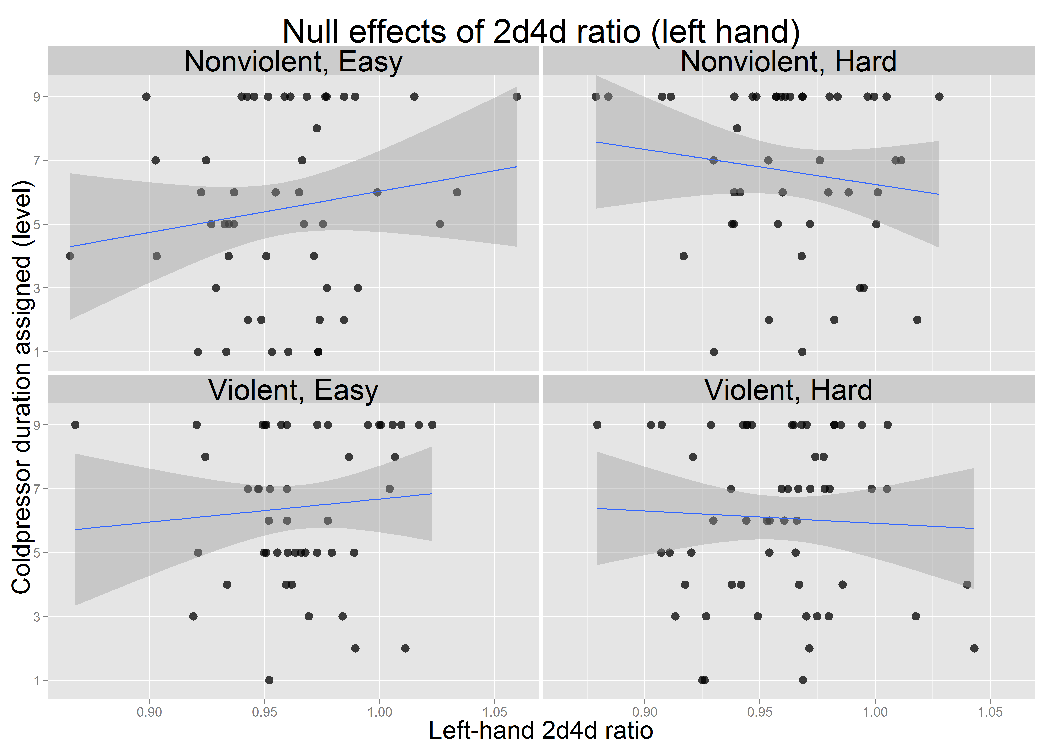
Effects of Video Game Violence, Game Difficulty, and Prenatal Testosterone on Aggressive Behavior
Joseph Hilgard, Christopher R. Engelhardt, & Bruce D. Bartholow
University of Missouri
Background
Decades of research have indicated a modest but reliable causal relationship between violent video games and increased aggressive behavior (see Anderson et al., 2010).
However, prior research has often lacked appropriate controls, comparing violent and nonviolent video games that differ in numerous ways (e.g., comparing racing games against shooter games; Hasan et al., 2013).
It has been suggested that this practice introduces confounds, such as changes in difficulty, which may be responsible for observed effects on aggressive behavior (Adachi & Willoughby, 2011; Przybylski et al., 2013).
The ratio of lengths of index and ring fingers (2d4d ratio) is thought to measure prenatal testosterone exposure (Lutchmaya et al., 2004; Manning et al., 1998).
While greater testosterone exposure would be expected to predict more aggressive behavior, the literature of 2d4d effects on aggressive behavior has been mixed. It has been suggested that 2d4d ratio may only be associated with aggression in response to provocation (Millet, 2011).
The present research attempts to test and extend previous findings but in a novel, closely-matched video game paradigm using two modified versions of the same game.
Small-Study Effects in Previous Experimental Research
While previous meta-analytic efforts have been hailed as decisive, inspection of the funnel plots reveals substantial asymmetry in experimental research, suggesting publication or selection bias.
PET-PEESE adjustment for publication bias suggests smaller effects: r = .00, .10, and .16 for aggressive affect, cognitions, and affect, respectively.
Contrary to findings of Anderson et al. (2010), “best-practices” studies seem to reflect greater bias, not larger true effect.
Previous research has done poor job of controlling for confounds (e.g. matching stimuli on basis of p > .05, attempting to partial out covariates measured w/ error) (see Hilgard, Engelhardt, and Bartholow, submitted.)
Aggressive Affect
Aggressive Cognition
Aggressive Behavior
Chex Quest (Non-Violent Game)
Player uses an electronic tool to teleport aliens back to their home.
Brutal Doom (Violent Game)
Player uses guns to kill enemies with extreme violence & gore.
Results
Bayes Factors model comparisons favored the null hypothesis:
3.18 : 1 against a violence-only model
4.16 : 1 against a difficulty-only model
14.1 : 1 against additive effects of violence and difficulty, and
4.16 : 1 against the full model with interactive effects of violence and difficulty.
Neither right-hand nor left-hand 2d4d ratio predicted provoked aggression.
Estimated effect size indicated lower 2d4d ratio was associated with less aggressive behavior.
Bayes Factors gave evidence of 6.0 : 1 and 3.2 : 1 for the null, left and right 2d4d.
Higher-order interactions of 2d4d and game contents were not supported by data.
2 Game X 2 Difficulty ANOVA
Violence: t(249) = 2.36,
r = .15 (.02, .27)
Difficulty: t(249) = 2.56,
r = .16 (.04, .28)
Interaction: t(249) = -2.48,
r = -.16 (-.27, -.03)
Without the interaction term,
main effects shrink dramatically,
r = .05 (-.07, .17), .07 (-.05, .19)
Purpose
This study tests the possibly-interactive effects of video game violence, video game difficulty, and prenatal testosterone on provoked aggressive behavior. Furthermore, it tests the media effects in an experimental paradigm that does not confound differences in gameplay with differences in violent content.
Figure 3. Funnel plots of Anderson et al. (2010) meta-analysis of violent game effects in experimental research. Top row is “best-practices” experiments, bottom row is all experiments.
Methods
Participants to date are 380 male undergraduates participating for partial course credit (preregistered final n=450).
During the experiment, the participant:
Scans his hands for later measurement of 2d4d ratio.
Writes an essay of his views on abortion and exchanges this essay with a partner (experimental confederate) for evaluation. The partner’s essay takes the opposite stance.
Plays a video game for 15 minutes. The game is modified so as to be violent or nonviolent, easy or difficult.
Receives insulting essay feedback from the experimental confederate, thereby being provoked.
Is informed that next task measures the ability to do a computer task while being distracted by holding a hand in painfully cold ice water
Samples ice water himself for 5 seconds
Is invited to assign the partner’s duration of ice water immersion (1-9 scale, 0-80 sec), “to prevent experimenter bias.” This is the “cold pressor task” often used in laboratory pain research (see Rutchick & Slepian, 2013).
A funneled debriefing checks for failures of deception.
Figure 1. Histogram of aggression per condition.
Discussion
Effects of violent games seem smaller than expected, providing evidence for the null hypothesis.
Evidence suggests 2d4d ratio does not predict aggressive behavior, even when subjects are provoked.
Carefully-matched game stimuli may reduce or eliminate previously-reported violent game effects.
Funnel-plot asymmetry suggests effects have been overestimated in meta-analysis. Selection of “best-practices” may introduce bias.
Subjects perhaps more aware of research hypothesis than researchers suspect. Time for fewer press releases?
Current results are speculative and may change with increasing sample size or more appropriate modeling of non-normal DV.
Analysis
Some participants indicated not being deceived (n = 35), and others’ data are still being entered and analyzed. Thus, the sample size used for current analyses is 253 for primary analyses, 200 for 2d4d ratio analyses.
In addition to effect sizes and confidence intervals, the present research uses Bayes Factors to quantify the strength of evidence for or against the alternative hypothesis of a small effect (R package ‘BayesFactor’ with rscaleFixed = .4; Morey et al., 2014).
Meta-analysis applies PET-PEESE metaregression (Stanley & Doucoliagos, 2014) to meta-analytic data provided by Anderson et al. (2010).
Figure 2. 2d4d ratio did not influence aggressive behavior.
Left hand: t(198) = 0.43, r = .03 (-.11, .17)
Right hand: t(198) = 1.22, r = .09 (-.05, .22)
References
Anderson, C.A., Akiko, S., Ihori, N., Swing, E.L., Bushman, B.J., Sakamoto, A., Rothstein, H.R., & Saleem, M. (2010) Violent video game effects on aggression, empathy, and prosocial behavior in Eastern and Western countries: A meta-analytic review. Psychological Bulletin, 136, 151-173.
Adachi, P.J.C., & Willoughby, T. (2011) The effect of violent video games on aggression: Is it more than just the violence? Aggression and Violent Behavior, 16, 55-62.
Hasan, Y., Begue, L., Scharkow, M., & Bushman, B.J. (2013) The more you play, the more aggressive you become: A long-term experimental study of cumulative violent video game effects on hostile expectations and aggressive behavior. Journal of Experimental Social Psychology, 49, 224-227.
Millet, K. (2011) An interactionist perspective on the relation between 2D:4D and behavior: An overview of (moderated) relationships between 2D:4D and economic decision making. Personality and Individual Differences, 51, 397-401.
Morey, R. D., Rouder, J.N., & Jamil, T. (2014). BayesFactor: Computation of Bayes factors for common designs. R package version 0.9.8.
Pryzyblski, A.K., Deci, E.L., Rigby, C.S., & Ryan, R.M. (2014) Competence-impeding electronic games and players’ aggressive feelings, thoughts, and behaviors. JPSP, 106, 441-457.
Stanley, T. D., & Doucouliagos, H. (2014). Meta-regression approximations to reduce publication selection bias. Research Synthesis Methods, 5, 60-78.

