Slide 1
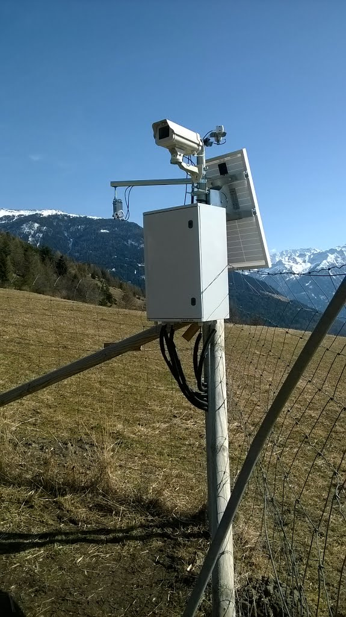
From Station to Database
Environmental Station
Specific Metrics
Differences between the Metrics:
Time of Acquisition
Time intervals
No. Observations
Units
Difficult to handle:
Multiple Stations with different sensors
Sensor replacement
Timeseries
Wishes of the users
Quick overview
Simple data access
Unproblematic data handling
Automatization
Solar Irradiance
Spectral indices
Soil related data
>> Standardization

Slide 2
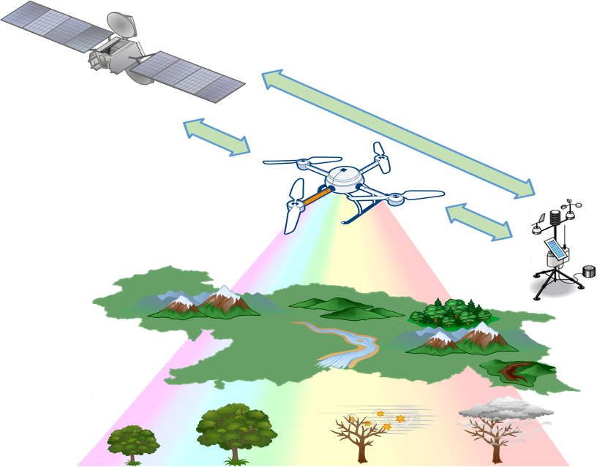



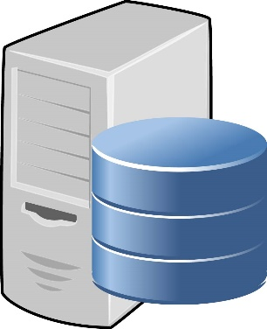
Sensor Web Enablement (SWE) defined by OGC
SWE provides the possibilities to:
Discover sensors, processes, and observations
Task sensors or models
Access observations and observation streams
Publish-subscribe capabilities for alerts
Robust sensor system and process descriptions
OGC (Open Geospatial Consortium):
International, non-profit organization
380 companies, agencies and universities
Introduced many standards for data handling

Slide 3


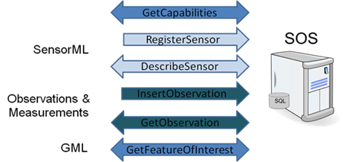

Server Structure and SOS Implementation
Sensor Observation Service (SOS)
An Open-Source implementation
Used @ EURAC
SensorML:
models and schema for sensor systems and processes surrounding measurements
Observations & Measurements(O&M):
models and schema for packaging observation values

Slide 4


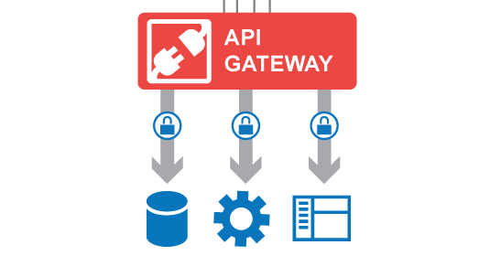


Data Access
Access by Programming
Access by Web Applications
The Server DB can be addressed and accessed via a Application Programming Interface (API)

Slide 5
Terminology
Feature of interest (FOI)
Real world object, monitoring station
Example: “vimes1500”
Procedure
The instrument/sensor on a monitoring station
Example: “QuantumSensor_vimes1500”
Offering
Logical grouping of measured parameters by one procedure
Example: “PAR_vimes1500”, the Photosynthetically Active Radiation
Observed Property
Measured parameter/phenomenon/category
Example: "PARup_vimes1500, Photosynthetically Active Radiation - incoming
Phenomenon Time/Timestamp
Timestamp of a measurement
Example: “2016-06-01T00:15:00”

