Slide 1
Automatic Comfort Controller
Giulio Muraro 218544 giulio.muraro@studenti.unitn.it
Tommaso Santus 226666 tommaso.santus@studenti.unitn.it

Slide 2
PROJECT OVERVIEW
Our project addresses the issue of discomfort in typical living spaces. Most buildings do not meet CasaClima standards for comfort.
Prototype Description:
Simulation: We created a small prototype of a room.
Sensors: The prototype measures air temperature, wall temperature, and light levels.
Solutions Implemented:
Lighting: LED lights are used to solve luminosity issues.
Temperature Control: A fan is used to adjust the temperature.
Heating Simulation: A buzzer simulates heating for colder temperatures.

Slide 3
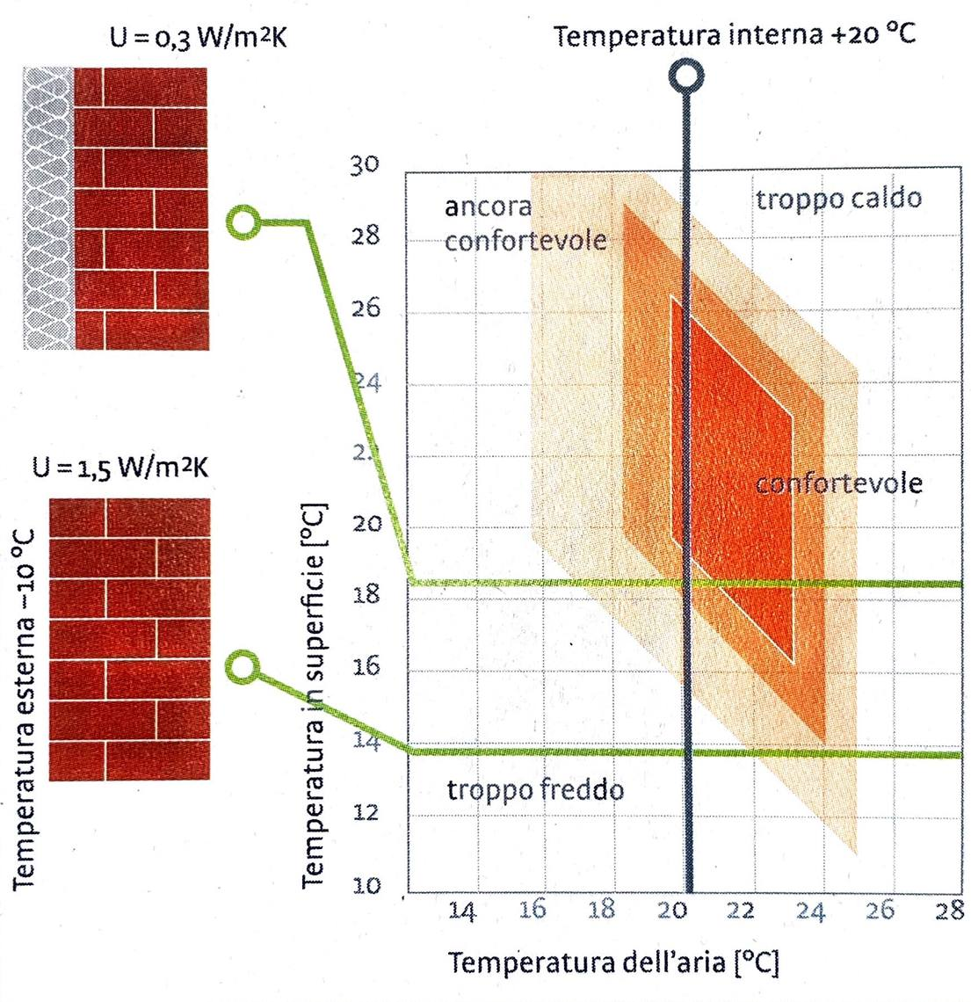
CASACLIMA STANDARDS
The CasaClima temperature standards say that less is the difference between the temperature of the air and the temperature of the walls higher will be the level of comfort. The standards for the light pointed more into natural illumination, specifying that the minimum amount should be of 125 lux.

Slide 4
CONTROL METHODS
by default the code runs in the automatic control mode
sense the data and react when is necessary
buttons can be used to gain control of the actuators
adjust light and temperature on your own
the telegram bot(ESP8266) aims to collect and control data readings that come from the MSP432
is suitable for HTTP request handling and Serial communication
the bot manage a Telegram chat to give the user a GUI to interact with the server
The ESP can return values and accept upload of new values, even commands via chat(“/command”). This let you test different actuators

Slide 5
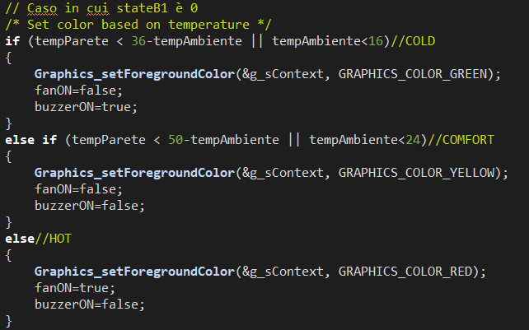
CODE MSP432
MSP432 important part: after check if the device has control over the actuators verify the temperature state and rect
the buzzer simulates the heating
verify if the temperature values are inside the comfort zone by checking if they enter the yellow area in the previous graph
tempParete < 50-tempAmbiente and tempParete < 36-tempAmbiente state the plain where there is no need of intervention.

Slide 6
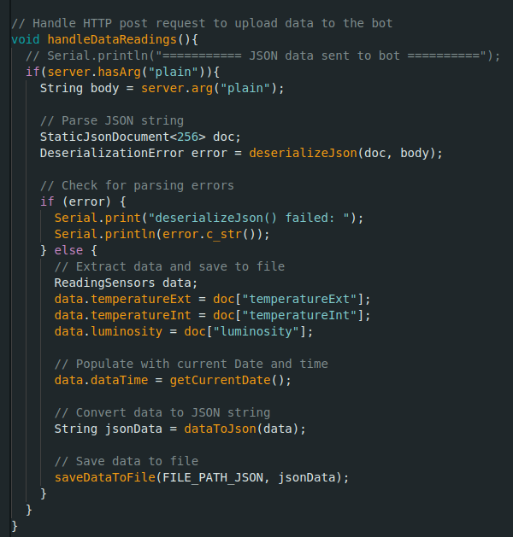
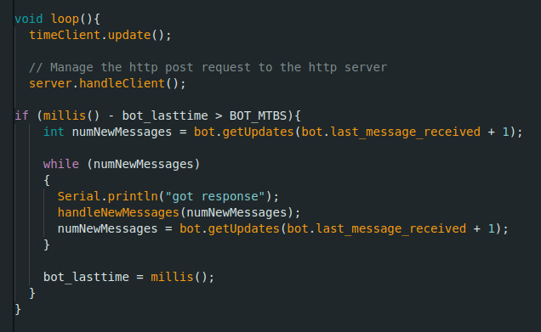
CODE ESP
The ESP manage the HTTP post requests of possibly the MSP and save the data in a Json file.
In the main loop, the ESP continues to check for incoming messages from the telegram chat, every period of time choosen

Slide 7
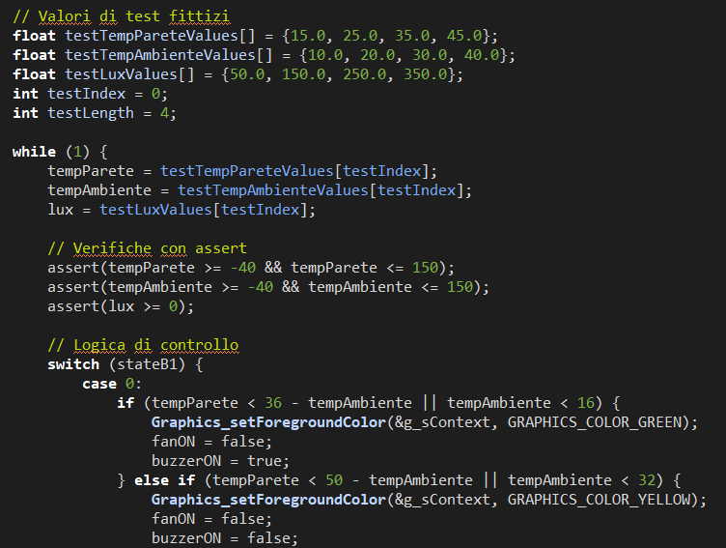
TEST & NEXT PROJECTS
We implemented the test, checking all the software dependent functions of the code with arbitrary results from the hardware dependent part
Next projects will be to add more actuators, like a servo to open the curtains and a proper heating system. Finishing and perfecting the connection between MSP and ESP.

