Slide 1








AR Guide
COMP0016: 2023-24 - Team 43
App to help diagnose telecom equipment
Client: NTT Data UK
Ahmed Ansari
Ayman Arif Khan
Giulio Zhu
Ahmed.ansari.22@ucl.ac.uk
Ayman.khan.22@ucl.ac.uk
Giulio.zhu.22@ucl.ac.uk

Slide 2
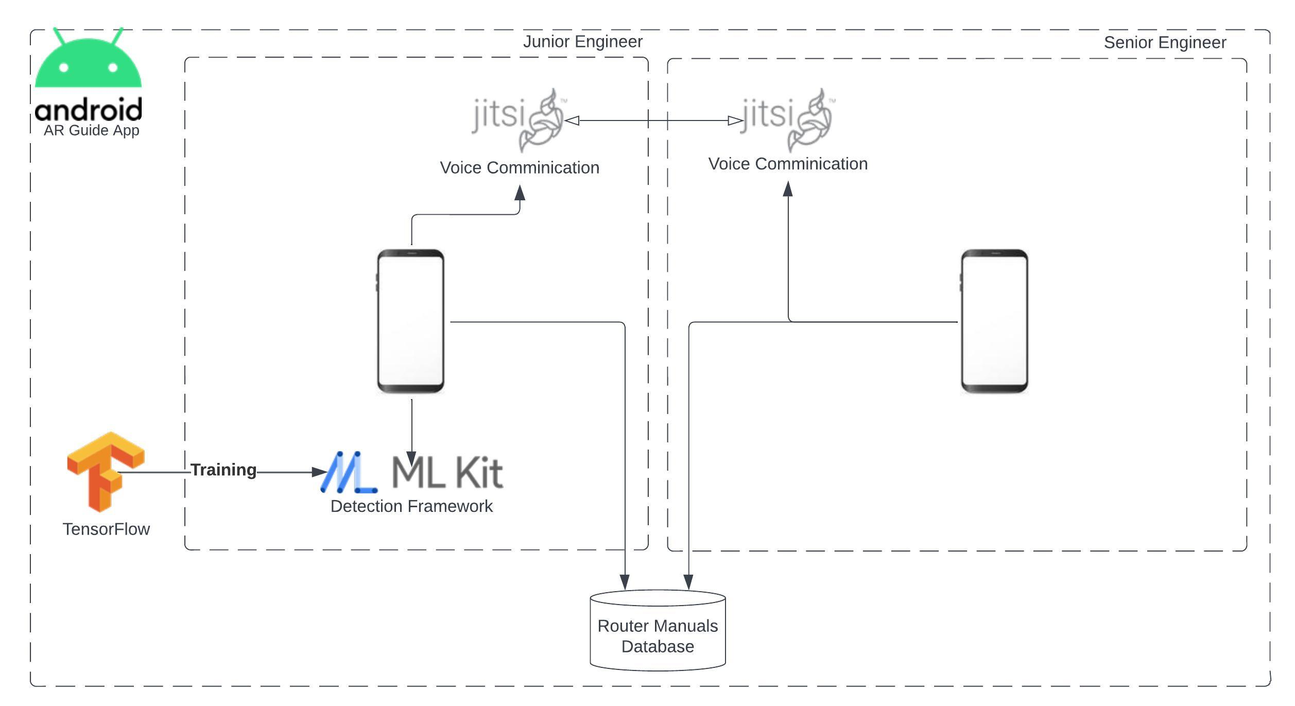
Project overview and System architecture
Problem:
Unexperienced Junior engineers require onsite assistance in diagnosing issues with telecom devices.
Solution:
An AR app to detect router issues and facilitates video calls between junior and senior engineers.
Target users: Network engineers
Project scope:
Android app development
Object recognition :ML Kit SDK
Machine learning: Tensor Flow
Video conferencing: Jitsi SDK
Augmented reality guidance: ARCore SDK
System Architecture
Notes:
The project scope that we’re dealing with is building the android application, developing an object recognition model using Tensor Flow. Integrating this model into our app using the ML Kit SDK. Providing AR guidance using the AR Core SDK and finally providing the VoIP functionality using Jitsi SDK, which is free and open source1

Slide 3


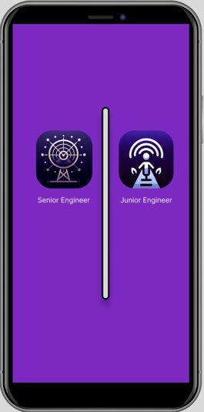


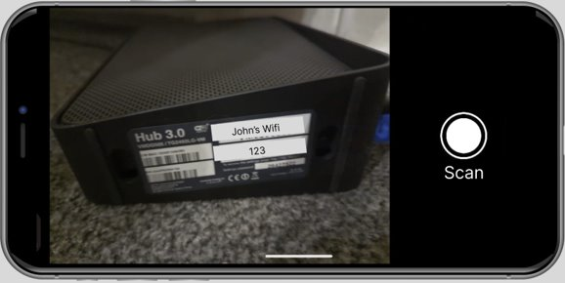
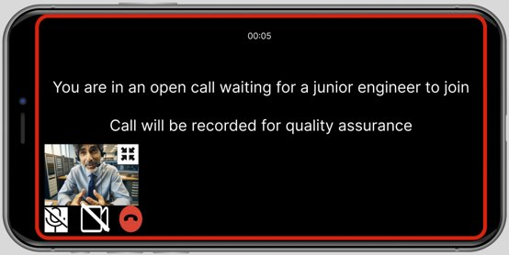

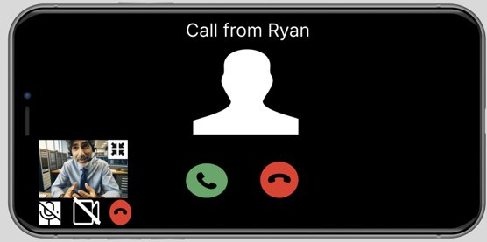
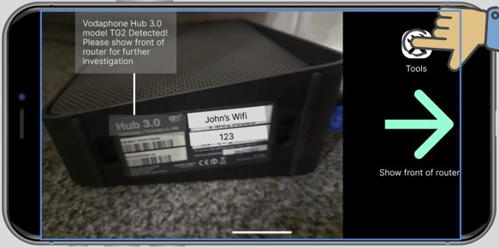

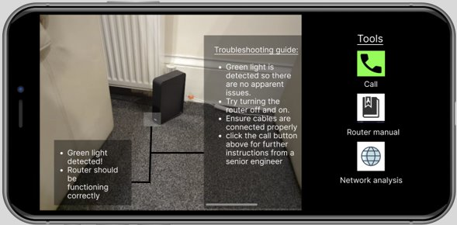
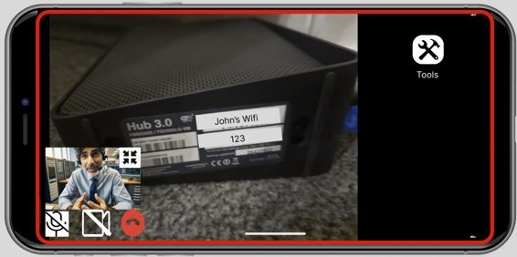
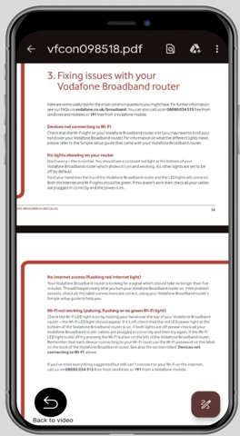
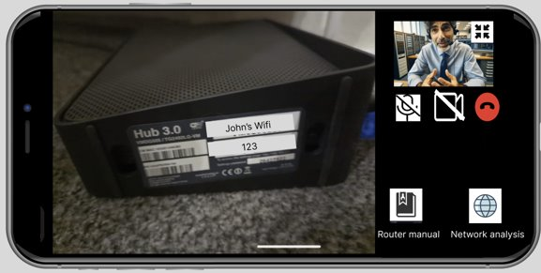
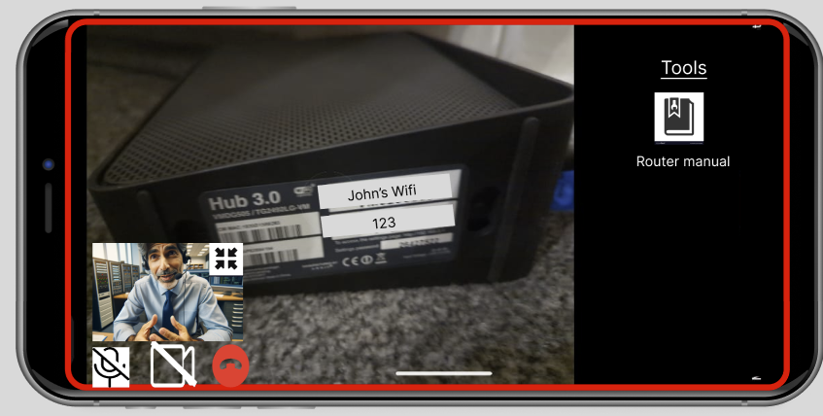
Project management and Deliverables
Junior Engineer
Senior Engineer
Notes:
In terms of project managements, we used Notion as a base for collecting all our notes and keeping track of our activities. We also used Lucidspark to create a Gantt chart and add that to the Notion. We were also able to add our GitHub to Notion which we use for version control and keeping records. WhatsApp and Microsoft Teams were used for daily updates and meetings when required.
For the Deliverables, we plan to make a Login screen to differentiate between a junior and senior engineer. In terms of the Junior engineer, they are able to scan the barcode of the router to identify what model it is, then move it to the front to diagnose the problem that show up as an overlay. There will also be a tools bar displaying call, router manual and network analysis buttons. In terms of the Senior engineer, they can assist a junior engineer when called.
For future deliverables, we are planning to implement:
Predictive maintenance using router data
API and Documentation

Slide 4
Thank you!
DEPARTMENT OF COMPUTER SCIENCE
Github https://github.com/Ahmed-Ansari02/COMP0016-NTT1-2023-
Blog https://students.cs.ucl.ac.uk/2023/group43/

