Slide 1







AR Guide
COMP0016: 2023-24 - Team 43
App to help diagnose telecom equipment
Client: NTT Data UK
Ahmed Ansari
Ayman Arif Khan
Giulio Zhu
Ahmed.ansari.22@ucl.ac.uk
Ayman.khan.22@ucl.ac.uk
Giulio.zhu.22@ucl.ac.uk
Notes:
Welcome to AR guide an app to help diagnose telecom equipment, our client is NTT data, given to you by Ahmed, Ayman, and Giulio

Slide 2
App Overview
Background
Router issues are common; solutions can be unclear.
Users often call for an engineer's assistance.
Engineers respond to address problems
Problem
Inexperienced junior engineers need assistance diagnosing the specific issue
Solution
Enhanced AR Troubleshooting for Router Issues
Direct Video Consultations with Senior Engineers
Comprehensive Application with Integrated Solutions
Notes:
Router issues often lead users to call for an engineer's assistance. However, the inexperienced junior engineers sent to tackle these problems can also find themselves in need of support. That's where the proposed solution comes into play: a seamless augmented reality guide to walk junior engineers through initial troubleshooting, and for the trickier cases, video consultations with seasoned engineers provide the necessary guidance. This dual approach streamlines the resolution process, empowering junior engineers with confidence and clarity.

Slide 3
Key Requirements (MoSCoW)
Id | Requirement | Priority | Status
1 | An Augmented Reality(AR) capable Android application | MUST | ✅
2 | Identify router features and apply appropriate labels over them | MUST | ✅
3 | Video conferencing with high quality video feed, call controls, and screen sharing | MUST | ✅
4 | Access router manuals from the application | MUST | ✅
5 | Detect router issues based on diagnostic LED light | MUST | ✅
6 | Recognise router model using barcode scanning | MUST | ✅
7 | Suggest possible fixes for router issues | COULD HAVE | ✅
8 | Use Large language models for information gathering and question answering based on manuals | COULD HAVE | ❌
✅: Requirement completed
❌: Feature not implemented

Slide 4
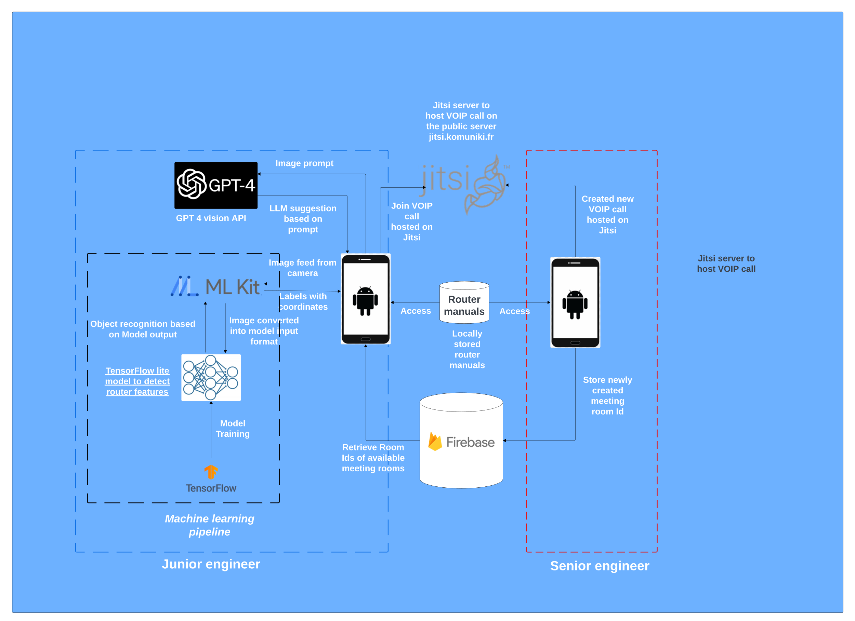
System architecture
Notes:
The project scope that we’re dealing with is building the android application, developing an object recognition model using Tensor Flow. Integrating this model into our app using the ML Kit SDK. Providing AR guidance using the AR Core SDK and finally providing the VoIP functionality using Jitsi SDK, which is free and open source1

Slide 5


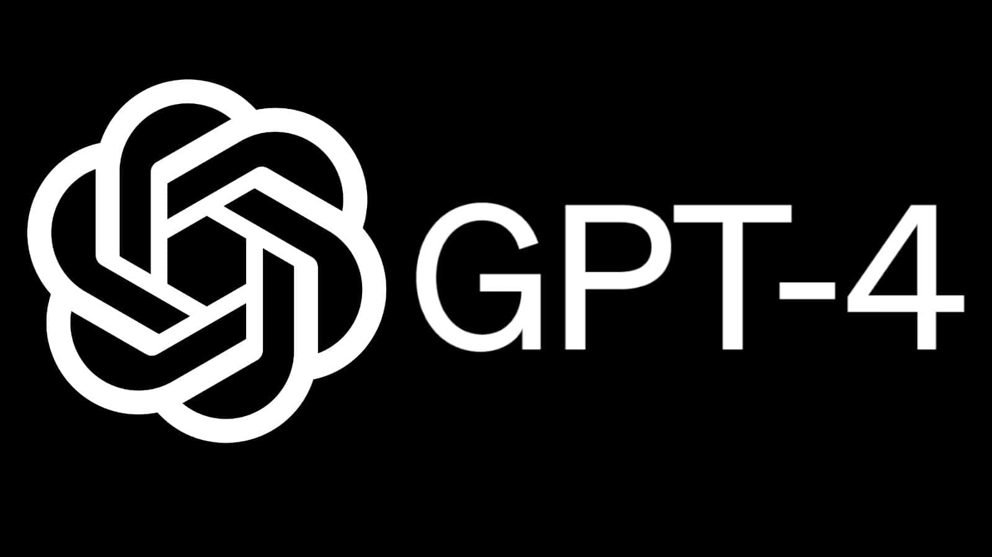


Employed Technologies
Backend
Backend
Backend
Database
Detection Model Training
AI Suggestions
Frontend
Frontend
Backend
Backend
Software Development
AR Features
Video Conferencing
Notes:
Here are all the technologies that we employed in the realization of this project.
The core of the project revolves around ML Kit (for object detection) and Jitsi (for video conferencing), while Firebase,Tensorflow and GPT4 provided the extra details necessary in the realization.

Slide 6
Summary & Main Takeaway
Our application provides many tools to assist Junior engineers in the field.
Router Detection
Built-in Router User Manuals
AI suggetions
Further assistance with video call on pip mode
APIs: ML Kit, Firebase, Jitsi, Tensor Flow, GPT 4
Documentation: provided in the Github repository
Installation Process:
Github clone
Can be considered – Google Playstore
Notes:
Our application provides many tools to assist Junior engineers in the field.
Router Detection features help Junior engineer identify router components
The app also provides router manuals AI suggestions
For further assistance, the junior engineer can video call the senior engineer in pip
APIs: ML Kit, Firebase, Jitsi, Tensor Flow
Documentation: provided in the Github repository
Installation Process:
Github clone
Can be considered – Google Playstore

Slide 7
Thank you!
DEPARTMENT OF COMPUTER SCIENCE
Github https://github.com/Ahmed-Ansari02/COMP0016-NTT1-2023-
Blog https://students.cs.ucl.ac.uk/2023/group43/
Notes:
Thank you for your time! Down below we have linked out github repo and our website for more information

